Slide 1
NLTK vs spaCy
NLP Libraries
Presented by
Trevon Woods

Slide 2
Content
1
NLTK
7
Comparative Analysis
2
Key Features
3
NLTK Code Examples
4
spaCy
5
Key Features
6
spaCy Code Examples

Slide 3
NLTK Background
Initially created in 2001 at the University of Pennsylvania by Steven Bird and Edward Loper
The library's purpose was mainly to support the teaching and research of NLP concepts.
Provides a way to experiment with different NLP concepts and techniques.
NLTK is open-source so its development is driven by the collaborative effort of researchers and developers.

Slide 4
NLTK Key Features
Tokenization
Stemming
Lemmatization
Text Classification
Parsing and Syntax Analysis
Natural Language Understanding
Named Entity Recognition

Slide 5
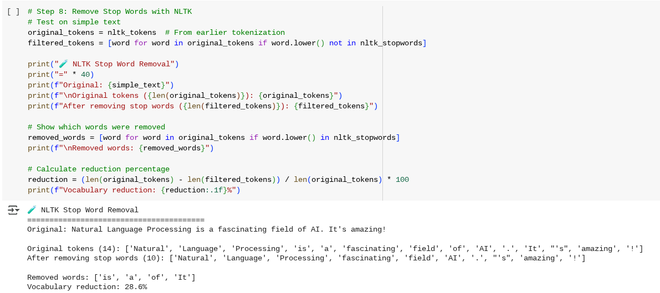
NLTK Code Snippet
Stop word Removal

Slide 6
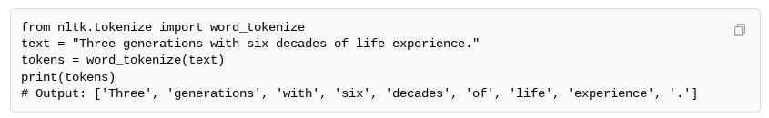
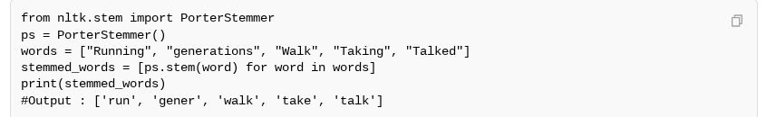
NLTK Code Snippet
Tokenization
Stemming

Slide 7
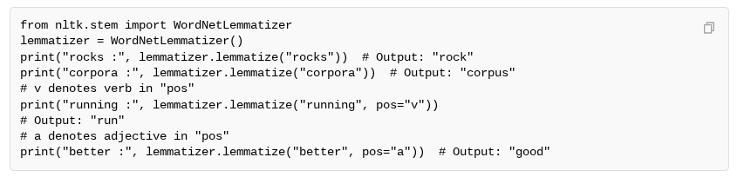
NLTK Code Snippet
Lemmatization

Slide 8
spaCy Background
First released in 2015 and developed by Explosion AI, a software company founded by Matthew Honnibal and Ines Montani.
Their initial motivation for creating the library was to provide an efficient and production-ready NLP library.
SpaCy is also an open-source project so its development is driven by the collaborative effort of its community
It has many purposes such as Industrial-Strength NLP, speed and efficiency, production readiness, accuracy, and a streamlined workflow.

Slide 9
spaCy Key Features
Tokenization
Part-of-speech (POS) Tagging
Named Entity Recognition
Sentence Segmentation
Text Classification
Rule-based Matching
Dependency Parsing
Word Vectors

Slide 10
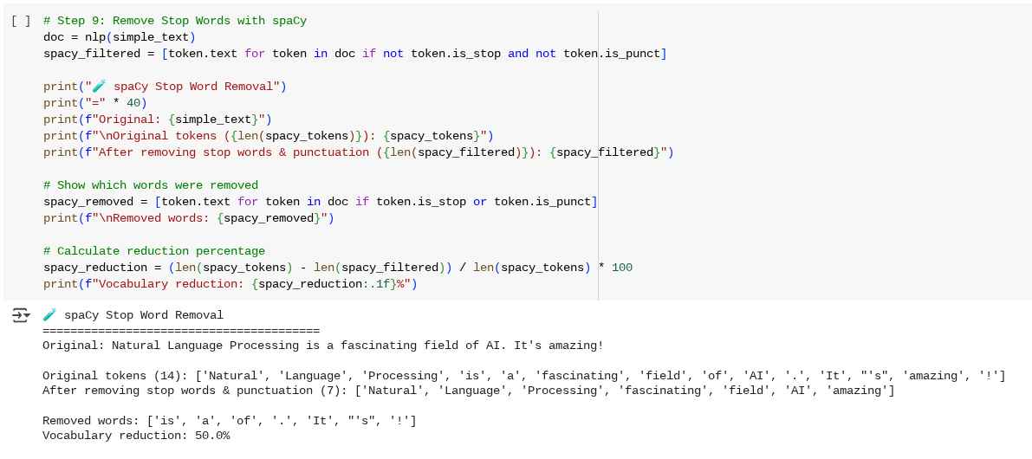
spaCy Code Snippet
Stop Word Removal

Slide 11
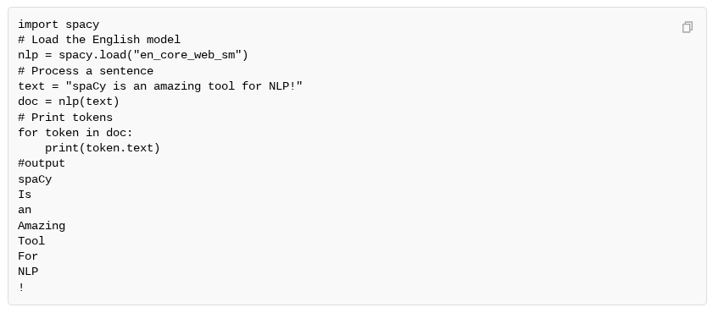
spaCy Code Snippet
Tokenization

Slide 12
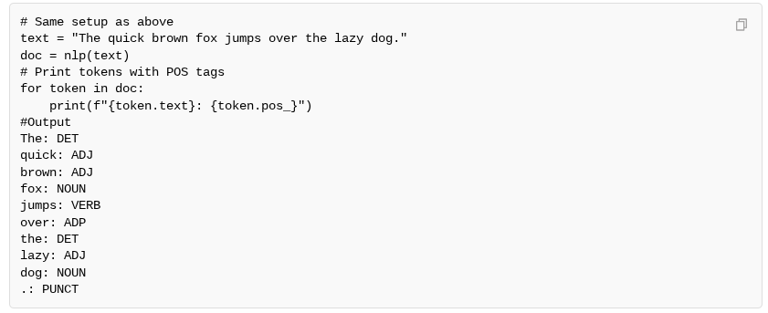
spaCy Code Snippet
Part-Of-Speech Tagging

Slide 13
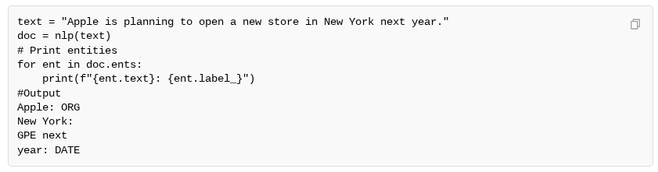
spaCy Code Snippet
Named Entity Recognition

Slide 14
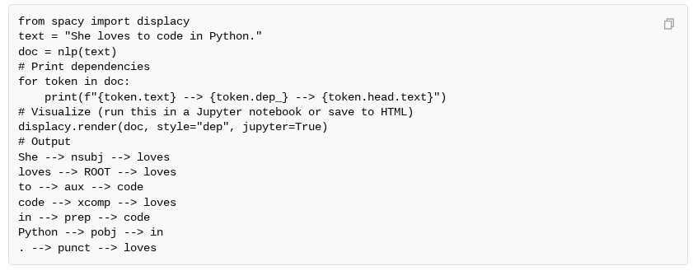
spaCy Code Snippet
Dependency Parsing

Slide 15

Comparative Analysis
Aspect | NLTK | spaCy
Integration with other Python libraries. | Offers seamless integration with NumPy, SciPy, pandas, and scikit-learn, facilitating data analysis | Compatible with pandas and NumPy for data handling; focuses on providing a self-contained solution
Compatibility with different operating systems. | Written in pure Python, ensuring compatibility across Windows, macOS, and Linux | Leverages pure Python; provides pre-built binaries for various platforms
Support for multilingual NLP tasks. | Built-in support for a wide range of languages, including English, French, German, Spanish, and more | Primarily focuses on English; support for other languages may require community contributions

Slide 16
Thank you
Any Questions?

