Slide 1
CS 460/660
Compiler Construction

Slide 2
Why Study Compilers?
Compilers are important
  Responsible for many aspects of system performance
Compilers are interesting
  Compilers include many applications of theory to practice
  Writing a compiler exposes practical algorithmic & engineering issues
Compilers are everywhere
  Many practical applications have embedded languages
  Commands, macros, formatting tags …
    Many applications have input formats that look like languages
Class 01

Slide 3
Intrinsic Merit
Compiler Construction poses some challenging and interesting problems:
  Compilers must do a lot but also run quickly
  Compilers have primary responsibility for run-time performance
Computer architects perpetually create new challenges for the compiler by building more complex machines
  Compilers must hide that complexity from the programmer
A successful compiler requires mastery of the many complex interactions between its constituent parts
Class 01

Slide 4
A True Capstone
Compiler construction involves ideas from many different parts of computer science
  Data Structures
    Greedy algorithms, Heuristic search techniques
  Algorithms
    Graph algorithms, union-find Dynamic programming
  Theory
    DFAs & PDAs, pattern matching, Fixed-point algorithms
  Systems
    Allocation & naming, Synchronization, locality
  Architecture
    Pipeline & hierarchy management, Instruction set use
Class 01

Slide 5
Why does it matter today?
In the last 2 years, most processors have gone multicore
  The era of clock-speed improvements seems to be drawing to an end
    Faster clock speeds mean higher power (n² effect)
    Smaller wires mean higher resistance for on-chip wires
  For the near term, performance improvement will come from placing multiple copies of the processor (core) on a single die
    Classic programs, written in old languages, are not well suited to capitalize on this kind of multiprocessor parallelism
  Parallel programs require sophisticated compilers
Class 01

Slide 6
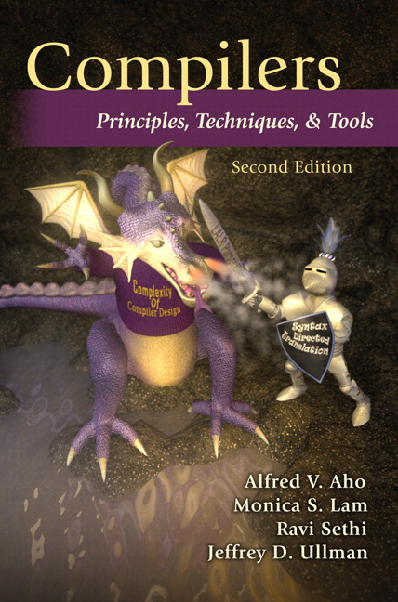

Textbook
Compilers: Principles, Techniques, and Tools
  The Dragon Book
You should read it,
It is a good book
I will cover some, but not all.
  Quizzes/Tests come from lectures and readings
Class 01

Slide 7
The Goal of Chapter 1
Introduce different forms of language translators
Give a high level overview of the structure of a typical compiler
Discuss trends in programming languages and machine architecture that are shaping compilers.
Class 01

Slide 8
What is a Compiler?
Def: Compiler --
  a program that translates a program written in a language like Pascal, C, PL/I, FORTRAN, or COBOL into another language.
An important role of the compiler is to report any errors that it detects.
Class 01

Slide 9
What is an Interpreter?
Def: Interpreter --
  Instead of producing a target program at translation, it appears to directly execute the operations specified in the source program on the inputs specified by the user.
Class 01

Slide 10
What are the Differences?
Compiler is usually much faster.
Interpreter usually gives better diagnostics.
Class 01

Slide 11
2. Structure of a Compiler
So far we have viewed the compiler as a single black box.
Class 01

Slide 12
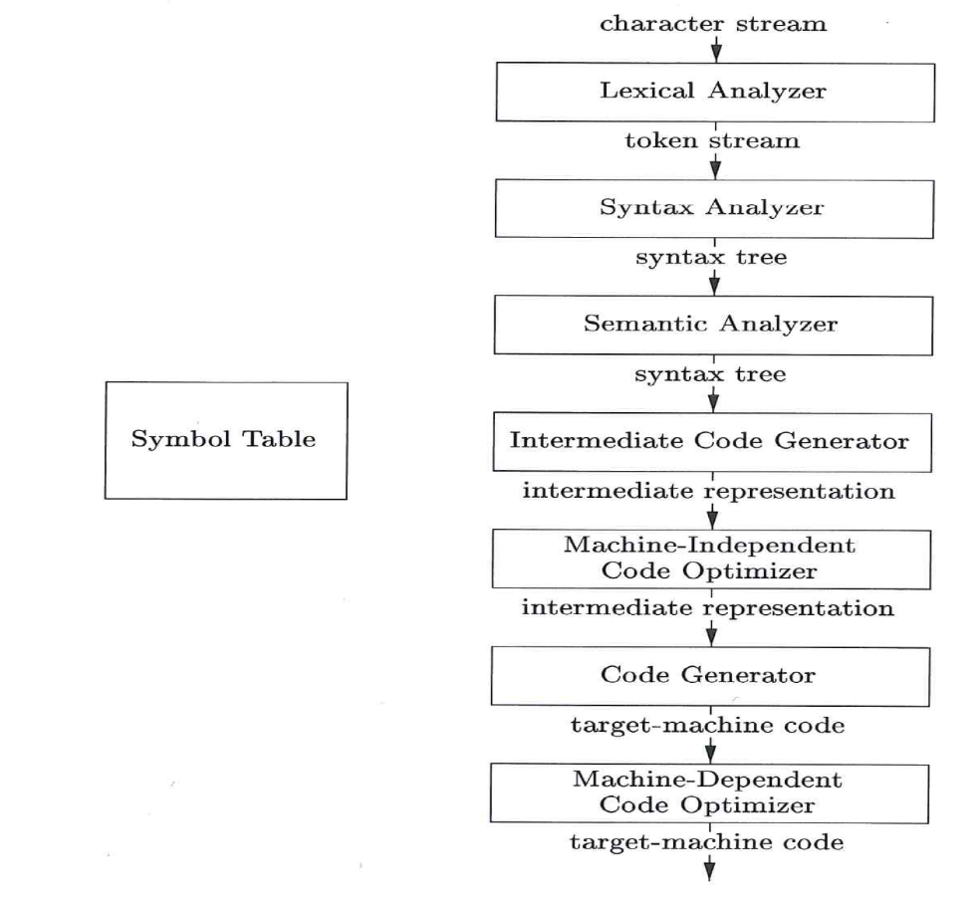
2. Structure of a Compiler
Now we want to open that box.
Class 01

Slide 13
Class 01

Slide 14
2. Structure of a Compiler
The Lexical Analyzer reads the stream of characters and groups them into meaningful sequences called lexemes.
The Syntax Analyzer depicts the grammatical structure of the lexemes in a syntax tree
The Semantic Analyzer checks the tree for semantic consistency (type checking)
Class 01

Slide 15
2. Structure of a Compiler
Intermediate Code Generation – produces assembly like instructions (three address code)
Code Optimization – seeks to improve intermediate code so better target code can be generated
Code Generation – takes the intermediate code and maps to the target code.
Class 01

Slide 16
2. Structure of a Compiler
Symbol Table Management - An essential function of the compiler is to record the variable names used in the source program and collect attributes of each name. (type, scope,…)
Class 01

Slide 17

2.8 The Grouping of the Phases into Passes
Pass – several phases may be grouped together into a pass that reads an input file and writes an output file.
  Front End
    Lexical Analysis, Syntax Analysis, Semantic Analysis, and Intermediate Code Generation
  Code Optimization
    Might be an optional pass.
  Back End
    Code Generation for a specific target machine.
Class 01

Slide 18
2.9 Compiler-Construction Tools
The compiler writer, like any software developer, can profitably use modern software development environments containing tools
  Editor, debugger, version managers, profilers, test harnesses, …
There are also tools to help implement various phases of a compiler.
  Scanner Generator, Parser generator, …
Class 01

Slide 19
Class 01

