Slide 1
Parsing Introduction
Syntactic Analysis I

Slide 2

The Role of the Parser
The Syntactic Analyzer, or Parser, is the heart of the front end of the compiler.
The parser's main task is to analyze the structure of the program and its component statements.

Slide 3

There are three general types of parsers for grammars:
  Universal
    Can parse any grammar
    Too inefficient to use in a production compiler
  Top-Down
  Bottom-Up

Slide 4
Our principle resource in Parser Design is the theory of Formal Languages.
We will use and study context free grammars (They cannot handle definition before use, but we can get around this other ways)

Slide 5
Grammars
Informal Definition -- a finite set of rules for generating an infinite set of sentences.
Def: Generative Grammar: this type of grammar builds a sentence in a series of steps, refining each step, to go from an abstract to a concrete sentence.

Slide 6
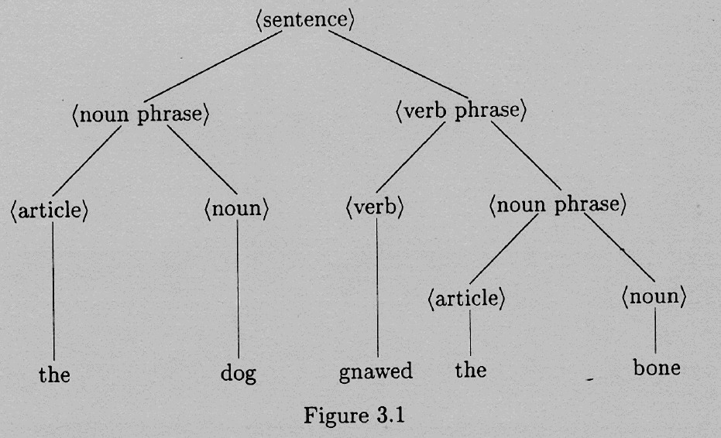
Def: Parse Tree: a tree that represents the analysis/structure of a sentence (following the refinement steps used by a generative grammar to build it.

Slide 7
Def: Productions/Re-Write Rules: rules that explain how to refine the steps of a generative grammar.
Def: Terminals: the actual words in the language.
Def: Non-Terminals: Symbols not in the language, but part of the refinement process.

Slide 8
Syntax and Semantics
Syntax deals with the way a sentence is put together.
Semantics deals with what the sentence means.
There are sentences that are grammatically correct that do not make any sense.

Slide 9
There are also things that make sense that are not grammatically correct.
The compiler will check for syntactical correctness, yet it is the programmers responsibility (usually during debugging) to make sure it makes sense.

Slide 10
Grammars: Formal Definition
G = (T,N,S,R)
  T = set of Terminals
  N = set of Non-Terminals
  S = Start Symbol (element of N)
  R = Set of Rewrite Rules (α -> β)

Slide 11
In your rewrite rules, if α is a single non-terminal the language is Context-Free.
BNF stands for Backus-Naur Form
  ::= is used in place of ->
  in extended BNF { } is equivalent to ( )*

Slide 12
Parse Trees and Derivations
a1 => a2 -- string a1 is changed to string a2 via 1 rewrite rule.
α =*=> β -- 0 or more re-write rules
sentential forms -- the strings appearing in various derivation steps
L(G) = { w | S =_{G}*=> w}

Slide 13
Rightmost and Leftmost Derivations
Which non-terminal do you rewrite-expand when there is more than one to choose from.
  If you always select the rightmost NonTerminal to expand, it is a Rightmost Derivation.
Leftmost and Rightmost derivations are unique.

Slide 14
Def: any sentential form occurring in a leftmost {rightmost} derivation is termed a left {right} sentential form.
Some parsers construct leftmost derivations and others rightmost, so it is important to understand the difference.

Slide 15
Given G_{E} = (T, N, S, R)
  T = { i, +, -, *, /, (, )},
  N = {E}
  S = E
  R = {
    E -> E + E E -> E - E
    E -> E * E E -> E / E
    E -> ( E ) E -> i }
consider: (i+i)/(i-i)

Slide 16
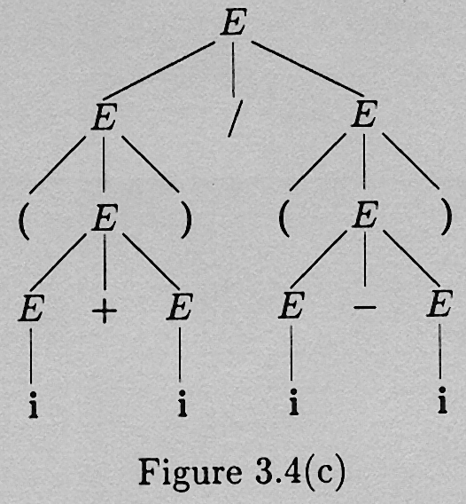

Slide 17
Ambiguous Grammars
Given G_{E} = (T, N, S, R)
  T = { i, +, -, *, /, (, )},
  N = {E}
  S = E
  R = {
    E -> E + E E -> E - E
    E -> E * E E -> E / E
    E -> ( E ) E -> i }
consider: i + i * i

Slide 18
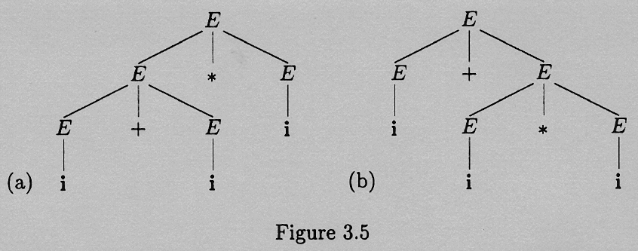

Slide 19
a grammar in which it is possible to parse even one sentence in two or more different ways is ambiguous
A language for which no unambiguous grammar exists is said to be inherently ambiguous

Slide 20
The previous example is "fixed" by operator-precedence rules,
or re-write the grammar
  E -> E + T | E - T | T
  T -> T * F | T / F | F
  F -> ( E ) | i
Try: i+i*i

Slide 21
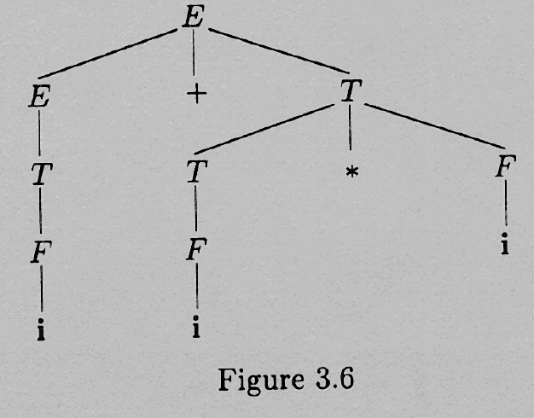

Slide 23
The Chomsky Hierarchy
(from the outside in)
Type 0 grammars
  γAδ -> γβδ
  these are called phrase structured, or unrestricted grammars.
  It takes a Turing Machine to recognize these types of languages.

Slide 24
Type 1 grammars
  γAδ -> γβδ β != ε
  therefore the sentential form never gets shorter.
  Context Sensitive Grammars.
  Recognized by a simpler Turing machine [linear bounded automata (lba)]

Slide 25
Type 2 grammars:
  A -> β
  Context Free Grammars
  it takes a stack automaton to recognize CFG's (FSA with temporary storage)
  Nondeterministic Stack Automaton cannot be mapped to a DSA, but all the languages we will look at will be DSA's

Slide 26
Type 3 grammars
  The Right Hand Side may be
    a single terminal
    a single non-terminal followed by a single terminal.
  Regular Grammars
  Recognized by FSA's

Slide 27
Some Context-Free and Non-Context-Free Languages
Example 1:
  S -> S S
  | (S)
  | ( )
  This is Context Free.

Slide 28
Example 2:
  a^{n}b^{n}c^{n}
this is NOT Context Free.

Slide 29
Example 3:
  S -> aSBC
  S -> abC
  CB -> BC
  bB -> bb
  bC -> bc
  cC -> cc
This is a Context Sensitive Grammar

Slide 30
L₂ = {wcw| w in (T-c)*} is NOT a Context Free Grammar.

Slide 31
More about the Chomsky Hierarchy
There is a close relationship between the productions in a CFG and the corresponding computations to be carried out by the program being parsed.
This is the basis of Syntax-directed translation which we use to generate intermediate code.

