Slide 1
Parsing Top-Down

Slide 2

Top-Down parsers
The top-down parser must start at the root of the tree and determine, from the token stream, how to grow the parse tree that results in the observed tokens.
This approach runs into several problems, which we will now deal with.

Slide 3
Left Recursion
Productions of the form (A->Aα) are left recursive.
No Top-Down parser can handle left recursive grammars.
Therefore we must re-write the grammar and eliminate both direct and indirect left recursion.

Slide 4

How to eliminate Left Recursion (direct)
  Given:
    A -> Aα₁ | Aα₂ | Aα₃ | …
    A -> δ₁ | δ₂ | δ₃ | ...
  Introduce A'
    A -> δ₁ A' | δ₂ A' | δ₃ A' | ...
    A' -> ε | α₁ A' | α₂ A' | α₃ A' | ...
  Example:
    S -> Sa | b
    Becomes
    S -> bS'
    S' -> ε | a S'

Slide 5
How to remove ALL Left Recursion.
  1.Sort the nonterminals
  2.for each nonterminal
    if B -> Aβ
    and A -> γ₁ | γ₂ | γ₃ | ...
    then B -> γ₁β | γ₂β | γ₃β | ...
  3.After all done, remove immediate left recursion.

Slide 6
Example:
  S -> aA | b | cS
  A -> Sd | e becomes
  S -> aA | b | cS
  A -> aAd | bd | cSd | e
note: the S in A(3) -> but it is NOT left recursion

Slide 7
Backtracking
One way to carry out a top-down parse is simply to have the parser try all applicable productions exhaustively until it finds a tree.
This is sometimes called the brute force method.
It is similar to depth-first search of a graph
Tokens may have to be put back on the input stream

Slide 8
Given a grammar:
  S -> ee | bAc | bAe
  A -> d | cA
A Backtracking algorithm will not work properly with this grammar.
Example: input string is bcde
  When you see a b you select S -> bAc
  This is wrong since the last letter is e not c

Slide 9
The solution is Left Factorization.
  Def: Left Factorization: -- create a new non-terminal for a unique right part of a left factorable production.
Left Factor the grammar given previously.
  S -> ee | bAQ
  Q -> c | e
  A -> d | cA

Slide 10
Recursive-Descent Parsing
There is one function for each non-terminal these functions try each production and call other functions for non-terminals.
The stack is invisible for CFG's
The problem is -- a new grammar requires new code.

Slide 11

else
if token_is ('c') then
writeln ('S --> c')
else
begin
error ('S');
S := false
end
end; { S }
Example:
  S -> bA | c
  A -> dSd | e
Code:
function S: boolean;
begin
S := true;
if token_is ('b') then
if A then
writeln('S --> bA')
else
S := false;

Slide 12
function A: boolean
begin
A := true;
if token_is ('d') then
begin
if S then
if token_is ('d') then
writeln('A --> dSd');
else
begin
error ('A');
A := false
end
else
A := false
end
else
if token_is ('e') then
writeln ('A --> e')
else
begin
error ('A');
A := false
end
end; { A }

Slide 13
Input String: bdcd

Slide 14
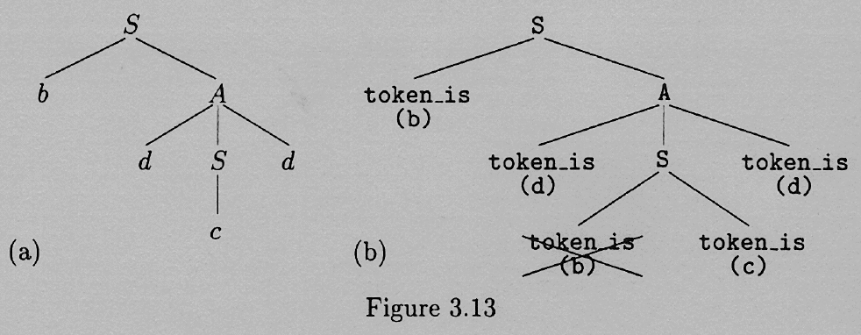

Slide 15
Predictive Parsers
The goal of a predictive parser is to know which characters on the input string trigger which productions in building the parse tree.
Backtracking can be avoided if the parser had the ability to look ahead in the grammar so as to anticipate what terminals are derivable (by leftmost derivations) from each of the various nonterminals on the RHS.

Slide 16
First (α) (you construct first() of RHS’s)
  1.if α begins with a terminal x,
    then first(α) = x.
  2.if α =*=> ε,
    then first(α) includes ε.
  3.First(ε) = {ε}.
  4.if α begins with a nonterminal A,
    then first(α) includes first(A) - {ε}

Slide 17
Follow(α)
  1.if A is the start symbol,
    then put the end marker $ into follow(A).
  2.for each production with A on the right hand side Q -> xAy
    1.if y begins with a terminal q,
      q is in follow(A).
    2.else follow(A) includes first(y)-ε.
    3.if y = ε, or y is nullable (y =*=> ε)
      then add follow(Q) to follow(A).

Slide 18
Grammar:
  E -> T Q
  Q -> + T Q | - T Q | epsilon
  T -> F R
  R -> * F R | / F R | epsilon
  F -> ( E ) | I
Construction of First and Follow Sets:

Slide 19
First(E) = First(T) = First(F) = {i,(}
First(Q) = {+,-,ε}
First(R) = {*,/,ε}
Follow(E) = {$,)}
Follow(Q) = Follow(E) = {$, )}
Follow(T) = First(Q) - ε + Follow(E) {+,-} + {),$}
Follow(R) = Follow(T)
Follow(F) = First(R) - ε + Follow(T) {*,/} + {+,-,),$}

Slide 20
LL(1) Grammars
  In a predictive parser, Follow tells us when to use the epsilon productions.
  Def: LL(1) -- Left to Right Scan of the tokens, Leftmost derivation, 1 token lookahead.

Slide 21
For a grammar to be LL(1), we require that for every pair of productions A -> α|β
  1.First(α)-ε and First(β)-ε must be disjoint.
  2.if α is nullable, then First(β) and Follow(A) must be disjoint.
  if rule 1 is violated, we may not know which right hand side to choose
  if rule 2 is violated, we may not know when to choose β or ε.

Slide 23
Table-Driven Predictive Parsers
Grammar
  E -> E + T | E - T | T
  T -> T * F | T / F | F
  F -> ( E ) | I
Step 1: Eliminate Left Recursion.

Slide 24
Grammar without left recursion
  E -> T Q
  Q -> + T Q | - T Q | epsilon
  T -> F R
  R -> * F R | / F R | epsilon
  F -> ( E ) | I
It is easier to show you the table, and how it is used first, and to show how the table is constructed afterward.

Slide 25
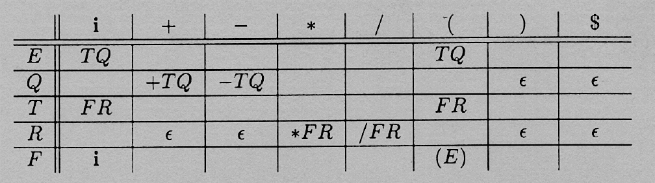
Table

Slide 26
Driver Algorithm:
  Push $ onto the stack
  Put a similar end marker on the end of the string.
  Push the start symbol onto the stack.

Slide 27
  While (stack not empty do)
    Let x = top of stack and a = incoming token.
    If x is in T (a terminal)
    if x == a then pop x and goto next input token
    else error
    else (nonterminal)
    if Table[x,a]
    pop x
    push Table[x,a] onto stack in reverse order
    else error
It is a successful parse if the stack is empty and the input is used up.

Slide 28
Example 1: (i+i)*i

Slide 29


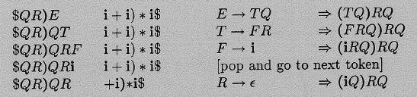

Slide 30
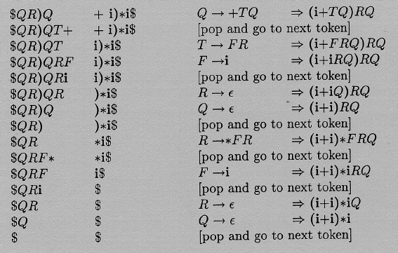

Slide 31
Example 2: (i*)

Slide 32
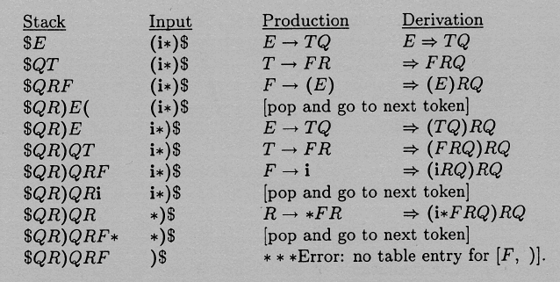

Slide 33
Constructing the Predictive Parser Table
Go through all the productions. X -> β is your typical production.
  1.For all terminals a in First(β), except ε, Table[X,a] = β.
  2.If β = ε, or if ε is in first(β) then For ALL a in Follow(X), Table[X,a] = ε.
So, Construct First and Follow for all Left and right hand sides.

Slide 34
Conflicts
A conflict occurs if there is more than 1 entry in a table slot. This can sometimes be fixed by Left Factoring, ...
If a grammar is LL(1) there will not be multiple entries.

Slide 35
Summary of Top Down
Left Recursion
Left Factorization
First (A)
Follow (A)
Predictive Parsers (table driven)

