Slide 1
Parsing Bottom-Up
LR Table Construction

Slide 3

Construction of
LR Parsing Tables
It is customary to cover the generation of LR parsing tables in a series of stages, showing three levels of LR parsers of increasing complexity.
  (1) Simple LR (SLR)
  (2) the Canonical LR parser, and
  (3) the lookahead LR (LALR) parser.

Slide 4
This approach leads us into the subject by gradual stages, each building on the previous one, until we reach the LALR parser, the most practical one, which is impossibly complicated if presented without the background provided by the other 2.
Let’s begin by introducing items that will be common for all three parsers.

Slide 5
Parser States
  In the LR parsers, each current state corresponds to a particular sequence of symbols at the top of the stack
  States in a FSA do two things. They reflect what has happened in the recent past, and they control how the FSA will respond to the next input.
  Hence, in the design of an LR parser, we must relate the state transition to what goes onto the stack.

Slide 6

Items
  An item is a production with a placeholder (.) telling how far we have gotten.
  The production E-> E+T gives rise to the following items.
    [E->.E+T]
    [E->E.+T]
    [E->E+.T]
    [E->E+T.]
  symbols to the left of the . are already on the stack; the rest is yet to come.

Slide 7
So, putting it all together:
  An item is a summary of the recent history of the parse.
  An LR parser is controlled by a finite-state machine.
  The recent history of a finite-state machine is contained in its state...So an item must correspond to a state in a LR parser

Slide 8
Almost,
  If we have a state for each item we basically have an NDFA.
  Getting the LR states parallels getting the DFA from the NDFA.
We need to tell the parser when to accept.
  For this we add a new "dummy" Non-Terminal Z-> E instead of reducing this production, we accept.

Slide 9
State Transitions
  Transitions are determined by the grammar and the item sets obtained from it.
  If we have 2 items P=[F->.(E)] and Q=[F->(.E)], then the structure of the items dictates that we have a transition on the symbol ( from P to Q.

Slide 10
Constructing the State Table
  State 0
    1. put Z -> .E into the set
    2. for all items in the set, if there is a . before a Non-Terminal include all their initial items. (initial items are where the N-T --> .stuff (note the . is first)
    3. Apply 2 until nothing can be added.
  for every item in a state C->a.Xb
    move the . past X
    perform closure

Slide 11
Our Language Example. -- by hand
  (0) Z -> E
  (1) E -> E + T
  (2) E -> E - T
  (3) E -> T
  (4) T -> T * F
  (5) T -> T / F
  (6) T -> F
  (7) F -> ( E )
  (8) F -> I

Slide 12
Our Language Example. -- by hand
  0:
    Z -> .E
    E -> .E+T
    E -> .E-T
    E -> .T
    T -> .T*F
    T -> .T/F
    T -> .F
    F -> .(E)
    F -> .i

Slide 13
  1: (move over E from 0)
    Z -> E.
    E -> E.+T
    E -> E.-T
  2: (move over T from 0)
    E -> T.
    T -> T.*F
    T -> T./F
  3: (move over F from 0)
    T -> F.
  4: (move over '(' from 0)
    F -> (.E)
    E -> .E+T
    E -> .E-T
    E -> .T
    T -> .T*F
    T -> .T/F
    T -> .F
    F -> .(E)
    F -> .i

Slide 14
  5: (move over i from 0)
    F -> i.
  6: (move over '+' from 1)
    E -> E+.T
    T -> .T*F
    T -> .T/F
    T -> .F
    F -> .(E)
    F -> .i
  7: (move over '-' from 1)
    E -> E-.T
    T -> .T*F
    T -> .T/F
    T -> .F
    F -> .(E)
    F -> .i
  8: (move over '*' from 2)
    T -> T*.F
    F -> .(E)
    F -> .i

Slide 15
  9: (move over '/' from 2)
    T -> T/.F
    F -> .(E)
    F -> .i
  10: (move over E from 4)
    F -> (E.)
    E -> E.+T
    E -> E.-T
  (over T from 4) -- same as 2
  (over F from 4) -- same as 3
  11: (over T from 6)
    E -> E+T.
    T -> T.*F
    T -> T./F
  12: (over T from 7)
    E -> E-T.
    T -> T.*F
    T -> T./F
  13: (over F from 8)
    T -> T*F.
  14: (over F from 9)
    T -> T/F.
  15: (over ')' from 10)
    F -> (E).

Slide 16
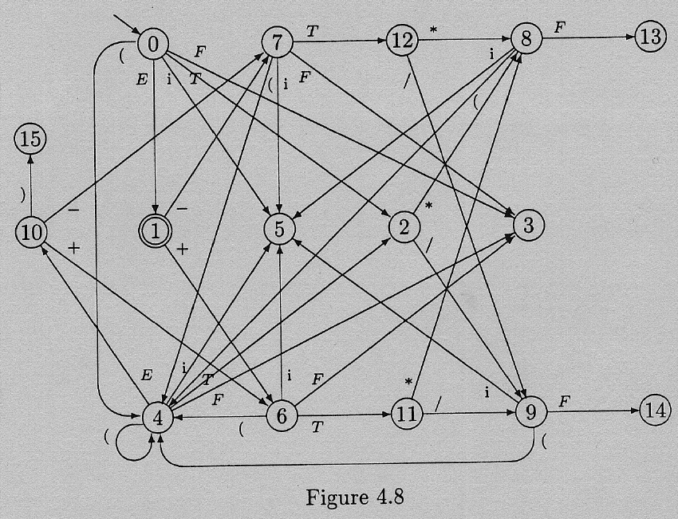

Slide 17
Our Language Example: Yacc grammar
    E
    : E PlusTok T
    | E MinusTok T
    | T
    ;
    T
    : T TimesTok F
    | T DivideTok F
    | F
    ;
    F
    : LParenTok E RParenTok
    | IDTok
    ;

Slide 18
Yacc output with states
  state 0
    $accept : _E $end
    IDTok shift 5
    LParenTok shift 4
    . error
    E goto 1
    T goto 2
    F goto 3
  state 1
    $accept : E_$end
    E : E_PlusTok T
    E : E_MinusTok T
    $end accept
    PlusTok shift 6
    MinusTok shift 7
    . error

Slide 19
  state 2
    E : T_ (3)
    T : T_TimesTok F
    T : T_DivideTok F
    TimesTok shift 8
    DivideTok shift 9
    . reduce 3
  state 3
    T : F_ (6)
    . reduce 6
  state 4
    F : LParenTok_E RParenTok
    IDTok shift 5
    LParenTok shift 4
    . error
    E goto 10
    T goto 2
    F goto 3
  state 5
    F : IDTok_ (8)
    . reduce 8
  state ...

Slide 20
Filling the Rows of the State Table
  State 0:

Slide 21
Creating Action Table Entries
  The shift entries are taken from the state table entries we just created. (terminals we moved across to get the next state).
  If a state, q, contains a completed item n:[C->β.] then for all inputs, x, in the Follow(C) reduce n is in [q,x]
  If State q contains [Z -> E.] then the action for [q,$] is "accept"

Slide 22
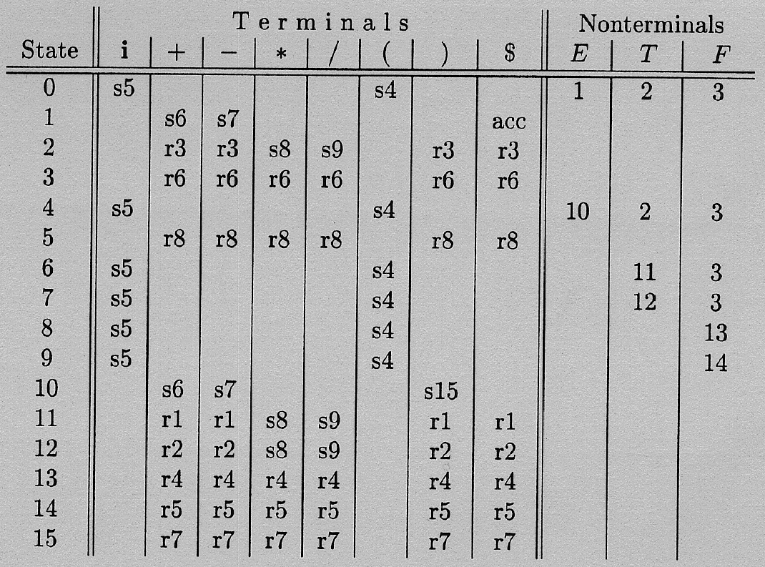

Slide 23
Error Handling
For each empty slot in your table, you can have a unique error message.
You could also try to guess what they left out.
Panic Mode -- ignore everything until a ;

Slide 24
Conflicts
If a grammar is not LR it will show up in the creation of the table.
No ambiguous grammar is LR.

Slide 26
Canonical LR Parsers
The SLR parser breaks down with a conflict.
LR(1) item sets
  standard item sets plus a lookahead symbol
  this creates a lot more states. It is possible to have |LR(0) item set| * |terminals|

Slide 27
Lookahead LR (LALR) Parsers
Why not just use the LR(0) item sets and only add a look ahead when we need one?
They are as powerful as Canonical LR parsers.
They are slower to detect errors (but will detect one before the next token is shifted onto the stack)

Slide 28
Two ways to construct these:
  1. Brute Force LALR Parser Construction
    Start with the LR(1) item sets and merge states.
  2. Efficient LALR Parser Construction
    Start with the LR(0) item sets and add lookaheads as needed.

Slide 29
Compiler-Compilers
YACC generates LALR(1) parser code
  When it runs into conflicts it notifies the user
  shift/reduce conflicts are resolved in favor of the shift.
  operators are right associative by default

Slide 30
Summary:
Which Parser Should I Use?
We have seen several different parsing techniques, of which the most realistic are probably the table driven parsers.
  Predictive parser,
  operator precedence parser, and
  LR parser

Slide 31
Summary:
Which Parser Should I Use?
Which is best?
  it seems to be personal taste.
Now that Yacc-like parser generators are available, the LR parser seems to be the inevitable choice, but, a lot of people still write predictive, recursive-descent parsers.

