Slide 1
Parsing Top-Down

Slide 2

Top-Down parsers
The top-down parser must start at the root of the tree and determine, from the token stream, how to grow the parse tree that results in the observed tokens.
This approach runs into several problems, which we will now deal with.
Parsing Top-Down

Slide 3
Left Recursion
Productions of the form (A->Aα) are left recursive.
No Top-Down parser can handle left recursive grammars.
Therefore we must re-write the grammar and eliminate both direct and indirect left recursion.
Parsing Top-Down

Slide 4

How to eliminate Left Recursion (direct)
  Given:
    A -> Aα₁ | Aα₂ | Aα₃ | …
    A -> δ₁ | δ₂ | δ₃ | ...
  Introduce A'
    A -> δ₁ A' | δ₂ A' | δ₃ A' | ...
    A' -> ε | α₁ A' | α₂ A' | α₃ A' | ...
  Example:
    S -> Sa | b
    Becomes
    S -> bS'
    S' -> ε | a S'
Parsing Top-Down

Slide 5
How to remove ALL Left Recursion.
  1.Sort the nonterminals
  2.for each nonterminal
    if B -> Aβ
    and A -> γ₁ | γ₂ | γ₃ | ...
    then B -> γ₁β | γ₂β | γ₃β | ...
  3.After all done, remove immediate left recursion.
Parsing Top-Down

Slide 6
Example:
  S -> aA | b | cS
  A -> Sd | e becomes
  S -> aA | b | cS
  A -> aAd | bd | cSd | e
note: the S in A(3) -> but it is NOT left recursion
Parsing Top-Down

Slide 7
Backtracking
One way to carry out a top-down parse is simply to have the parser try all applicable productions exhaustively until it finds a tree.
This is sometimes called the brute force method.
It is similar to depth-first search of a graph
Tokens may have to be put back on the input stream
Parsing Top-Down

Slide 8
Given a grammar:
  S -> ee | bAc | bAe
  A -> d | cA
A Backtracking algorithm will not work properly with this grammar.
Example: input string is bcde
  When you see a b you select S -> bAc
  This is wrong since the last letter is e not c
Parsing Top-Down

Slide 9
The solution is Left Factorization.
  Def: Left Factorization: -- create a new non-terminal for a unique right part of a left factorable production.
Left Factor the grammar given previously.
  S -> ee | bAQ
  Q -> c | e
  A -> d | cA
Parsing Top-Down

Slide 10
Recursive-Descent Parsing
There is one function for each non-terminal these functions try each production and call other functions for non-terminals.
The stack is invisible for CFG's
The problem is -- a new grammar requires new code.
Parsing Top-Down

Slide 11

else
if token_is ('c') then
writeln ('S --> c')
else
begin
error ('S');
S := false
end
end; { S }
Example:
  S -> bA | c
  A -> dSd | e
Code:
function S: boolean;
begin
S := true;
if token_is ('b') then
if A then
writeln('S --> bA')
else
S := false;
Parsing Top-Down

Slide 12
function A: boolean
begin
A := true;
if token_is ('d') then
begin
if S then
if token_is ('d') then
writeln('A --> dSd');
else
begin
error ('A');
A := false
end
else
A := false
end
else
if token_is ('e') then
writeln ('A --> e')
else
begin
error ('A');
A := false
end
end; { A }
Parsing Top-Down

Slide 13
Input String: bdcd
Parsing Top-Down

Slide 14
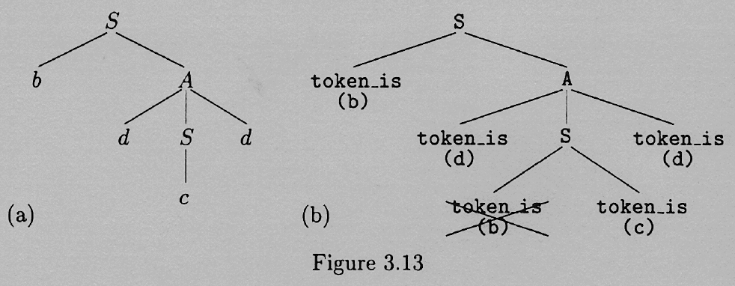
Parsing Top-Down

Slide 15
Predictive Parsers
The goal of a predictive parser is to know which characters on the input string trigger which productions in building the parse tree.
Backtracking can be avoided if the parser had the ability to look ahead in the grammar so as to anticipate what terminals are derivable (by leftmost derivations) from each of the various nonterminals on the RHS.
Parsing Top-Down

Slide 16
First (α) (you construct first() of RHS’s)
  1.if α begins with a terminal x,
    then first(α) = x.
  2.if α =*=> ε,
    then first(α) includes ε.
  3.First(ε) = {ε}.
  4.if α begins with a nonterminal A,
    then first(α) includes first(A) - {ε}
Parsing Top-Down

Slide 17
Follow(α)
  1.if A is the start symbol,
    then put the end marker $ into follow(A).
  2.for each production with A on the right hand side Q -> xAy
    A) if y begins with a terminal q,
      q is in follow(A).
    else follow(A) includes first(y)-ε.
    B) if y = ε, or y is nullable (y =*=> ε)
      then add follow(Q) to follow(A).
Parsing Top-Down

Slide 18
Grammar:
  E -> T Q
  Q -> + T Q | - T Q | epsilon
  T -> F R
  R -> * F R | / F R | epsilon
  F -> ( E ) | I
Construction of First and Follow Sets:
Parsing Top-Down

Slide 19

First(E->TQ) =
  First(T) =
  First(F) = {i,(}
First(Q->+TQ) = {+}
First(Q->-TQ) = {-}
First(Q-> ε) = {ε}
First(R-> *FR) = {*}
First(R->/FR) = {/}
First(R-> ε) = {ε}
First(F-> (E) ) = {(}
First(F-> I) = {I}
Follow(E) = {$,)}
Follow(Q) = Follow(E) = {$, )}
Follow(T) =
  First(Q) - ε + Follow(E) =
  {+,-} + {),$}
Follow(R) = Follow(T)
Follow(F) =
  First(R) - ε + Follow(T) =
  {*,/} + {+,-,),$}
Parsing Top-Down

Slide 20
First(E) = First(T) = First(F) = {i,(}
First(Q) = {+,-,ε}
First(R) = {*,/,ε}
Follow(E) = {$,)}
Follow(Q) = Follow(E) = {$, )}
Follow(T) = First(Q) - ε + Follow(E) {+,-} + {),$}
Follow(R) = Follow(T)
Follow(F) = First(R) - ε + Follow(T) {*,/} + {+,-,),$}
Parsing Top-Down

Slide 21
LL(1) Grammars
  In a predictive parser, Follow tells us when to use the epsilon productions.
  Def: LL(1) -- Left to Right Scan of the tokens, Leftmost derivation, 1 token lookahead.
Parsing Top-Down

Slide 22
For a grammar to be LL(1), we require that for every pair of productions A -> α|β
  1.First(α)-ε and First(β)-ε must be disjoint.
  2.if α is nullable, then First(β) and Follow(A) must be disjoint.
  if rule 1 is violated, we may not know which right hand side to choose
  if rule 2 is violated, we may not know when to choose β or ε.
Parsing Top-Down

Slide 23
Parsing Top-Down

Slide 24
Table-Driven Predictive Parsers
Grammar
  E -> E + T | E - T | T
  T -> T * F | T / F | F
  F -> ( E ) | I
Step 1: Eliminate Left Recursion.
Parsing Top-Down

Slide 25
Grammar without left recursion
  E -> T Q
  Q -> + T Q | - T Q | epsilon
  T -> F R
  R -> * F R | / F R | epsilon
  F -> ( E ) | I
It is easier to show you the table, and how it is used first, and to show how the table is constructed afterward.
Parsing Top-Down

Slide 26
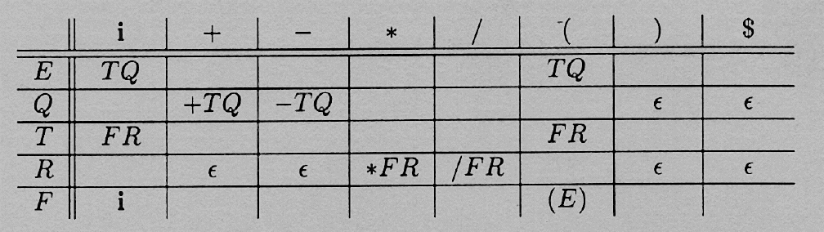
Table
Parsing Top-Down

Slide 27
Driver Algorithm:
  Push $ onto the stack
  Put a similar end marker on the end of the string.
  Push the start symbol onto the stack.
Parsing Top-Down

Slide 28
  While (stack not empty do)
    Let x = top of stack and a = incoming token.
    If x is in T (a terminal)
    if x == a then pop x and goto next input token
    else error
    else (nonterminal)
    if Table[x,a]
    pop x
    push Table[x,a] onto stack in reverse order
    else error
It is a successful parse if the stack is empty and the input is used up.
Parsing Top-Down

Slide 29
Example 1: (i+i)*i
Parsing Top-Down

Slide 30


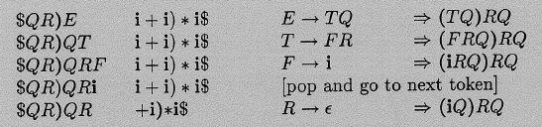
Parsing Top-Down

Slide 31
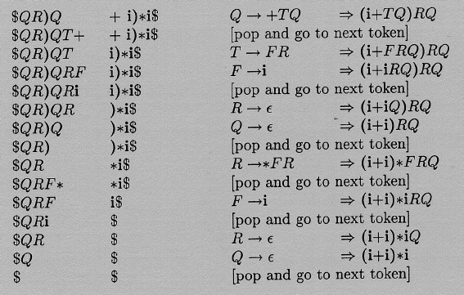
Parsing Top-Down

Slide 32
Example 2: (i*)
Parsing Top-Down

Slide 33
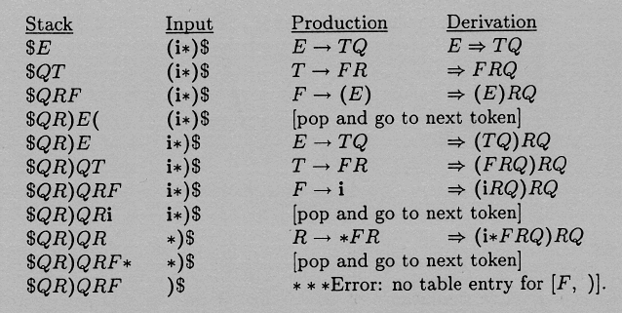
Parsing Top-Down

Slide 34
Constructing the Predictive Parser Table
Go through all the productions. X -> β is your typical production.
  1.For all terminals a in First(β), except ε, Table[X,a] = β.
  2.If β = ε, or if ε is in first(β) then For ALL a in Follow(X), Table[X,a] = ε.
So, Construct First and Follow for all Left and right hand sides.
Parsing Top-Down

Slide 35
Conflicts
A conflict occurs if there is more than 1 entry in a table slot. This can sometimes be fixed by Left Factoring, ...
If a grammar is LL(1) there will not be multiple entries.
Parsing Top-Down

Slide 36
Summary of Top Down
Left Recursion
Left Factorization
First (A)
Follow (A)
Predictive Parsers (table driven)
Parsing Top-Down

