Slide 1

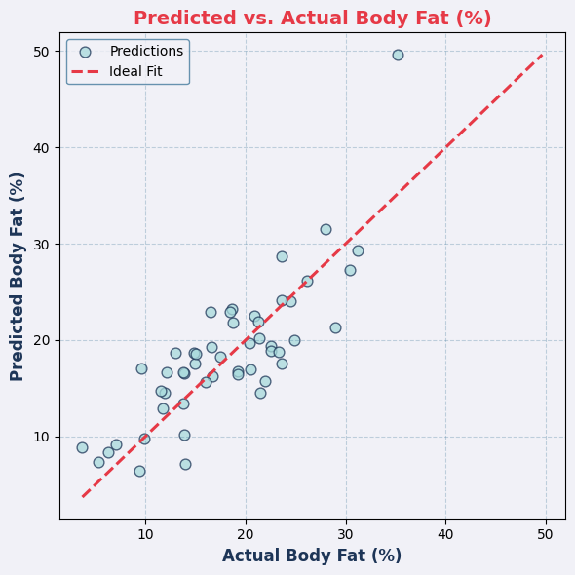
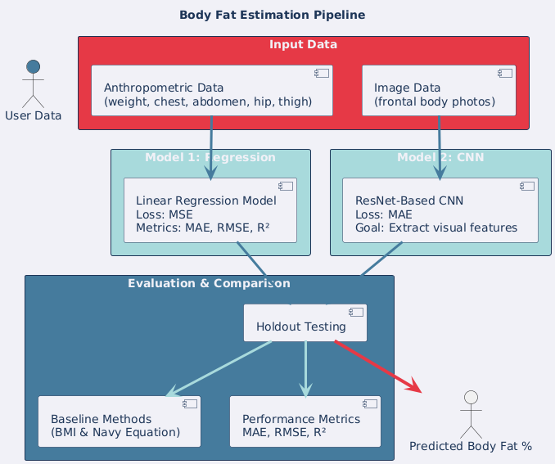
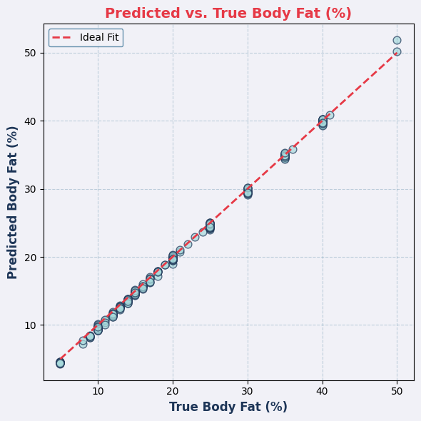
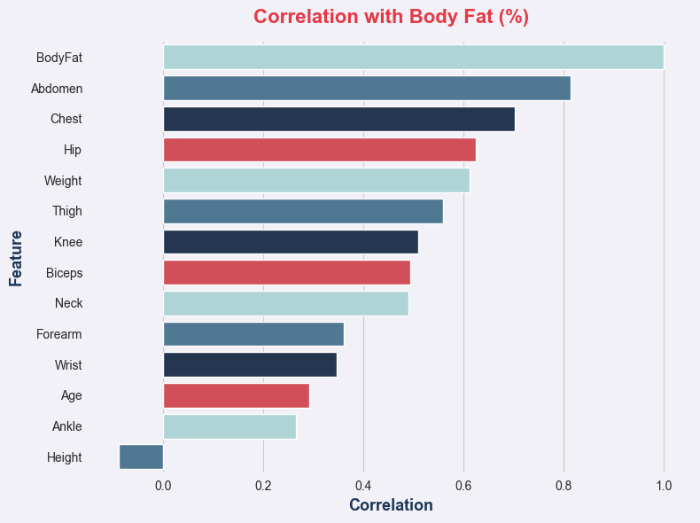
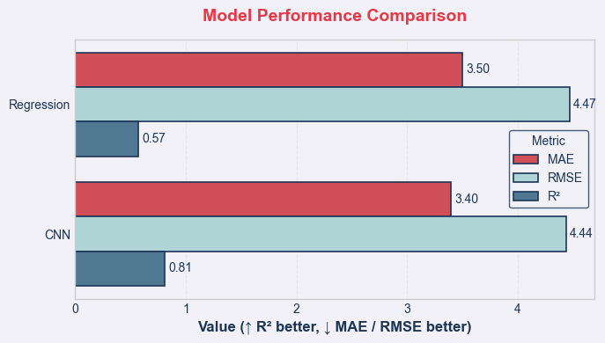


Multimodal AI for Body Fat Estimation: Computer Vision and Anthropometry with DEXA Benchmarks
Rayan ALDajani – Rayandajani21@gmail.com
Lassonde School of Engineering - York University
Abstract
Methodology
Results
Conclusion
AI-based models were tested as low-cost alternatives to DEXA scans for body fat estimation. Using 535 samples (253 anthropometric, 282 image), two models were trained:
CNN (ResNet) on body images → R² = 0.81, RMSE = 4.44%, MAE = 3.34%
Regression on body measurements → R² = 0.57, RMSE = 4.47%, MAE = 3.52%
CNN significantly outperformed traditional methods (BMI, Navy), showing potential for accessible health tracking.
Regression using anthropometric data:
Inputs: body measurements (weight, chest, abdomen, hip, thigh)
Loss: Mean Squared Error (MSE)
Metrics: MAE, RMSE, R²
CNN using image data
Architecture: Convolutional Neural Network based on ResNet
Inputs: frontal body images
Goal:
Extract visual features describing body composition
Evaluation
Both models were evaluated on holdout sets
Both models were not only compared to each other, but also against baseline methods (BMI & Navy equation)
Anthropometric Regression Model
Accuracy: R² = 0.57, RMSE = 4.47%
Strongest predictor: abdominal circumference
Moderate performance, limited at extreme BF% ranges
Image-Based CNN Model
Accuracy: R² = 0.81, RMSE = 4.44%
Recognized visual patterns in addition to the measurements
Scatter plots suggested good mid-range predictions, but variability at extremes
Loss curves: stable convergence, with mild overfitting (small dataset)
Comparison
Both AI models outperformed heuristic baselines (BMI, Navy formula)
CNN provided the best estimates overall
Feasibility: AI approaches have a good prospect for inexpensive body fat estimation.
Performance: The CNN model (R² = 0.81) outperformed the regression model (R² = 0.57) and baseline methods.
Weaknesses: Small sample size, only anthropometric records from males, and reliance on self-reported BF% values.
Substance: This represents a meaningful step towards the development of scalable, AI-supported health tools to help create equity in tracking of body composition. However, validating against large multimodal datasets will be an important next step.
Introduction
Importance of Body Fat %1
Key indicator of overall health, fitness, and disease risk.
Problem: DEXA scans are accurate but expensive and inaccessible, while BMI and Navy methods lack precision.
Opportunity: Advances in AI and computer vision can bridge the gap between accuracy and accessibility.
Goal: Evaluate whether AI models can estimate BF% near DEXA-level accuracy while remaining affordable and scalable to the public.
Figure 5 shows a positive correlation between predicted and actual body fat values, though with greater variability across samples.
Figure 3 shows a strong linear relationship between predicted and true body fat values, indicating high model accuracy and consistency.
Future Work
Figure 2 shows the overall body fat estimation pipeline, outlining both regression and CNN models from data input to evaluation and prediction.
This research indicated that AI-based methods for estimating body fat can be developed, however, the following avenues remain for future research:
Paired Multimodal Data - Data sets that include both image data and anthropometric measurements taken from the same subjects so true multimodal fusion models can be created.
Larger and More Diverse Sample Cohort - More data will be available if samples include females, variability in ethnicities, and diverse body types, improving the generalizability of the methods in this thesis.
Academic Validation - Future work should include comparison of our estimates against gold standard measures (DEXA, MRI) through controlled study designs to establish the academic validity.
Dataset
Figure 1 shows the correlation between Bodyfat and different body measurements
References
Figure 4 shows the different results after training both models, highlighting the superiority of the Image-Based Model over Anthropometric Model
S. B. Heymsfield et al., Human Body Composition: Advances in Models and Methods, Annu. Rev. Nutr., vol. 17, pp. 527–558, 1997.
J. A. Hodgdon and M. B. Beckett, Prediction of Percent Body Fat for U.S. Navy Men from Body Circumferences and Height, Naval Health Research Center Report No. 84-11, 1984.

