Slide 1
AI-Powered Mobile App for Network Threat Detection and Response
1 - Mazen Saleh Alghamdi / 2040773
2 - Ahmed Khaled Alahmri / 2140672
3 - Ryan Hamed Alsubhi / 2140882
4 - Muhannad Amin Almahdi / 2140728

Slide 2
Table of content
Project background and motivation
Business case analysis 2.1 Strategic Business Objective 2.2 Requirement Engineering 2.3 Budget estimates and Financial analysis 2.4 Schedule Estimate 2.5 Potential Risks 2.6 SWOT Micro Analysis
Project charter
Project scope processes and reports
Project schedule processes and reports
lessons- learned and experience gained

Slide 3
Project background and motivation
The project is aimed at providing a secure and safe online experience for users by protecting them from various cyber threats such as malware, phishing attacks, and unauthorized access. The app will leverage AI and machine learning algorithms to analyze network traffic and system logs to respond to threats in real-time. The motivation for this project is to provide a solution that is effective, efficient, and user-friendly in protecting users' online presence, data, and privacy. With the increasing prevalence of cyber threats, there is a need for a reliable and robust solution to protect users from these threats.

Slide 4
Strategic Business Objective
1. To compete in the market of mobile security solutions within Jeddah region
2. Delivering exceptional user protection against cyber threats
3. Increasing market share through rapid customer acquisition

Slide 5
Requirement Engineering
functional requirements 1.1 Real-time network threat detection and response 1.2 AI and Machine Learning-powered algorithms Signature-based and Anomaly-based detection 1.3 Secure communication and data protection 1.4 Customizable security settings 1.5 Reporting and analytics capabilities
Non-functional requirements 2.1 User-friendly interface 2.2 Performance stable with various network traffic amount 2.3 Supports 10 languages 2.4 Run perfectly on open source mobile OS. (ex. Android) 2.5 Customer support 2.6 Work effectively with high-performance mobile devices.

Slide 6
Budget estimates and Financial analysis
Preliminary estimate of costs for the entire project is $475,000
• Project manager: 36 hours/week at $35/hour
• Database Administrator: 36 hours/week at $30/hour
• Software Developers (3 people): 101 hours/week at $30/hour
• AI and ML Expert (3 people): 63 hours/week at $40/hour
• Cyber Security Experts (3 people): 72 hours/week at $35/hour
• Legal Advisor: 20 hours/week at $50/hour
• Business Analyst: 22 hours/week at $45/hour
Purchasing services from suppliers is $35,000
Maintenance costs $42,000
The total project benefits will be 40,000 subscribers * $15 = $600,000 per year

Slide 7
Budget estimates and Financial analysis
Discount rate |  | 10%
Assume the project is done in about 8 months |  | year
 | 0 | 1 | 2 | 3 | total
Costs | 475,000 | 42,000 | 42,000 | 42,000
Discount factor | 1 | 0.910 | 0.826 | 0.751
Discounted costs | 475,000 | 38,220 | 34,692 | 31,542 | 579,454
Benefits | 0 | 600,000 | 600,000 | 600,000
Discount factor | 1 | 0.91 | 0.826 | 0.751
Discounted benefits | 0 | 545,454 | 495,867 | 450,789 | 1,492,110
Discounted benefits - costs | (475,000) | 507,234 | 461,175 | 419,247
Cumulative benefits - costs | (475,000) | 32,234 | 493,409 | 912,656 | ← NPV
 |  | Payback in Year1
Discounted life cycle ROI → | 157.50%

Slide 8
Schedule Estimate
The sponsor would like to see the project completed in duration of 8 months, but there will be some flexibility. Additionally, we predict the system lifecycle to at least be three years.

Slide 9
Potential Risks
• Evolving cyber threats require ongoing adaptation of (Security Technologies)
• The local competitive landscape could shift quickly
• Staying competitive globally is not an easy task
• The governments may ban or limit some features for users’ privacy or data access concerns

Slide 10
SWOT Micro Analysis
Strengths | Weaknesses | Opportunities | Threat
Comprehensive detection against various cyber threats | The app may require continuous updates to adapt to new types of cyber threats | Saudi Arabia provides assistances to creative ideas | Could face strong competition from existing (global) cyber security solutions
Robust reporting and analytics capabilities | The need to balance performance on lower-end devices. | Limited competition in the cybersecurity market in Jeddah and Saudi Arabia | Could have hard time trying to adjust some features in the app to be compatible with legal and regulation standards

Slide 11
Project charter
Project Title: AI-Powered Mobile App for Network Threat Detection and Response
Project Start Date: May 19 Projected Finish Date: 20 Jan
Budget Information: A $475,000 has been allocated for this project. The majority of costs for this project will be spent on internal staffs. An initial estimate provides a total of 101 hours per week.
Project Manager: Mazen Alghamdi, 0591207427, mazen.alghamdiCS@gmail.com
Project Objectives: The app will be designed to protect users from falling victims to various cyber threats, such as malware, phishing attacks, unauthorized access etc...) It will use artificial intelligence (AI) and machine learning (ML) algorithms to analyze network traffic and system logs to respond to threats in real-time. By constantly updating its knowledge base with the latest threat intelligence and industry best practices, it can identify and block potential vulnerabilities before they can be exploited. The AI and ML algorithms utilized by our app continuously learn from new data and try to adapt to evolving cyber threats, ensuring that users are always protected against risks.
Main Project Success Criteria: The project should pay for itself within one year of completion.

Slide 12
Project charter
Approach:
• Conduct market research and user interviews to identify key features and requirements for the AI-powered mobile app, prioritizing the needs of users and businesses in the context of network threat detection and response.
• Review and analyze existing solutions, technologies, and best practices in network security, AI, and mobile app development to convey the design and functionality of the proposed app.
• Collaborate with subject matter experts (SMEs) in cybersecurity, algorithm design, and AI to develop a robust and efficient AI-powered threat detection and response system that can be integrated into the mobile app.
• Develop a prototype of the mobile app using an agile development methodology, incorporating user feedback and iterative improvements throughout the development process to ensure the final product meets users and stakeholders needs and expectations.
• Conduct thorough testing of the app's functionality, security, and performance, enlisting the help of cybersecurity experts and users to identify and address potential vulnerabilities and areas for improvement.
• Develop a plan for ongoing maintenance, updates, and improvements to the app, based on user feedback, emerging security threats, and advancements in AI and network security technologies.

Slide 13
Stakeholder management strategy
Name | Level of interest | Level of influence | Potential Management Strategies
Tom Anderson | High | High | Tom Anderson is a visionary CEO who values innovation and growth. He likes to stay on top of key projects and has a keen eye for potential financial benefits. We can expect him to be actively engaged and willing to contribute to the project's success.
Dr. Wafaa Ghonaim | Low | High | Wafaa Ghonaim is a successful entrepreneur with a diverse investment portfolio. We can increase his engagement by highlighting the potential financial returns and competitive advantages of the AI-Powered Mobile App for Network Threat Detection and Response.
Dr. Sultan Aljaberi | Medium | High | Sultan Aljaberi is an experienced investor with a strong background in technology and cybersecurity. We can increase his engagement by emphasizing the potential positive impact on the community of Jeddah and the innovative AI and Machine Learning-powered features of the app.
David Gentry | Low | High | May require additional efforts to keep him engaged in the project. To maximize his involvement and leverage his expertise we can clearly articulate the value of his contributions to the project and how his expertise can help drive the project's success.
Drew Joseph | Medium | Medium | Drew Joseph is a good legal advisor who excels at identifying potential legal risks and ensuring compliance with relevant regulations. He a little bit seems interested, we should quickly take advantage of this and involve him early in the decision-making process and consult him on legal matters regularly. By maintaining open lines of communication and incorporating Drew's guidance into the project's strategy, we can minimize legal risks and ensure that the project proceeds smoothly without encountering regulatory obstacles.

Slide 14
project scope processes and reports
Project Summary and Justification: Tom Anderson, CEO, requested this project to assist the company in meeting its strategic goals. The new AI-driven platform will increase the company's expertise visibility to current and potential clients. It will also help reduce internal costs and improve profitability by providing cutting-edge AI and Machine Learning solutions. The budget for the project is $475,000, including the internal staff, services from suppliers, and maintenance costs. Estimated benefits are $600,000 each year, based on acquiring 40,000 subscribers in the first year, each paying a subscription fee of $15 per year. It is important to focus on the system paying for itself within one year of its completion.

Slide 15
project scope processes and reports
Product Characteristics and Requirements:
1. AI-driven app
2. Scalability and flexibility
3. User interface and accessibility
4. Security and compliance
5. Performance and reliability

Slide 16
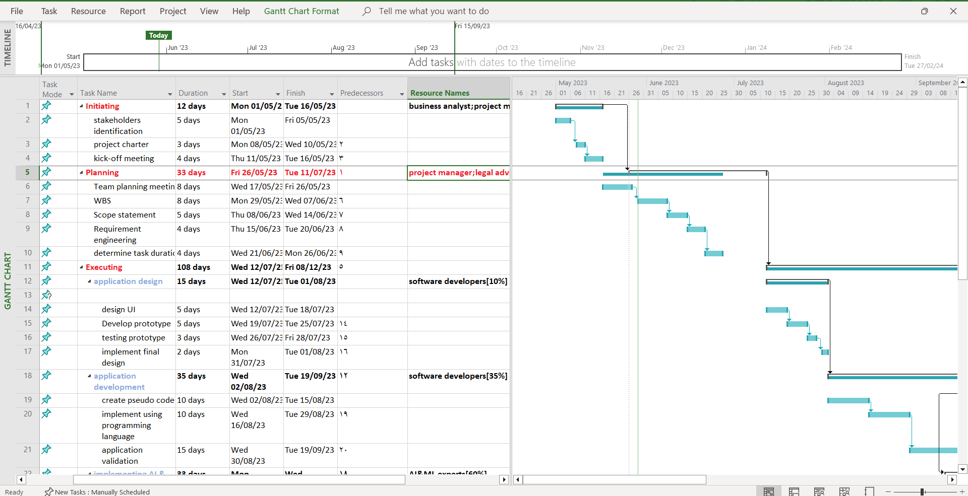
Project schedule processes and reports
Gantt chart

Slide 17
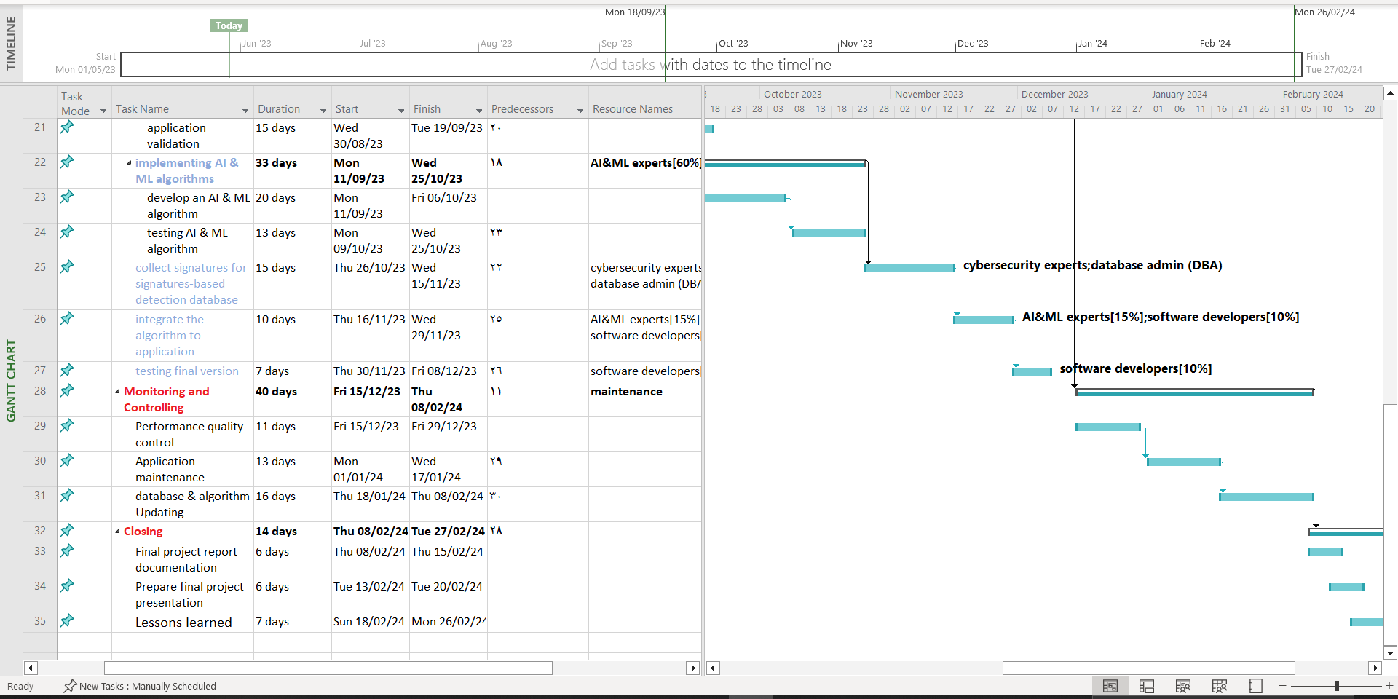
Project schedule processes and reports
Gantt chart

Slide 18
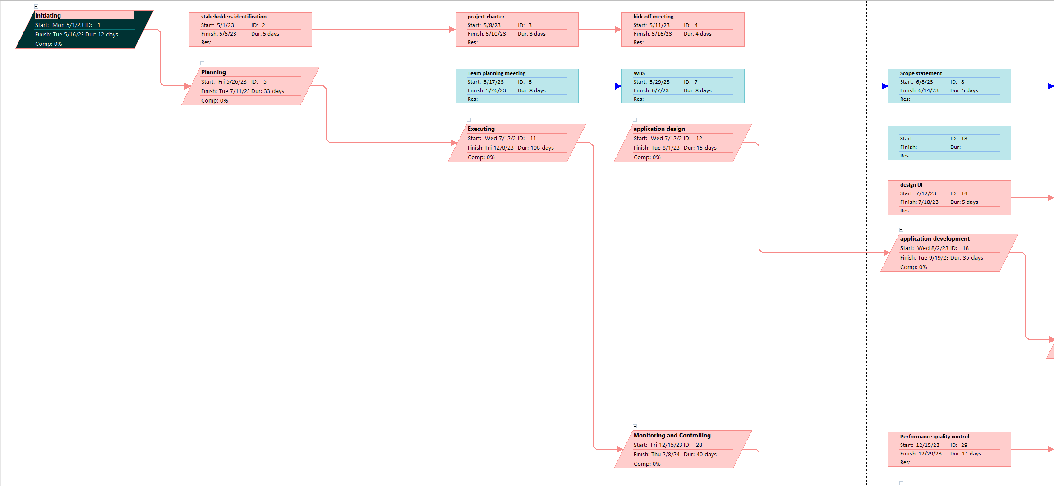
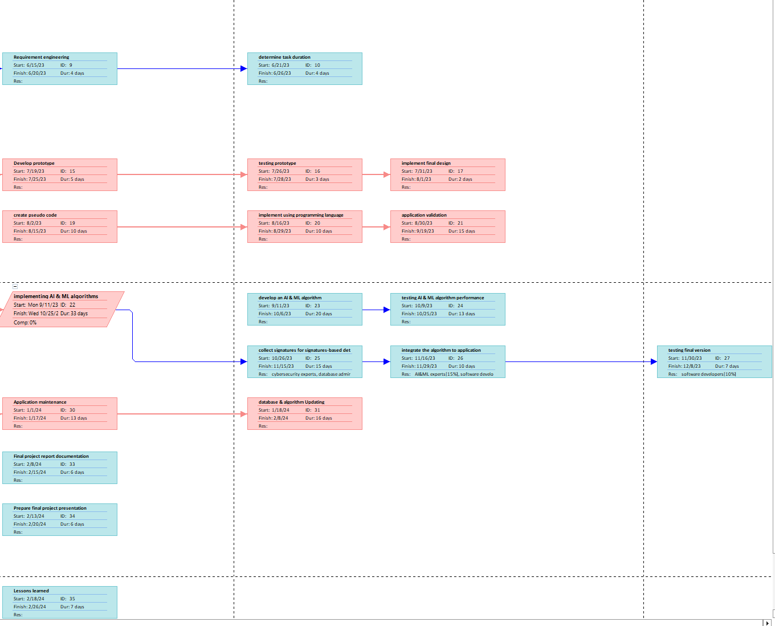
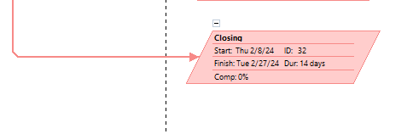
Project schedule processes and reports
Network diagram

Slide 19
lessons- learned and experience gained
Project Name: AI-Powered Mobile App for Network Threat Detection and Response
Project Sponsor: Tom Anderson Projected Manager: Mazen Alghamdi Projected dates: May 19 – January 20 Final budget: $500,000

Slide 20
lessons- learned and experience gained (cont.)
Lessons Learned Report for the AI-Driven Platform Development Project
1 .Did the project meet scope, time, and cost goals?
The project met scope and time goals. However, we requested an additional $25,000, which the sponsor approved.
2. What were the success criteria listed in the project scope statement?
Below is what we put in our project scope statement under project success criteria:
"Our goal is to develop and deploy the AI-driven platform within eight months for no more than $475,000. The project sponsor, Tom Anderson, has emphasized the importance of the platform paying for itself within one year after completion. To meet this financial goal, the platform must attract 40,000 subscribers in the first year, each paying a subscription fee of $15 per year. We must also ensure that the platform provides cutting-edge AI and Machine Learning solutions that enhance our company's expertise visibility. If the project takes a little longer to complete or costs a little more than planned, the firm will still view it as a success if it has a good payback and helps promote the company's image as an innovative organization."
3. Reflect on whether you met the project success criteria. The sponsor has a keen eye for potential financial benefits as long as the platform would have a good payback period and help promote our company's reputation. We have already observed some financial benefits of the new AI-driven platform. For instance, we have seen an increase in client satisfaction, which has had a positive impact on our revenue. Additionally, the platform has attracted new clients and strategic partners, further enhancing our reputation as an innovative organization in the industry. We continue to monitor the platform's performance to ensure that it meets our objectives and provides a strong return on investment.

Slide 21
THANK YOU FOR LISTINING

