Slide 1
AI · MULTI-AGENT · DUE DILIGENCE
Dealigent
Agentic M&A Due Diligence Platform
A multi-agent system that runs a full first-pass diligence review — commercial, financial, operational, legal, technology, management — in minutes.
Anish Chatterjee · Deal Lead | BETA

Slide 2
THE PROBLEM
Due diligence is high-value work done by hand, every deal
▸ Repetitive. Every transaction demands the same structured review across the same six pillars.
▸ Slow & costly. Weeks of analyst-hours are spent assembling the picture before anyone reaches a judgment.
▸ Fragmented. Financials, market data, news, and the data room live in different places and formats.
▸ Hard to trust AI with. A tool that hallucinates a revenue figure or a red flag is a liability, not a help.

Slide 3
WHAT IT DOES
Point it at a target — get an IC-ready first-pass read
▸ Scored analysis across all 6 diligence pillars, each with evidence behind every finding
▸ A prioritized red-flag register with severity and confidence
▸ Live financial statements + a sector-aware valuation view (over/under-payment signal)
▸ A partner-level synthesis: Proceed / Conditional / Abort, with conditions precedent & a 100-day plan
▸ Optional data-room upload — agents cite your documents directly
▸ One-click, exportable investment-committee report

Slide 4
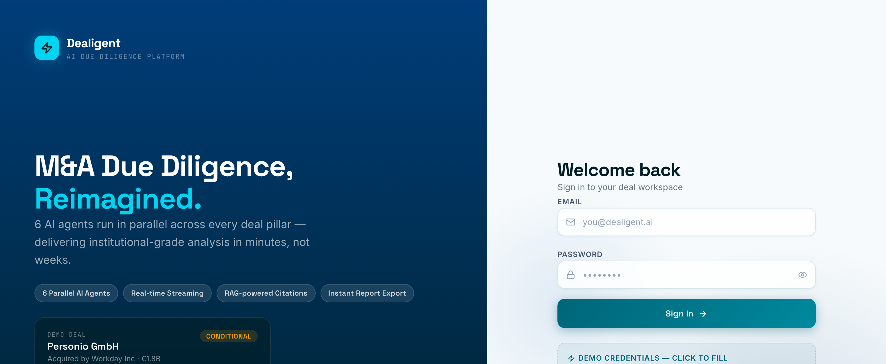
THE PRODUCT
A focused workspace for the deal team
Login → Setup Wizard → Live DD Dashboard → Pillars → Red Flags → Financials → Synthesis → Report

Slide 5
HOW IT WORKS
A multi-agent pipeline — not a chatbot
1 · RESEARCH 5 agents gather profile, live financials, market/TAM & news — then seed a vector store (RAG)
2 · DILIGENCE 6 agents run in parallel, one per pillar, each scoring its domain & citing evidence
3 · CRITIC / QA a supervisory agent reviews every pillar for cross-pillar contradictions
4 · SYNTHESIS a partner agent weighs it all into a recommendation, conditions & 100-day plan
Orchestrated with LangGraph · multi-model fallback (Groq → Gemini) keeps runs alive through rate limits

Slide 6
THE AGENTS
19 agent roles across four layers
Research ×5
Diligence ×6
Oversight ×2
On-demand ×6
▸ Company profile
▸ Live Yahoo Finance
▸ Market / TAM
▸ News + sentiment
▸ RAG seeder
▸ Commercial
▸ Financial
▸ Operational
▸ Legal
▸ Technology
▸ Management
▸ Critic / QA reviewer
▸ Partner synthesis
▸ Per-pillar deep-dive
▸ drill into any domain
▸ for detailed analysis

Slide 7
WHY IT'S CREDIBLE
Built for trust, not just demos
▸ Financials are never AI-estimated. Pulled live from market data & benchmarked to sector multiples.
▸ Every finding carries its evidence + confidence. HIGH / MEDIUM / LOW, with the source snippet — no black box.
▸ Data-room grounding. Upload documents and agents cite them; a Data Confidence score rates the whole read.
▸ “What would change my mind.” Each pillar surfaces the decisive open questions that would move its score.

Slide 8
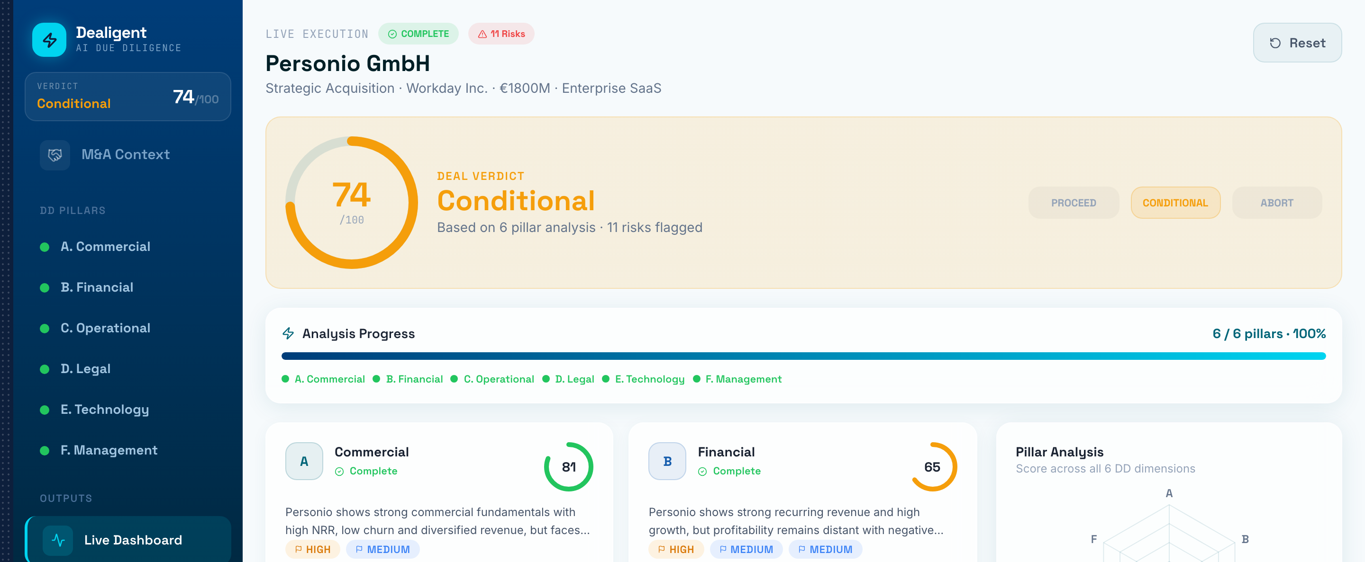
LIVE DASHBOARD · PERSONIO (SaaS)
The command center — scores, radar & risks at a glance
Six agents complete in parallel; overall score, verdict and red-flag count update live.

Slide 9
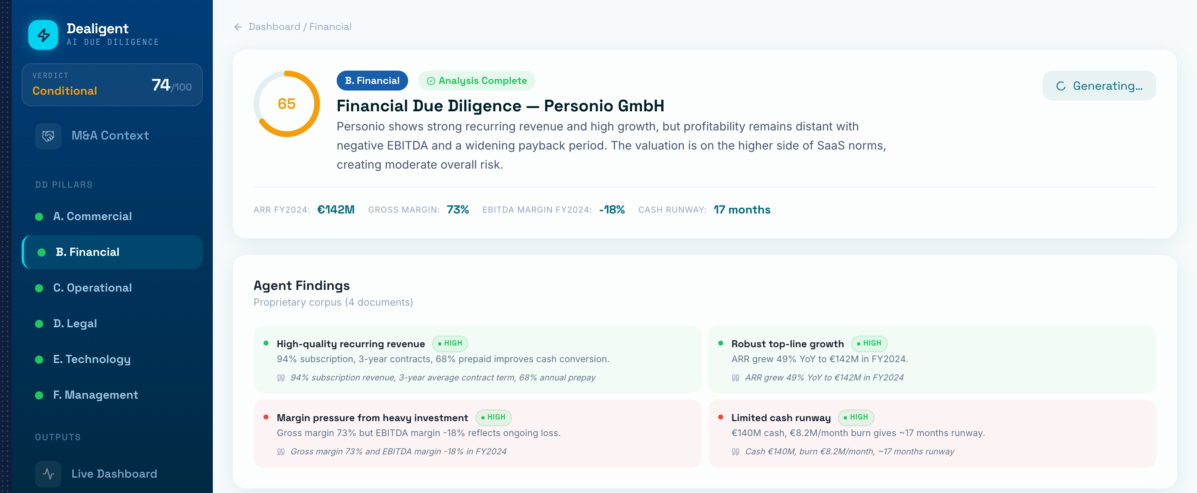
PILLAR DETAIL · PERSONIO
Evidence, confidence & “what would change my mind”
Every finding cites its source with a confidence badge; each pillar lists the questions that would move the score.

Slide 10
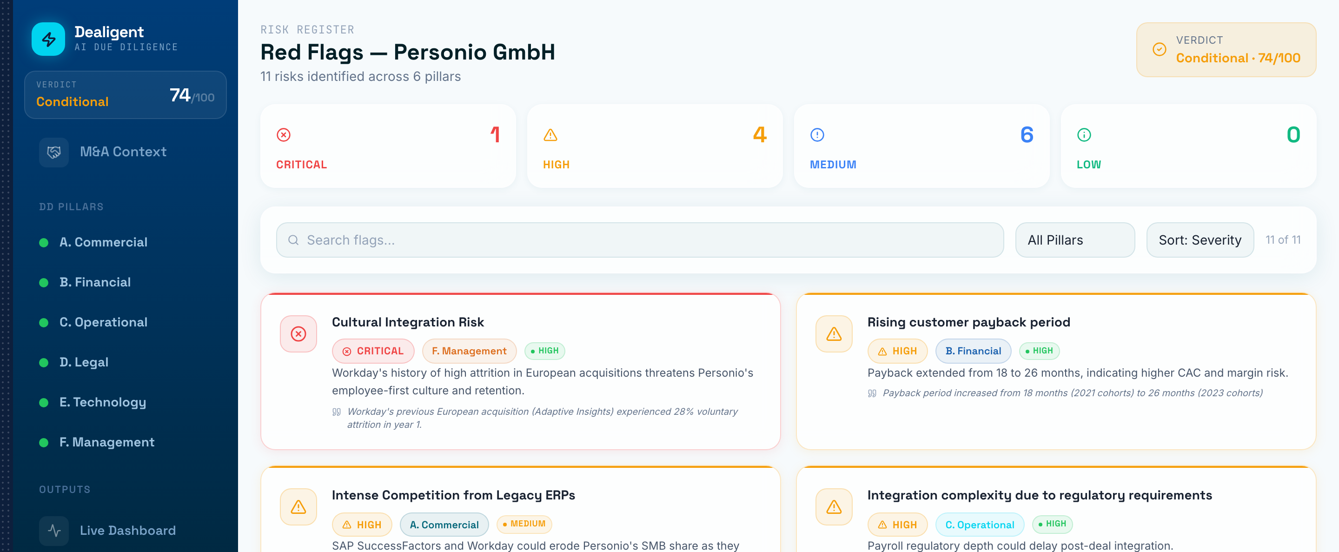
RED FLAGS · PERSONIO
A filterable risk register with severity & confidence
Risks aggregated across all pillars, sortable by severity, each traceable to its evidence.

Slide 11
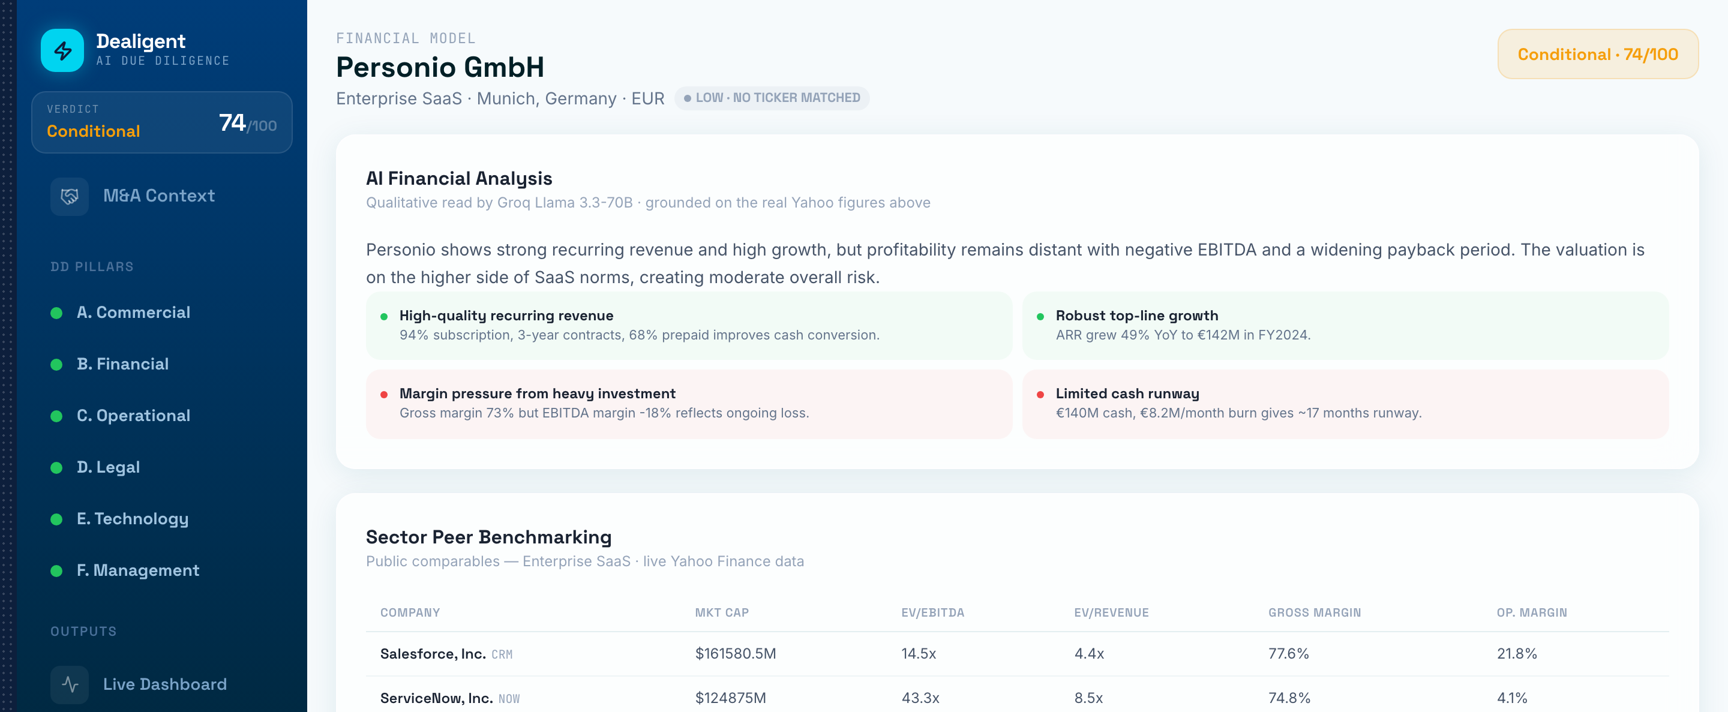
FINANCIALS · PERSONIO
Numbers from the market — never from the model
Live statements and a sector-aware valuation view flag over- or under-payment vs. fundamentals.

Slide 12
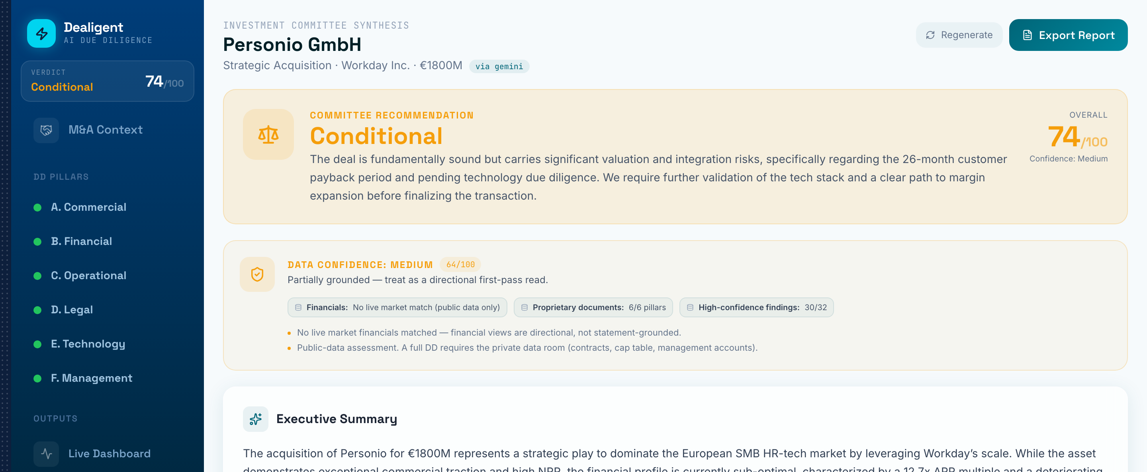
SYNTHESIS · PERSONIO
Partner-level recommendation + a Data Confidence banner
Proceed / Conditional / Abort with rationale, conditions precedent, value levers — and an honest data-quality score.

Slide 13
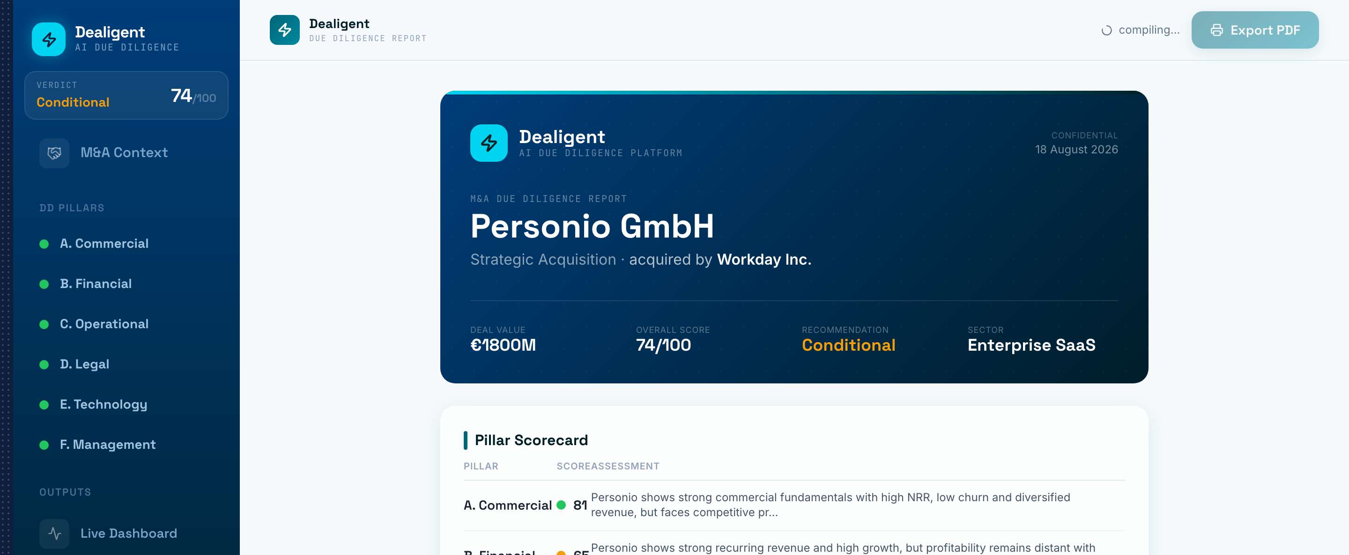
EXPORT · PERSONIO
A one-click investment-committee report
Cover, data confidence, pillar scorecard, financials, strengths & risks, and a red-flag register with citations.

Slide 14
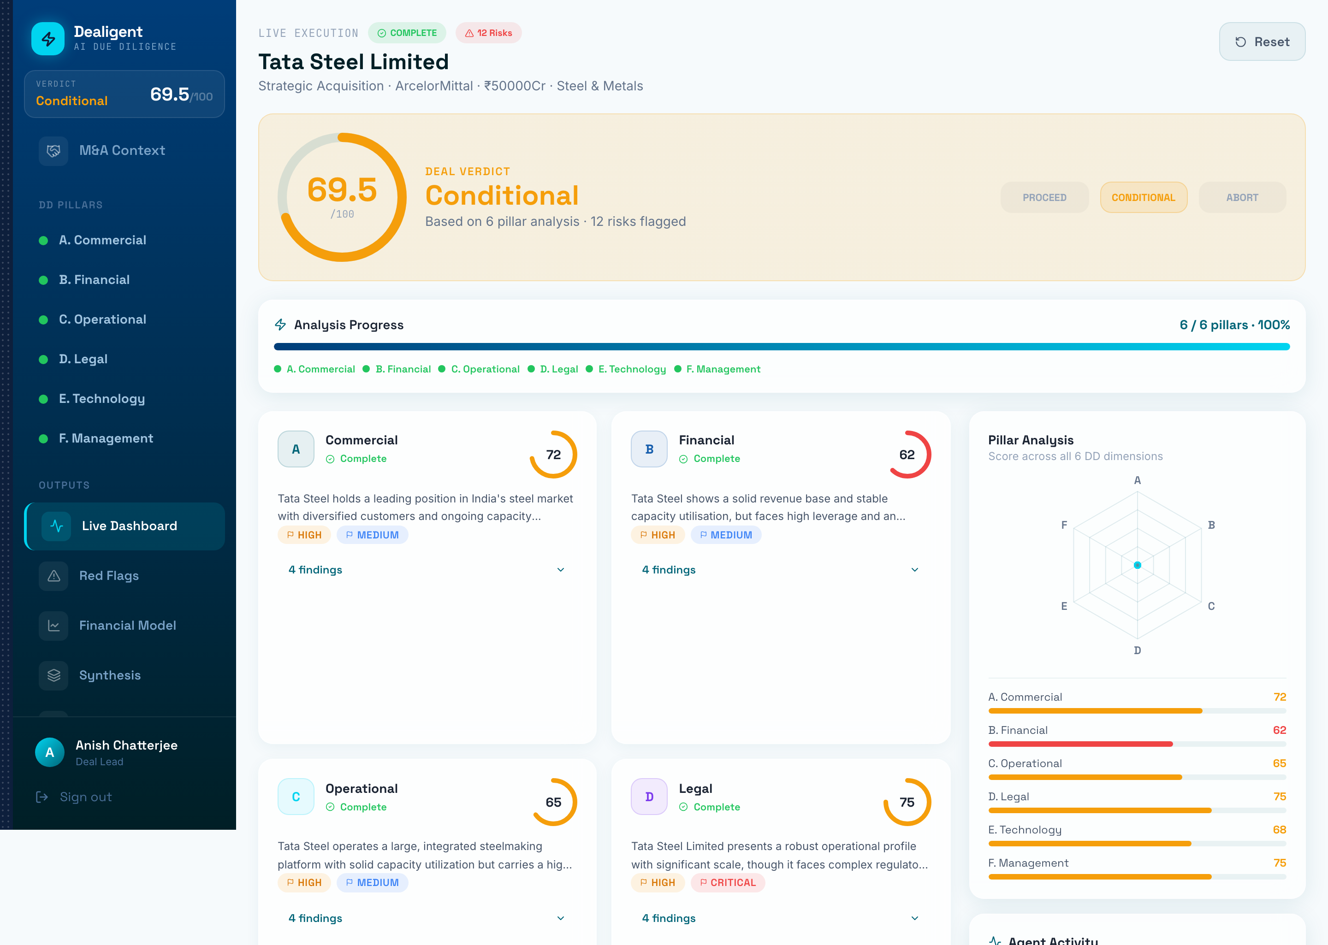
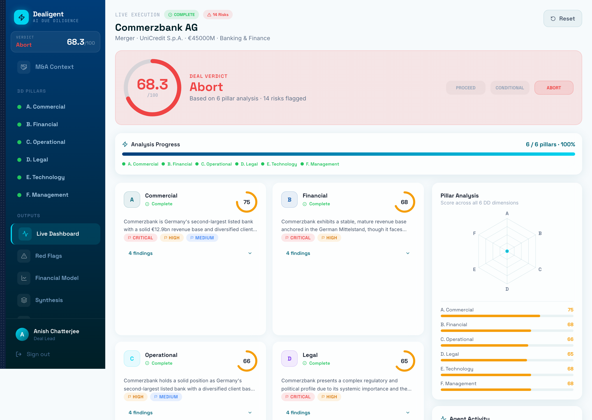
ACROSS SECTORS & VERDICTS
Same pipeline — steel, banking, software
Tata Steel — Steel & Metals
Commerzbank — Banking & Finance

Slide 15
UNDER THE HOOD
Tech stack
▸ Frontend React · Vite · Tailwind · Recharts · Framer Motion · Zustand
▸ Backend FastAPI · async SQLite
▸ Orchestration LangGraph multi-agent graph
▸ Retrieval ChromaDB vector store (RAG) + pypdf ingestion
▸ LLMs Groq & Gemini with automatic fallback
▸ Market data yfinance (live Yahoo Finance)

Slide 16
HONEST STATUS
Beta — a screening tool, not a decision
▸ Reads text, not scanned image PDFs yet (OCR is on the roadmap)
▸ A human verifies every red flag before it reaches a committee
▸ Single-user local build — auth, multi-tenant & audit trail are next
▸ The point: hand the analyst a Day-1 draft so they spend their hours on judgment, not assembly

Slide 17
Dealigent
AI that makes the analyst sharper — not redundant.
Anish Chatterjee · Built with React, FastAPI, LangGraph & a lot of nights

