Slide 1
Working of Sequence-to-Sequence Model
By Reiyo
Let's dive into the inner workings of Sequence-to-Sequence (Seq2Seq) models. These models are deep learning architectures that handle sequential data inputs and outputs. They have found applications in various natural language processing tasks, such as machine translation, text summarisation, speech recognition, etc.

Slide 2
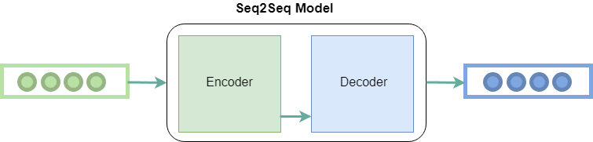
Introduction to Sequence-to-Sequence Models
Definition: Sequence-to-Sequence (Seq2Seq) models are deep learning architectures designed to handle sequential data inputs and outputs.
A Seq2Seq model consists of two main components - the Encoder and the Decoder. The primary purpose of this architecture is to process an input sequence, such as a sentence, and generate an output sequence, which can be of a different length or structure.
Applications: Machine Translation, Text Summarization, Speech Recognition, etc.

Slide 3
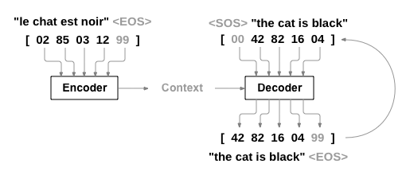
Architecture Overview: Encoder-Decoder Structure
Encoder: Processes the input sequence and creates a fixed-length context vector
Decoder: Uses the context vector as an initial hidden state and uses it to generate the output sequence step by step.

Slide 4
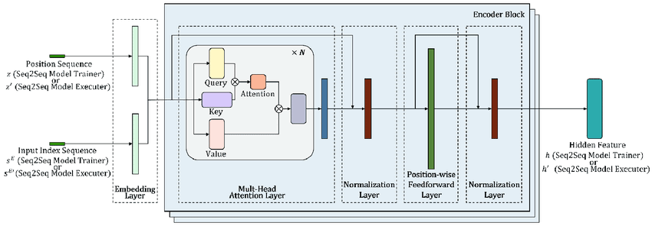
Encoder
Input Sequence: Tokenized input text (e.g., words, characters) represented as numerical vectors.
RNN/LSTM/GRU Layer: Recurrent Neural Network or Long Short-Term Memory or Gated Recurrent Unit to capture sequential information.
Encoder Hidden State: Encodes the input sequence into a context vector representing the input's meaning

Slide 5
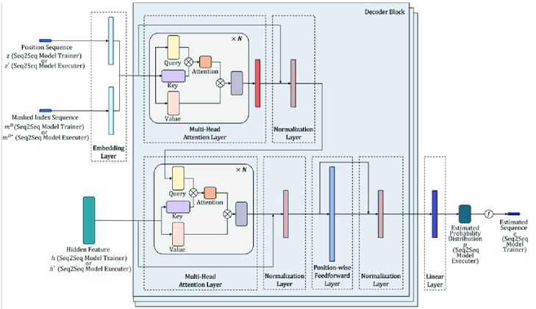
Decoder
Context Vector: Obtained from the encoder, serves as the initial hidden state of the decoder.
RNN/LSTM/GRU Layer: Generates the output sequence step by step.
Vocabulary: A predefined set of tokens that the decoder can use to construct the output sequence.

Slide 6
Attention Mechanism
The Attention Mechanism is an optional component in Seq2Seq models, but it has become a crucial innovation. It helps the model focus on relevant parts of the input sequence during decoding. This attention mechanism assigns weights to each element of the input sequence, indicating its importance for generating each output token during decoding.
Importance: Helps the model focus on relevant parts of the input sequence during decoding.
Weights: Attention weights are assigned to each input element during decoding.

Slide 7
Training the Seq2Seq Model
During training, the Seq2Seq model uses a process called "Teacher Forcing” can be used. This means that true target outputs are used as inputs to the Decoder during training. The model's performance is evaluated using a loss function, usually, the cross-entropy loss, which measures the difference between the predicted and actual output sequences. Backpropagation is then employed to update the model parameters and improve its performance.
Teacher Forcing: During training, use true target outputs as inputs to the decoder.
Loss Function: Usually cross-entropy loss between predicted and actual outputs.
Backpropagation: Gradient-based optimization to update model parameters.

Slide 8
Inference with Seq2Seq Model
During Inference: Predictions are generated one token at a time using the previously generated tokens. During inference, the model generates predictions one token at a time. It starts with a special "start" token and iteratively generates subsequent tokens, using the previously generated tokens as input. The process continues until the model predicts an "end" token or reaches a predefined maximum length for the output sequence.
Start and Stop Tokens: Special tokens to indicate the start and end of the output sequence.
Beam Search: Optionally used to explore multiple candidate sequences during decoding.

Slide 9

Advantages and Challenges
Advantages:
Effective for handling sequential data,
versatile for various tasks like text generation, machine translation, image captioning, text summarization
Can handle variable-length inputs/outputs.
Challenges:
Sensitive to input length
Potential loss of context in long sequences.
Computationally Expensive
Overfitting

Slide 10
Conclusion
Recap: Sequence-to-Sequence models use an encoder-decoder architecture to process sequential data.
Versatility: They have demonstrated success in various natural language processing tasks.
Ongoing Research: Continuous improvements and advancements in Seq2Seq models.

Slide 11
References :
“Attention Is All You Need” by Vaswani et al.(2017) https://arxiv.org/abs/1706.03762
https://pytorch.org/tutorials/intermediate/seq2seq_translation_tutorial.html
Link to Github repo :
https://github.com/R3IYO/Seq2Seq

Slide 12
Thank You

