Slide 1
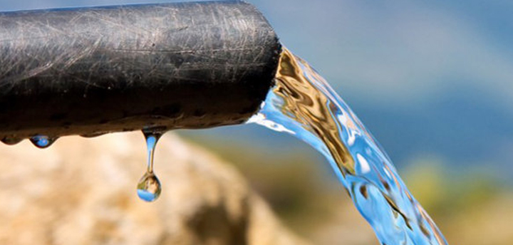
Tanzani Water Wells Classification

Slide 2
Introduction
STAKEHolders:
Taarifa and The Tanzania Ministry of Water.
Goal:
To aid in Predictive Maintenance of water wells
Using Machine Learning

Slide 3
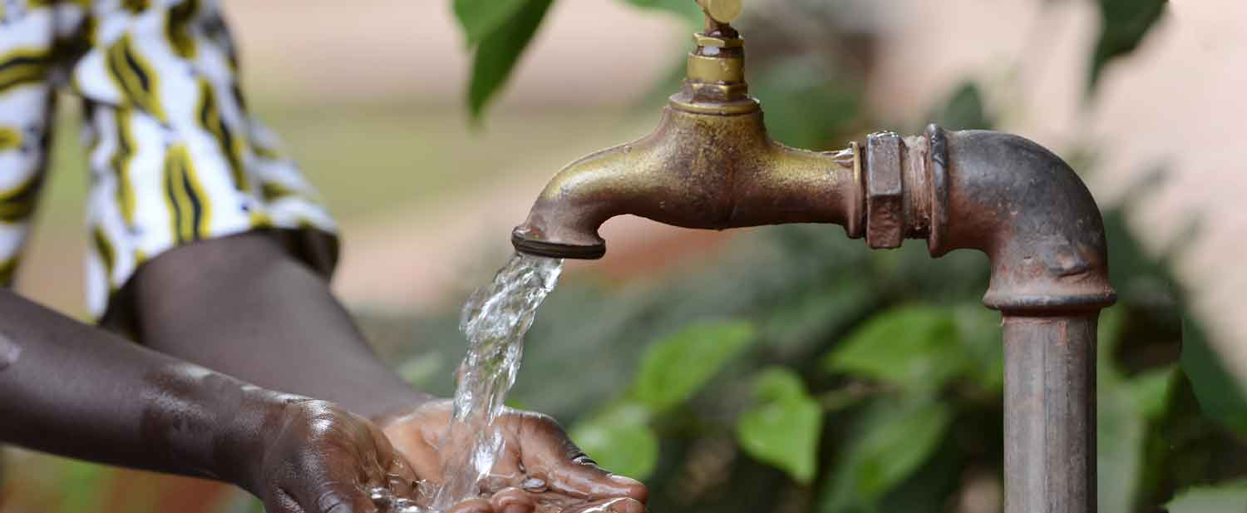
Problem Overview
Access
While much of Tanzanians population has access to basic water services, a large 39% of households still lack this basic need
Maintenance
Predictive maintenance of the water wells that provide water to much of the rural population is needed.

Slide 4
Objectives
Feature Identification
Modeling
Evaluation
To identify the best features to use in building the predictive model
To build and train a classification model that can predict which wells are likely to need repairs.
To evaluate the effectiveness and improve performance of the model built.

Slide 5
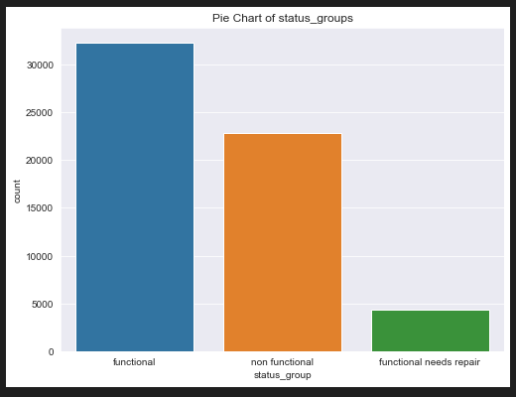
Feature Identification
The distribution of wells by the functioning status.

Slide 6
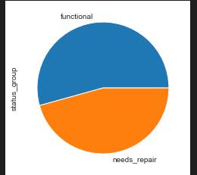
Feature Identification
To reduce class imbalance we combined the two columns into one called ‘needs repair’

Slide 7
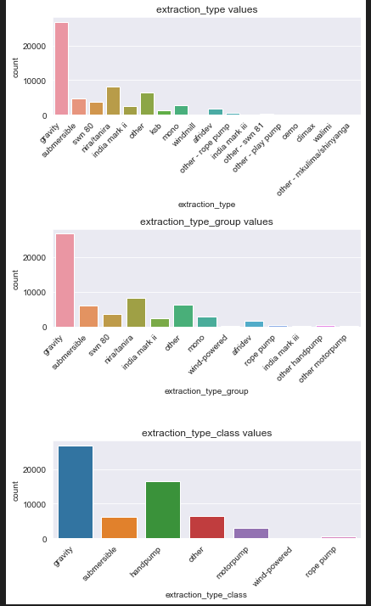
Feature Identification
To better generalize some, some columns were dropped in the model.

Slide 8
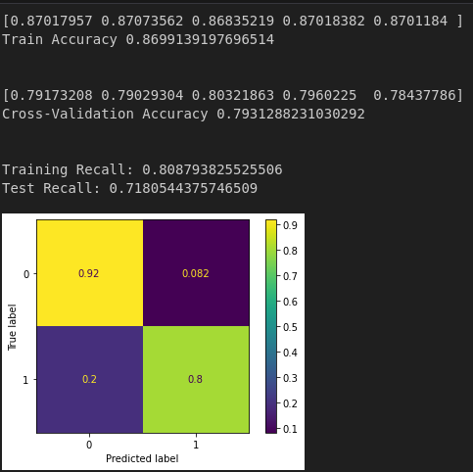
Modelling
The best model was a Logistic Regression model that was able to predict with 79% accuracy.

Slide 9
Evaluation
Best Model:
Logistic Regression
Accuracy:
79%

Slide 10
Recommendations
More data can be sourced to improve the model
The model can be deployed in an environment of choice to help ensure water security.

Slide 11

Thank you
CC by SA, Risyad Rais

