Slide 1
Tweet Talk
Twitter's Take on Apple vs. Google Products:
Sentiment Analysis

Slide 2
Table of Contents
01
02
03
04
05
Business Understanding
Business Challenges
Solutions
Project Overview
Problem Statement & Objectives
Metrics of Success
Data Understanding
Overview of the data
EDA
Model Evaluation
What model was the best performing?
Recommendations
What’s the way forward?

Slide 3
01
Business Understanding

Slide 4
Business Overview
In today's technology-driven era, businesses understand the importance of comprehending customer perceptions and adapting to market changes. Social media platforms like Twitter provide a valuable tool for tracking and analyzing user sentiments regarding different products.
By utilizing sentiment analysis, businesses gain insights to refine strategies and meet evolving customer expectations.
This understanding allows them to make informed decisions and drive customer satisfaction in a competitive market.

Slide 5
Challenges
Brand Reputation
Product Development
Competitive Analysis
Apple & Google would be interested in maintaining and/or improving their Brand Reputation.
Not understanding the customer preferences when it comes to the development of new products.
Monitor the sentiments that are related to their competitors.

Slide 6
Proposed Solutions
Brand Reputation
Product Development
Competitive Analysis
Quality Customer Service
Proactive Online Monitoring
Prioritize customer feedback in the Research & Development process
Monitor competitor sentiments and identify market gaps to differentiate your offerings.

Slide 7
02
Project Overview

Slide 8
Problem Statement
Social media sentiments are important for businesses to understand customer perceptions.
This sentiment analysis project focuses on analyzing Twitter data.
The goal is to extract insights about the sentiments related to Apple and Google products mentioned in tweets.

Slide 9
Problem Objectives
The main objective of this project is to create a model that when given a tweet or series of tweets and a product would determine how the user felt about that product.
Text Classifier – to accurately distinguish between positive, neutral, and negative sentiments, as well as point out why they are classified as such.
Competitive Analysis – Compare the sentiment towards Apple and Google products to identify any significant differences in public perception.
Give insights as to where the company can increase customer satisfaction.

Slide 10
Success Metrics
The model performance of this project will be analyzed using the following performance metrics:
Accuracy
Precision and Recall
F1 Score
For the multi-class classification, the recall macro average was used to compare the models.

Slide 11
03
Data Understanding

Slide 12
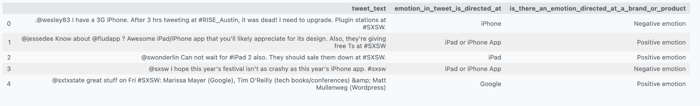
Data Understanding
The data was collected from DataWorld provided by CrowdFlower which has tweets about Apple and Google from the South by Southwest (SXSW) conference. There were 9093 rows and 3 Columns in the data.

Slide 13
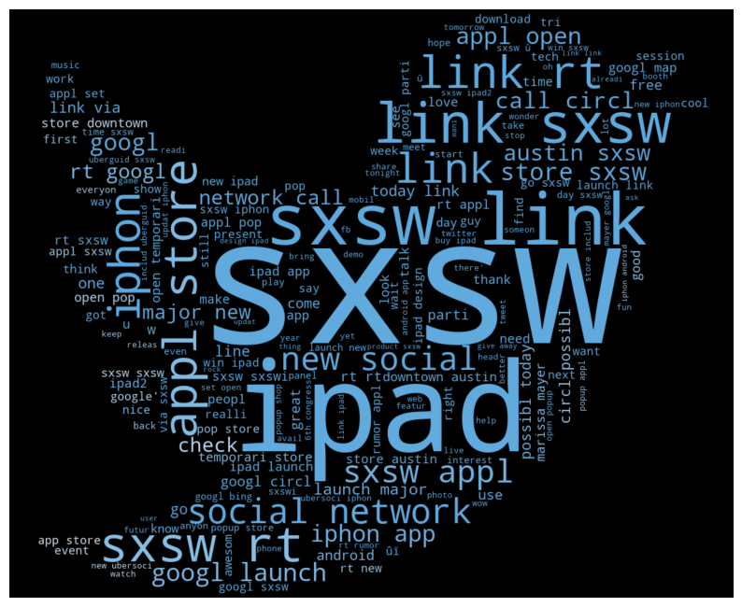
WordCloud

Slide 14
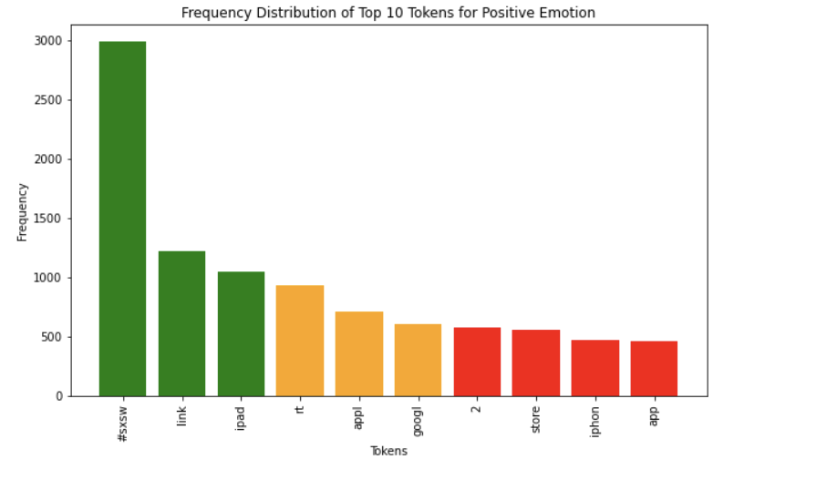
Distribution of the top 10 words (tokens) used for positive emotion

Slide 15
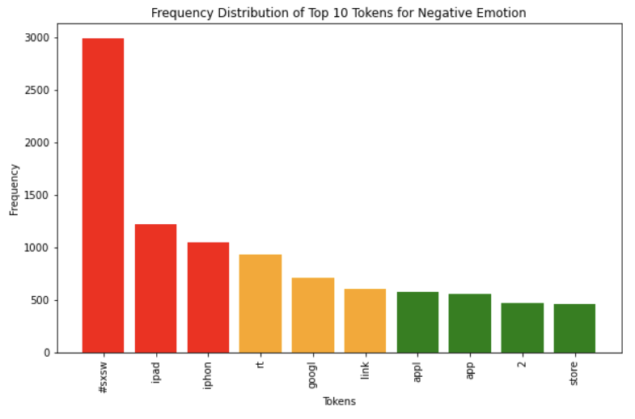
Distribution of the top 10 words (tokens) used for negative emotion

Slide 16
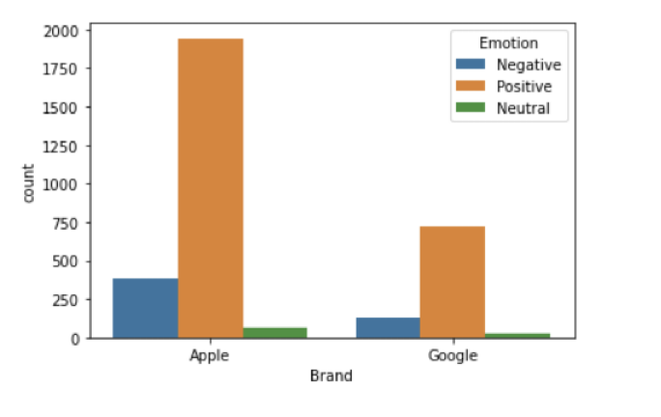
Data Understanding
Since the data set compares sentiments by brand for products from Google and Apple comparison of sentiments by brand yielded the following results shown above.

Slide 17
04
Model Evaluation

Slide 18
Model Evaluation
The best performing model in the multiclass classification was the Tuned Oversampled Logistic Regression model
Accuracy score : 67%
Testing : 53%
Training : 54%
The XGBoost model had a test dataset prediction score of 65% and 85% However, its accuracy score decreased from 0.51 before and after GridSearchCV tuning.

Slide 19
05
Recommendations & Conclusion

Slide 20
Word on the street
Apple
Google
The battery life on the iPhone received negative feedback
Android Operating System was a pain point for majority
❌
The increase in size of the new iPad 2 was disapproved
Poor customer service was observed
❌
iPhone trumped Android in the tweet thread on user preferences.
Google Chrome was the preferred web browser for the majority.
✅

Slide 21
Recommendations
Improve Customer Service
Monitoring Social Media
01
02
This would help improve brand reputation.
Develop a social media strategy so that sentiments can be monitored & can remain informed
Product Improvement
Competitor Analysis
03
04
Extend the analysis to competitors in the industry, so as to understand customer perceptions and opportunities for differentiation
Based on the sentiments made, improve the quality of products/services, e.g iPhone battery life.

Slide 22
Thanks!
Do you have any questions?
Project Contributors:
Aaron Onserio
Diana Mwaura
Joshua Rwanda
Samuel Kyalo
Stella Kitur
Stephanie Mbithe
GitHub Repository

