Slide 1
Java
Swings

Slide 2
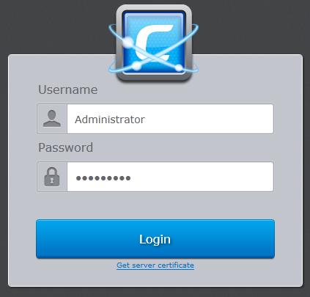
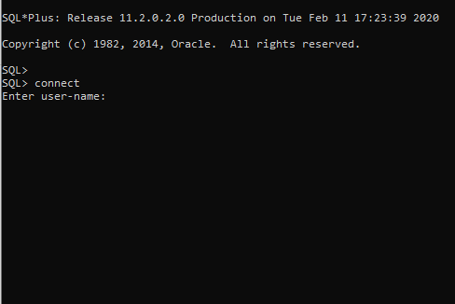
Graphical User
Interface
Command Line
Interface

Slide 3
History of GUI using Java
AWT
Abstract Window Toolkit
Introduced with JDK 1.0
Swings
Introduced with Java 2
Light weighted
JavaFX
Introduced with Java 8
Includes Animations
Heavy weighted
Package: java.awt
Identical on Different Platforms
Inherits AWT
Modern UI
Replaces Swings

