Slide 1

IMPLEMENTATION OF LINEAR REGRESSION IN CAR PRICE PREDICTION SYSTEM
Presented to the faculty of Engineering of
COSMOS COLLEGE OF MANAGEMENT AND TECHNOLOGY
In partial fulfillment of the requirements for the award of the degree of
Bachelor
In
Computer Science & Engineering
Presented By:
ATUL POKHAREL (170308)
NABIN RAJ DHUNGEL (170322)
NABIN JOSHI (170323)
RAKSHYA BHETWAL (170334)

Slide 2
OVERVIEW
This project will provide the overview for developing machine learning models.
This project of CAR PRICE PREDICTION SYSTEM will be used to accurately predict the price of a used car based on its features.
It shall provide efficient and flexible collection of information in order to make informed purchases.

Slide 3
OBJECTIVES
To predict the price of second-hand cars on the basis of given attributes,
To provide feature based system(i.e. feature wise prediction must be possible).

Slide 4
INTRODUCTION
This project ‘CAR PRICE PREDICTION SYSTEM ’; a web-based platform embedded with machine learning.
The system contains the complete information about the vehicle such as vehicle model, kilometers travelled, fuel type and so on.
The system increases accuracy as the value of the car will be forecasted using multiple attributes.

Slide 5
PROBLEM DEFINITION
  This project highlights the confusion of the buyers and helps them get a suitable car as per their requirements.
  Similarly, Aid shall be provided to the sellers for predicting the reasonable price to sell their car with the help of information about current market situation.

Slide 6
LITERATURE REVIEW
Pal et al. (2018) used Random Forest, a controlled learning method to estimate the price of used cars.
Noor and Jan (2017) offer a vehicle price forecasting system.
Richardson (2009) in his thesis work applied multiple regression analysis and demonstrated that hybrid cars retain their value for longer time than traditional cars.
Other platforms as Cars24, Get Vehicle Price, etc.

Slide 7
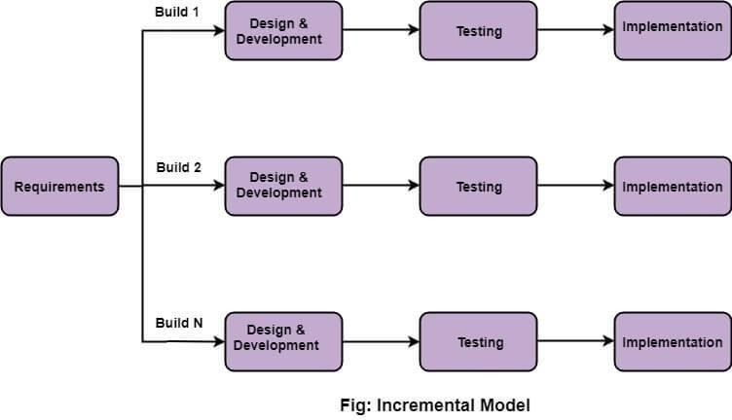
SOFTWARE DEVELOPMENT APPROACH

Slide 8
DATA FLOWDIAGRAM

Slide 9
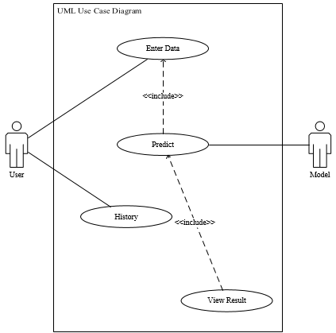
UML USE CASE DIAGRAM

Slide 10
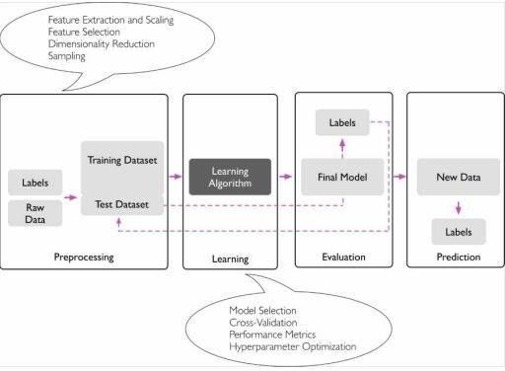
MODEL IMPLEMENTATION

Slide 11
SYSTEM WORKFLOW

Slide 12
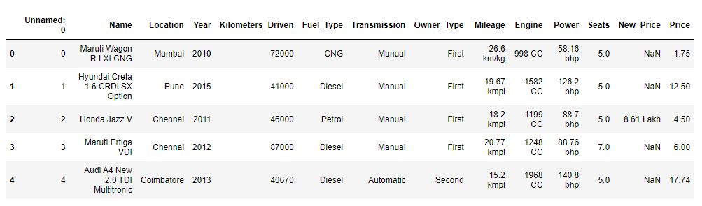
  DATASET SAMPLE

Slide 13
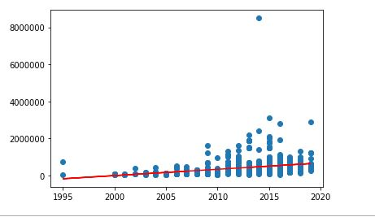
PREDICTION GRAPH
Y-axis: Price
X-axis: Year of Purchase
Price
Year of Purchase

Slide 14
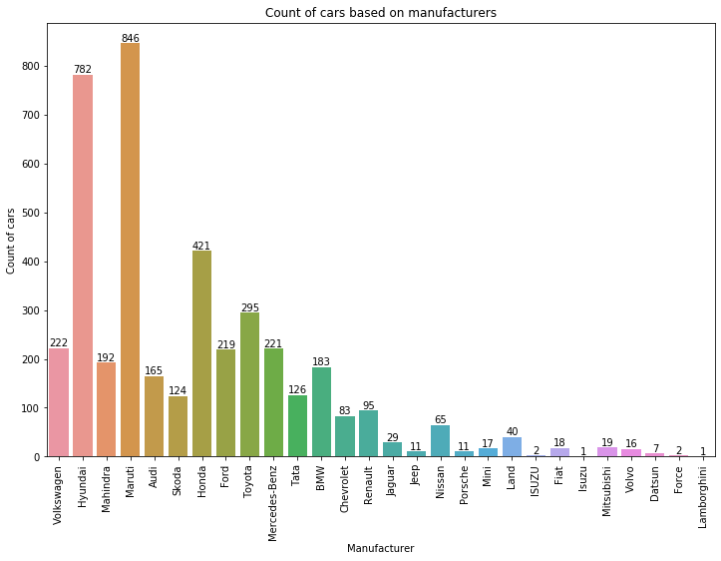
BAR GRAPH
COUNT OF CARS ON THE BASIS OF MANUFACTURING COMPANY

Slide 15
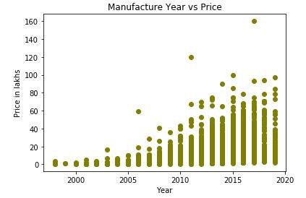
SCATTER PLOT
Effect on Price due to Manufacturing Year

Slide 16
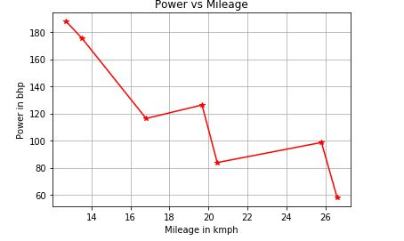
LINE CHART
Power vs. Mileage

Slide 17
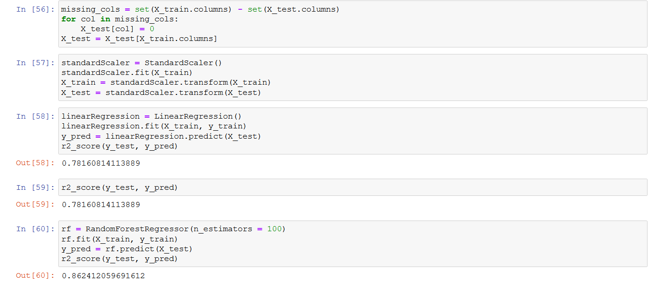
  SNAPSHOT

Slide 18
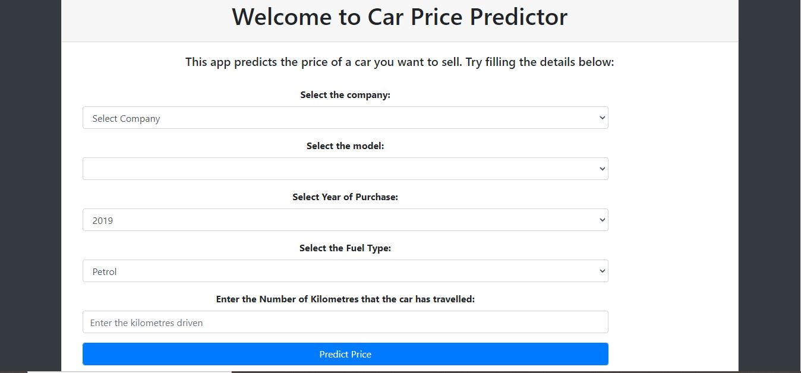
  SNAPSHOT

Slide 19
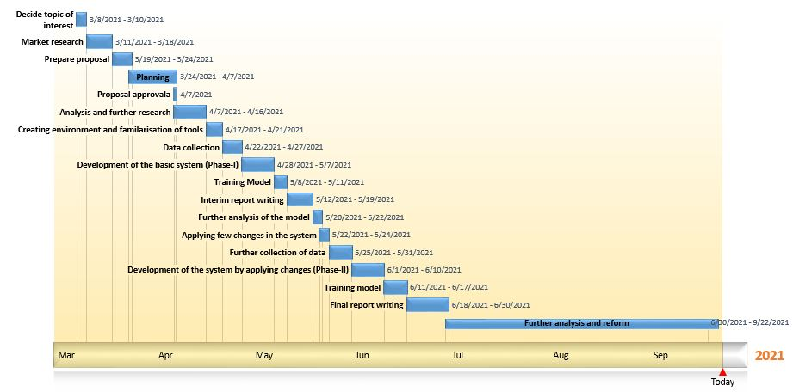
WORKING SCHEDULE

Slide 20
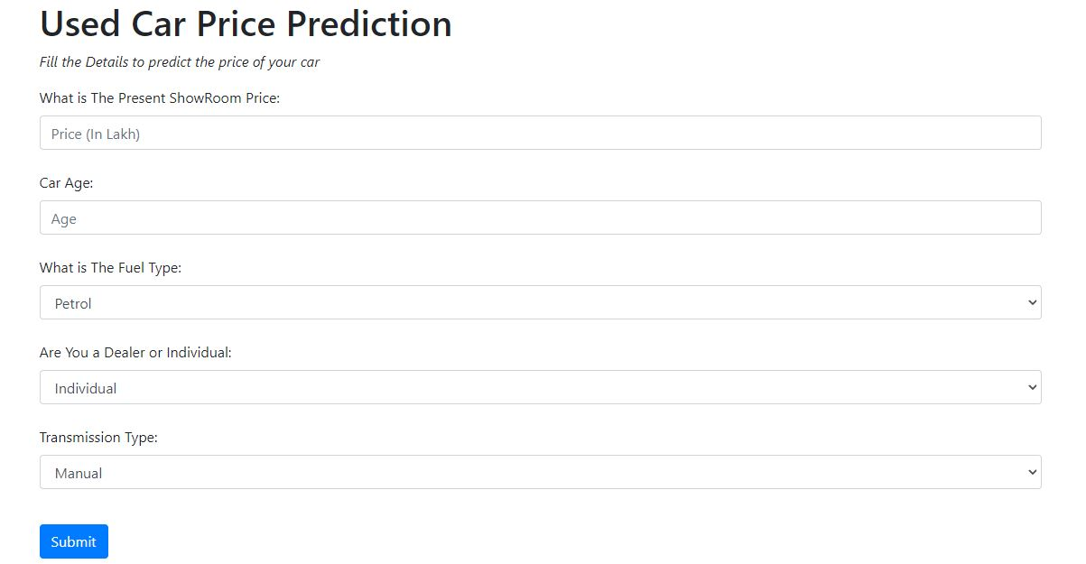
  SNAPSHOT

Slide 21
FURTHER ENHANCEMENT
In future, it is possible to predict price using image of car and also detect defect on car using the same.
It is also possible to increase accuracy of the predicting model by increasing attributes in dataset.
Customer Review and Ownership Rating can be implemented for trusted trading.

Slide 22
THANK YOU…

