Slide 1
HD-Vis: A visual analysis of global Human Development
Giuseppe Fosci
Emilio Martino
Alessio Rago
Visual Analytics – Project Presentation Sapienza University of Rome

Slide 2
Table of contents
Introduction
Related Works
Dataset
Visualizations
Insight
Live Demo
‹#›

Slide 3
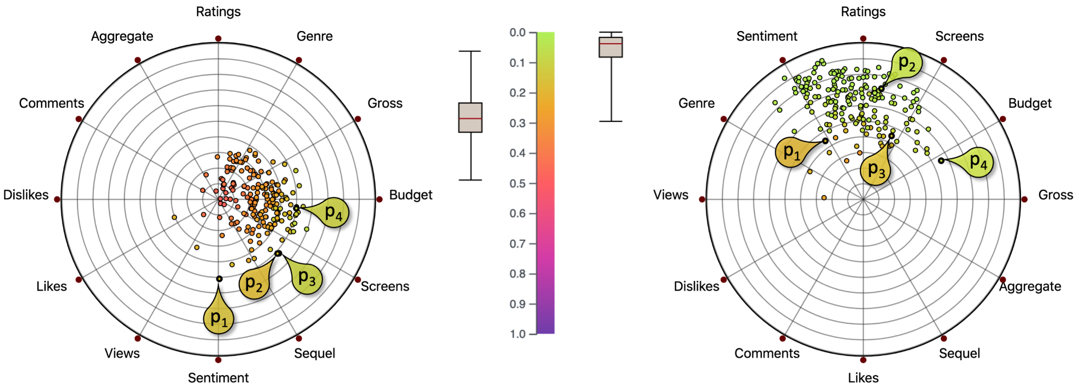
Introduction
HDI overview
This dashboard was created to allow comparison between different partitions of data between RadViz and different other types of graphs and through this comparison you can highlight the pros and cons of using RadViz depending on the size and variety of the data sets.
‹#›

Slide 4
Related Works
Scientific papers related to RadViz
This work is an implementation and practical demonstration of the concepts presented in the following research papers, which provided the theoretical foundation for the project:
[1] “To RadViz or not to RadViz": M. Ficorella, S. Lenti, and G. Santucci, "To RadViz or not to RadViz", in Eurographics Conference on Visualization (EuroVis) 2023, D. Archambault, R. Bujack, and T. Schreck (Guest Editors), vol. 42, no. 3, 2023
[2] “Towards Enhancing RadViz Analysis and Interpretation": M. Angelini, G. Blasilli, S. Lenti, A. Palleschi and G. Santucci, "Towards Enhancing RadViz Analysis and Interpretation", 2019 IEEE Visualization Conference (VIS), Vancouver, BC, Canada, 2019, pp. 226-230
‹#›

Slide 5
Dataset
Dataset description
For the dashboard, 6 completely different data categories were used, all of which can be selected from the side menu:
“Unconstrained Data” → Heterogeneous values → (RadViz not suitable)
“Unconstrained Positive Data” → Only positive values → File: “dati_caso2_vini.csv”, (RadViz not recommended)
“Fixed Active Domains” → Predefined ranges (e.g., SAT 400-1600) → File: “dati_caso3_specifiche_auto.csv” (RadViz has limited usefulness)
“Fixed & Common Active Domains” → Same scale (e.g., 18-30) → File: “dati_caso4_voti_universitari.csv” (RadViz is useful)
“[0,1] Domain Data” → Pre-normalized (e.g., percentages) → File: “dati_caso5_salute_ambientale.csv” (Radviz is an excellent tool)
“Partition Data” → Sums to 1 (100%) → File: “dati_caso6_elezioni.csv” (RadViz is an ideal tool)
‹#›

Slide 6
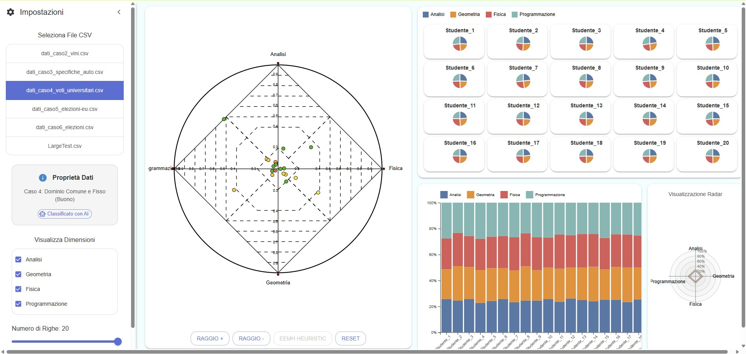
Visualizations
Complete Dashboard
‹#›

Slide 7
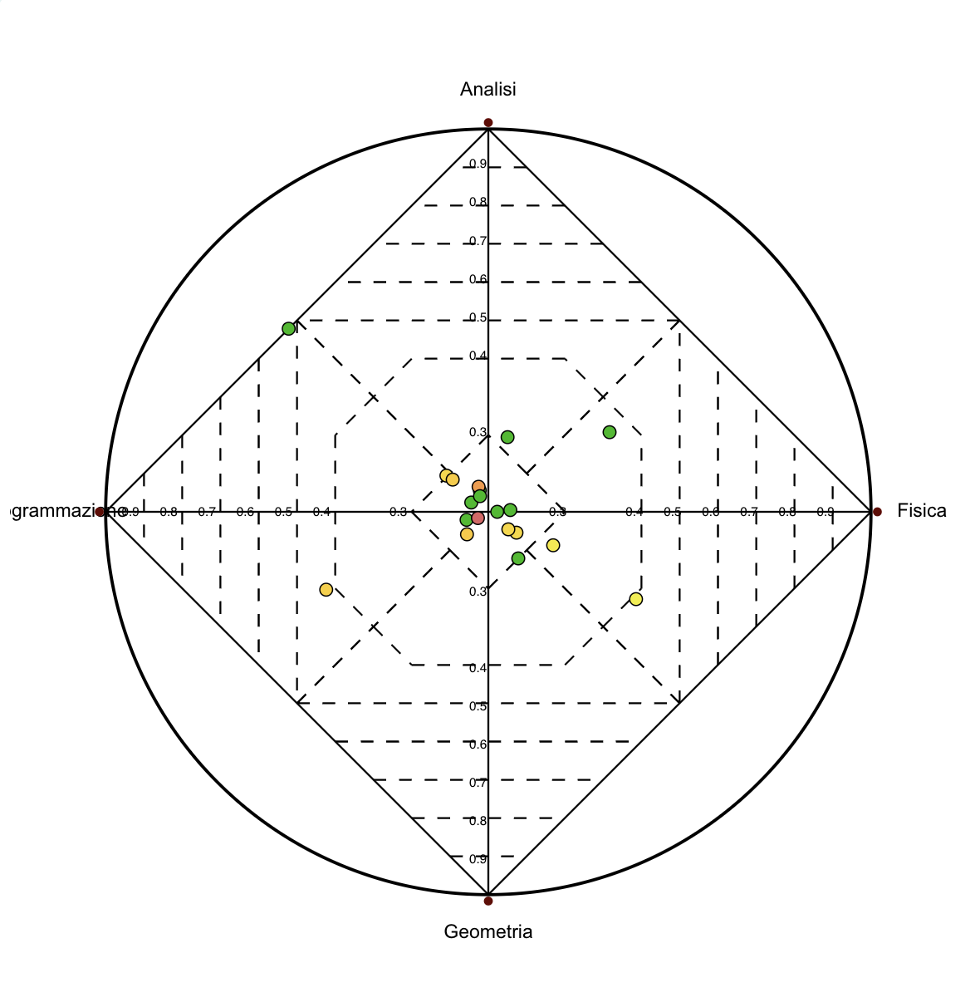
Visualizations
RadViz
Used for visualizing high-dimensional data in two dimensions
Each variable is represented as an anchor placed evenly around a circle
Data points are positioned based on the relative influence of all variables
Helps reveal patterns, clusters, and data spread in a compact view
Suitable for datasets with comparable variables
‹#›

Slide 8
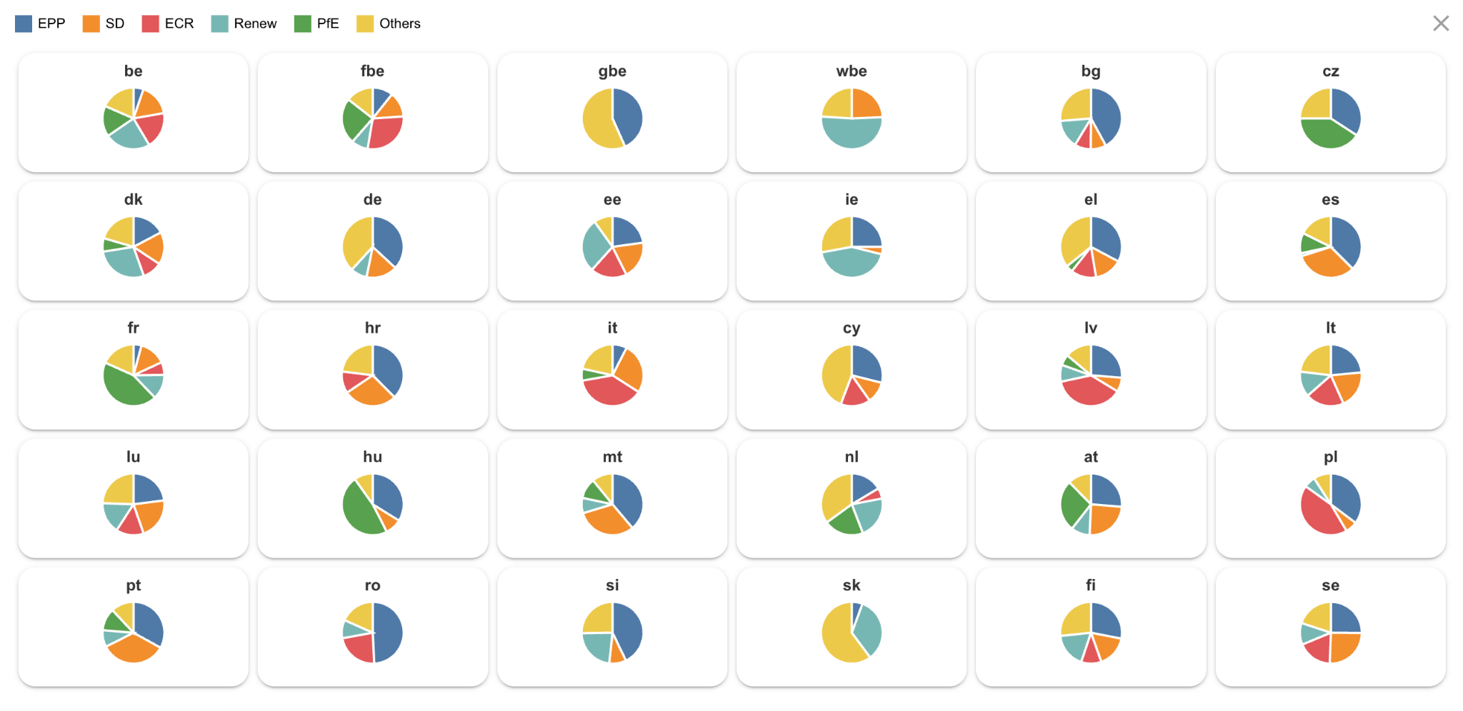
Visualizations
Small multiples pie chart
Each pie chart represents a single observation positioned according to its Radviz coordinates
Makes it easy to compare data by its own divisions
Good for seeing how points with close positions might still have different variable distributions
‹#›

Slide 9
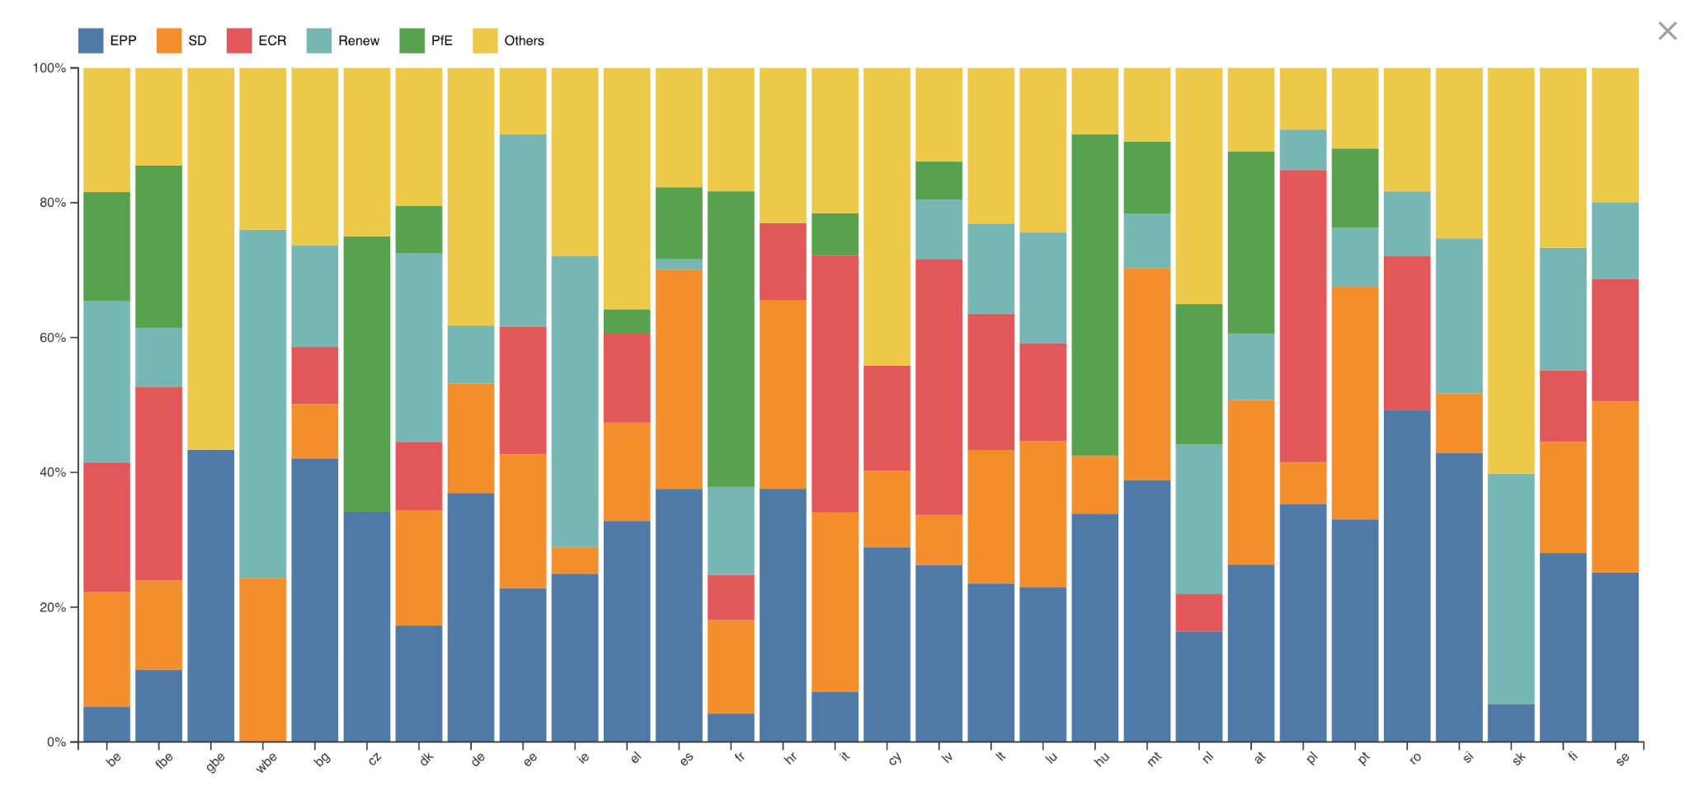
Visualizations
Stacked bar chart
Each bar represents a single entity in the dataset
The segments within each bar show how the total is divided across different categories
Useful for comparing both totals and internal composition between points
Ideal for visualizing proportional data that adds up to a whole (e.g. 100%)
‹#›

Slide 10
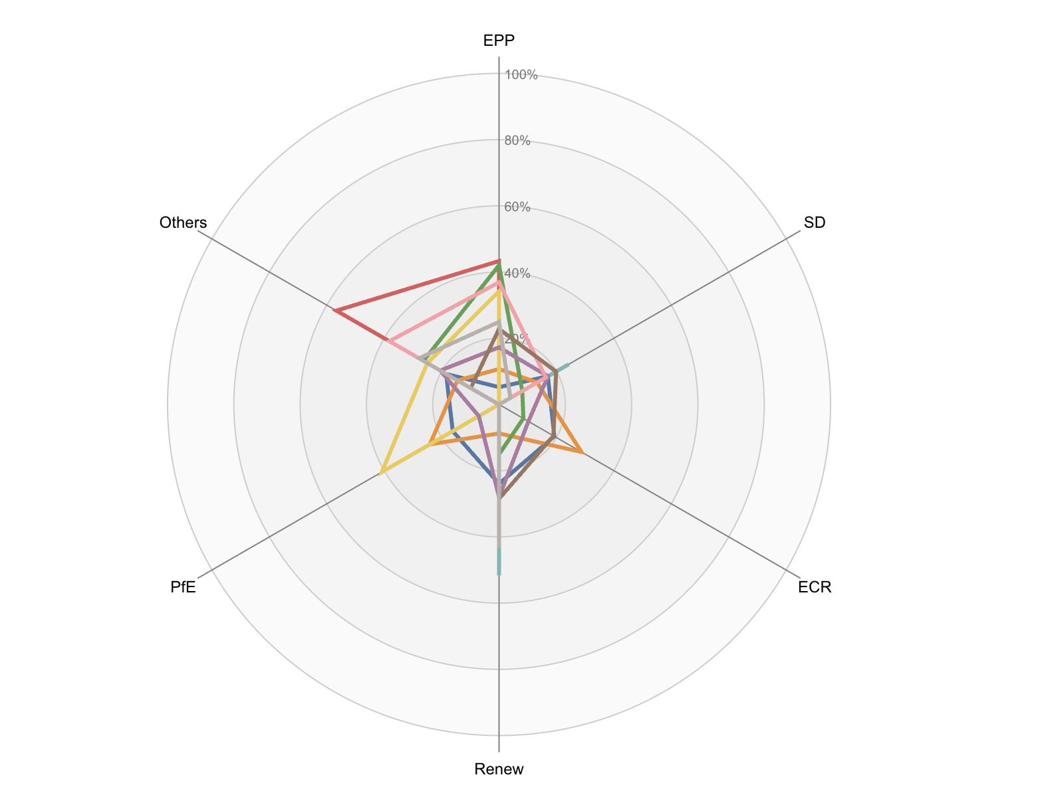
Visualizations
Radar chart
Each entity is shown as a bordered shape connecting its values across multiple variables
Variables are arranged as axes radiating from a central point
The distance from the center shows the magnitude for each variable
Useful for spotting strengths, weaknesses, or similarities in multivariable data
‹#›

Slide 11
Analytics
Correlations
The user can do a real time computation on the correlations between the various indices or indicators present in the dataset.
Compute the Pearson correlation coefficient between mean year of schooling and inequality in education.
The correlation coefficient is a measure of the linear relationship between two variables.
The result is in the range [-1,1]: -1 indicates a perfect negative correlation, 0 indicates no correlation, and 1 indicates a perfect positive correlation.
The user can compute the correlation coefficient also on the filtered data.
Minimum and maximum correlation coefficents from all possible pairs of attributes.
‹#›

Slide 12
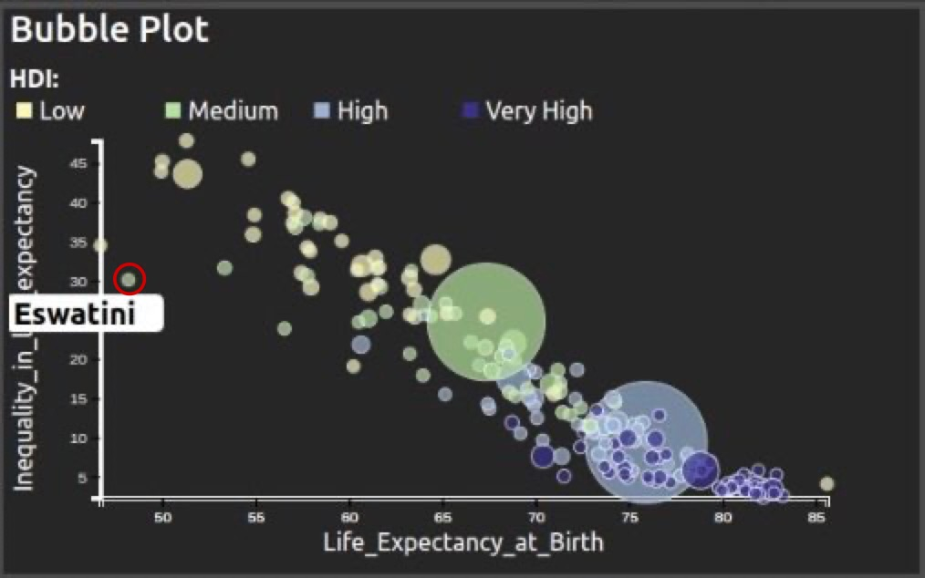
Insights
Correlations in bubble plot: Estwaini insight
Correlation coefficients provide insights on relationships between indexes in the data.
High inequality in life expectancy mostly seen in African countries with low HDI, except for Eswatini and Lesotho from 2011-2014.
Life expectancy in Estwain increased by almost 10 years from 2011 to 2021, but inequality conditions did not improve on average.
‹#›

Slide 13
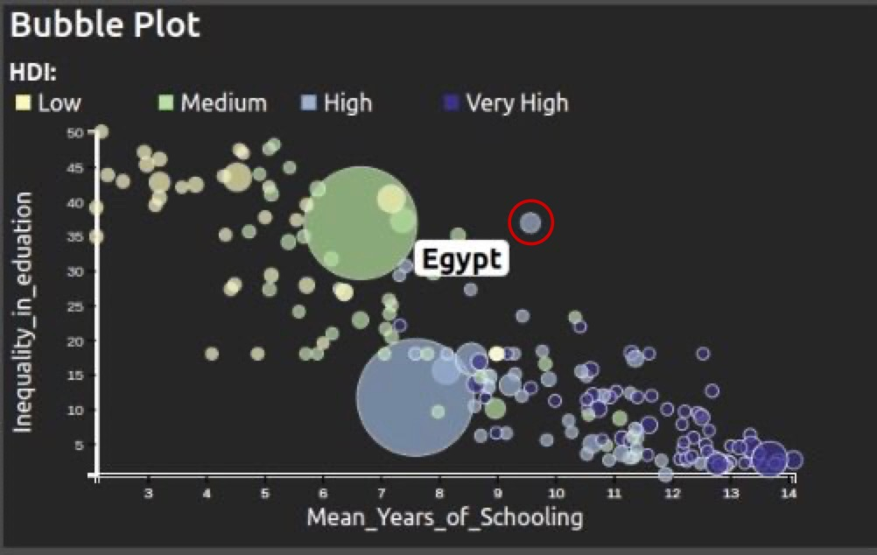
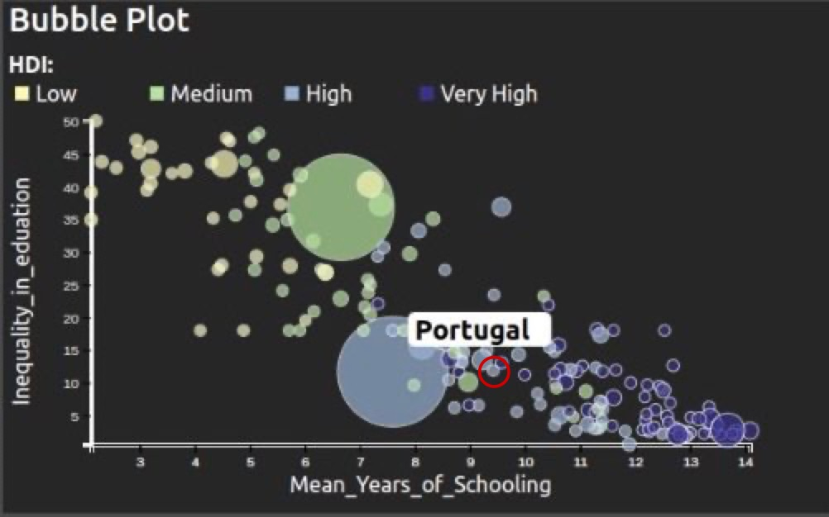
Insights
Correlations in bubble plot: Egypt vs Portugal
Inequality in Education is negatively correlated with Mean Years of Schooling.
As inequality in education increases, average years of schooling decrease.
Egypt is more affected by inequality in education compared to other countries with similar Mean Years of Schooling (e.g. Portugal).
‹#›

Slide 14
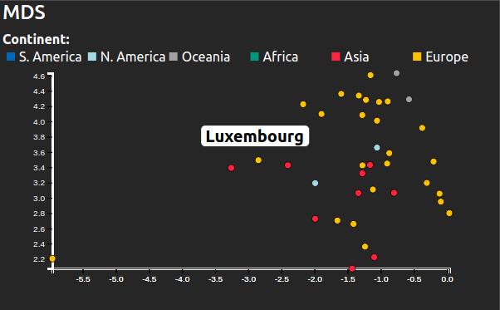
Insights
MDS Continent Clusters: The case of Luxembourg
MDS plot shows how countries from different continents cluster together.
High HDI European countries cluster together, with Luxembourg being most similar to Singapore and Hong Kong.
Low HDI countries are mostly in Africa, except for Yemen, Afghanistan, and Pakistan, which are similar to Senegal and Gambia.
‹#›

Slide 15
Live Demo
A live demo is available at the following site:
Dashboard with RadViz

Slide 16
Thank you for the attention!

