Slide 1
OmniViz: A Unified Dashboard for Multivariate Data Analysis
Giuseppe Fosci - 1855832
Emilio Martino - 1715650
Alessio Rago - 1840854
Visual Analytics – Project Presentation Sapienza University of Rome

Slide 2
Table of contents
Introduction
Related Works
Dataset
Visualizations
Insight
Live Demo
‹#›

Slide 3
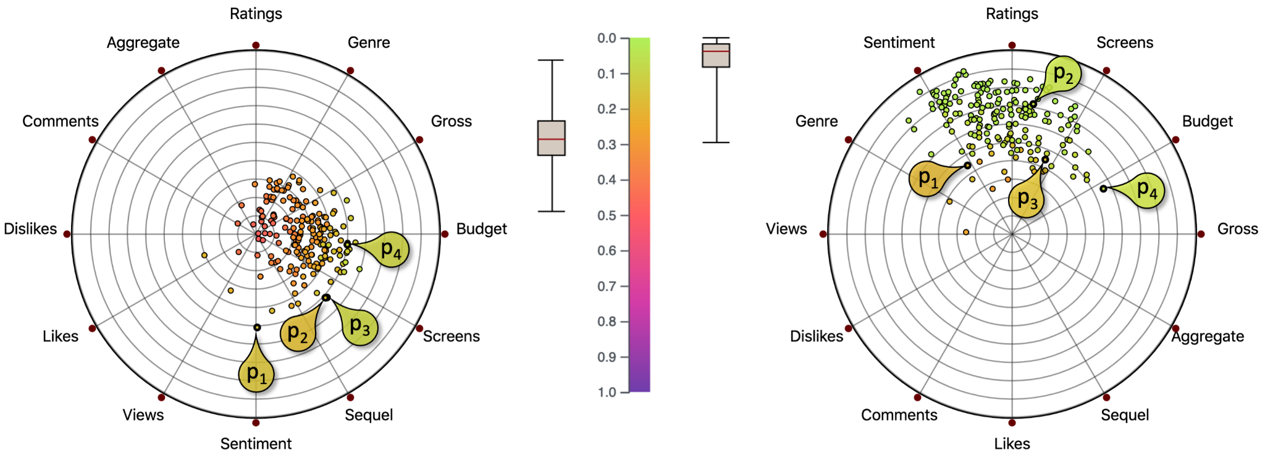
Introduction
HDI overview
This dashboard was created to allow comparison between different partitions of data between RadViz and different other types of graphs and through this comparison you can highlight the pros and cons of using RadViz depending on the size and variety of the data sets.
‹#›

Slide 4
Related Works
Scientific papers related to RadViz
This work is an implementation and practical demonstration of the concepts presented in the following research papers, which provided the theoretical foundation for the project:
[1] “To RadViz or not to RadViz": M. Ficorella, S. Lenti, and G. Santucci, "To RadViz or not to RadViz", in Eurographics Conference on Visualization (EuroVis) 2023, D. Archambault, R. Bujack, and T. Schreck (Guest Editors), vol. 42, no. 3, 2023
[2] “Towards Enhancing RadViz Analysis and Interpretation": M. Angelini, G. Blasilli, S. Lenti, A. Palleschi and G. Santucci, "Towards Enhancing RadViz Analysis and Interpretation", 2019 IEEE Visualization Conference (VIS), Vancouver, BC, Canada, 2019, pp. 226-230
‹#›

Slide 5
Dataset
Dataset description
For the dashboard, 6 completely different data categories were used, all of which can be selected from the side menu:
“Unconstrained Data” → Heterogeneous values → (RadViz not suitable)
“Unconstrained Positive Data” → Only positive values → File: “dati_caso2_vini.csv”, (RadViz not recommended)
“Fixed Active Domains” → Predefined ranges (e.g., SAT 400-1600) → File: “dati_caso3_specifiche_auto.csv” (RadViz has limited usefulness)
“Fixed & Common Active Domains” → Same scale (e.g., 18-30) → File: “dati_caso4_voti_universitari.csv” (RadViz is useful)
“[0,1] Domain Data” → Pre-normalized (e.g., percentages) → File: “dati_caso5_salute_ambientale.csv” (Radviz is an excellent tool)
“Partition Data” → Sums to 1 (100%) → File: “dati_caso6_elezioni.csv” (RadViz is an ideal tool)
‹#›

Slide 6
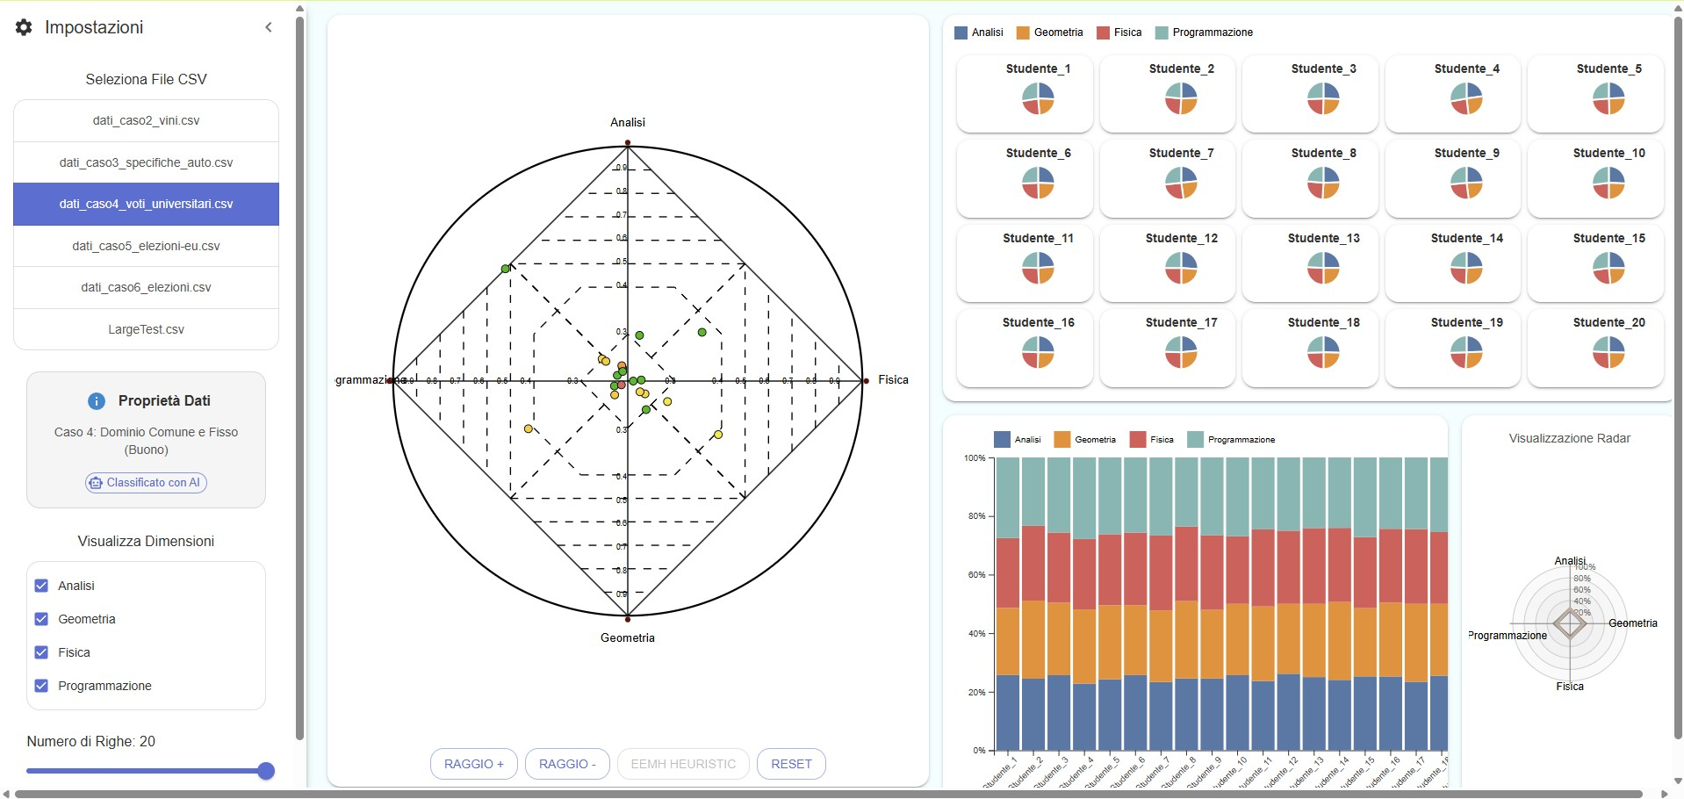
Visualizations
Complete Dashboard
‹#›

Slide 7
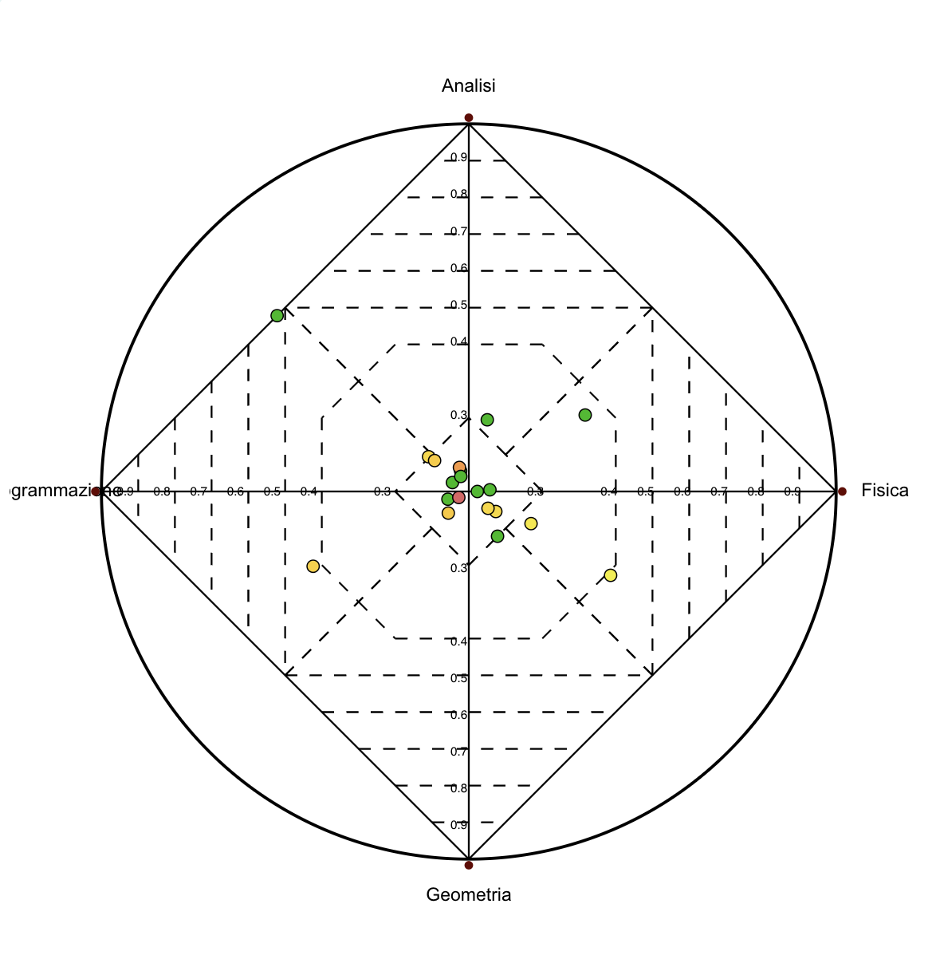
Visualizations
RadViz
Used for visualizing high-dimensional data in two dimensions
Each variable is represented as an anchor placed evenly around a circle
Data points are positioned based on the relative influence of all variables
Helps reveal patterns, clusters, and data spread in a compact view
Suitable for datasets with comparable variables
‹#›

Slide 8
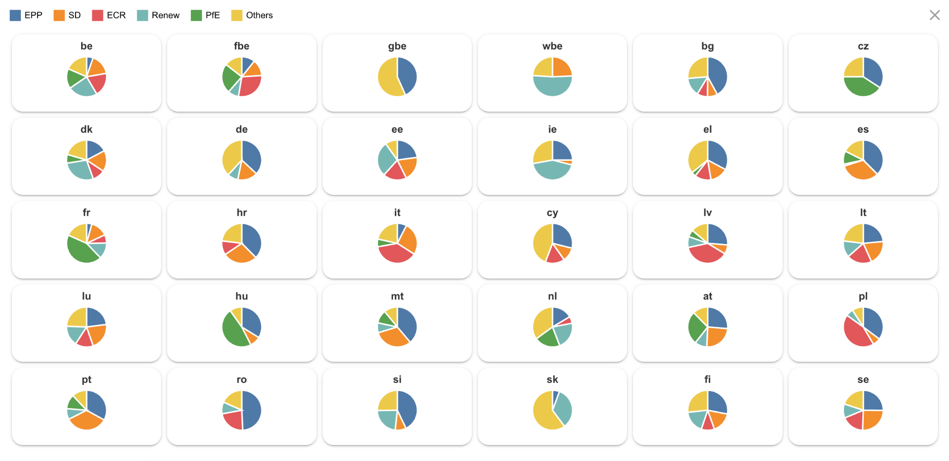
Visualizations
Small multiples pie chart
Each pie chart represents a single observation positioned according to its Radviz coordinates
Makes it easy to compare data by its own divisions
Good for seeing how points with close positions might still have different variable distributions
‹#›

Slide 9
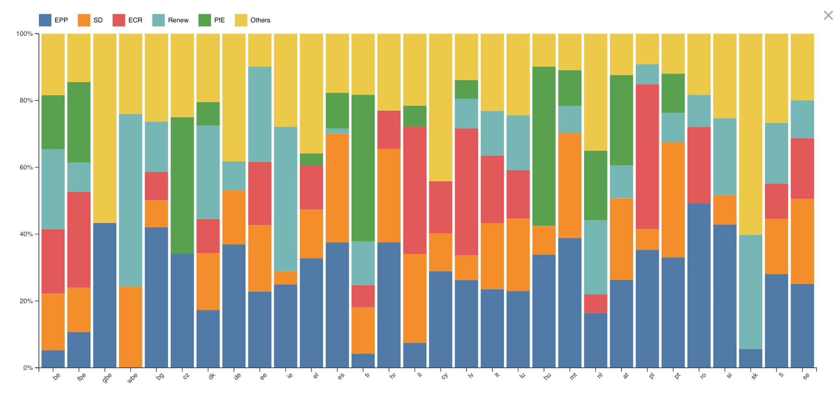
Visualizations
Stacked bar chart
Each bar represents a single entity in the dataset
The segments within each bar show how the total is divided across different categories
Useful for comparing both totals and internal composition between points
Ideal for visualizing proportional data that adds up to a whole (e.g. 100%)
‹#›

Slide 10
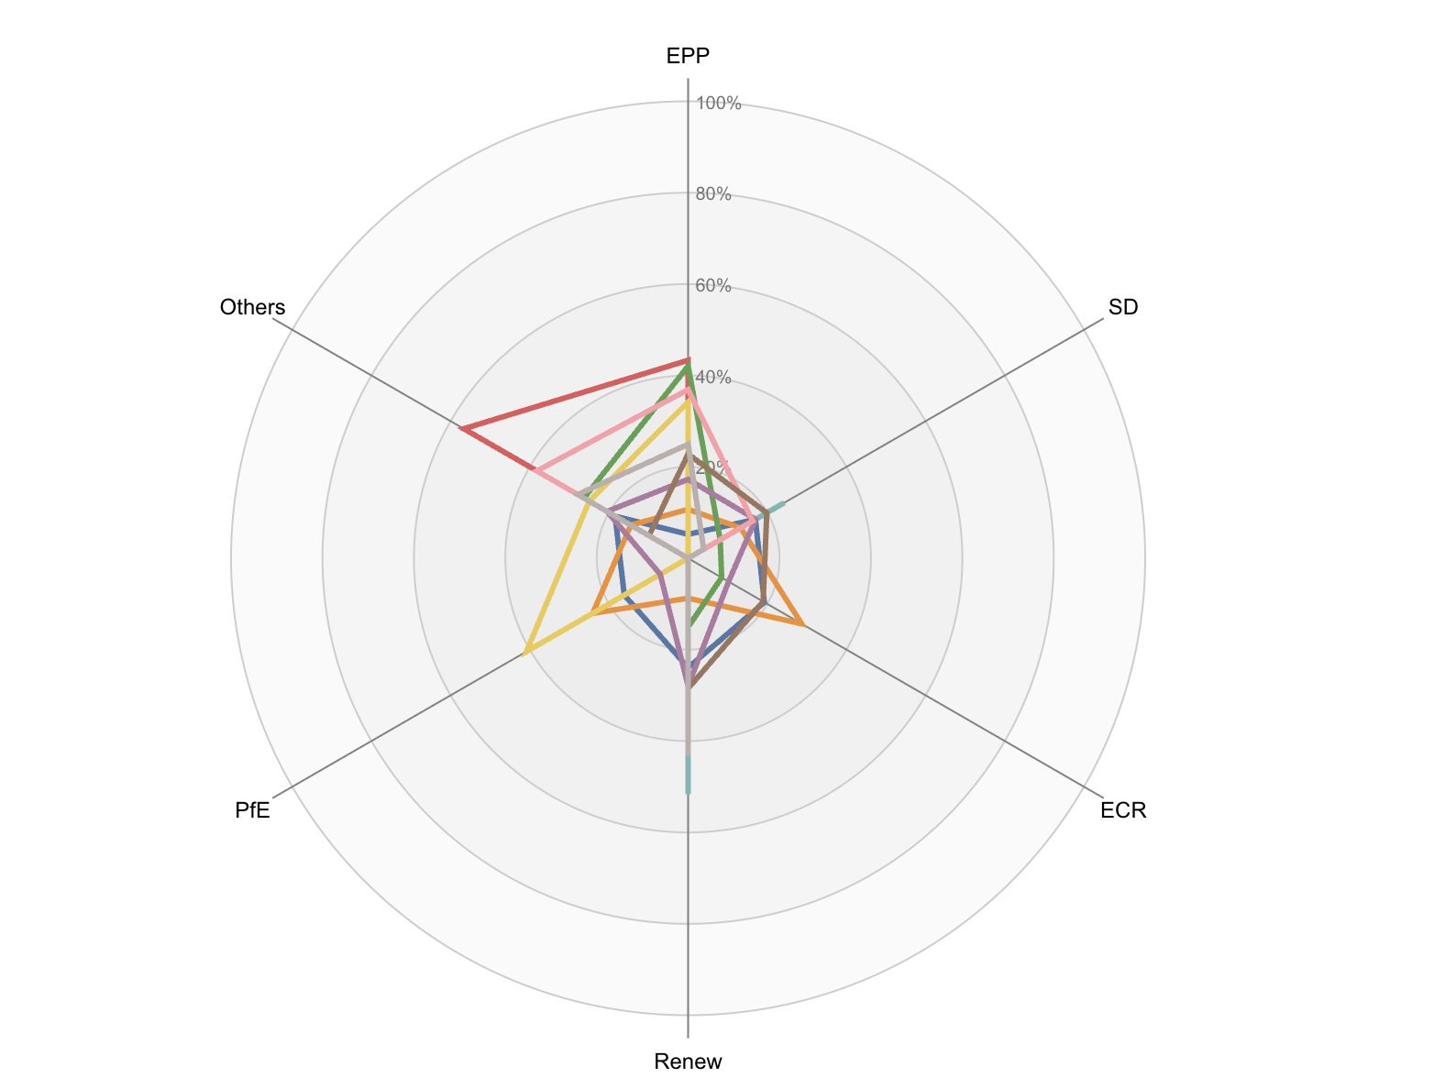
Visualizations
Radar chart
Each entity is shown as a bordered shape connecting its values across multiple variables
Variables are arranged as axes radiating from a central point
The distance from the center shows the magnitude for each variable
Useful for spotting strengths, weaknesses, or similarities in multivariable data
‹#›

Slide 11
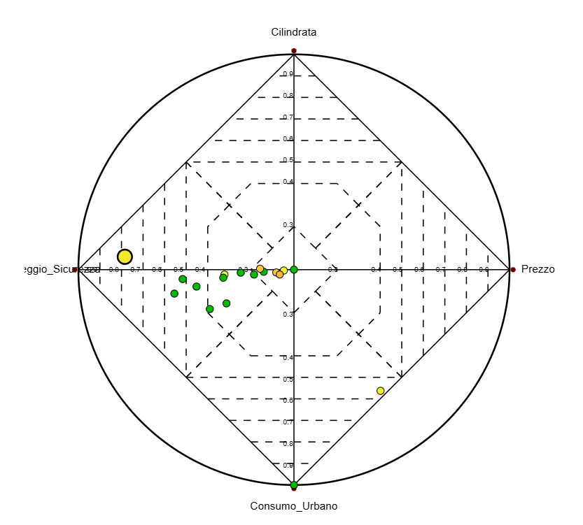
Insights
Cluster and outlier in cars’ specifics
There is a cluster between the safety score and the urban consumption anchors, directly showing that the engine size is not much relevant and that safe cars often have a high consumption, representing a clear trade-off
There is an outlier between the safety score and the engine size, it might represent a good model of a car with a low price, low consumption and a very high safety score, however it’s a yellow point so it cannot be taken into account
‹#›

Slide 12
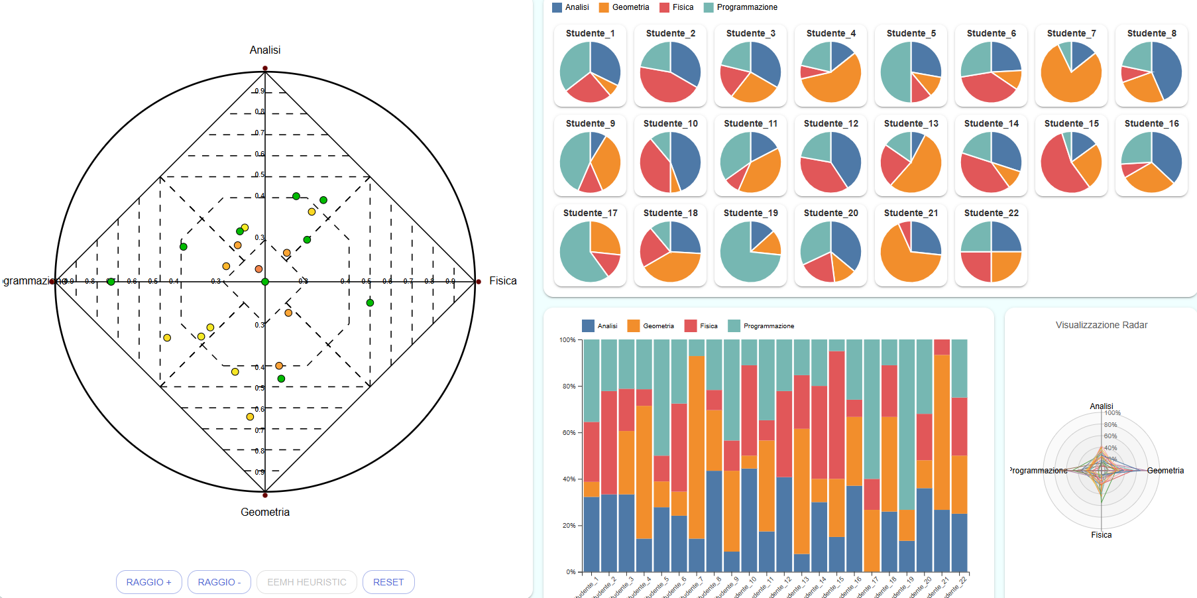
Insights
Coherent dispersion in students’ grades
Radviz offers a clear view of a dispersion of grades: there isn’t any defined cluster and the values are distributed evenly across the anchors
At first glance, we can see that the majority of the students performed better in programming, according to the points in the radviz. Such an information is not easily understood by only watching the pie charts or the stacked bar chart
‹#›

Slide 13
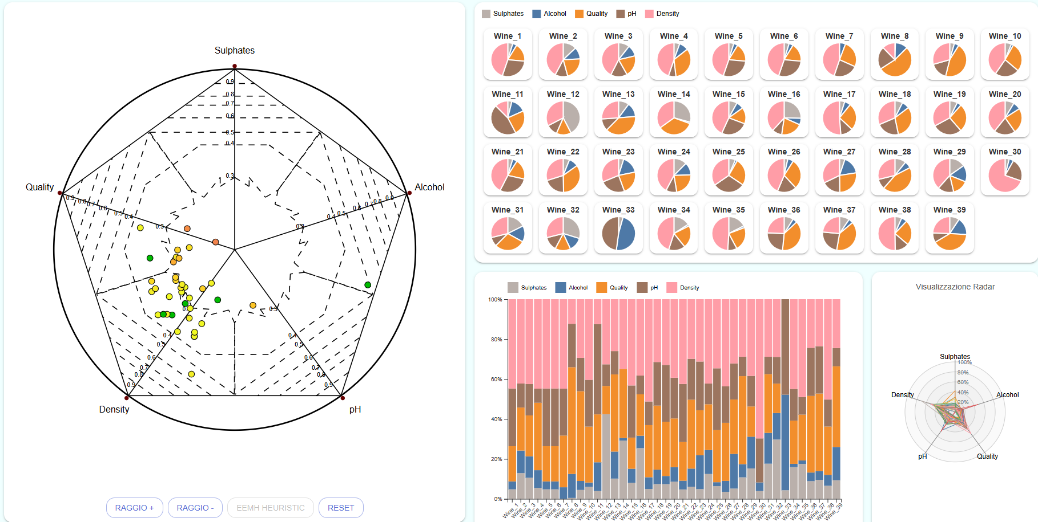
Insights
Comparison of RadViz with other charts
Density value is predominant among other anchors, however it is not correlated with quality; it is actually a standard value of almost all wines
In this case, the RadViz does not add anything new with respect to other well-known charts; for example, we can clearly see from the pie charts and the bar charts that the density value is always present with a very high value
‹#›

Slide 14
Live Demo
A live demo is available at the following site:
Dashboard with RadViz

Slide 15
Thank you for the attention!

