Slide 1
OmniViz: A Unified Dashboard for Multivariate Data Analysis
Giuseppe Fosci - 1855832
Emilio Martino - 1715650
Alessio Rago - 1840854
Visual Analytics – Project Presentation Sapienza University of Rome

Slide 2
Table of contents
Introduction
Related Works
Dataset
Visualizations
Insight
Live Demo
‹#›

Slide 3
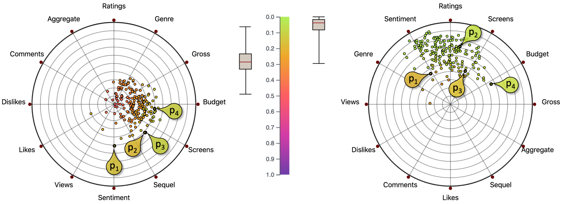
Introduction
HDI overview
This dashboard was created to allow comparison between different partitions of data between RadViz and different other types of graphs and through this comparison you can highlight the pros and cons of using RadViz depending on the size and variety of the data sets.
‹#›

Slide 4
Related Works
Scientific papers related to RadViz
This work is an implementation and practical demonstration of the concepts presented in the following research papers, which provided the theoretical foundation for the project:
[1] “To RadViz or not to RadViz": M. Ficorella, S. Lenti, and G. Santucci, "To RadViz or not to RadViz", in Eurographics Conference on Visualization (EuroVis) 2023, D. Archambault, R. Bujack, and T. Schreck (Guest Editors), vol. 42, no. 3, 2023
[2] “Towards Enhancing RadViz Analysis and Interpretation": M. Angelini, G. Blasilli, S. Lenti, A. Palleschi and G. Santucci, "Towards Enhancing RadViz Analysis and Interpretation", 2019 IEEE Visualization Conference (VIS), Vancouver, BC, Canada, 2019, pp. 226-230
‹#›

Slide 5
Dataset
Dataset description
For the dashboard, 6 completely different data categories were used, all of which can be selected from the side menu:
“Unconstrained Data” → Heterogeneous values → (RadViz not suitable)
“Unconstrained Positive Data” → Only positive values → File: “dati_caso2_vini.csv”, (RadViz not recommended)
“Fixed Active Domains” → Predefined ranges (e.g., SAT 400-1600) → File: “dati_caso3_specifiche_auto.csv” (RadViz has limited usefulness)
“Fixed & Common Active Domains” → Same scale (e.g., 18-30) → File: “dati_caso4_voti_universitari.csv” (RadViz is useful)
“[0,1] Domain Data” → Pre-normalized (e.g., percentages) → File: “dati_caso5_salute_ambientale.csv” (Radviz is an excellent tool)
“Partition Data” → Sums to 1 (100%) → File: “dati_caso6_elezioni.csv” (RadViz is an ideal tool)
‹#›

Slide 6
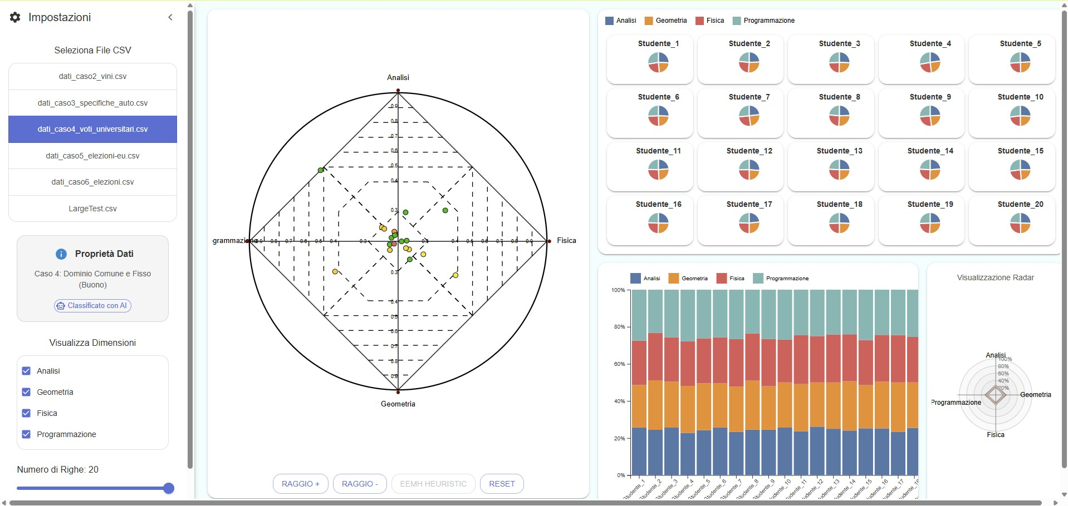
Visualizations
Complete Dashboard
‹#›

Slide 7
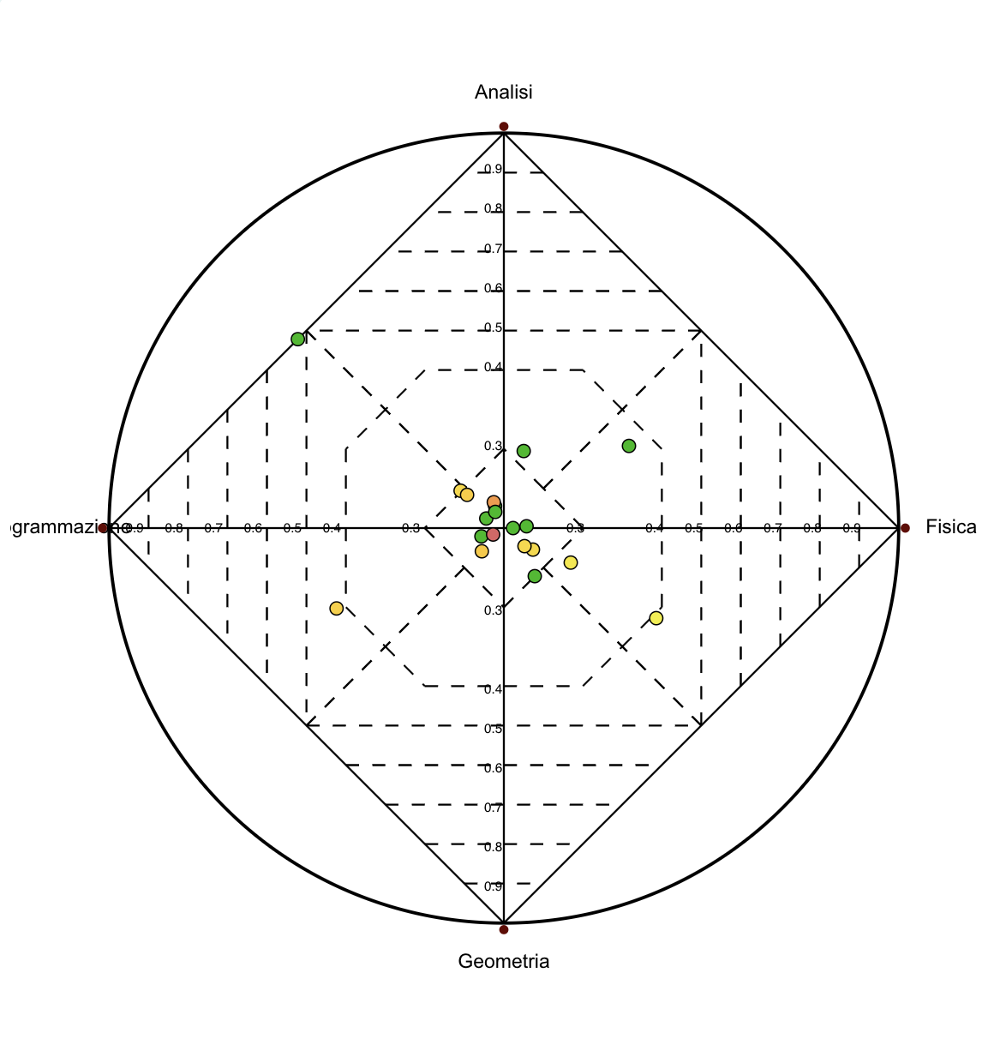
Visualizations
RadViz
Used for visualizing high-dimensional data in two dimensions
Each variable is represented as an anchor placed evenly around a circle
Data points are positioned based on the relative influence of all variables
Helps reveal patterns, clusters, and data spread in a compact view
Suitable for datasets with comparable variables
‹#›

Slide 8
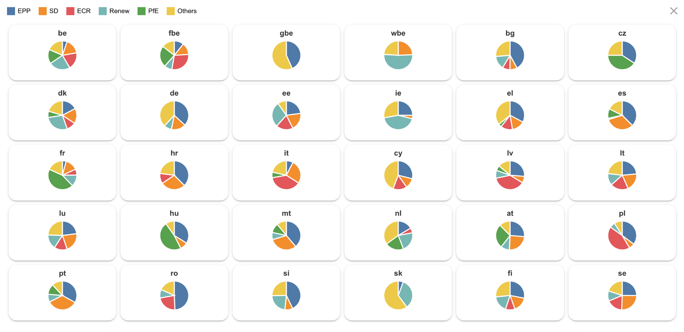
Visualizations
Small multiples pie chart
Each pie chart represents a single observation positioned according to its Radviz coordinates
Makes it easy to compare data by its own divisions
Good for seeing how points with close positions might still have different variable distributions
‹#›

Slide 9
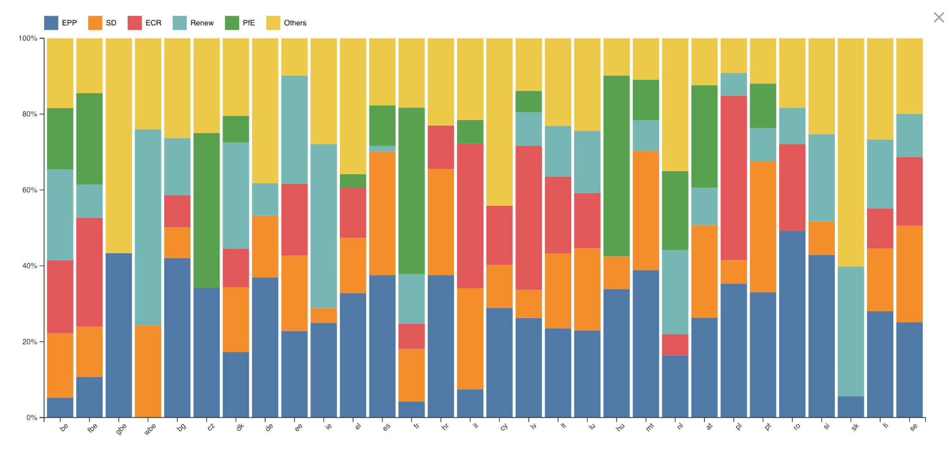
Visualizations
Stacked bar chart
Each bar represents a single entity in the dataset
The segments within each bar show how the total is divided across different categories
Useful for comparing both totals and internal composition between points
Ideal for visualizing proportional data that adds up to a whole (e.g. 100%)
‹#›

Slide 10
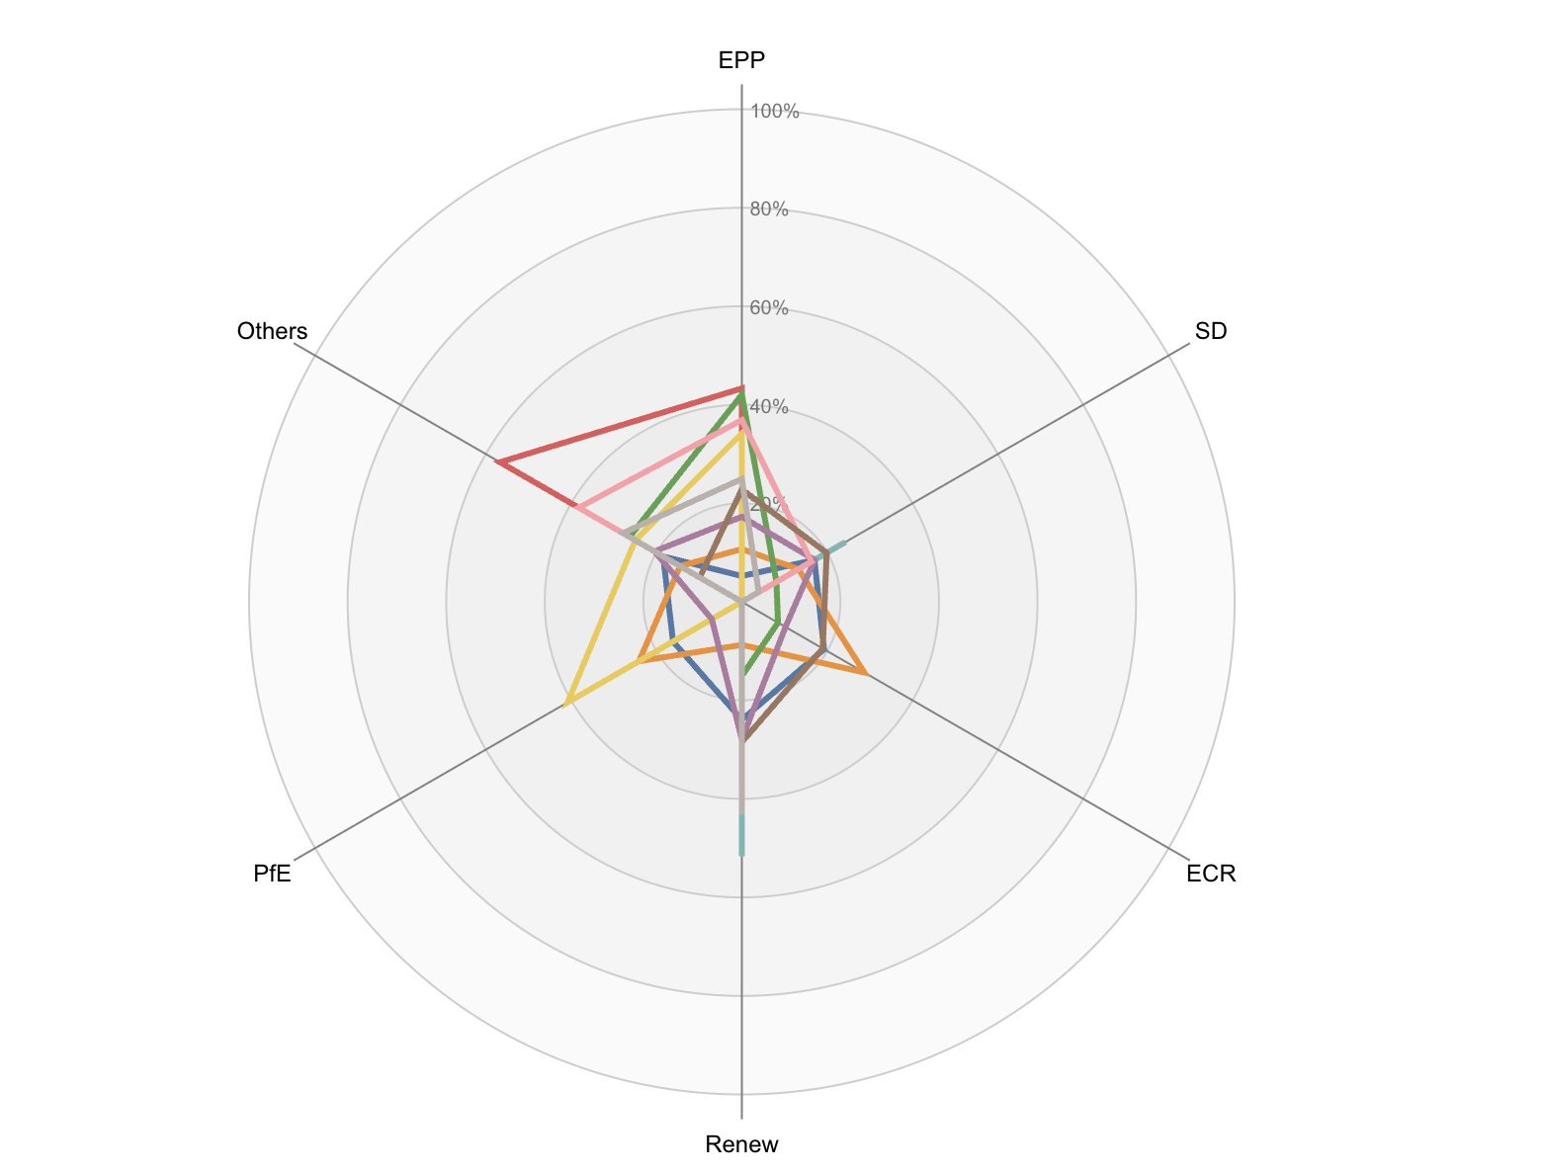
Visualizations
Radar chart
Each entity is shown as a bordered shape connecting its values across multiple variables
Variables are arranged as axes radiating from a central point
The distance from the center shows the magnitude for each variable
Useful for spotting strengths, weaknesses, or similarities in multivariable data
‹#›

Slide 11
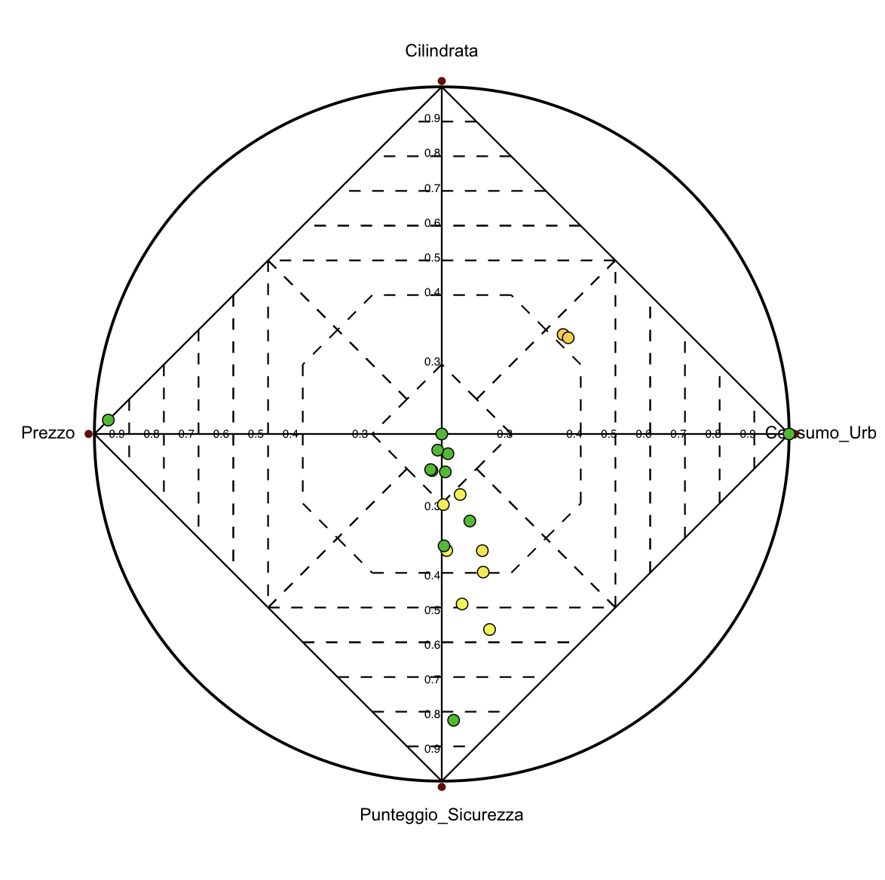
Insights
Data with fixed active domains
The graph is indeed stable but it highly depends on the domains and their correlation
The choice of ranges strongly impacts the visualization, the selected domain may empathise or suppress certain features
In this case, “punteggio_sicurezza” dominates the chart, making it hard to find any correlation with the other anchors
‹#›

Slide 12
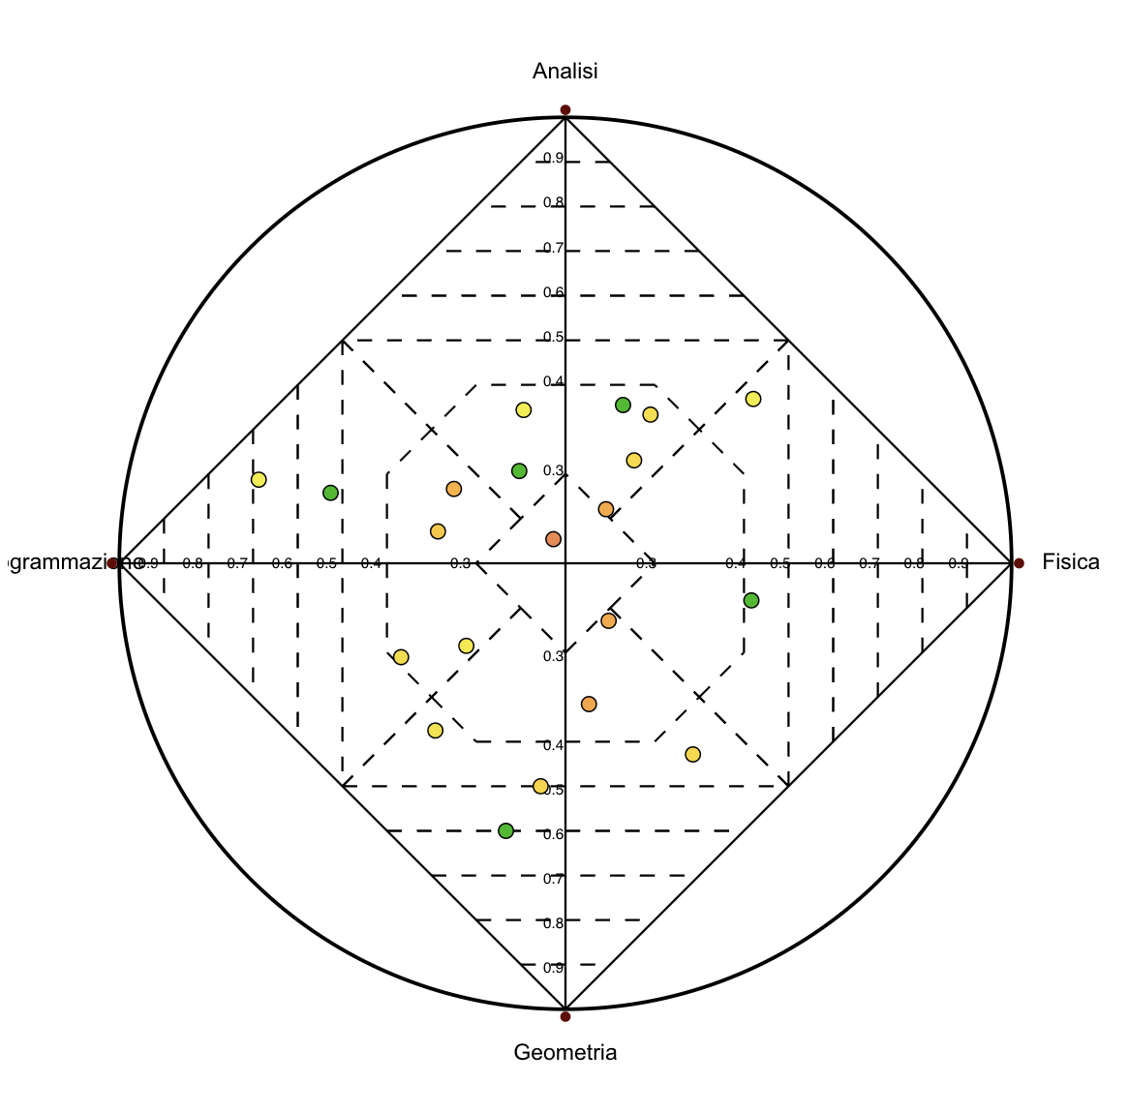
Insights
Data with fixed and common active domains
Normalization is simple and balanced, all grades are on the same 18–30 scale, so bringing them to [0,1] doesn’t introduce bias between subjects
Unlike percentages or vote shares, grades don’t naturally combine; different subjects don’t add up to something meaningful, so when a point is in the middle of the chart, it’s not always clear what that means in reality
The visualization is indeed more readable and clear and common domains help spotting patterns and grouping
‹#›

Slide 13
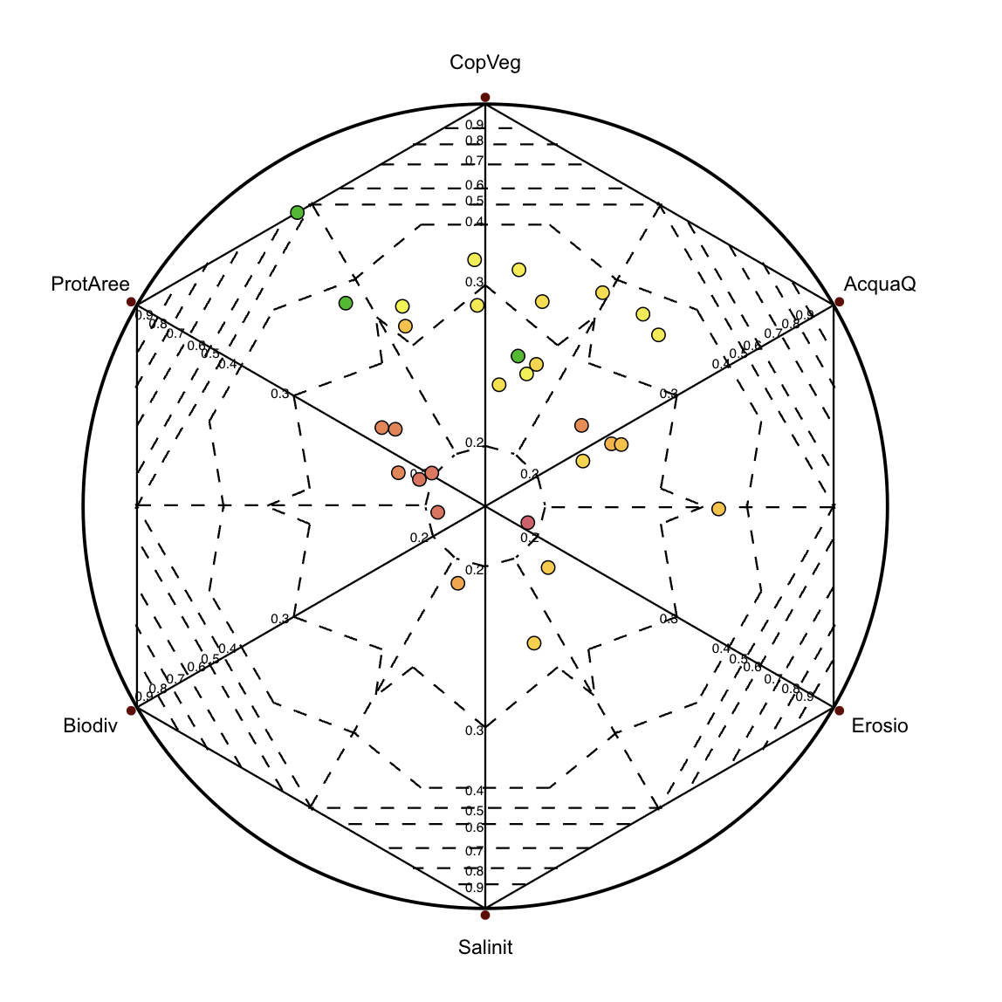
Insights
Data with all active domains fixed to [0,1]
All features share the same fixed range [0,1], making normalization unnecessary, data is directly comparable
Since values naturally represent proportions, distances and positions in the chart reflect real-world meanings
Looking at the “gbe” point between the “CopVeg” and “ProtAree” anchors, its analysis appears to be direct and clear
‹#›

Slide 14
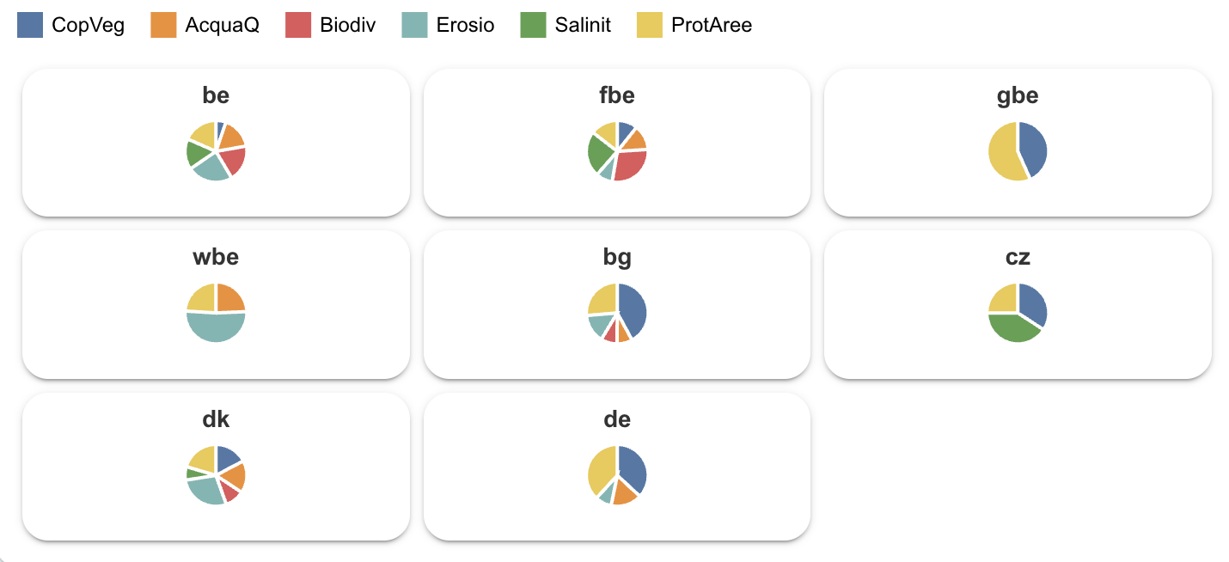
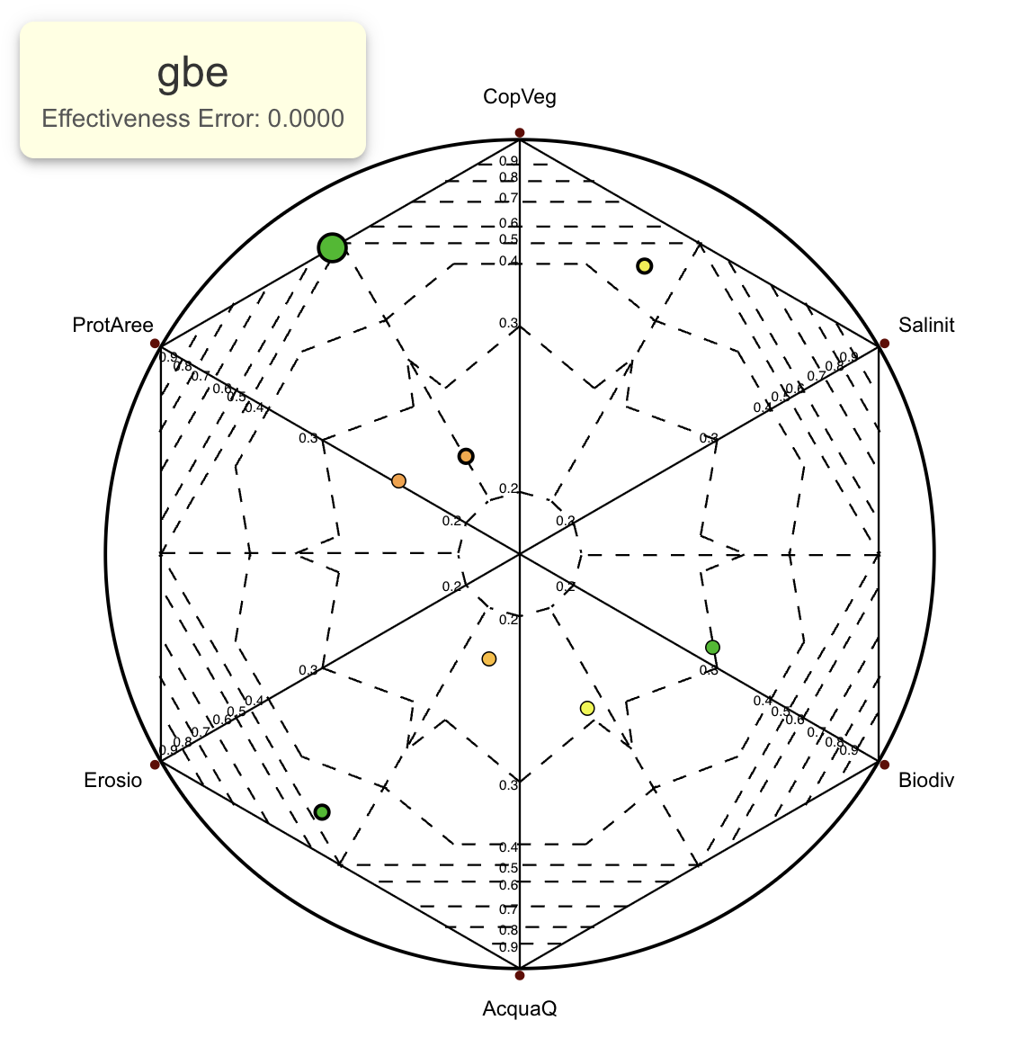
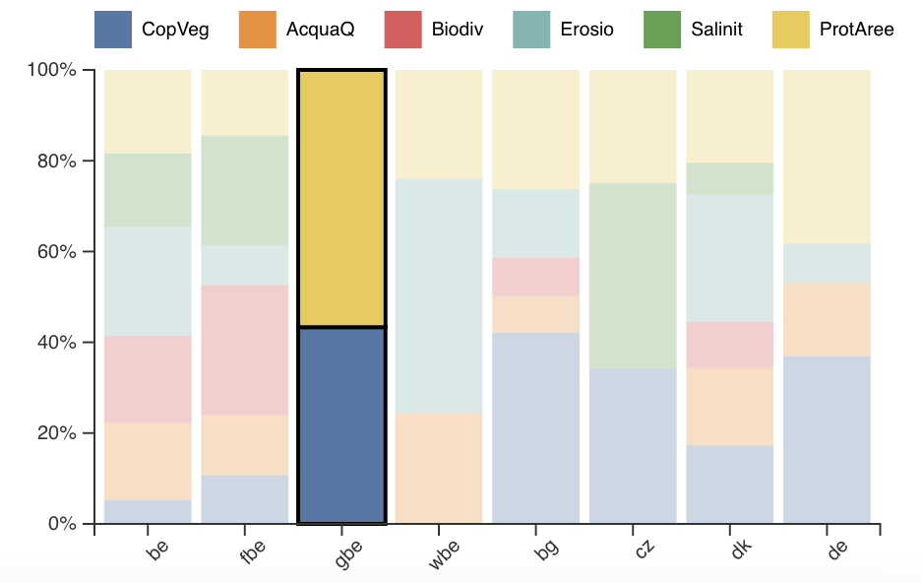
Insights
Data with all active domains fixed to [0,1]
‹#›

Slide 15
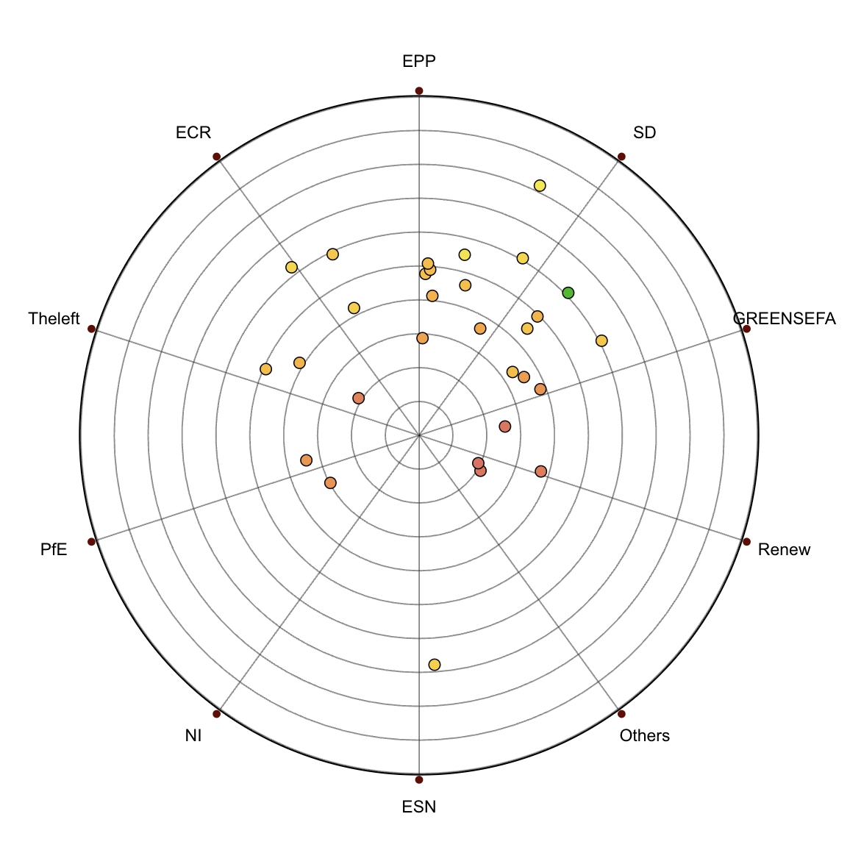
Insights
Data that presents partitions
Each feature shows a part of the whole and values represent true proportions. Positions in Radviz directly reflect meaningful shares
Error coloring helps a lot. Points colored from green to red make it easy to identify which samples are well predicted
Yet, the number of anchors strongly affects the result; too many anchors, despite the positioning algorithm, make it difficult to obtain a clear and stable chart
‹#›

Slide 16
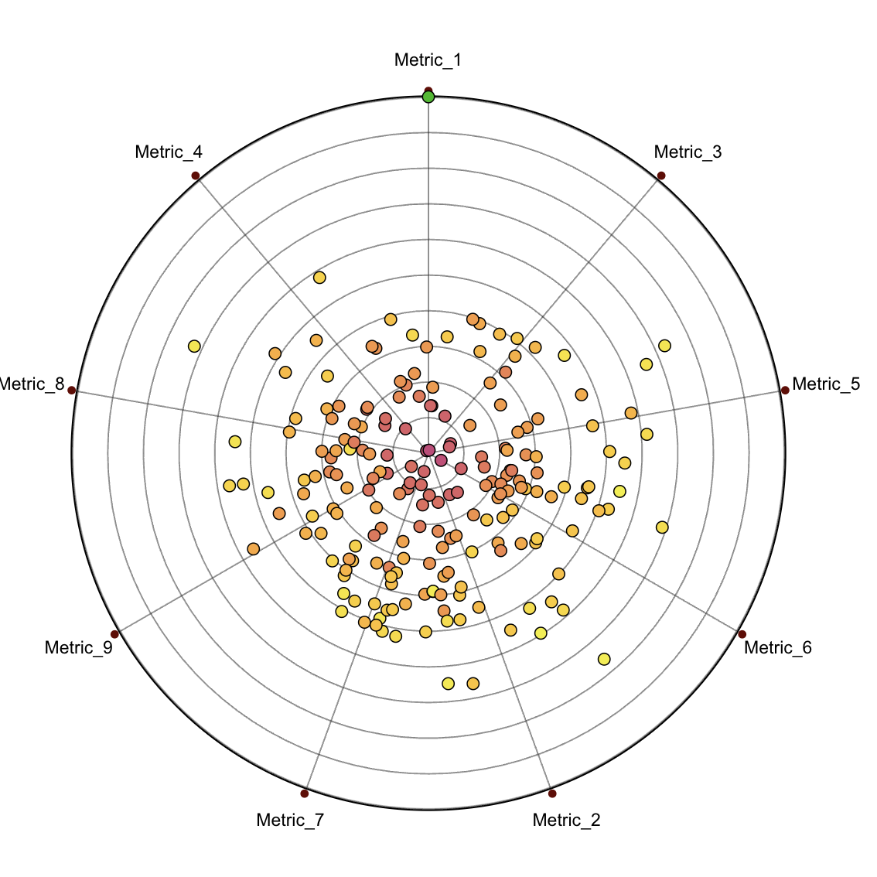
Insights
Data that presents partitions (large dataset)
Using a large dataset with many anchors results in a overcrowded inner circle and a high rate of errors
Every point is pulled to different directions, thus losing important information
However, RadViz manages to display large data better than other common charts, making it easier to spot outliers or eventual trends
‹#›

Slide 17
Live Demo
A live demo is available at the following site:
Dashboard with RadViz

Slide 18
Thank you for the attention!

