Slide 1

Leadership Lunar Crisis
Presentation by Russell, Steven, Ryan, Izaiah, Braxton
Notes:
Steven

Slide 2
Grimaldi Crater
(crash site)
Secondary Pickup
Site
Primary Pickup
Site
Notes:
Steven

Slide 3
TIME UNTIL RESCUE TEAM LEAVES: 4 HOURS
TIME UNTIL RESCUE TEAM LEAVES: 4 HOURS
What We Know:
Co-Commander needs IMMEDIATE medical attention.
The countdown starts for the Space Modules powers and O2.
The rescue team will either go to Primary Site or Secondary Site.
The Distance is 10 Miles for each site.
Grimaldi Crater
(crash site)
10 Miles to EACH
site
Secondary Pickup
Site
Primary Pickup
Site
Notes:
Steven

Slide 4
TIME UNTIL RESCUE TEAM LEAVES: 4 HOURS
TIME UNTIL RESCUE TEAM LEAVES: 4 HOURS
Plan to Find Correct Site:
Use the:
Life Raft
100LB Oxygen Tank
Flare Gun
50 FT rope
To create a makeshift rocket to propel the Navigator to 70ft in the air.
Grimaldi Crater
(crash site)
10 Miles to EACH
site
Secondary Pickup
Site
Primary Pickup
Site
Oxygen Status Levels:
Co-Commander:
Navigator: 45 Min
Medical Specialist: 45 Min
Geologist: 45 Min
Communications Specialist: 45 Min
Oxygen Tank: 1 Hr
Lunar Rover: 2 Hr
Notes:
Steven

Slide 5
Ranking of Items:
1x100 lb oxygen
Self-inflating life raft
50ft of nylon rope
Solar powered FM radio receiver
Stellar and lunar map booklet
1 Nylon Drogue Parachute
4 red emergency signal flares
1 first aid kit
1 five-gallon water can with 5 gallons of H2O
1 portable electric heating unit
Two .45 caliber pistols
20 Food concentrate packages
1 case of dehydrated Milk
Magnetic Compass
One box of Matches
Notes:
Steven

Slide 6
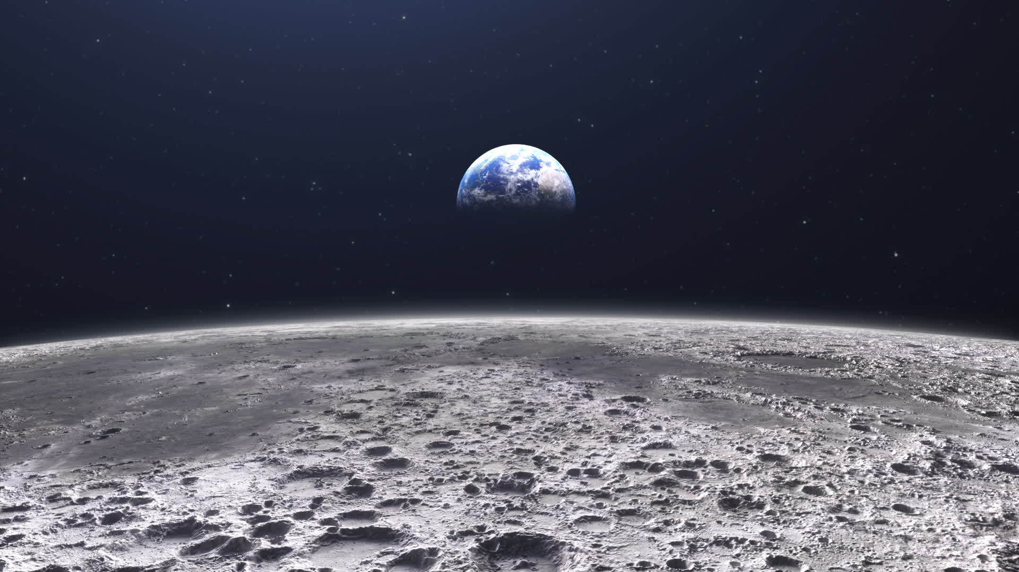
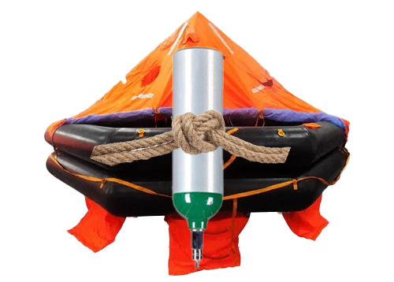
TIME UNTIL RESCUE TEAM LEAVES: 2.3 HOURS
Step 1: Create “rocket’
Wait for around an 1 hour 20 minutes, to verify that the rescue team has landed.
Using the Raft, Oxygen, Rope to create a makeshift rocket.
Oxygen Status Levels:
Co-Commander:
Navigator: 45 Min
Medical Specialist: 45 Min
Geologist: 45 Min
Communications Specialist: 45 Min
Oxygen Tank: 1 Hr
Lunar Rover: 2 Hr
Notes:
Ryan

Slide 7
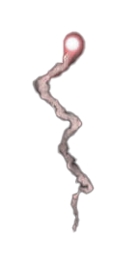
TIME UNTIL RESCUE TEAM LEAVES: 2.3 HOURS
TIME UNTIL RESCUE TEAM LEAVES: 4 HOURS
Step 2: Plan to Find Correct Site:
Fly up to around 70 feet. Regulator flow value to 2.
Maintain height for around 10-20 seconds. Regulator flow value to 1.
Freefall for about 4 seconds. Regulator flow value to 0.
Slow Speed. Regulator flow value to 5.
Land. Regulator flow value to 1.
- this uses 10 minutes of oxygen
100 ft
Oxygen Status Levels:
Co-Commander:
Navigator: 45 Min
Medical Specialist: 45 Min
Geologist: 45 Min
Communications Specialist: 45 Min
Oxygen Tank: 50 Min
Lunar Rover: 2 Hr
0 ft
Notes:
Ryan

Slide 8
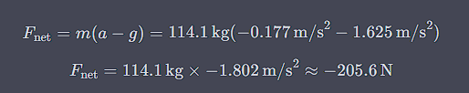

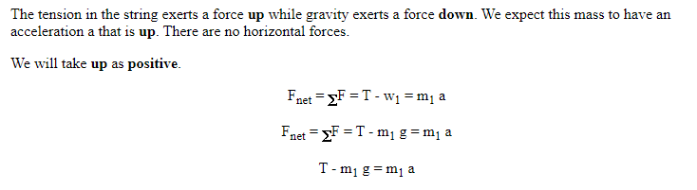
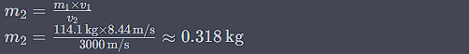

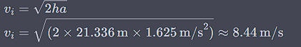
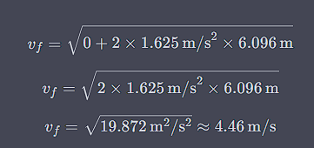
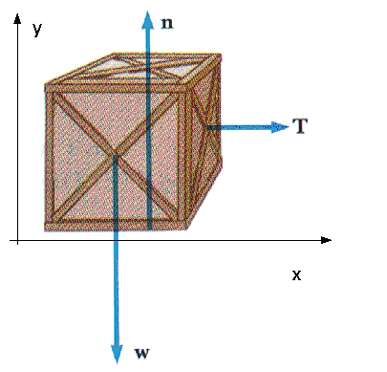

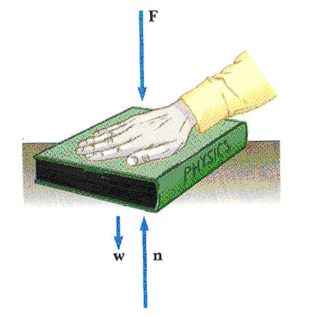


Math behind the propulsion.
Notes:
Ryan

Slide 9
TIME UNTIL RESCUE TEAM LEAVES: 2.1 HOURS
TIME UNTIL RESCUE TEAM LEAVES: 4 HOURS
Step 4: Divide up the oxygen and start the trip.
Refill 50 Minute oxygen tank from the lunar module back to 1 hour again.
Dividing up the 1 hour of oxygen from the tank between the 3 riders in the back. (see bottom right)
The Geologist and Navigator will be able to tap into Lunar Rover’s oxygen supply.
45 Minutes of oxygen to each of the drivers.
30 Minutes of oxygen between each of the raft riders.
Based off of the description of the Lunar Rover and NASA’s specifications of it the Lunar Rover will travel at max speed (10mph) for a lesser range (11 miles) since the payload (people riding and in the back). This trip will take 1 hour.
Oxygen Status Levels:
Co-Commander: 1 Hr 15 Min
Navigator: 1 Hr 30 Min
Medical Specialist: 1 Hr 15 Min
Geologist: 1 Hr 30 Min
Communications Specialist: 1 Hr 15 Min
Oxygen Tank: 0 Hr
Lunar Rover: 0 Hr
Notes:
Russell

Slide 10
TIME UNTIL RESCUE TEAM LEAVES: 2.1 HOURS
TIME UNTIL RESCUE TEAM LEAVES: 4 HOURS
Step 3: Once Site is Confirmed:
Create a make-shift spacesuit. Near the “Grimaldi crater” the temp on the moon is 63F. Which means we do not need to account for temperatures. We will use the existing spacesuit then making it secure with the drogue parachute. Assuming the oxygen tank is still in operation from the suit but the suit internal features are broken the co-pilot still has oxygen (45 mins).
Driving the Lunar Module are the Geologist and the Navigator.
Tied in the back to the raft with the 50ft Nylon rope are the: Communications Specialist Medical Specialist Co-Commander Commander (Dead)
Refilling the O2 from 50 minutes to 1 hour again using the lunar module.
Oxygen Status Levels:
Co-Commander: 1 Hr 15 Min
Navigator: 1 Hr 30 Min
Medical Specialist: 1 Hr 15 Min
Geologist: 1 Hr 30 Min
Communications Specialist: 1 Hr 15 Min
Oxygen Tank: 0 Hr
Lunar Rover: 0 Hr
Oxygen Status Levels:
Co-Commander:
Navigator: 45 Min
Medical Specialist: 45 Min
Geologist: 45 Min
Communications Specialist: 45 Min
Oxygen Tank: 1 Hr
Lunar Rover: 2 Hr
Notes:
Russell

Slide 11
TIME UNTIL RESCUE TEAM LEAVES: 1.1 HOURS
TIME UNTIL RESCUE TEAM LEAVES: 4 HOURS
Step 5: Arrive at rescue site and meet rescue team.
Arrive at the rescue site and meet the rescue team.
Load up the personnel into the rescue ship.
Oxygen Status Levels:
Co-Commander: 15 Min
Navigator: 30 Min
Medical Specialist: 15 Min
Geologist: 30 Min
Communications Specialist: 15 Min
Oxygen Tank: 0 Hr
Lunar Rover: 0 Hr
Notes:
Russell

Slide 12
Using critical thinking in order to eliminate alternate ideas.
First Idea: hot air balloon (No oxygen, heater would work inside a module but not outside)​
Second Idea: propulsion using the .45 caliber pistols (Pistol force would not be able to lift people and raft collectively)
Third idea: Driving to middle point, shooting flare and retrieving everyone
Notes:
Izaiah

Slide 13
Decision making process
Leadership was prevalent in our thought process as we considered new ideas and consistently evolved. All of us would pitch in ideas and influence the group to make a better plan, such as removing the hot air Balloon idea.
As a group we participated in a constraint analysis system. We identified all limiting factors, such as limited oxygen and suits, however we made ideas, evaluated the ideas, and proceeded with the most logically sound ones.
Notes:
Izaiah

Slide 14
Group Organization
Throughout our group, it was a collective decision on how to accomplish our task; no roles were assigned as we bounced ideas off each other leading us to take up multiple roles.
Notes:
Izaiah

Slide 15
Group conflict resolution and rationality
In the group, everyone's ideas were heard and taken into consideration. We had two ideas shot down due to error in logic, such as the pistol propulsion idea. If two or more group members had dissenting views, the group would collectively analyze and make a rational decision on which idea made more sense.
All of our actions were rationalized. For an idea to be implemented, it went through rigorous testing and we asked questions such as are we guessing or do we know for certain. Our group only made two assumptions, and all were made from the input of all members. Our two assumptions were the rescue site had an f.m. radio receiver, and that it was a lunar day on the moon. We backed both ideas by using rational thinking and stating that our supplies were sufficient and useful in the case of an accident.
Notes:
Izaiah

Slide 16
Leadership and followership
We all demonstrated a form of leadership as a group. The most prevalent form was emergent leadership with the informational basis of power. We would get ideas and spread them, giving influence and demonstrating information in a certain matter.
When being a follower, we all were exemplary followers. All members would ask questions and present new ideas forward. No one was scared to speak out and say an idea was not logically sound.
Notes:
Izaiah

Slide 17
Ethical Approach
Considering every factor of the crisis we ultimately took the ethical approach of utilitarianism, creating the greatest good for the greatest number of people.
We considered ending the life of the co-pilot, but morally we felt obligated to keep her alive.
Notes:
Braxton

Slide 18
Moral Complacency and Groupthink
Groupthink was not a relevant factor. Everyone did not blindly agree with what was being said, rather used rational thinking to prove or disprove the idea at hand. Moral Complacency also did not prove to be a powerful factor, as we scrapped any idea that did not make sense, no matter how convenient it was. We could have killed off the co-pilot and made our journey much simpler, but we decided to do what is morally just and keep them alive.
Notes:
Braxton

Slide 19
Bibliography
Sources: Roston, Brittany. “NASA Viper Rover Gets New Car-like Led Floodlights for Hunting Mission.” SlashGear, SlashGear, 30 Oct. 2020, www.slashgear.com/nasa-viper-rover-gets-new-car-like-led-floodlights-for-hunting-mission-30645242/#:~:text=NASA%20is%20giving%20its%20VIPER%20lunar%20rover%20a,in%20places%20it%20would%20otherwise%20struggle%20to%20see.
Howell, Elizabeth. “Here’s How NASA’s Artemis 1 Orion Spacecraft Will Splash Down to End Its Moon Mission in 8 Not-so-Easy Steps.” Space.Com, Space, 10 Dec. 2022, www.space.com/artemis-1-orion-spacecraft-landing-sequence.
“Working the Night Shift on the Moon – Climate Change: Vital Signs of the Planet.” NASA, NASA, 24 Feb. 2015, climate.nasa.gov/news/951/working-the-night-shift-on-the-moon/#:~:text=Future%20lunar%20missions%20will%20require%20rovers%20that,can%20work%20through%20the%20two-week%20lunar%20night.
The Distance Visible to the Horizon from Different Heights, www.totally-cuckoo.com/distance_visible_to_the_horizon.htm. Accessed 23 Oct. 2023.
How to Solve Projectile Motion Problems: Applying Newton’s ... - Owlcation, owlcation.com/stem/Solving-Projectile-Motion-Problems-Applying-Newtons-Equations-of-Motion-to-Ballistics. Accessed 24 Oct. 2023.
“General Thrust Equation.” NASA, NASA, www.grc.nasa.gov/www/k-12/VirtualAero/BottleRocket/airplane/thrsteq.html. Accessed 23 Oct. 2023.
“Momentum Conservation Principle.” The Physics Classroom, www.physicsclassroom.com/class/momentum/Lesson-2/Momentum-Conservation-Principle. Accessed 23 Oct. 2023.
Notes:
Everyone

