Slide 1
EDA & Capstone Dashboard Presentation
Customer, Product, Sales & Supplier Insights
Presented by: Sushant Raj
Date: June 2025

Slide 2
Objectives
- Explore customer behaviors and order trends
- Analyze product, sales, and supplier patterns
- Understand employee distributions
- Identify high-value segments, trends, and anomalies

Slide 3
Datasets Used
| Dataset | Key Columns |
|---------|-----------------------------|
| Customers | CustomerID, City, Country, Region |
| Orders | OrderID, CustomerID, OrderDate |
| Order Details | OrderID, ProductID, Quantity, UnitPrice |
| Products | ProductID, CategoryID, UnitsInStock, Price |
| Categories | CategoryID, CategoryName |
| Employees | EmployeeID, Title, Region, HireDate |
| Suppliers | SupplierID, Country, ContactTitle |

Slide 4
DAX Measures Created
| Measure Name | Purpose |
|---------------|-----------------------------|
| CustomerOrderCount | # of Orders per Customer |
| ProductRevenue | Total revenue per product |
| AvgOrderValue | Revenue ÷ Order Count |
| MonthlySalesTrend | Revenue trend over time |
| SupplierProductCount | Count of Products by Supplier |
| ShippingDurationAvg | Average delivery time |

Slide 5
Customer Insights
Visuals:
- Bar chart: Orders by customer
- Bar: Spend per customer
- Map: Customer distribution
- KPI: Avg Orders per Customer
Insights:
- Top 5 repeat customers identified
- Orders concentrated in USA and Germany

Slide 6
Product & Category Analysis
Visuals:
- Tree map: Revenue by category
- Bar chart: Top products by revenue
- Histogram: Price distribution
Insights:
- Beverages & Condiments generate most revenue
- Price range mainly mid-tier

Slide 7
Time Series Trends
Visuals:
- Line: Monthly revenue trend
- Area: Quantity sold over time
Insights:
- Peak sales during holiday months
- Consistent product demand

Slide 8
Employee Analysis
Visuals:
- Bar chart: Titles by region
- Line: Hire trends by title
- Pie chart: Courtesy title distribution
Insights:
- Majority of staff are Sales Representatives
- Hiring peaks observed in 1993-1994

Slide 9
Supplier Insights
Visuals:
Bar: Products per supplier
Map: Supplier locations
Donut chart: Price per supplier
Insights:
Suppliers clustered in Europe
Wide variation in pricing per supplier

Slide 10
Key Insights
Repeat customers drive significant revenue
Germany & USA dominate customer geography
Beverages & Condiments lead category revenue
Supplier pricing varies heavily by region
Sales Rep roles dominate employee structure

Slide 11
Recommendations
Focus on high-value customer retention
Optimize top-product pricing strategy
Audit underperforming suppliers
Hire for underrepresented regions

Slide 12
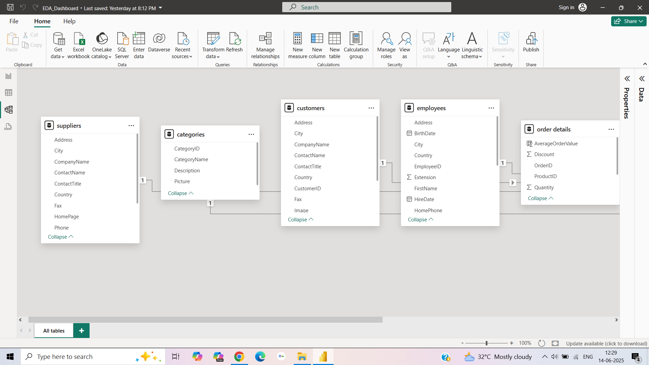
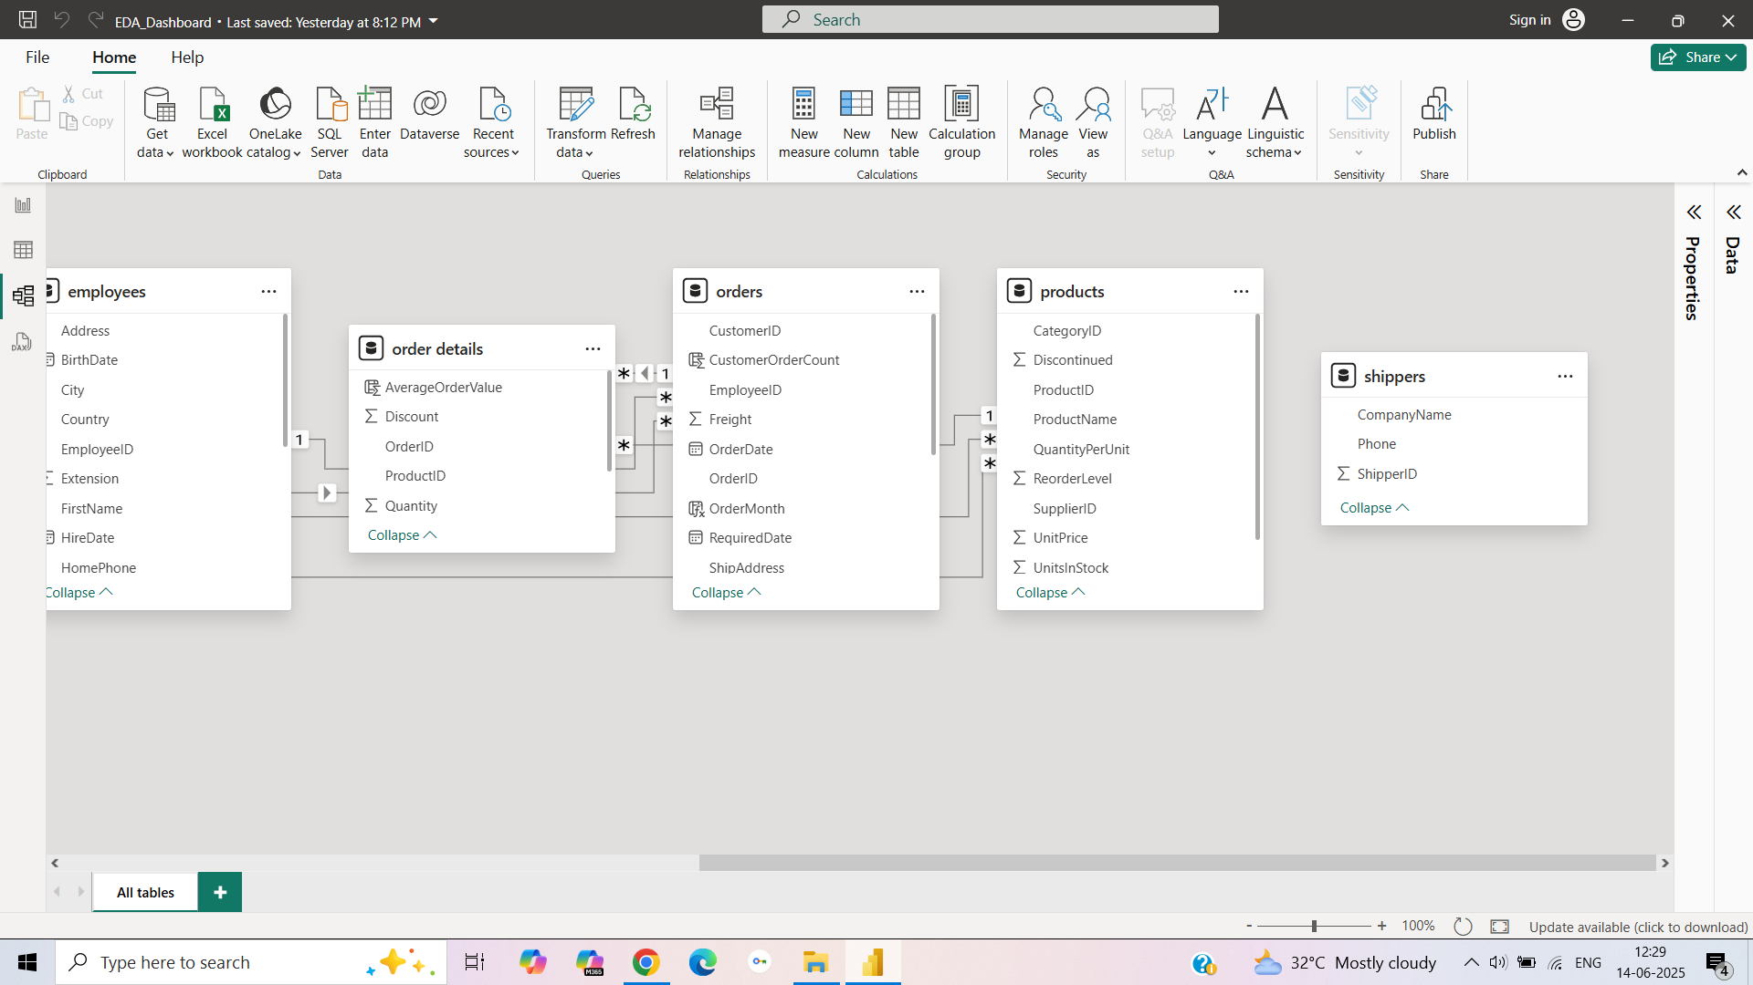
MODEL VIEW

Slide 13
Capstone Dashboard Overview
Capstone project focuses on business performance metrics across:
Customers
Sales Trends
Product Analytics
Logistics & Shipping
Used Power BI for interactive dashboard creation.

Slide 14
Capstone - Customer Analytics
Visuals:
Repeat customers and spend
-Country-wise distribution
Insights:
USA & Germany dominate customer base
Some customers place more than 10 orders

Slide 15
Capstone - Sales Trends
Visuals:
Monthly Revenue and Quantity trends
Seasonality check
Insights:
End-of-year peak in sales
Demand consistent for core products

Slide 16
Capstone - Product Insights
Visuals:
Revenue by Product and Category
Pricing distribution
Insights:
Beverages top in both volume and value
Price variations suggest segmentation opportunity

Slide 17
Capstone - Shipping & Logistics
Visuals:
Shipping duration
Shipper performance
Insights:
Average shipping takes 4–5 days
Some shippers perform consistently better

Slide 18
Capstone - Strategic Recommendations
Promote best-selling products in underperforming regions
Partner with fast and reliable shippers
Optimize prices for low-revenue but high-demand products
Focus on repeat customers through loyalty programs

Slide 19
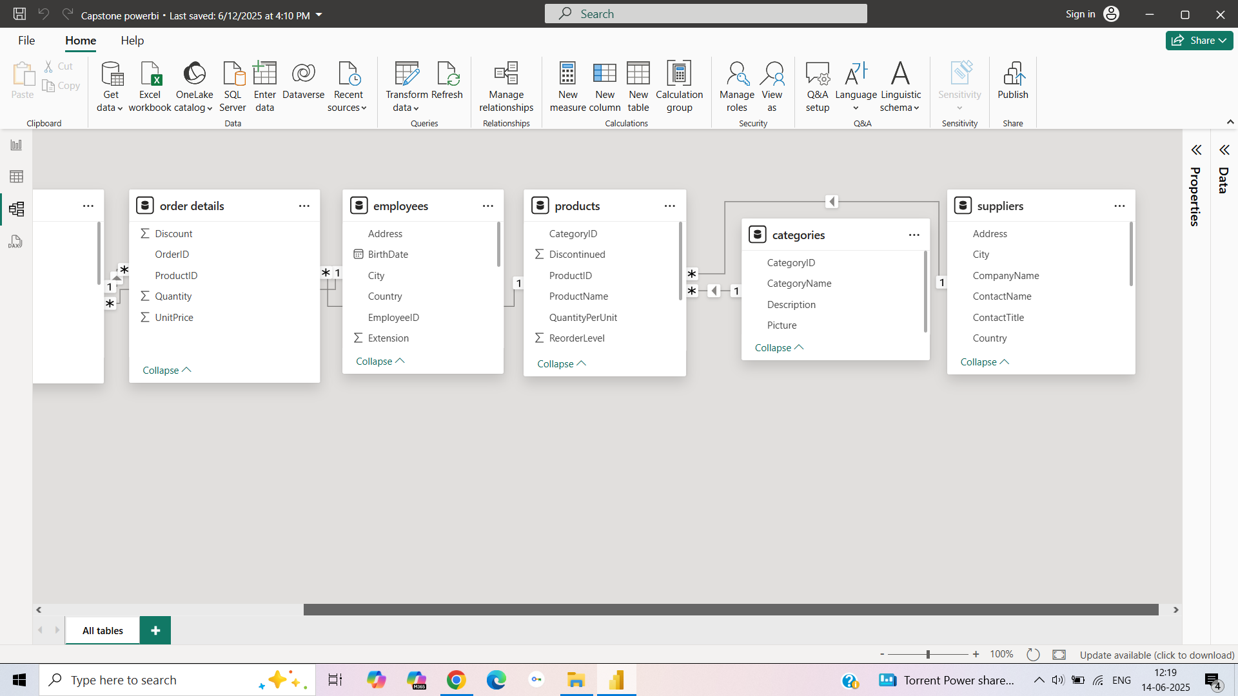
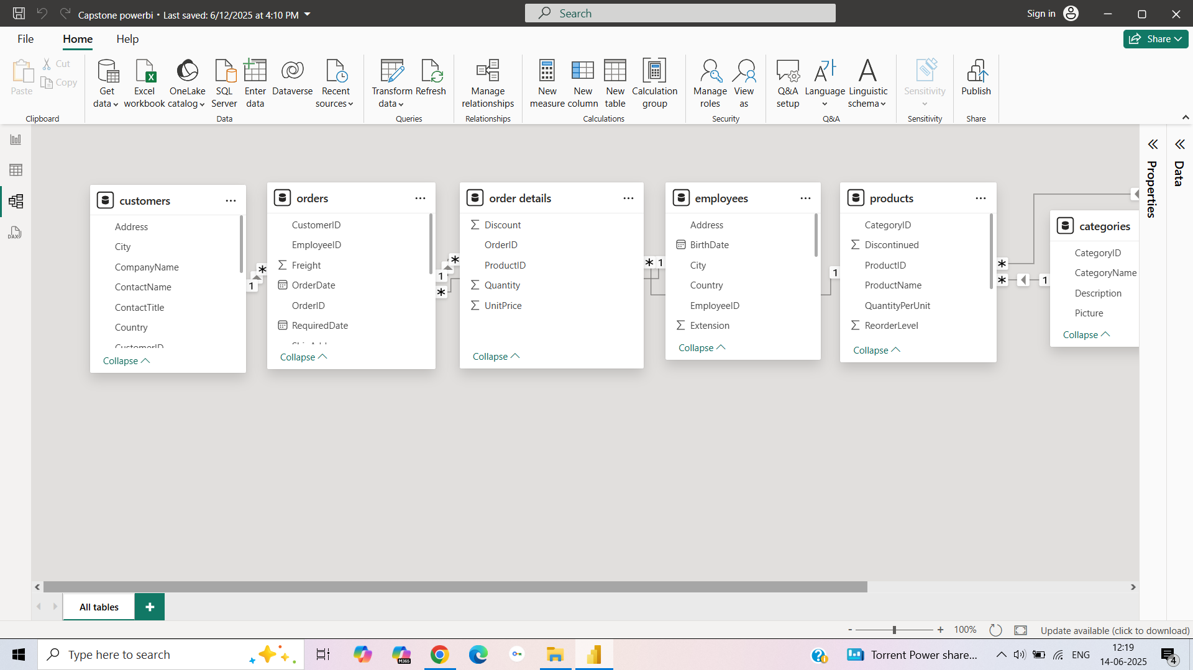
MODEL VIEW

