Slide 1
JavaScript
Open and Cross-platform programming language

Slide 2
TABLE OF CONTENTS
01
03
02
04
Introduction
Variables and Datatypes
Fundamentals of JavaScript
Operators

Slide 3
—Mary Kay Ash
“Never give up because you never know if the next try is going to be the one that works.”

Slide 4
01
Introduction

Slide 5

What is JavaScript?
JavaScript is the world's most popular programming language.
JavaScript is the programming language of the Web.
JavaScript is easy to learn.
This tutorial will teach you JavaScript from basic to advanced.

Slide 6
JavaScript
JavaScript is a lightweight, open and cross-platform programming language. It is omnipresent in modern development and is used by programmers across the world to create dynamic and interactive web content like applications and browsers. It is one of the core technologies of the World Wide Web, alongside HTML and CSS, and the powerhouse behind the rapidly evolving internet by helping create beautiful and crazy-fast websites.

Slide 7
02
Fundamentals of JavaScript

Slide 8
Fundamentals of JavaScript
Two types of commenting single-line and multiline.
To use JavaScript on website we need to attach the JavaScript file to the HTML file.
To do a better code, we should also do the commenting during the code.
JavaScript comments can be extremely useful to explain JavaScript code and help understand what’s going on in your code and make it more readable.
Single-line comments: Start a single-line comment with “//”.
Multi-line comments: Wrap the comment in /* and*/ if it spans multiple lines.

Slide 9
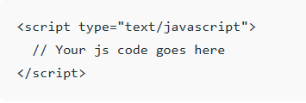

Fundamentals ….
For a browser to know the code is written in JavaScript and execute it we must enclose the code within the <script> tag to include it on the HTML page.
An external JavaScript file can also be written separately and included within our HTML file using the script tag as:

Slide 10
03
Variables and Datatypes

Slide 11
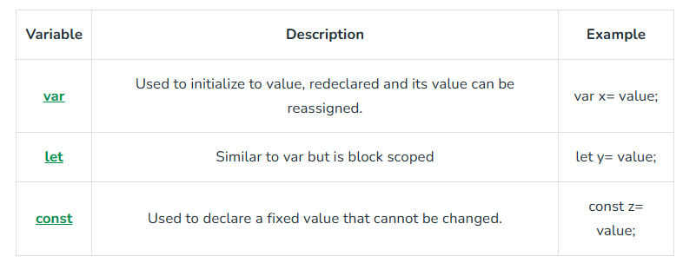
Variables
Variables in JavaScript are containers for storing data. JavaScript allows the usage of variables in the following three ways:

Slide 12
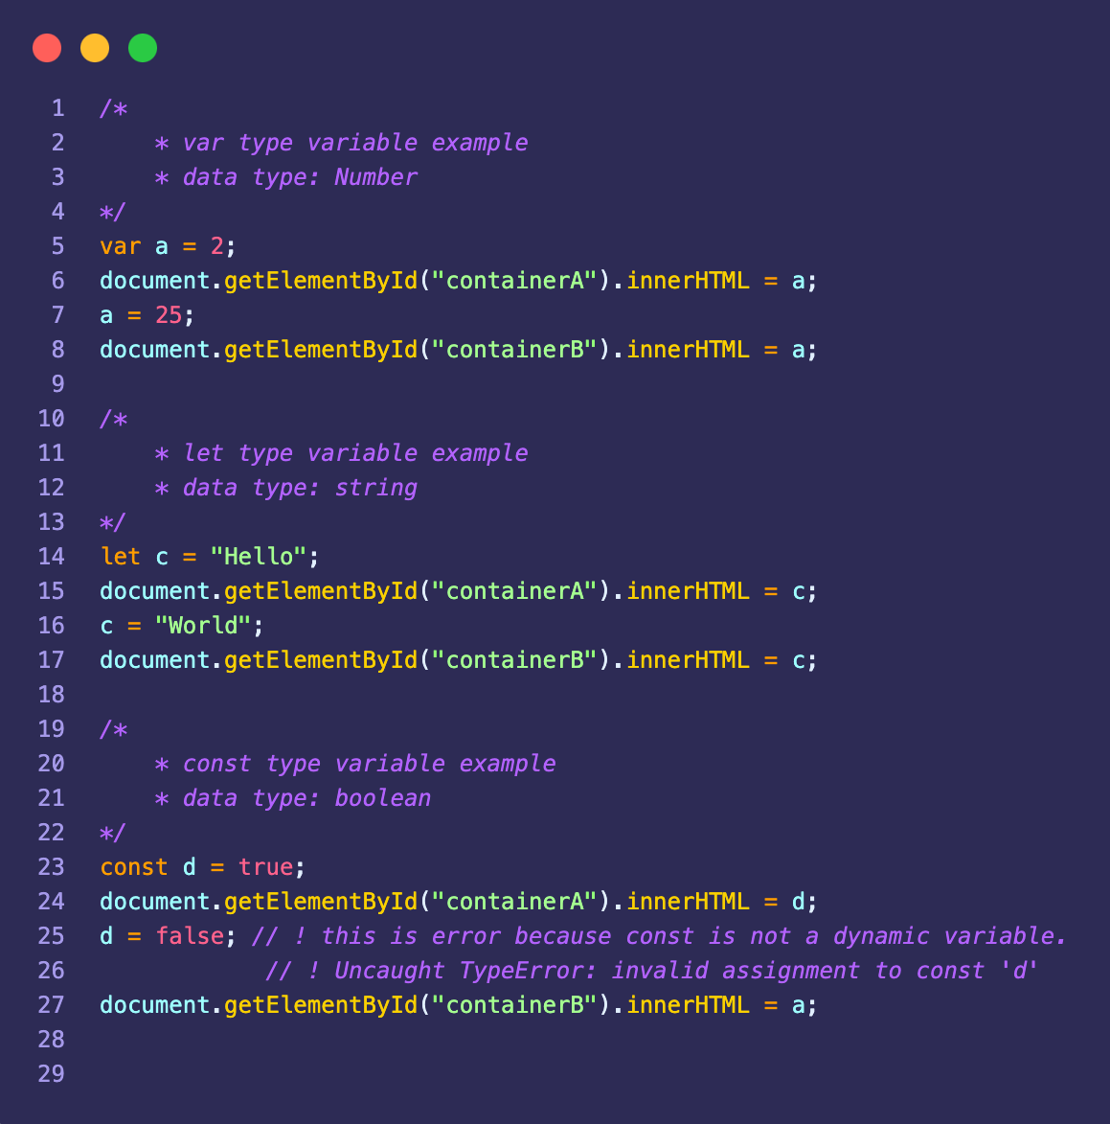
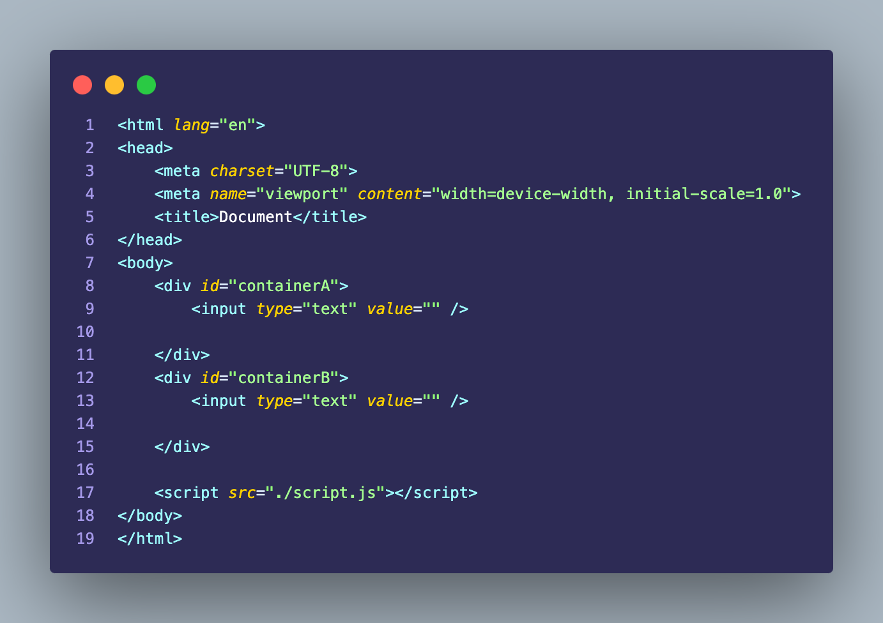
Example

Slide 13
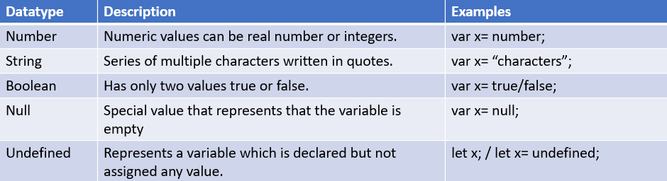
Datatypes of JavaScript
There are different types of values and data that can be stored in JavaScript variables.
For the machine to be able to operate on variables, and correctly evaluate the expressions it is important to know about the type of variables involved.

Slide 14
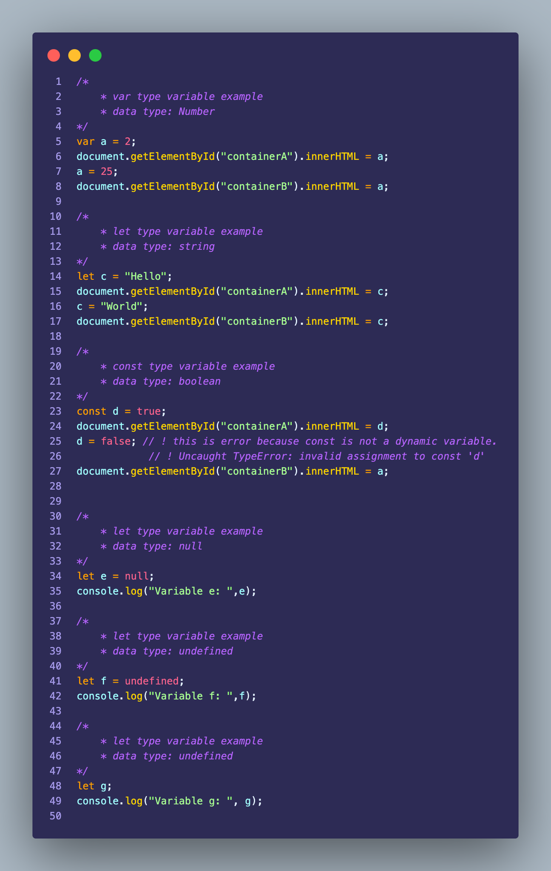
Example

Slide 15
04
Operators

Slide 16
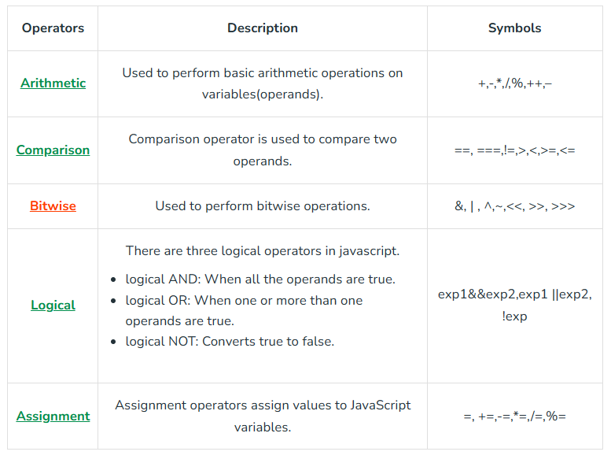
OPERATORS
JavaScript operators are symbols used to perform various operations on variables (operands).

Slide 17
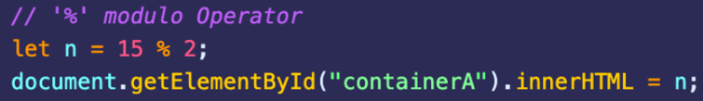
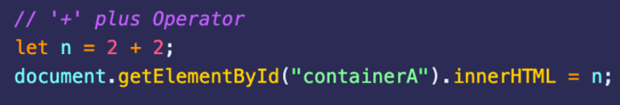
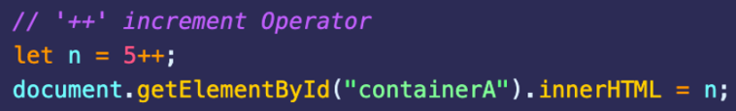
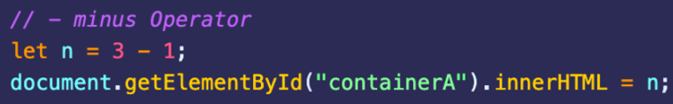
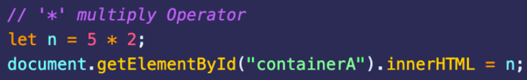
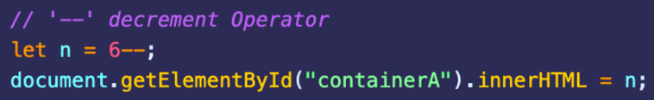
ARITHMETIC OPERATORS
Addition
Modulus
Subtraction
Increment
Decrement
Multiplication

Slide 18


