Slide 1
Flappymania: A Remake of the Classic Bird Game
Md. Shifat Alam
Roll: 2003135

Slide 2
Outline
Introduction Project Objectives Software Features
Tools and Technologies Justiﬁcation for Tool Selection
Conclusion

Slide 3
Introduction: Reviving the Classic - Flappy Bird
Recreating the iconic Flappy Bird, which once took the gaming world by storm in the year 2014.
But, by just using HTML, CSS, and JS in VS Code!

Slide 4
Objectives
Exploring the world of Game Development Learning and applying HTML, CSS, and JavaScript skills
Recreating the Flappy Bird game experience

Slide 5
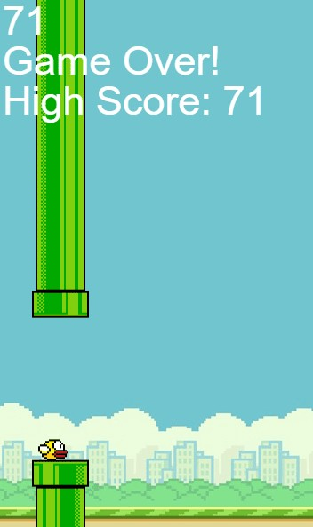
Software Features
Press-to-ﬂy mechanics
Obstacle collision detection Scoring system
High score tracking Sound effects

Slide 6
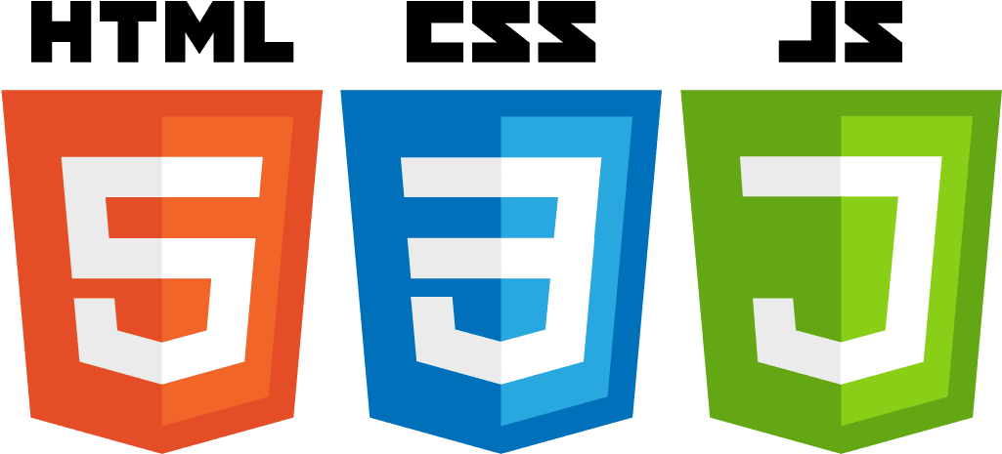
HTML CSS
Language & Tools
JavaScript
Visual Studio Code IDE

Slide 7

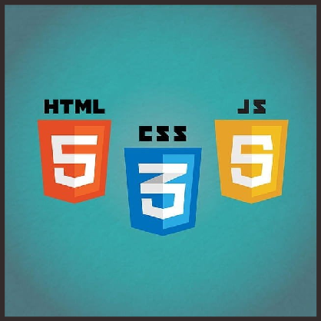
Justification for Using the Tools
HTML for creating the game's structure and layout
CSS for styling and making the game visually appealing JavaScript for game functionality and interactivity
VS Code for its versatility, extensions, and developer-friendly environment

Slide 8
Thanks!

