Slide 1
iGiant Business Systems
TARA TECHNOLOGIES
Notes:
Project name – pick a cool sounding name for your project
Sponsors – list your project sponsors here (the people with the money)
Putting your sponsors name boldly out there for all to see is a great way to get their engagement and attention (necessary for any successful project).

Slide 2
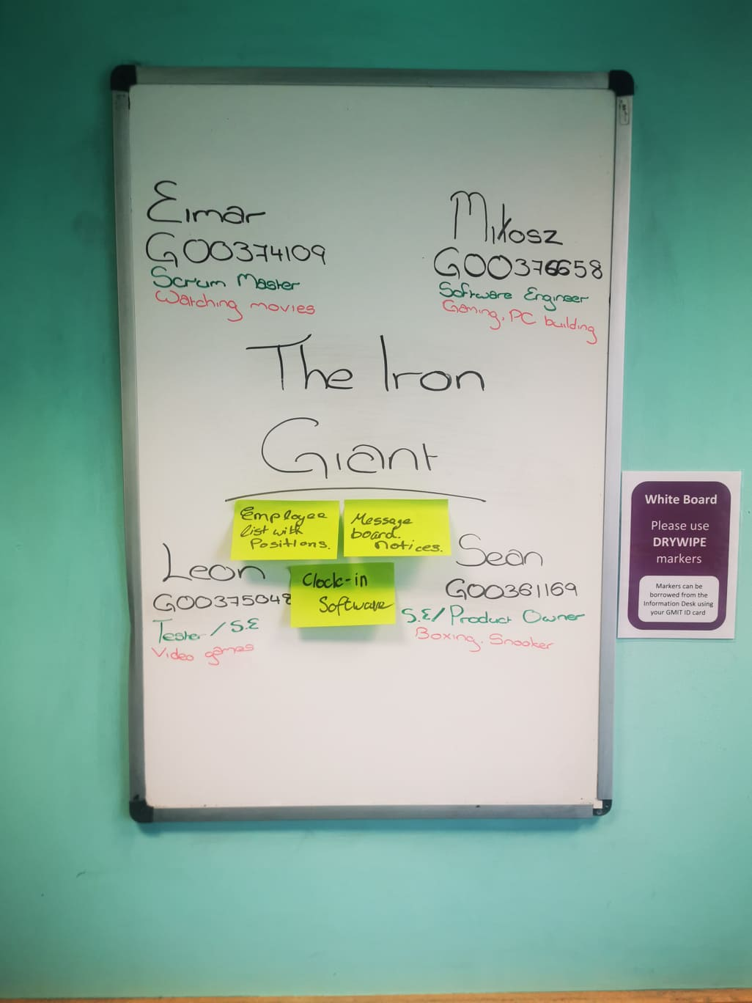

Slide 3

Why are we here?
To develop a user friendly website
Improve our coding skills
Get used to a teamworking environment
<#1 reason for doing this project>
Notes:
Write down all the reasons why your company would want to spend money on this project in the first place.
Then pick and highlight the most important one.

Slide 4
The elevator pitch
For small-medium businesses
Who have a system in place that helps them feel connected to their employees and manage their company with great ease
the The Iron Giant
is a Business management software
that Business organisation and time saving
Unlike Hard copy timetable and avoid counting stock
our project is user friendly to both the manager and employee bodies in the business.

Slide 5
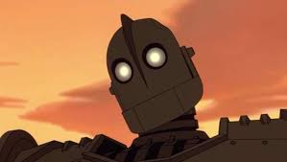
Product box
iGiant Business Systems
Bringing managers and employees together
Online organization of timetables and inventory management Online user friendly clock-in systems for employees
Notes:
If you could walk into a store, and buy the shrink wrapped version of your software, what the design of the box look like and what would it say?
Point here is to get your team looking at your project through the eyes of your end customer.

Slide 6
The NOT list
IN | OUT
EMPLOYEE AND MANAGER LIST | MOBILE APP
ROLE POSITIONS | PAYROLLS / PAYSLIPS
CLOCK IN AND OUT TIMES | EVENT/HOLIDAY SCHEDULES
GENERAL INFO ABOUT EMPLOYEES (Phone numbers, dates of birth)
BASIC SEARCH
WEB VERSION
UNRESOLVED
STOCK SYSTEM
TIME TABLE
MESSAGE BOARD (NOTICE OF SWAPPED SHIFTS etc.)
Notes:
List all the big ticket items you are (and are NOT) going to deliver within the scope of this project.
Before starting your project move all the UNRESOLVED ones to either IN or OUT.

Slide 7



Your project community
Stack overflow
Managers and employees using the app
Your core team
Other teams collaborating with us
IT Team GMIT
... is always bigger than you think!
Notes:
List everyone you are going to have to interact with at some point during the course of your project.
Goal is to start building relationships with these people and let them know we are coming down the tracks (before we actually get there).

Slide 8



Technical solution
Technologies:
CSS, HTML, Angular, JS, SQL
MySQL
Jira, Notepad++, MySQL Workbench,
Linux, Web Server (NGINX, Apache2)
Danger!
Out of scope
Notes:
This is about letting people know how we plan on building this thing.
If there are any tools or libraries assumptions you are making list them here.
Also if there are areas of the application architecture that are risky highlight those too.

Slide 9

What keeps us up at night
SQL skillset
Member attendance
Deadlines
Being too ambitious
Notes:
This is your chance to call out any craziness you’ve heard while building the deck, and having a frank conversation with your sponsors and your team about how you are going to handle it.
This is perhaps on of the most powerful slides in the deck – it’s your chance to ask for whatever you need to be successful and the consequences if you don’t get it.
Use it!

Slide 10
The A-Team
# | Role | Competencies/Expectations
1 | Analyst / Tester | Comfortable with just-in-time analysis. Likes to test. Comfortable with rapid iterative development.
3 | Developers | HTML and CSS experience. SQL experience – Webmaster experience, hosting websites etc.
1 | Project manager / SCRUM Master | Responsible for outward facing communication Status reports, scope, budget, and reporting upwards
1 | Product Owner | Responsible for team backlog, making sure deadlines are met and we are staying in-scope
Notes:
Set expectations around who you are going to need and what kind of skills they will need to have to pull this off.
Use names if specific people are important (i.e. Billy is the only guy who can do X).

Slide 11

How big is this thing?
Ship it!
Planning
Research
Development
2 weeks
1 week
3 months
This is a guess. Not a commitment.
Notes:
Give your sponsors some idea of how big this thing is (1, 3, or 6 monther).
Before you can complete this slide you and the team should create and estimate a high-level story list for the project.
This isn’t a commitment (too many unknowns). It’s just a really rough guess. Don’t treat it as anything else.

Slide 12
Trade-off sliders
 | The classic four
 | Feature completeness (scope)
 | Stay within budget (budget)
 | Deliver project on time (time)
 | High quality, low defects (quality)
OFF
ON
OFF
ON
OFF
ON
OFF
ON
 | Other important things
 | Ease of use
 | Don’t make me think!
 | Detailed audits (log everything)
OFF
ON
OFF
ON
OFF
ON
Notes:
When push comes to shove, something has to give. Here we want to be clear on what that is.
On agile projects we flex on scope. But there could be others factors at play here so get ready to listen as you customer tells you which forces can bend (scope) and which are written in stone (usually budget).
Slider rules:
1. No two sliders can occupy the same level.
2. List other important project factors down below.

Slide 13

The first release
Ship it!
Construction
UAT
Training
3 months
2 weeks
2 weeks
4 people, 4 mosnths, $10
Notes:
Stakeholders are usually interested in two things:
How much is this going to cost.
When is it going to be done.
Here we do our best to answer those two questions so they can decide if the project is still worth doing by showing them what it’s going to take.

