Slide 1
Mathematics
-Presented by
1.Anshika Maurya
2.Rishita Pandey
3.Rupali Sharma
4.Shaipali Maurya

Slide 2
CHAPTER 1 SETS
Mathematics, a set is defined as a collection of distinct, well-defined objects forming a group. There can be any number of items, be it a collection of whole numbers, months of a year, types of birds, and so on. Each item in the set is known as an element of the set. We use curly brackets while writing a set.

Slide 3
Suppose two sets A = {a, b} and B = {1, 2, 3}. Find A×B and B×A.Here,A = {a, b}B = {1, 2, 3}Now,A×B = {(a,1), (a,2), (a,3), (b,1), (b,2), (b,3)}B×A = {(1,a), (1,b), (2,a),(2,b), (3,a), (3,b)}

Slide 4
Roaster Form
Roster FormIn Roster form, all the elements of a set are listed.For example, the set of natural numbers less than 5.Natural Number = 1, 2, 3, 4, 5, 6, 7, 8,……….Natural Number less than 5 = 1, 2, 3, 4Therefore, the set is N = { 1, 2, 3, 4 }Set Builder FormThe general form is, A = { x : property }
Example: Write the following sets in set builder form: A={2, 4, 6, 8}Solution:2 = 2 x 14 = 2 x 26 = 2 x 38 = 2 x 4So, the set builder form is A = {x: x=2n, n ∈ N and 1 ≤ n ≤ 4}Also, Venn Diagrams are the simple and best way for visualized representation of sets

Slide 5
Example 2: Find A U B and A ⋂ B and A – B.If A = {a, b, c, d} and B = {c, d}.Solution: A = {a, b, c, d} and B = {c, d}A U B = {a, b, c, d} A ⋂ B = {c, d} and A – B = {a, b}
Sets FormulasSome of the most important set formulas are:For any three sets A, B and Cn ( A ∪ B ) = n(A) + n(B) – n ( A ∩ B)If A ∩ B = ∅, then n ( A ∪ B ) = n(A) + n(B)n( A – B) + n( A ∩ B ) = n(A)n( B – A) + n( A ∩ B ) = n(B)n( A – B) + n ( A ∩ B) + n( B – A) = n ( A ∪ B )n ( A ∪ B ∪ C ) = n(A) + n(B) + n(C) – n ( A ∩ B) – n ( B ∩ C) – n ( C ∩ A) + n ( A ∩ B ∩ C)

Slide 6
CHAPTER 2 Exponential and logarithm functions
specify for which values of a the exponential function f(x) = a x may be defined,
• recognize the domain and range of an exponential function,
• identify a particular point which is on the graph of every exponential function,
• specify for which values of a the logarithm function f(x) = loga x may be defined,
• recognize the domain and range of a logarithm function,
• identify a particular point which is on the graph of every logarithm function,
• understand the relationship between the exponential function f(x) = e x and t

Slide 7
1. Exponential functions
Consider a function of the form f(x) = a x , where a > 0. Such a function is called an exponential function. We can take three different cases, where a = 1, 0 < a < 1 and a > 1. If a = 1 then f(x) = 1x = 1. So this just gives us the constant function f(x) = 1.
This example demonstrates the general shape for graphs of functions of the form f(x) = a x when a > 1. What is the effect of varying a? We can see this by looking at sketches of a few graphs of similar functions. f(x) x

Slide 8
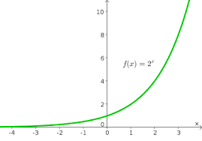
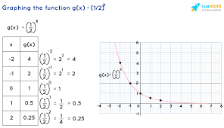

Slide 9
Logarithm functions
We shall now look at logarithm functions. These are functions of the form f(x) = loga x where a > 0. We do not consider the case a = 1, as this will not give us a valid function.
What happens if a > 1? To examine this case, take a numerical example. Suppose that a = 2. Then
f(x) = log2 x means 2 f(x) = x.
An important point to note here is that, regardless of the argument, 2 f(x) > 0. So we shall consider only positive arguments.
f(1) = log2 1 means 2 f(1) = 1 so f(1) = 0
f(2) = log2 2 means 2 f(2) = 2 so f(2) = 1
f(4) = log2 4 means 2 f(4) = 4 so f(4) = 2
f( 1 2 ) = log2 ( 1 2 ) means 2 f( 1 2 ) = 1 2 = 2−1 so f( 1 2 ) = −1
f( 1 4 ) = log2 ( 1 4 ) means 2 f( 1 4 ) = 1 4 = 2−2 so f( 1 4 ) = −2
We can put these results into a table, and plot a graph of the function.

Slide 10
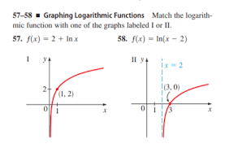

Slide 11
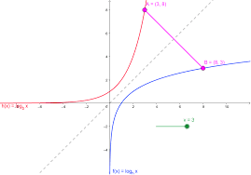
The relationship between exponential functions and logarithm functions
We can see the relationship between the exponential function f(x) = e x and the logarithm function f(x) = ln x by looking at their graphs.
f(You can see straight away that the logarithm function is a reflection of the exponential function in the line represented by f(x) = x

Slide 12
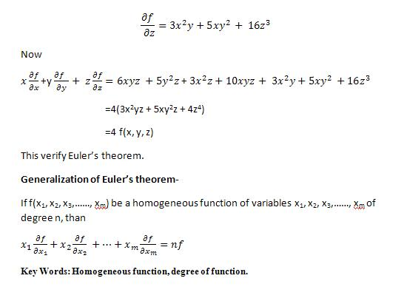
CHAPTER 3 Euler’s Theorem
1.Homogeneous Function
A function f of two independent variables x, y is said to be a homogeneous function of degree n if it can be put in either of the following two forms :

Slide 13
Contents
1.Homogeneous Function
2. Euler’s Theorem on Homogeneous Function of Two Variables
3. Euler’s Theorem on Homogeneous Function of Three Variables

Slide 14
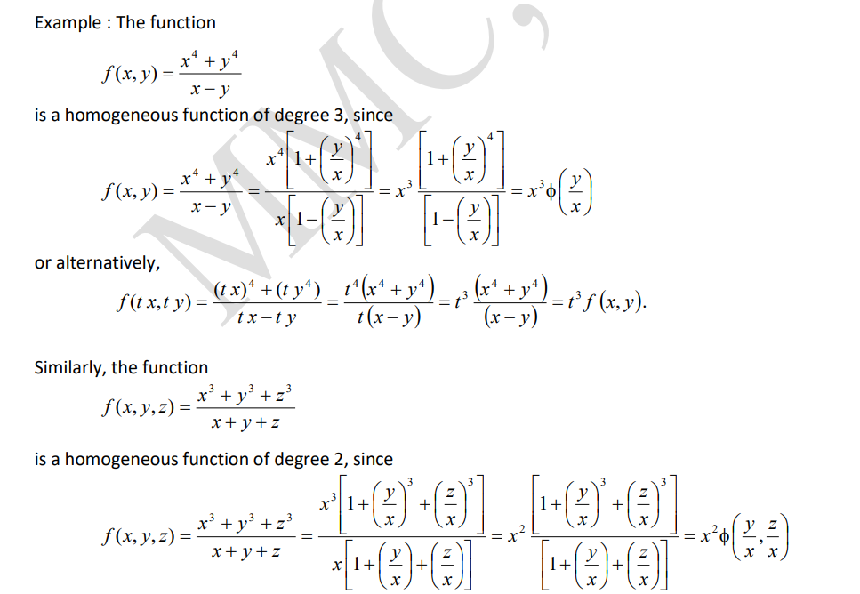
1. Homogeneous Function

Slide 15
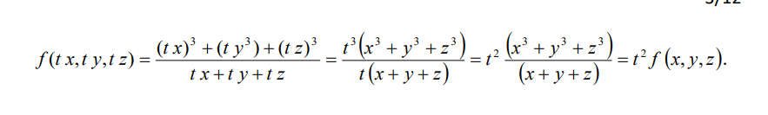

Slide 16
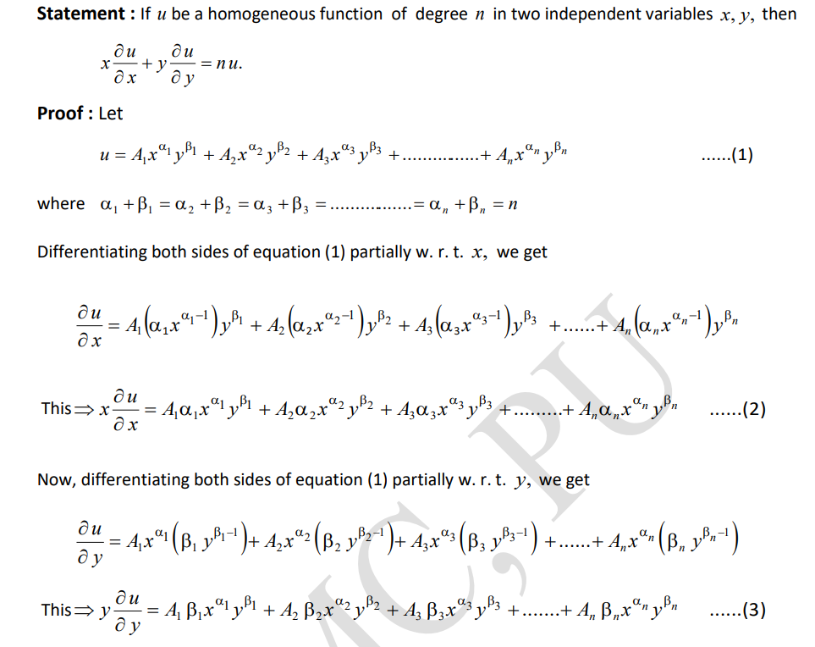
2. Euler’s Theorem on Homogeneous Function of Two Variables

Slide 17
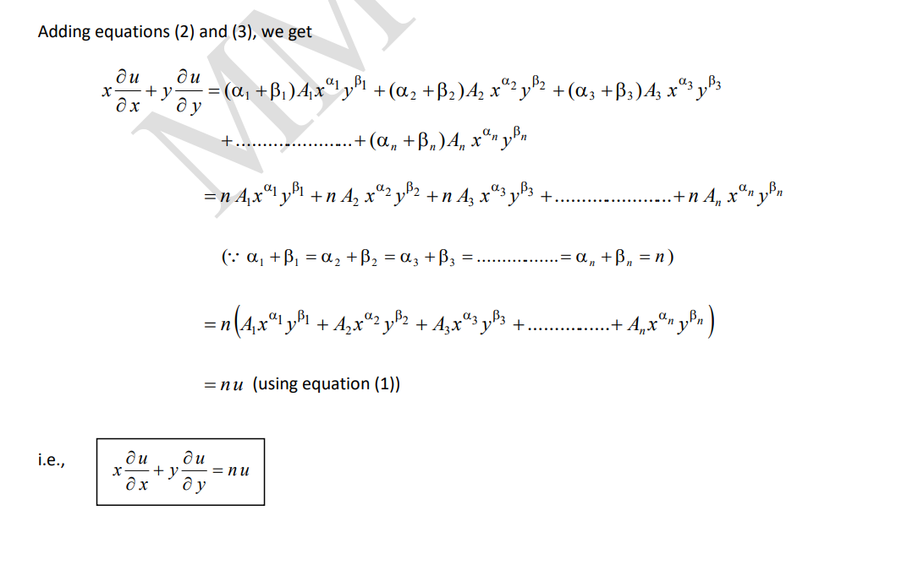

Slide 18
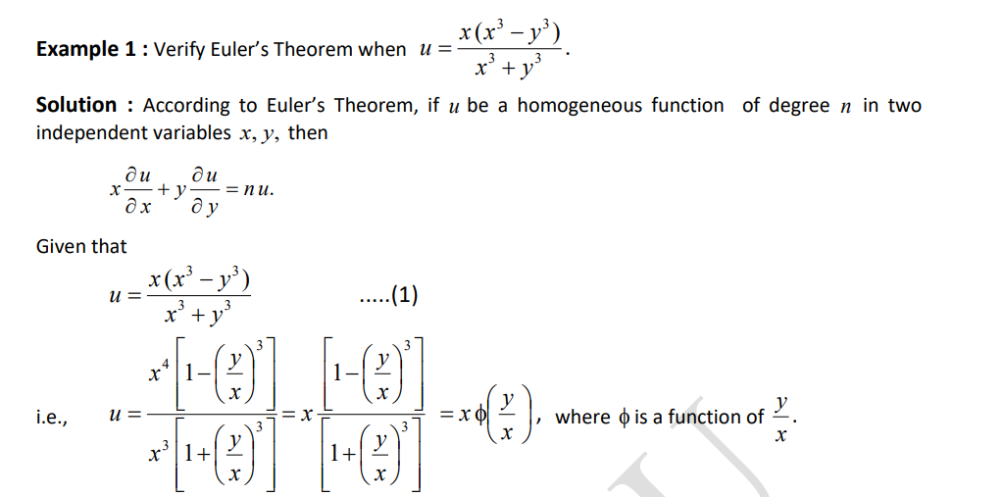
Example

Slide 19
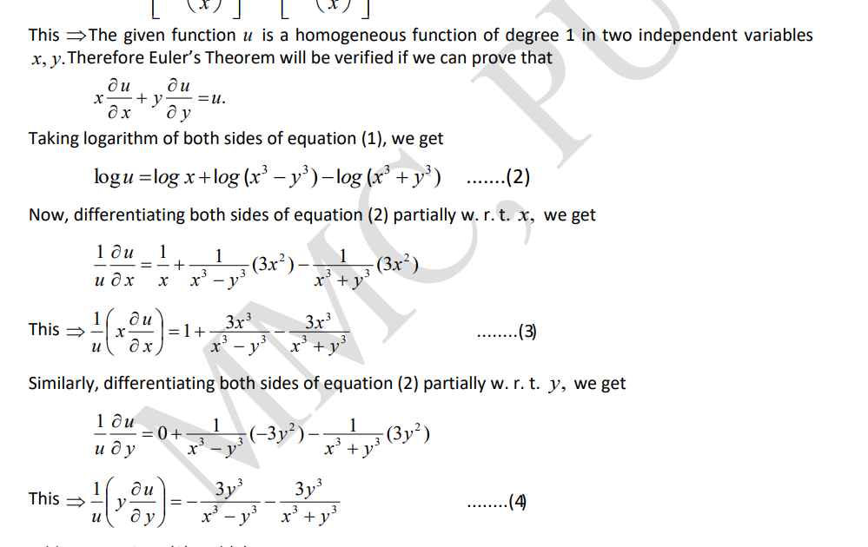

Slide 20
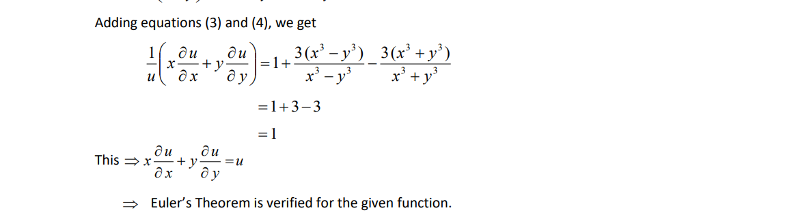

Slide 21
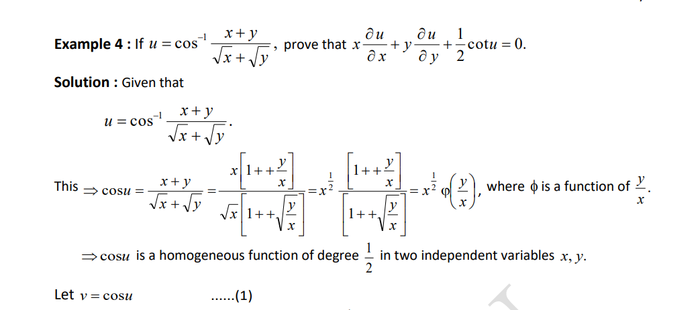

Slide 22
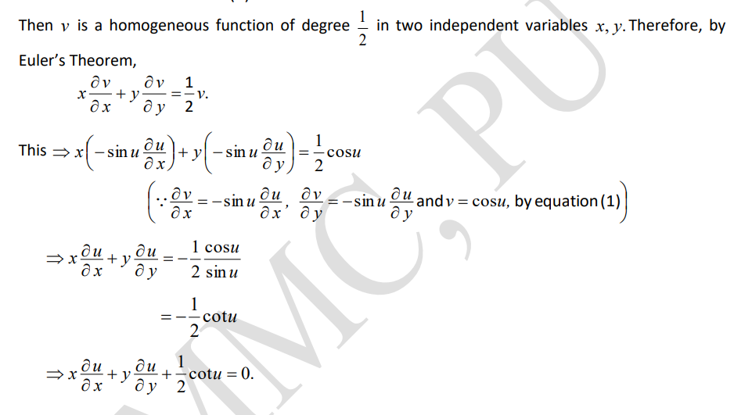

Slide 23

About Auther
Shaipali Maurya is Student of Second Semester student.
She is a brilliant Programmer in Python and she have knowlwdge of C Programming
and html, css etc .
She is a good mathematician and write this ppt by her mathematical knowledge incorporation with her friends.

