Slide 1
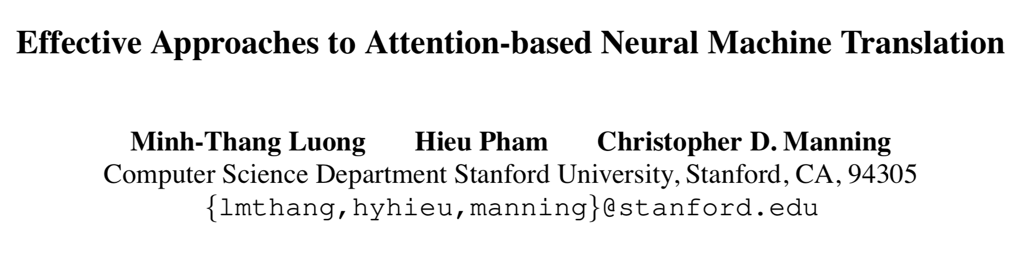
http://aclweb.org/anthology/D15-1166
Kang Wen Wei

Slide 2
Bahdanau 2015
Purpose
Attention mechanism
Datasets
Evaluate

Slide 3

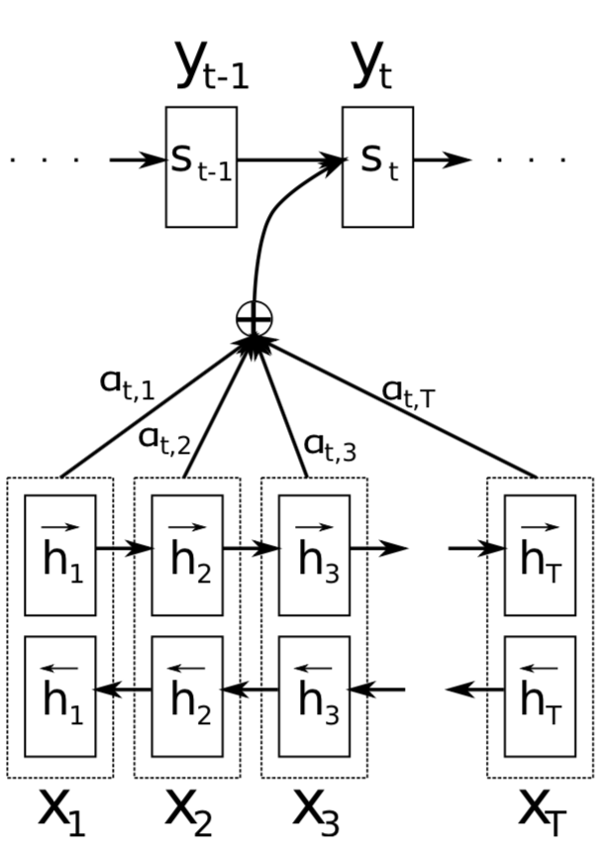













Bahdanau 2015
https://arxiv.org/abs/1409.0473
Initial_state
GRU*
Alignment vector
dotproduct
Alignment weight
alignment
Bi-RNNs
concat

Slide 4
Purpose
Global attention：
Consider all the hidden-states of the encoder when deriving the context vector
Local attention：
Choose to focus on a subset of hidden-states of the encoder per target word
Input-feeding Approach：
Choose to focus on a subset of hidden-states of the encoder per target word
New aligned metrics (content based function)
Local-m (Monotonic alignment)
Local-p (Predictive alignment)

Slide 5
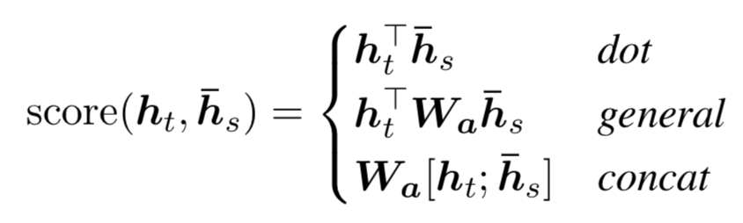
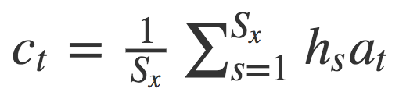
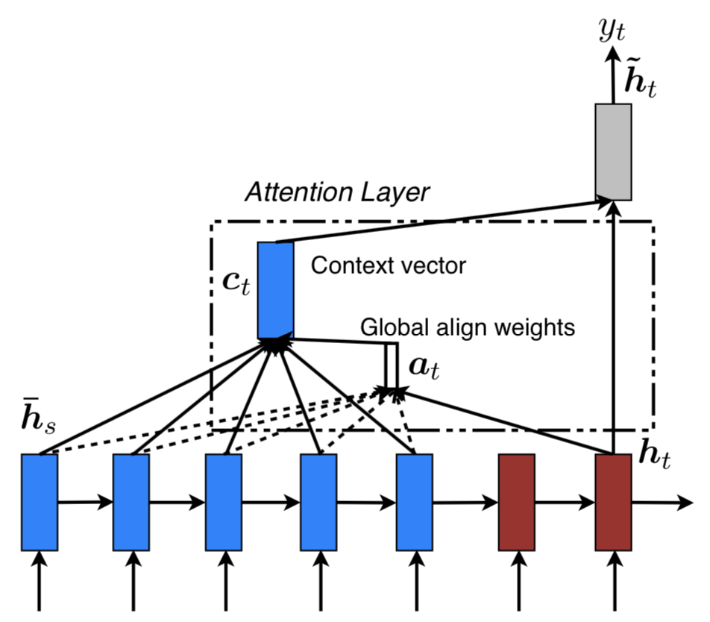



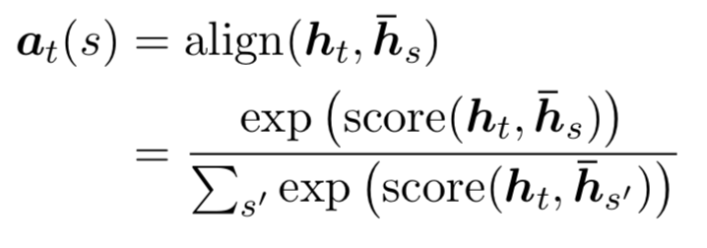

Mechanism-Global attention
3.
4.
dot：
general：
2.
*
Encoder
Decoder

Slide 6


Comparison with Bahdanau 2015
GRU*
concat and dense layer
dot product
weighted average
alignment
alignment
Bi-GRU：concat
Bahdanau 2015
Global attention

Slide 7
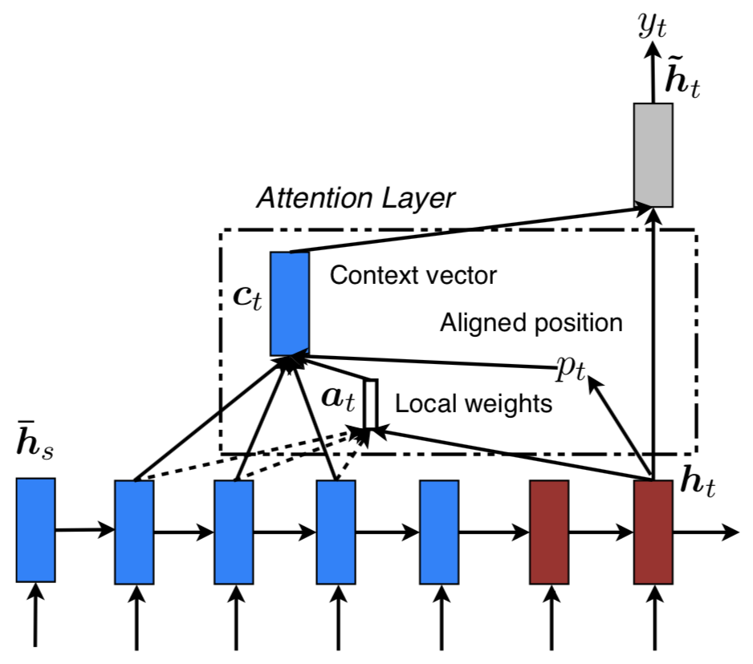



Mechanism-Local attention
Global attention attends to all words on the source side for each target word, which is expansive and can potentially render it impractical to translate longer sequences.
Generate an aligned position and
aligned boundary
Compute aligned weight
Compute context vector (weighted average)
Monotonic alignment (local-m)
Predictive alignment (local-p)
Encoder
Decoder

Slide 8



Monotonic alignment (local-m)
h1
ht-1
ht
ht+1
ht+2
ht
...
...
...
Encoder
Decoder

Slide 9
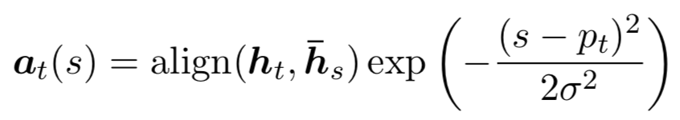


Predictive alignment (local-p)
h1
ht-1
ht
ht+1
ht+2
ht
...
...
...
Encoder
Decoder

Slide 10
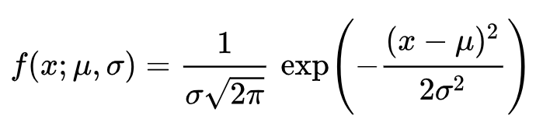
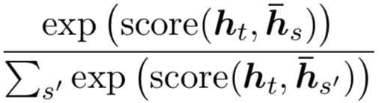
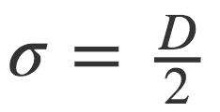





Monotonic alignment (local-p)
Normal distribution
Restrict aligned weight again !
ht-2
ht-1
ht
ht+1
ht+2
ht
...
...

Slide 11
Monotonic alignment (local attention)
concat and dense layer
concat and dense layer
weighted average
weighted average
aligned position
alignment
alignment
Global attention
Local attention

Slide 12
Attention - alignment pair
New aligned metrics
 | location | dot | general | concat
global attention | global (location) | global (dot) | global (general)
local-m |  | local-m (dot) | local-m (general)
local-p |  | local-p (dot) | local-p (general)
Global
Attention
Local
Attention

Slide 13
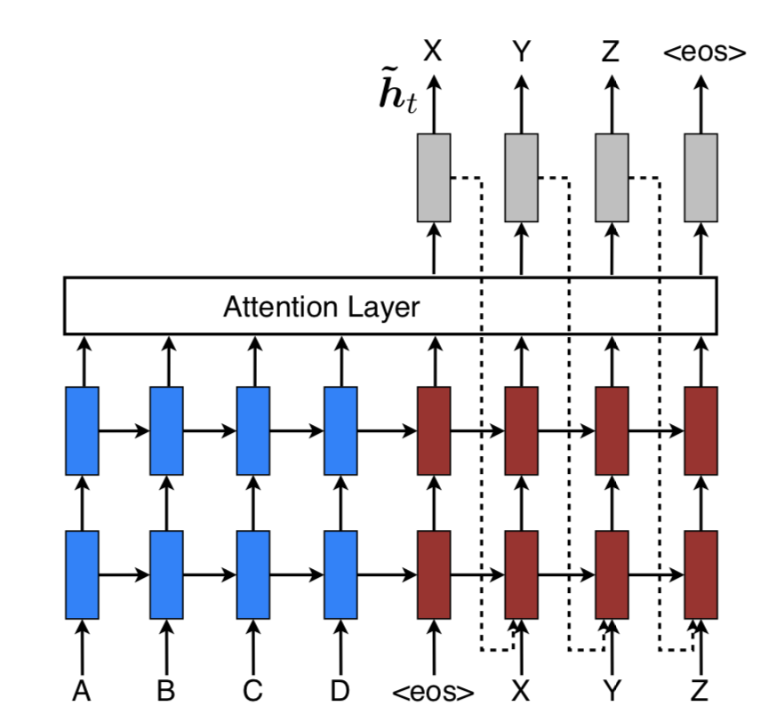

Input-feeding Approach
Attentional vectors are fed as inputs to the next time steps to inform model about past alignment decisions
Hope to make the model fully aware of previous alignment choices
Create a very deep network spanning both horizontally and vertically

Slide 14

Input-feeding Approach
concat and dense layer
concat and dense layer
weighted average
weighted average
alignment
alignment
Global attention
Input-feeding

Slide 15
Datasets (English - German in both directions )
WMT’14
Training data：4.5M sentences pairs (116M English words, 110M German words)
Use Top 50k most frequent words for both languages, others replaced <unk>
Filter out sentence pairs whose lengths exceed 50 words
Validation：newstest-2013(3000sentences)
Test： newstest-2014(2737sentences), newstest-2015(2169sentences)
4 layers LSTM、1000 cells、1000 dimensional embedding
Parameters are uniformly initialized in [-0.1, 0.1]
Train for 10 epochs using SGD
Start with learning rate of 1, after 5 epochs, begin halve the learning rate every epoch
Batch_size: 128
Normalized gradient rescaled whenever its’ norm exceeds 5
For Dropout models, train for 12 epochs and start halving the learning rate after 8 epochs

Slide 16

Performance
Performance (WMT’14 English - German Result)
：Proposed a method which solves the softmax of output layer.
：Replacing each <unk> token with the aligned source word.
：Reverse the words in the source sentence.
。 蘋果 一顆 是 這
。 蘋果 一顆 是 這
S5
S4
S3
S2
S1
S5
S4
S3
S2
S1
C
C
S1
S2
S3
S4
S5
S1
S2
S3
S4
S5
Reverse
This is a apple .
. apple a is This

Slide 17
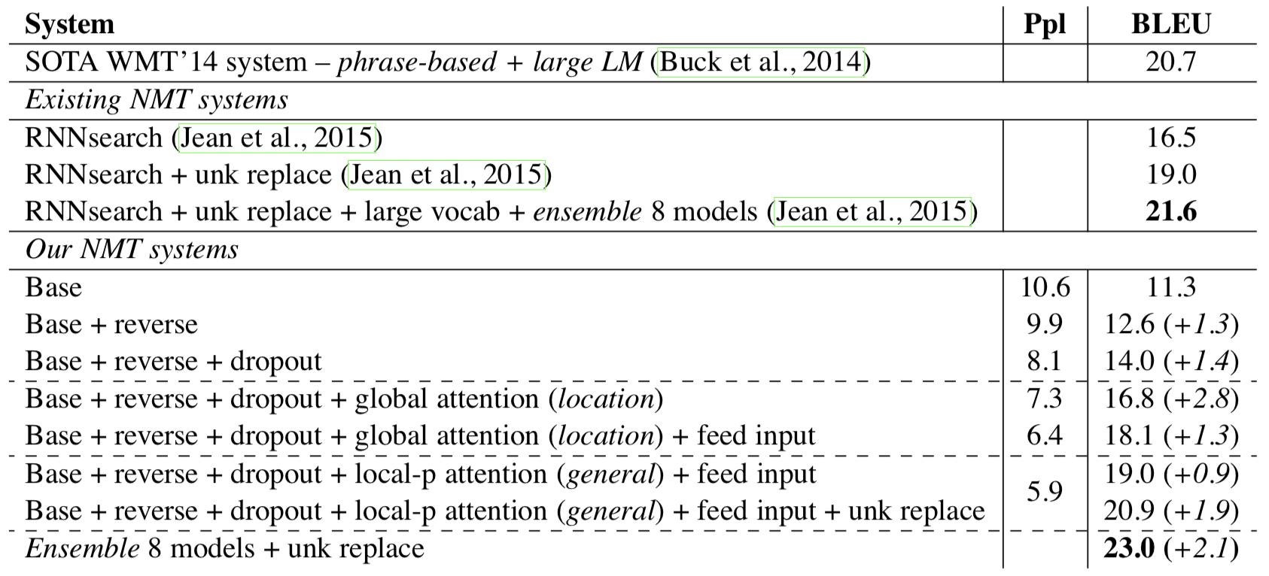
Performance (WMT’14 English - German Result)
Using different attention approaches, with and without dropout

Slide 18
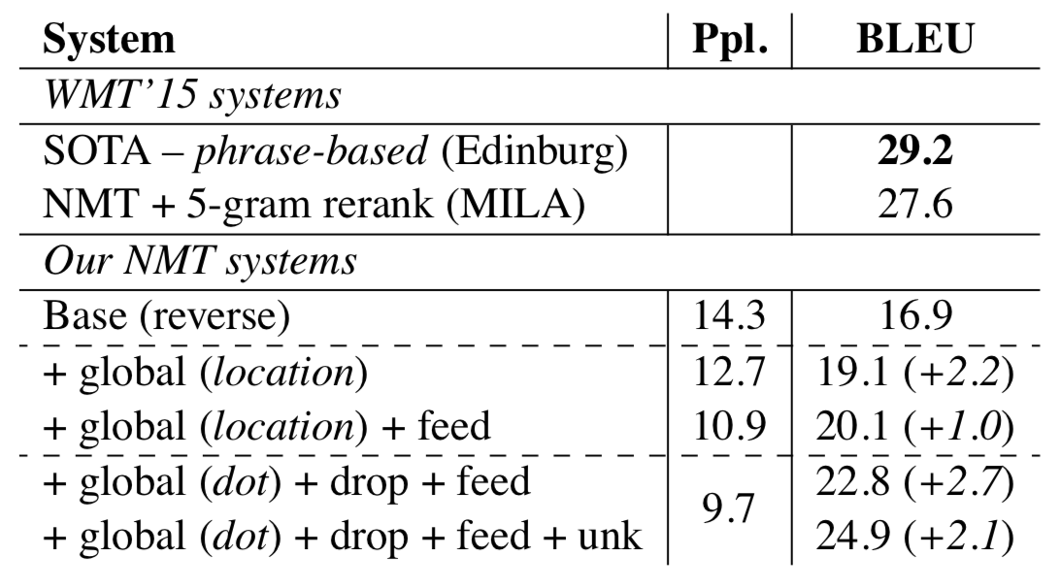
Performance (WMT’15 German - English Result)

Slide 19
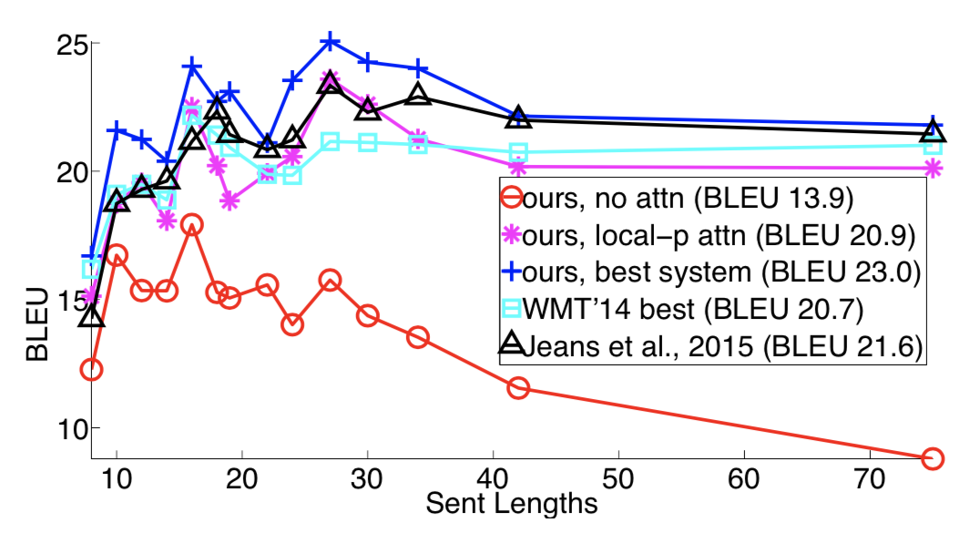
Performance (Length Analysis)

Slide 20
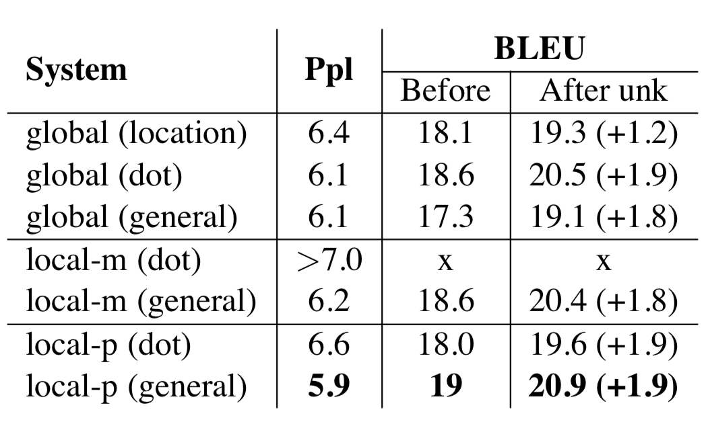
Performance (Attention Architectures)

