Slide 1
Background
Single Neuron
Limitation of single Neuron
Single Layer
Limitaion of single Layer
Kang Wen-Wei

Slide 2
Notation
Cost Function
Gradient Descent
Back propagation

Slide 3


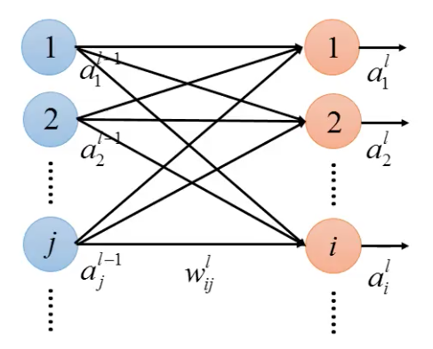








Slide 4
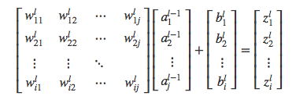
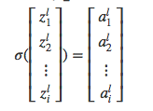

Slide 5


Cost Function
Input
Actual
Minimize

Slide 6





Gradient Descent
(The Simplest optimization)
Randomly start at
Compute Gradient at
Converagence condition：
Interation times
Min Cost
Gradient ≈ 0
...

Slide 7



Chain rule
Independent Variable
Dependent
Variable
Mediator
Variable

Slide 8



Backpropagation
First Term
Second Term

Slide 9





First Term：
Input layer to layer 1：
Layer l-1 to layer l：
Forward Pass

Slide 10


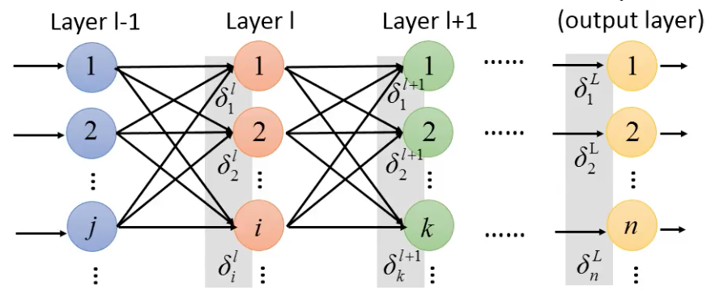



Second Term：
(Error signal)
Layer L

Slide 11




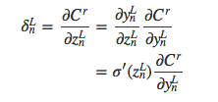

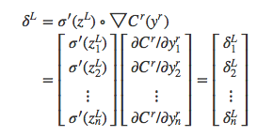
Depending on the definition of cost function
element-wise multiplication
Notes:
bigtriangleup：變化量
bigtriangledown：偏導數組成的向量
element-wise multiplication

Slide 12








The relation of and

Slide 13
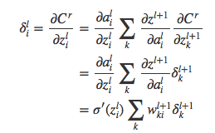



Slide 14











Backward Pass

Slide 15









Backward Pass

Slide 16
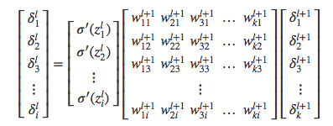

Slide 17

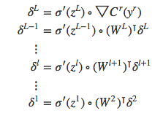
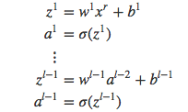
Gradient
Forward Pass
Backward Pass

