Slide 1
BackPropagation Through Time (BPTT)
Kang Wen-Wei

Slide 2
RNNs
LSTMs (Input, forget, output)

Slide 3
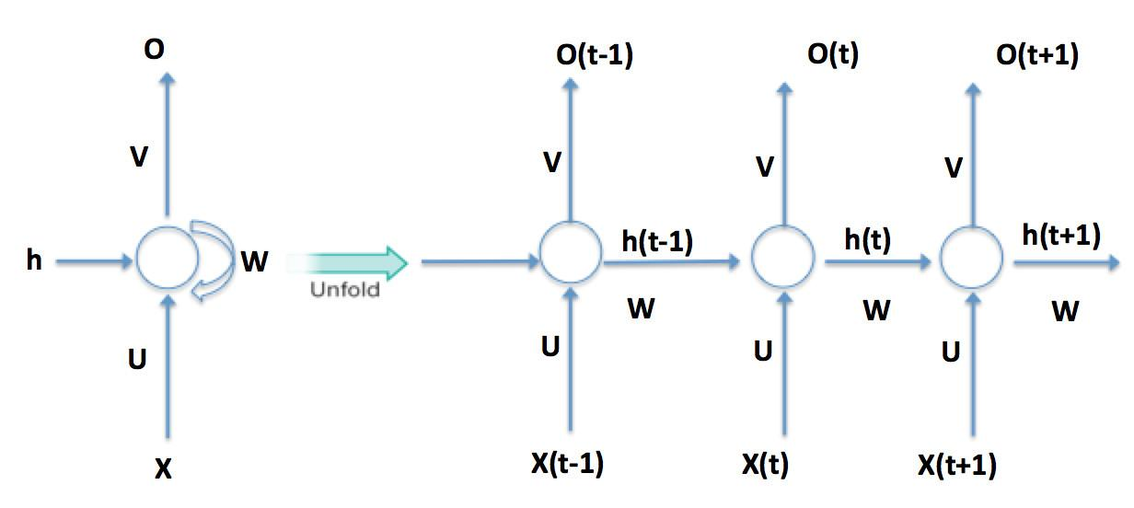
Basic RNNs
Unrolled version of RNN from https://www.linkedin.com/pulse/deep-learning-sequences-rnn-lstm-manish-tripathi/

Slide 4




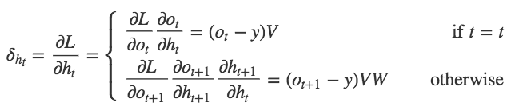
1
2
1
2

Slide 5
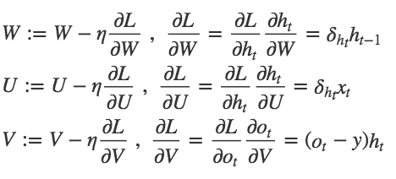
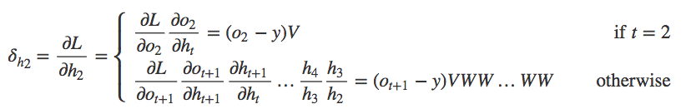
Gradient Descent
Gradient Vansh (Explode)

Slide 6
LSTMs
1997： + Input gate, Output gate
2000： + Forget gate
2001： + Peephole connection

Slide 7
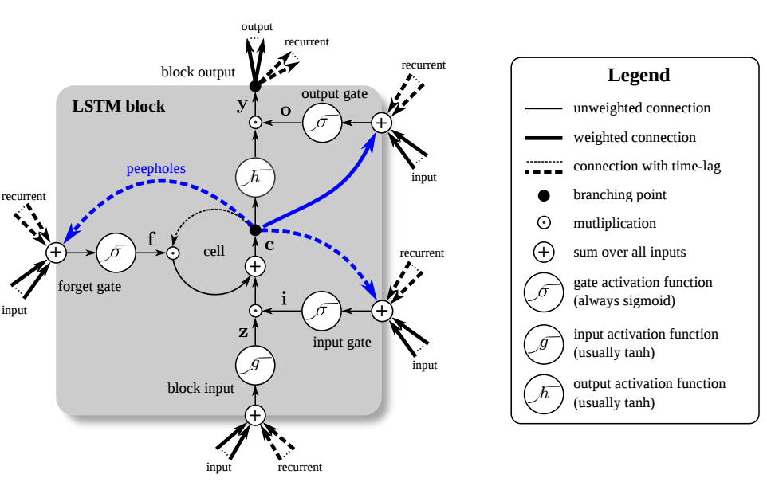
LSTMs cell
Ignore the peepholes !
Take by URL

Slide 8




Slide 9


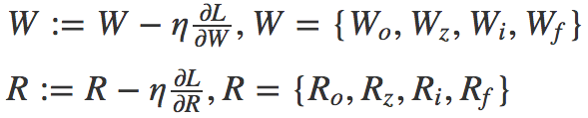


BPTT (Gradient Descent)
Randomly start at at
Compute Gradient at
Randomly start at at
Compute Gradient at

Slide 10






BPTT
(Chain rule)
Prepare for
computing
and

Slide 11
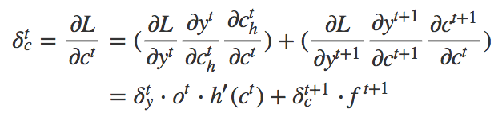
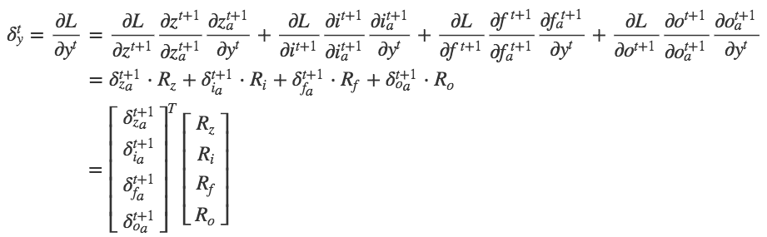
BPTT
(Chain rule)
Prepare for
computing
and
State c will influence next timestep
Output y will influence next timestep
from
activation input
to
output gate !

Slide 12
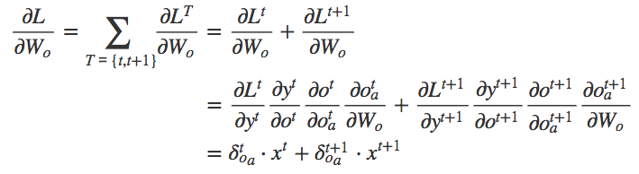



BPTT
(Chain rule)
Suppose there’re
two timesteps
As same as way !

Slide 13
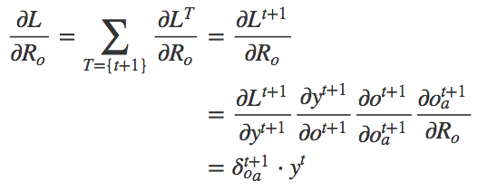



BPTT
(Chain rule)
Just for next timestep
As same as way !
Finally, we got all the gradient, and so can Gradient descent for each Weights !

Slide 14

Comparison-BP
MLP：
RNN：
LSTMs：

