Slide 1
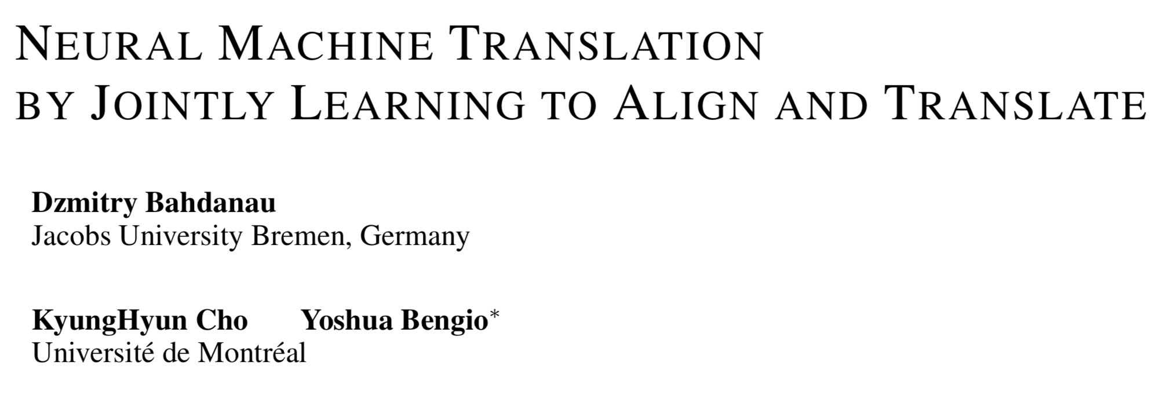
https://arxiv.org/abs/1409.0473
Kang Wen Wei

Slide 2
Purpose
Background
Limitation of RNN Encoder-Decoder
Attention mechanism
Overall
Encoder
Alignment Model + Decoder
Datasets (Train、Valid、Test)
Comparison with RNN Encoder-Decoder
Performance

Slide 3
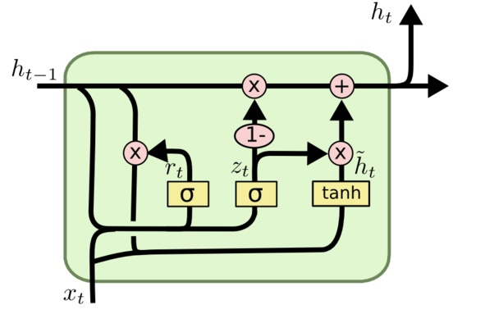
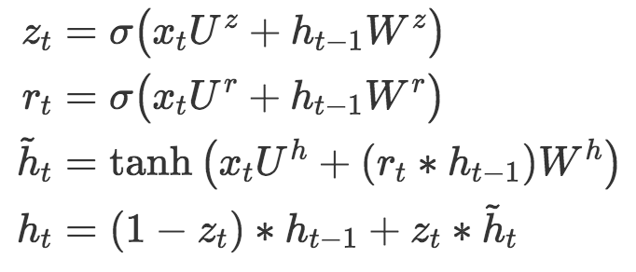
Purpose - Background
GRU - Gated Recurrent Unit
Reset gate
Update gate
reset gate
Update gate
State candidate
Current State

Slide 4
Purpose - Background
Tk
T1
T0
Target_sequence
Decoder
Dk
D1
D0
…...
Initial_state
C
Encoder
context vector
E0
E1
En-1
En
…...
S0
S1
Sn-1
Sn
Source_sequence

Slide 5


Purpose - Limitation
Decoder
Same weight for each target sentence
Initial_state
C
Encoder
context vector
Encode each source sentence into a fix-length context vector
Notes:
ht is hidden state at time t
c is context vector generated from the sequence of the hidden states
f and q are some nonlinear function
如果以上一次的seq2seq版本，c就是最後一個timestamps所產生的context vector
在decoder部分，yt的概率是基於前面的y1~yt-1還有c context vector
條件概率可以寫成g(yt-1,st,c), yt-1是上一個timestamp的output, st是t時間點的hidden_state

Slide 6







Purpose - Limitation
St
St-1
S2
S1
…...
C

Slide 7

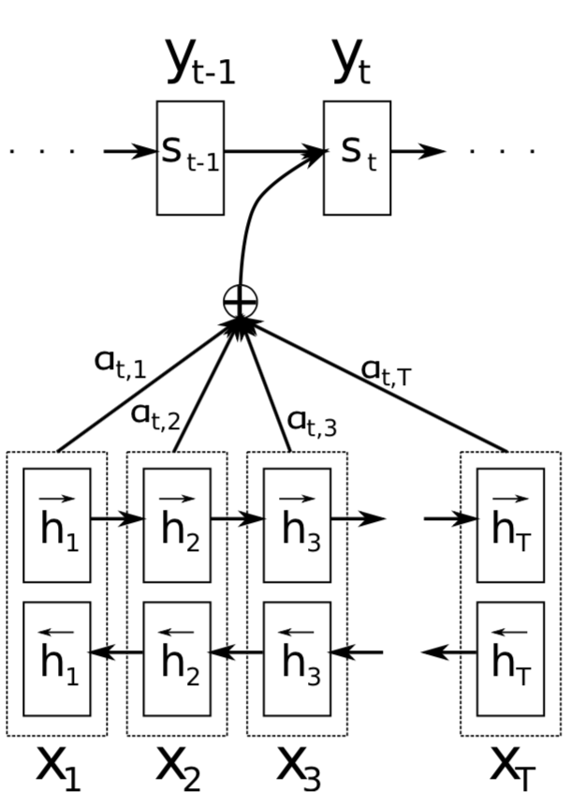



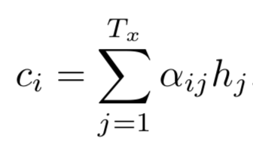
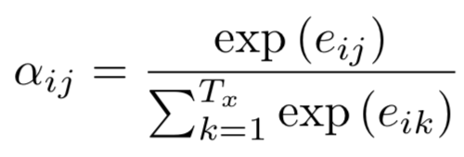
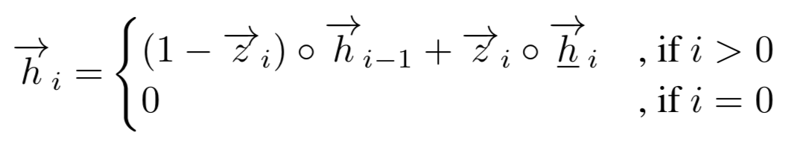



Attention - Overall
Decoder
Alignment
Model
1.
3.
2.
Encoder
：State candidate
：Update gate
：Current state

Slide 8


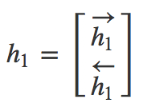
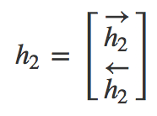
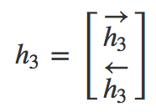
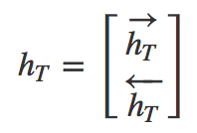


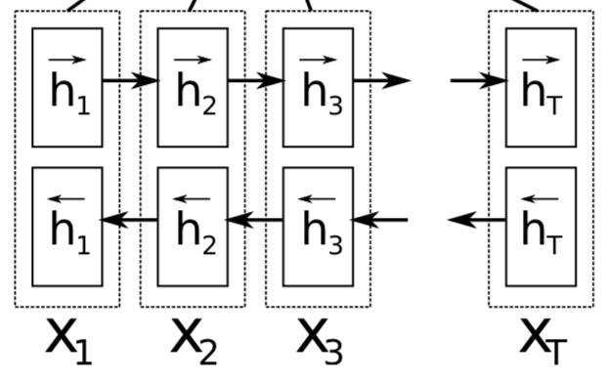


Overall - Encoder - 1
Bi-directional GRU (Forward)
：Element-wise Multiplication
Forward
Backward

Slide 9

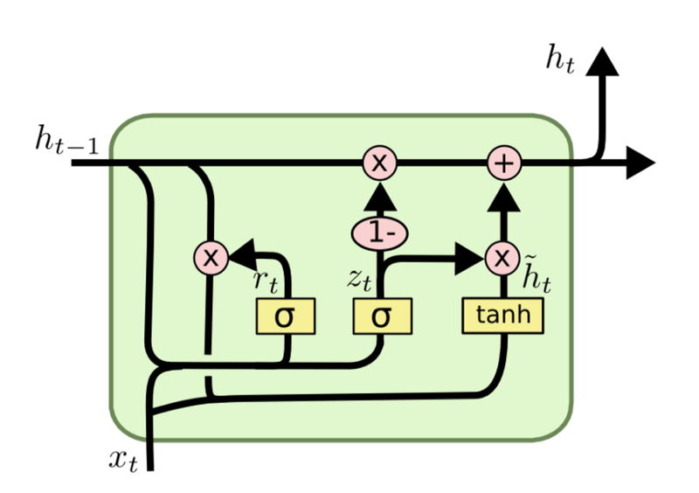


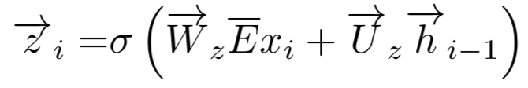
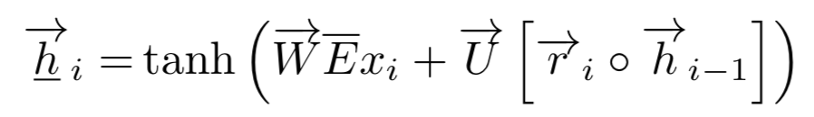
Overall - Encoder - 2
：Update gate
：Reset gate
：Sigmoid
：State candidate
GRU
：Word Embedding matrix
Weight sharing

Slide 10

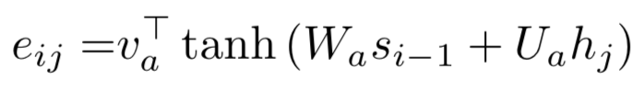


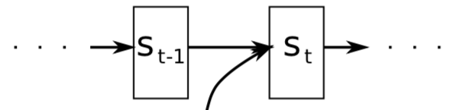









Overall - Alignment Model - 1
1.
Soft-Alignment
How Match between 1-th source word and t-th target word

Slide 11







Overall - Alignment Model - 2
3.
Regard as weigth for each h
2.
：Dot product

Slide 12



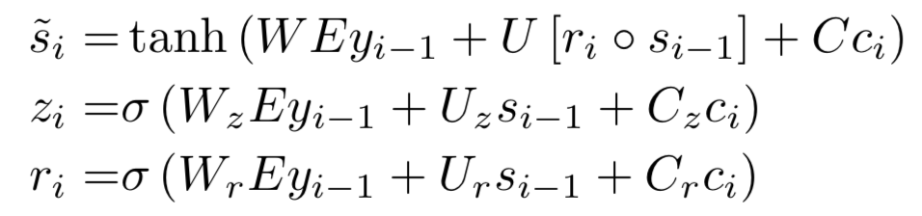



Overall - Alignment Model - 3
Output layer can be freely define
Be a little different from GRU

Slide 13
Datasets
English - French translation
Source：ACL WMT’ 14
Association for Computational Linguistics
Workshop on Statistical Machine Translation 2014
Europarl (61M)
News commentary (5.5M)
Train
850M words
348M
UN corpus (421M)
Two crawled corpora (90M, 272.5M)
news-test-2012
Valid
news-test-2013
Test
news-test-2014
which consists of 3003 sentences not present in the training data
http://www.statmt.org/wmt14/translation-task.html

Slide 14
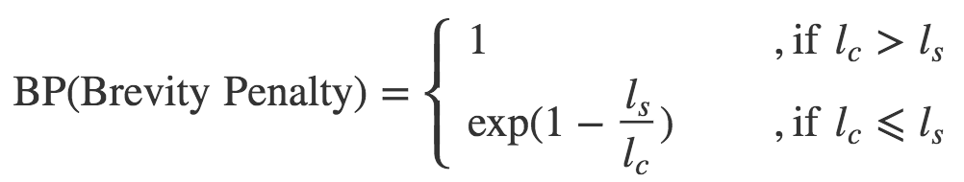
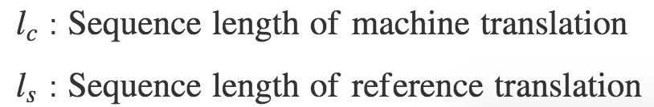


BLEU (Bilingual Evaluation Understudy)
Calculate Similarity between two sequence by n-gram

Slide 15







BLEU (Bilingual Evaluation Understudy)
Calculate Similarity between two sequence by n-gram
Machine： Going to play basketball this afternoon?
Reference： Going to play basketball in the afternoon?
：How many words as same as machine translation
Machine：
Going to
to play
play basketball
basketball this
this afternoon
afternoon ?

Slide 16
BLEU (Bilingual Evaluation Understudy)
Calculate Similarity between two sequence by n-gram
Notes:
BP衡量兩個句子的長度，若機器翻譯比參考答案長度還要小的話，就小於0

Slide 17
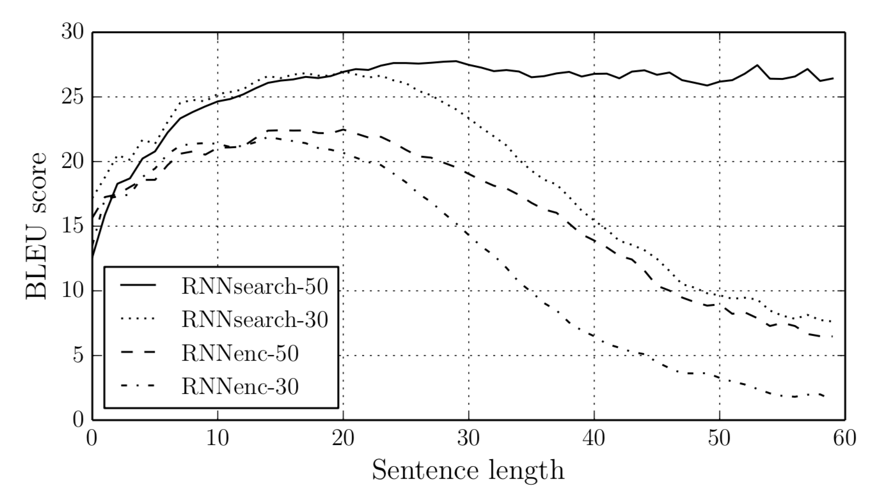
Comparison
Sentence of length up to 30 words (RNNencdec-30, RNNsearch-30)
Sentence of length up to 50 words (RNNencdec-50, RNNsearch-50)
Training：
Testing：
On the full test set which includes sentences having unknow words

Slide 18
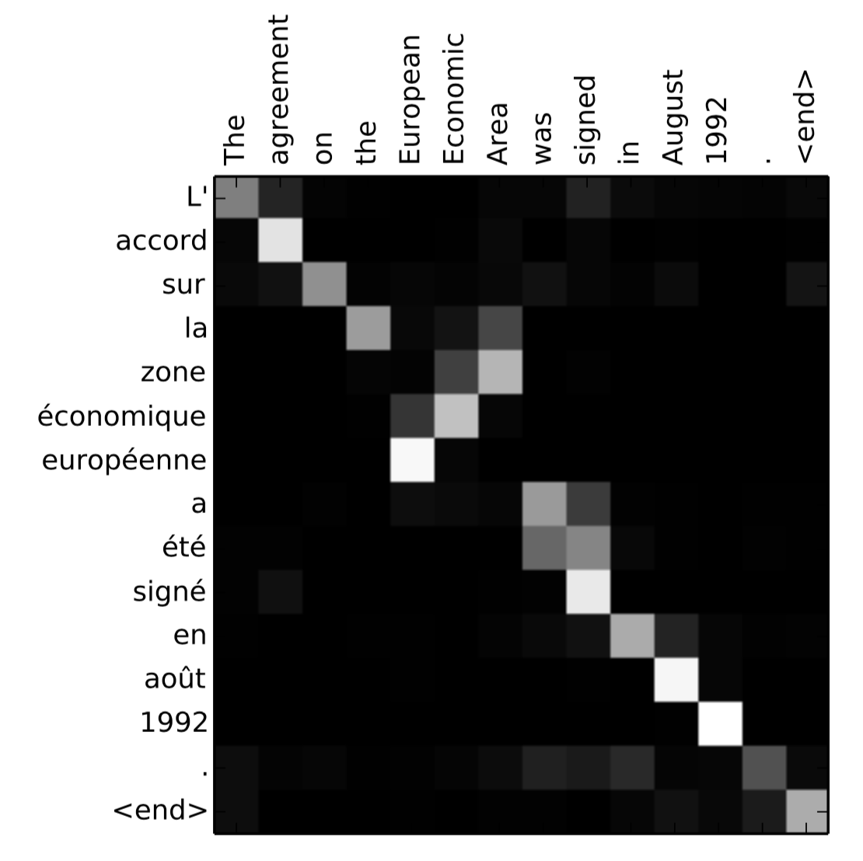
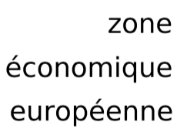
Performance on RNNsearch-50
Cond：Arbitary sentence on test set
Includes sentences having unknown words
French
English
European
Economic
Area

Slide 19
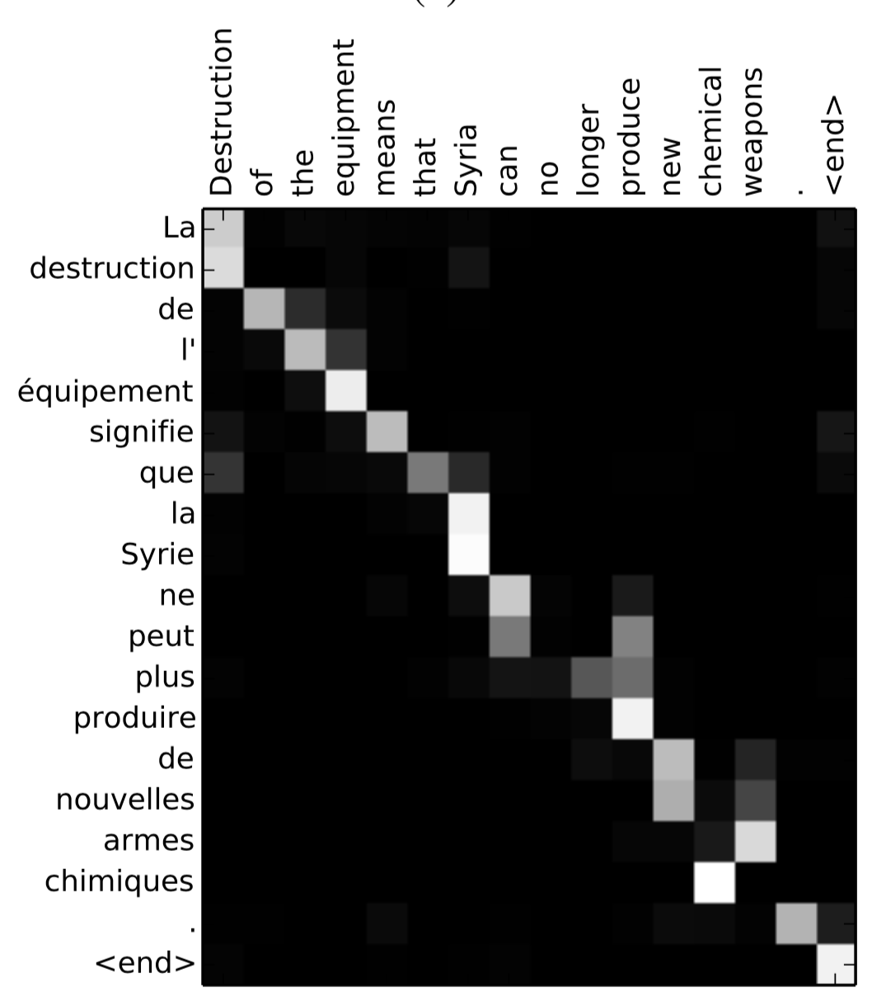

Performance on RNNsearch-50
Cond：
Without any unknown words and of length between 10 and 20 words from the test set
French
English
armes
chemical
chimiques
weapons
Destruction

Slide 20
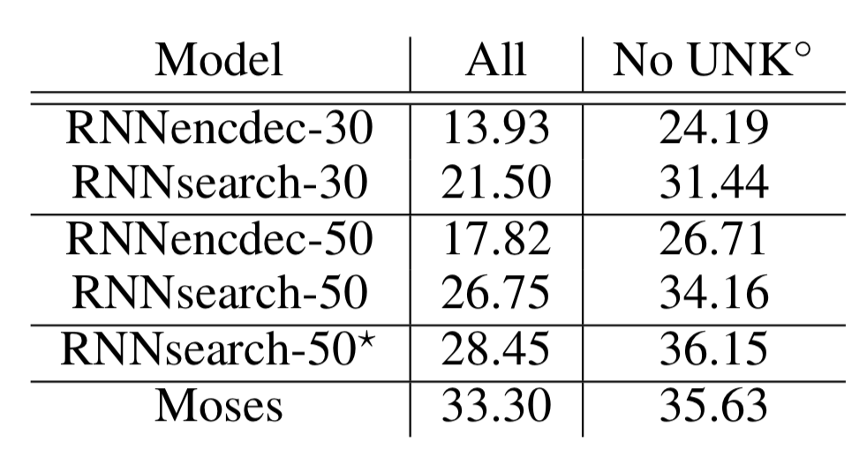
Performance
BLEU scores of the models computed on the test set
All：All the test set
No UNK：Without any unknown words on test set
RNNsearch-50*：Train longer until the performance on the valid stopped improving
Moses：http://www.statmt.org/moses/?n=Moses.Overview
Notes:
Moses是基於統計方法

Slide 21
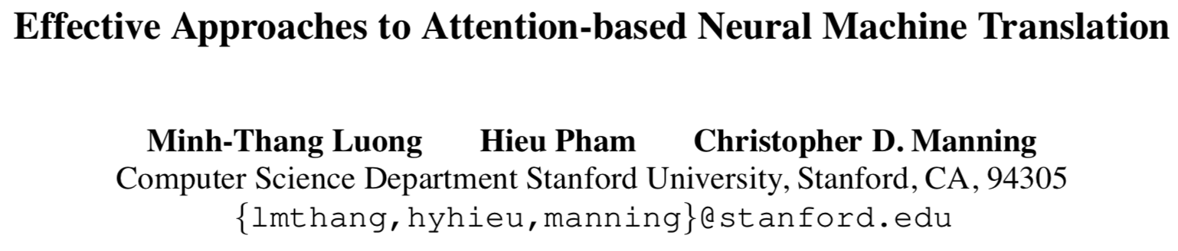
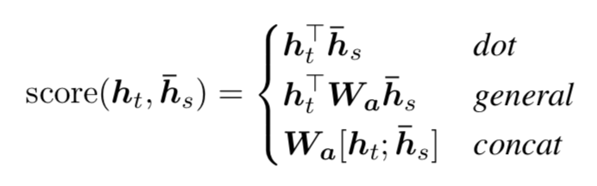
Next...
New alignment model

