Slide 1
CANSAT 2022-23 Critical Design Review (CDR)
Team ID:2022ASI-002 AstroPeep

Slide 2
Index
Serial No. | Contents
1 | System Overview
2 | Requirements Compliance
3 | Electric systems Design and Analysis (power, communication, data handling
4 | Budget
5 | Flight Software (FSW) Design
6 | Ground Control System (GCS) Design
7 | Mission Operations & Analysis
8 | CANSAT Location and Recovery
9 | CANSAT Integration and Test results
10 | Conclusions

Slide 3
Sponsorship for CANSAT
We as Team AstroPeep have received the sponsorship from different organization and institutions, in form of money and in the form of goods.
List of sponsors are as mentioned below:
Institute of Infrastructure Technology Research and Management, Ahmedabad
Centre of Advanced Defense Technologies, IITRAM, Ahmedabad
Indian Studytech Services Pvt. Ltd., Dholpur, Rajasthan
RudraBots Pvt. Ltd., Ahmedabad

Slide 4
Team Description
FACULTY ADVISOR
Dr. Abhishek Rawat
MENTOR
Dr. Jagat Joyti Rath
MENTOR
Dhaval Joshi
Communication and Data handling
Purvang Mistry
Purvang Mistry
Akash Payghan
Ashotosh Jha
Software
Ashutosh Jha
Electronics
Akash Payghan
Victor Azad
Somesh Swami
Mechanical Analysis
Rishabh Raushan
Anuj Jha
TEAM LEADER
Victor Azad
Mechanical Design
Sagar Parihar
Victor Azad
Somesh Swami
Victor Azad
Ashutosh Jha

Slide 5
List of Acronyms
Acronyms | Meaning
3D | 3-Dimensional
A | Analysis
cm | Centimeter
D | Demonstration
dB | Decibel
EPS | Electrical power Subsystem
FRR | Flight Readiness Review
FSW | Flight Software
GCS | Ground Control System
gm | Gram
GPS | Global Positioning System
Acronyms | Meaning
GUI | Graphical User Interface
Hz | Hertz
I | Inspection
I2C | Inter-Integrated Circuit
IC | Integrated Circuits
LED | Light Emitting Diode
PC | Personal Computer
QHA | Quasi Harmonic Function
RTC | Real Time Clock
T | Test
VM | Verification Method
Acronyms | Meaning
GHz | Giga Hertz
s | Second
csv | Comma separated values
hrs | Hours
PCB | Printed Circuit Board
mAh | Milli ampere hour
m | Meter
V | Volts
FSS | Flight Software State

Slide 6
System Overview

Slide 7
MISSION SUMMARY
Innovative Mechanical Gyro-control system that shall demonstrate the descent control of the CANSAT.
CANSAT descent control system that shall open at an altitude of 500 m.
CANSATs will be launched to an altitude of 800.0 m to 900.0 m from the ground level and above the launch site & deployed near the peak altitude. During the ejection from the rocket orientation of the CANSAT is not controlled. The CANSAT must remain intact during the course of the entire mission and send the data to the ground station through a telemetry link.

Slide 8



Connection between the CANSAT and the Ground Station is stablished
Altimeter sensor defines an altitude reference.
GNSS stablishes a valid connection with satellites (3 at least).
CANSAT stablishes a framework with gyroscope and accelerometer in order to calculate tilt.
CANSAT recognizes a valid SD card and stores the data backup.
Once the CANSAT reaches an altitude of 500[m], the first parachute is detached from the container and the second parachute gets deployed.
CANSAT checks constantly, the absolute altitude change.
Once the CANSAT is released from launching vehicle the First parachute itself deploys
Once the CANSAT reaches the ground, the transmission will be stopped.
Payload checks constantly the altitude change
Audio beacon will be powered on.
CANSAT will be recovered and the telemetry will be verified further.
LANDING
FLIGHT
GROUND OPERATION

Slide 9
Requirement Compliance

Slide 10
Sr.no. | Requirement | Priority | Fulfillment | VM
 |  |  |  | A | I | T | D
1 | Total mass of the CANSAT shall be under 0.700 kg (+/- 0.050 kg) | High | Mass of Cansat is within limits. | x |  |  | X
2 | CANSAT shall fit in a cylindrical body of 0.125 m diameter x 0.310 m height. Tolerances are to be included to facilitate container deployment from the rocket fairing. | High | Cansat is designed with appropriate dimensions. | X |  |  | X
3 | Any sharp edges on the container body shall be avoided as it can cause interfere during the CANSAT ejection from the rocket. | High | No sharp Edges are present. | X |  |  | X
4 | Color of the CANSAT body shall be fluorescent i.e., pink, red or orange, and shall embody the Indian flag. | High | Color will be fluorescent and will embody Indian Flag. |  |  |  | X
5 | The CANSAT shall consist of necessary sensors to provide the following mandatory Real-time datasets: Position data, altitude, pressure, temperature, orientation data, power data & system status. | High | Cansat has necessary sensors required for measuring mandatory data. | X |  |  | x

Slide 11
Sr no. | Requirements | Priority | Fulfillment | VM
 |  |  |  | A | I | T | D
6 | Each data field shall be displayed in real-time on the ground station user interface/software. | High | GUI will be developed for displaying Data.
7 | CANSAT shall also record the data and save it into an onboard SD card in case of telemetry connection loss. | High | The data shall be recorded in SD Card.
8 | All electronics shall be enclosed and shielded from the environment. No electronics can be exposed except for sensors. There must be a structural enclosure. | High | No Electronics is exposed. | x |  |  | X
9 | CANSAT structure shall be built to survive 15 Gs of launch acceleration & 30 Gs of shock. | High | CANSAT will survive required shock. |  |  |  | X
10 | The CANSAT shall have an external power switch with an indicator light or sound for being turned on or off, in order to avoid the de-assembling of CANSATs on the launch pad. | High | CANSAT has an external power switch. | x |  |  | X
11 | The CANSAT shall contain a total of 2 descent control mechanisms, to be used at different stages while descent. | High | has 2-descent control mechanism. |  |  |  | x
12 | CANSAT shall immediately deploy the first parachute after ejection from the rocket. | High | 1st parachute will be immediately deployed after ejection. |  |  |  | x

Slide 12
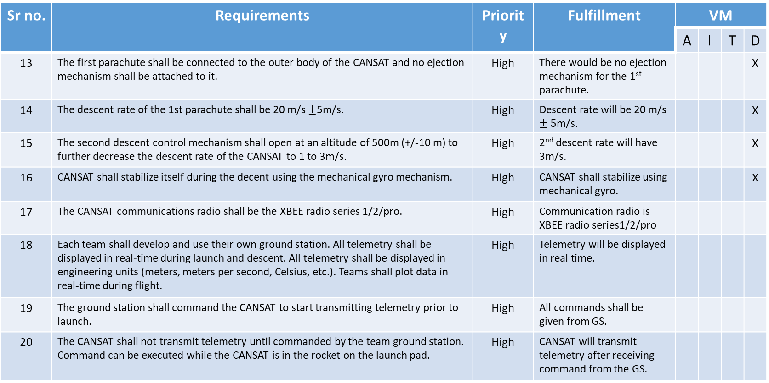
Sr no. | Requirements | Priority | Fulfillment | VM
 |  |  |  | A | I | T | D
13 | The first parachute shall be connected to the outer body of the CANSAT and no ejection mechanism shall be attached to it. | High | There would be no ejection mechanism for the 1st parachute. |  |  |  | X
14 | The descent rate of the 1st parachute shall be 20 m/s $±$5m/s. | High | Descent rate will be 20 m/s $±5$m/s. |  |  |  | X
15 | The second descent control mechanism shall open at an altitude of 500m (+/-10 m) to further decrease the descent rate of the CANSAT to 1 to 3m/s. | High | 2nd descent rate will have 3m/s. |  |  |  | X
16 | CANSAT shall stabilize itself during the decent using the mechanical gyro mechanism. | High | CANSAT shall stabilize using mechanical gyro. |  |  |  | X
17 | The CANSAT communications radio shall be the XBEE radio series 1/2/pro. | High | Communication radio is XBEE radio series1/2/pro
18 | Each team shall develop and use their own ground station. All telemetry shall be displayed in real-time during launch and descent. All telemetry shall be displayed in engineering units (meters, meters per second, Celsius, etc.). Teams shall plot data in real-time during flight. | High | Telemetry will be displayed in real time.
19 | The ground station shall command the CANSAT to start transmitting telemetry prior to launch. | High | All commands shall be given from GS.
20 | The CANSAT shall not transmit telemetry until commanded by the team ground station. Command can be executed while the CANSAT is in the rocket on the launch pad. | High | CANSAT will transmit telemetry after receiving command from the GS.

Slide 13
Sr no. | Requirements | Priority | Fulfillment | VM
 |  |  |  | A | I | T | D
21 | The ground station shall generate .csv files of all sensor data as specified in the Telemetry Requirements section. | High | GS shall display .csv files.
22 | Telemetry shall include mission time with one second or better resolution. | High | Telemetry shall have appropriate resolution.
23 | Mission time/timestamp and system status states shall not be affected in the event of a processor reset during the launch and mission. | High | Will not be affected during launch
24 | The ground station shall include one laptop computer with a minimum of two hours of battery operation, XBEE radio and a hand-held antenna. | High | Has required items |  |  |  | X
25 | The flight software shall maintain and telemeter an indicator of the CANSAT flight software state. An example set of states is 0 (BOOT), 1 (TEST_MODE), 2 (LAUNCH_PAD), 3 (ASCENT), 4 (ROCKET_DEPLOY), 5 (DESCENT), 6 (AEROBREAK_RELEASE), and 7 (IMPACT). | High | FSW shall maintain FSS. |  |  |  | X
26 | Upon powering up, the CANSAT shall collect the required telemetry at a 1 Hz sample rate or more. The telemetry data shall be transmitted with ASCII comma-separated fields followed by a carriage return. | High | Telemetry data will be transmitted as specified.

Slide 14
Cost

Slide 15
Cost
Mechanical Design Manufacturing:
Component Number | Component Name | Description | Procurement Type | Quantity | Price per unit (in Rupees) | Total Cost (in Rupees)
001 | Aluminium 7075 sheets | - | Purchase off-the- shelf | 10 | 400 | 4000
002 | PC/ABS Printing filament roll | For 3-d printing our models | Purchase off-the- shelf | 1 | 3300 | 3300
003 | Mechanical Gyroscope | - | Manufactured to project specifications | 1 | 1500 | 1500
004 | Dampers and foam | - | Purchase off-the- shelf | - | - | 2000
005 | Shackles | - | Manufactured to project specifications | 2 | 300 | 600
006 | Carbon Fibre Tube (hollow) | - | Purchase off-the- shelf | 4 | 1000 | 4000
007 | Carbon Fibre Sheets | - | Purchase off-the- shelf | 4 | 5841 | 23364
008 | Servo motors | - | Purchase off-the- shelf | 4 | 250 | 1000
 |  |  |  |  | Total | 39764

Slide 16
Parachute Manufacturing:
Component Number | Component Name | Description | Procurement Type | Quantity | Price per unit (in Rupees) | Total Cost (in Rupees)
009 | Ripstop nylon fabric | - | Purchase off-the-shelf | - | 1200 | 1200
010 | Pogo pins | Spring loaded pins | Purchase off-the-shelf | 6 | 30 | 180
011 | Screws, Rivets, washers, nuts | - | Purchase off-the- shelf | - | - | 800
012 | Parachute Cords | - | Purchase off-the-shelf | - | - | 400
013 | Sewing nylon thread | - | Purchase off-the-shelf | 1 | 300 | 300
014 | Machining Cost | For operations like spot cloth Welding | As per project specifications | - | - | 2500
 |  |  |  |  | Total | 5,380

Slide 17
Electronics Components:
Component Number | Component Name | Description | Procurement Type | Quantity | Price per unit (in Rupees) | Total Cost (in Rupees)
015 | BMP280 | Pressure Sensor | Purchase off-the- shelf | 1 | 200 | 200
016 | Sandisk Ultra | Memory card | Purchase off-the- shelf | 1 | 600 | 600
017 | MPU6050 | Acc. and gyro sensor | Purchase off-the- shelf | 1 | 180 | 180
018 | XBEE pro s2c | Wireless communication | Purchase off-the- shelf | 2 | 2500 | 5000
019 | STM32F103 | CPU | Purchase off-the- shelf | 1 | 1800 | 1800
020 | Voltage Sensor | - | Purchase off-the- shelf | 1 | 50 | 50
021 | Tenergy 9v 600mAh | Batteries | Purchase off-the- shelf | 2 | 900 | 1800

Slide 18
Electronic Components
022 | Buzzer | - | Purchase off-the- shelf | 1 | 300 | 300
023 | PCBs | 3 different pcbs | Manufactured to project specifications | - | - | 2000
024 | Microstrip Antenna | To be planted in CANSAT | Manufactured to project specifications | 1 | 500 | 500
025 | Ground Station Antenna | - | Purchase off-the- shelf | 1 | 200 | 200
026 | Wiring | - | Purchase off-the- shelf | - | - | 100
027 | GNSS or GPS module | - | Purchase off-the- shelf | 1 | 300 | 300
028 | Voltage regulator | - | Purchase off-the- shelf | 1 | 100 | 100
029 | Real time clock | - | Purchase off-the- shelf | 1 | 300 | 300
030 | ESP32-CAM wifi module | Camera | Purchase off-the- shelf | 1 | 1000 | 1000
 |  |  |  |  | Total | 14,430

Slide 19
Promotional T-Shirts with Logo:
Component Number | Component Name | Description | Procurement Type | Quantity | Price per unit (in Rupees) | Total Cost (in Rupees)
031 | t-shirts | With promotional logo of our sponsor | Manufactured to project specifications | 11 | 600 | 6,600
Total Amount of Funding Required = ₹ 86,174

Slide 20
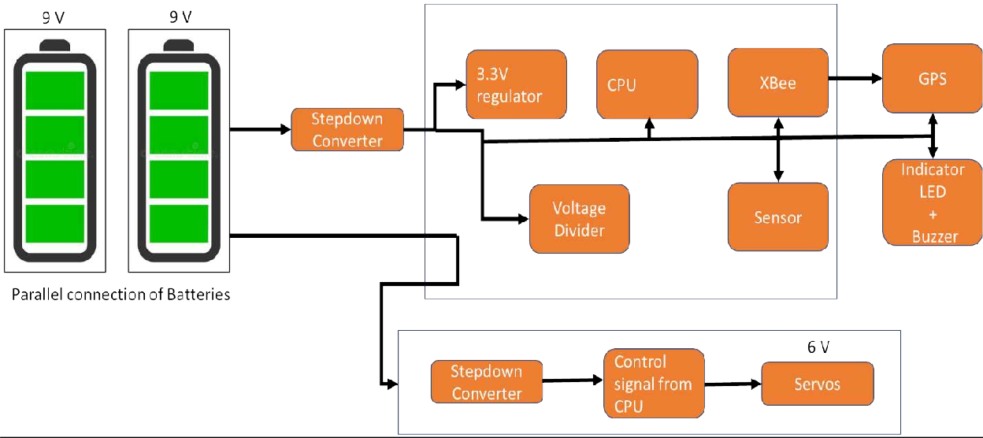
ELECTRICAL POWER SUBSYSTEM
There are only some minor changes in Electrical power subsystem as mentioned below :
The battery configuration is changed from series to parallel which made the step down process more efficient.
The position of switch is also modified from bottom to panel side of CANSAT.
Electrical Block Diagram
Fig. Electrical Power Subsystem Block Diagram

Slide 21
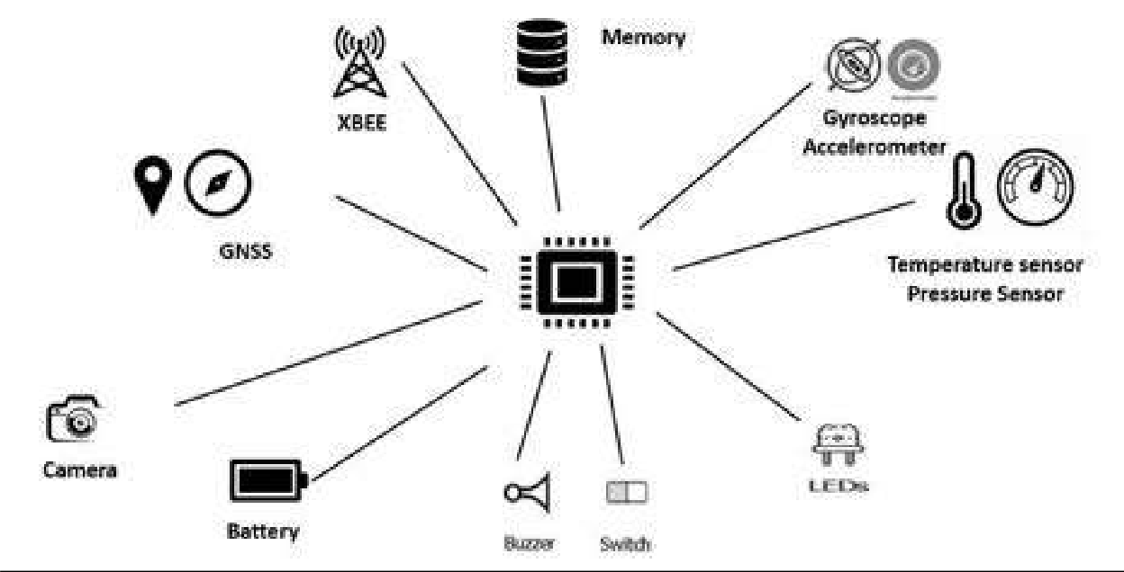
COMMUNICATION AND DATA HANDLING SUBSYSTEM DESIGN
Fig. Communication and Data Handling Overview

Slide 22
MECHANICAL SUB-SYSTEM

Slide 23
Innovative Materials Selection:
Material Proposed as in PDR:
As in Preliminary Design Report (PDR) of our CANSAT had:
Serial No. | Component | Previous Material | Modified material
1. | Outer Body Panels | ABS Polycarbonate Sheets | ABS Polycarbonate Sheets
2. | Vertical Rods | 2024 T3 Al Alloy | CFRP Z-100
3. | Horizontal Bases | 2024 T3 Al Alloy | CFRP Z-100
4. | Circular Support Rings | -- | CFRP Z-100
5. | Top Lid | Polyethene Film | Polyethene Film
6. | Parachute & Chords | Ripstop Nylon | Ripstop Nylon

Slide 24
Reason to Change Materials:
The change in the material of the structure including the Vertical Rods, Horizontal bases and the circular ring support were previously proposed as to be made up of 2024 T3 Al Alloy which is replaced by Carbon Fiber Reinforced Plastic (CFRP) because of the following reasons:
Stress-Strain Curve: Lower yield point of the Aluminium in general which would have led to the increase in the deformation as compared to that of the CFRP. Also the ductility as a property in not needed for our use.
Availability: Market availability of the Aluminium and it’s alloy is very rare due to the import and export restrictions and also due to the scarcity in the global market and so is not the case with the CFRP Z-100 as the spools, sheets, rods, and plates all are available in the local market.
Economics: The cost of Aluminum is too high and cannot fit in the budget constrain of CANSAT whereas cost of CFRP is relatively lower than 2024 T3 Al Alloy.
Material Acquisition:
Material for prototype testing was received in early January 2023 but it was sample piece used to validate our own mathematical model as computed.
Material to be used in the fabrication of the main structure have been ordered and are in process.
We have received all our electronical components as ordered for the testing and analysis purposes.

Slide 25
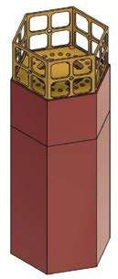
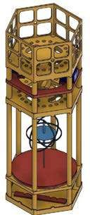
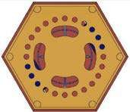
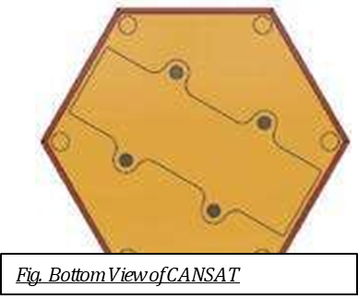
PHYSICAL LAYOUT:
Fig. Top View of CANSAT
Fig. Home View For CANSAT
Fig. Home View of CANSAT without body panels
Fig. Bottom View of CANSAT

Slide 26
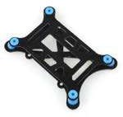


DAMPING
To deal with the vibration and shock due to thrust of launching vehicle. We have planned of adding up foam and carbon fiber shock dampers to the PCB plates, servo housing, battery setup, camera module and buzzer module.
All the components are a vital part of the CANSAT and for the proper data acquisition all of the components has to be damped against vibration.
Types of Damping Used:
Shock Absorber for the PCB and Battery plates:
Shock Absorbing Foam Padding being used for servo motors used for ejection mechanism and gyroscope control
Rubber Shock Absorber are being used for the screws which are being used to mount the Outer Body Panel on the CANSAT Frame:

Slide 27
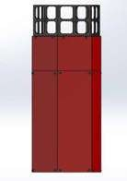
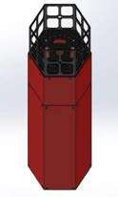


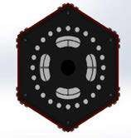
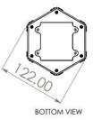
SYSTEM CONFIGURATION CONCEPTS:
Selected Design Concept of PDR:
As proposed in the Preliminary Design Review (PDR) round held in the September 2022. We have the following design concept proposed:
Fig. Concept 1 Design Dimensions

Slide 28
All the below mentioned results were analyzed to simulate the
Total Deformation: This is to check deformation along the yaw, pitch & roll caused due to the axial loadings.
Equivalent stress: According to the Von-mises Theory, the Equivalent Stress or Von-mises Stress, is most used criteria for checking yield conditions for any structure.
Stress Intensity: This is to check the magnitude of the stress generated in a particular component in the CANSAT.
Shear Stress: It is the stress generated at the edge of the structure of CANSAT parallel to the vertical axis i.e. the roll axis of the CANSAT.

Slide 29
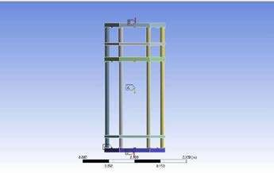
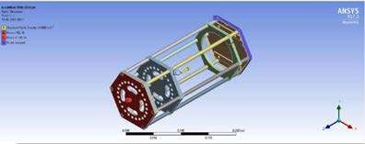
CANSAT PDR Proposed Design
Fig. Structure considered for the analysis.

Slide 30
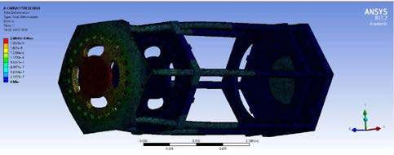
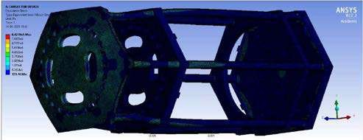
For the same meshed structure, the solution goes as follows:
1. Total Deformation:
2. Equivalent Stress:

Slide 31
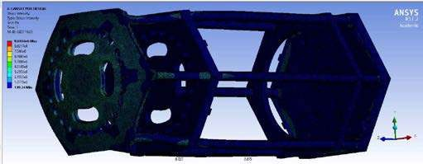
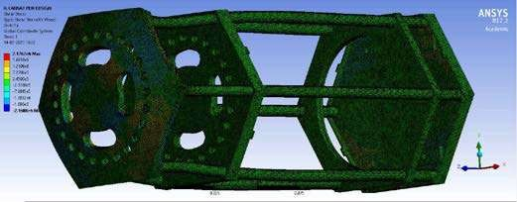
3. Stress Intensity:
4. Shear Stress:

Slide 32
Observation:
Looking to the simulation results achieved and as discussed about the change in the material, we have found out that the structure fails if constructed out of normal Carbon Fiber spool with this amount of loading.
Conclusion:
To avoid any such failure during the launch or ascent we then decided to go with the Carbon Fiber Reinforced Polymer. And adding up a extra horizontal support to the structure and replacing the hollow hexagonal faced pipes with the solid circular faced rods.
Solution Derived:
For the same three different design versions were prepared and analyzed. The changes to the CANSAT were as follows:
Increasing the Diameter of the Vertical Rods
Adding Up a circular ring to the compartment deforming
Increased Diameter of rods with a circular ring added to the deforming compartment.
Out of all these the 3rd design alteration gave us the best possible results which is as follows:

Slide 33
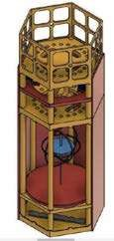
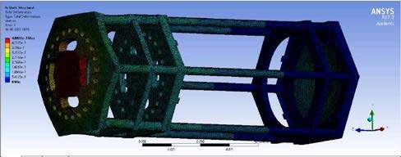
CANSAT Improved Design & Analysis:
The design proposed after the alteration is as follows:
The solution to the analysis with the same constraint as of the previous one is as follows:
1. Total Deformation: (Negligible Distortion was observed)
Fig. No/ Negligible Deformation Observed

Slide 34

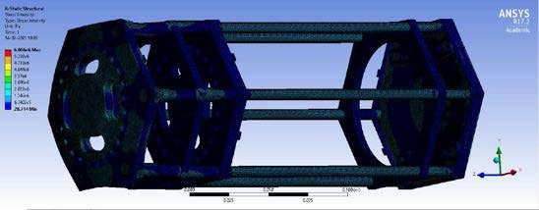
2. Equivalent Stress:
3. Stress Intensity:
Fig. Reduction In the Equivalent(Von-Mises) Stress of the CANSAT
Fig. Reduction in the Stress Intensity generated in the components.

Slide 35
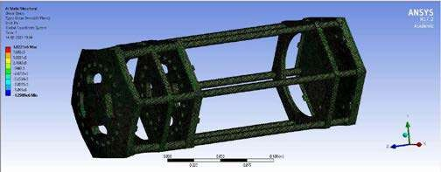
4. Shear Stress:
Conclusion:
Looking to the results observed we hereby consider this particular design of structure of CANSAT to be the best fitted for our purpose.
Fig. Decrement in the Shear Stresses around the CANSAT

Slide 36










Changes in Mechanical Design Dimensions
Changes Made | Previous Dimensions | Previous | New Dimensions | New
Increased Rod Diameter in Battery and Gyro Compartment | 5 mm |  | 7 mm
Increased thickness of Base Plate and Parachute2 Base Plate | 2 mm |  | 5 mm
Increased Parachute1 Base Plate thickness | 2 mm |  | 7 mm
Added a support Plate to increase strength in Parachute 2 Container | 0 mm |  | 5 mm
Added a hook to grab parachute | - |  | -

Slide 37

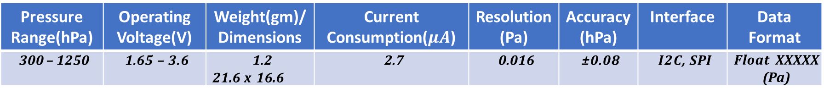
Payload Air Pressure Sensor Summary (1 of 2)
Sensor-Adafruit BMP 280
Pressure Range(hPa) | Operating Voltage(V) | Weight(gm)/Dimensions | Current Consumption($μA$) | Resolution(Pa) | Accuracy(hPa) | Interface | Data Format
300 – 1250 | 1.65 – 3.6 | 1.2 21.6 x 16.6 | 2.7 | 0.016 | ±0.08 | I2C, SPI | Float XXXXX (Pa)
Altitude above sea level can be calculated from Barometric Equation below. However, output from sensor is very noisy so that a Kalman filter will be used to estimate the pressure value
Barometric Equation

Slide 38
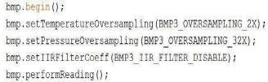
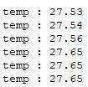
Payload Air Pressure Sensor Summary (2 of 2)
Temperature data will be collected and processed with the help of
Sensor |  |  |  | Adafruit BMP 280
Temperature Range (°C) | Operating Voltage (V) | Weight (g) / Dimension (mm) | Current Consumption (uA) |  | Resolution (Pa) | Accuracy (hPa) | Interface | Data Format
0 – 65 | 1.65 – 3.6 | 1.2 21.6 x 16.6 | 2,7 |  | 0.016 | ±0.08 | I2C, SPI | Float XX.XX (C)
Data Processing
Sample Output

Slide 39
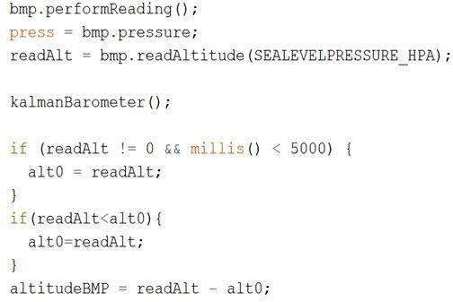
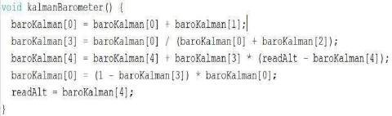
Data Processing
Kalman Filter

Slide 40
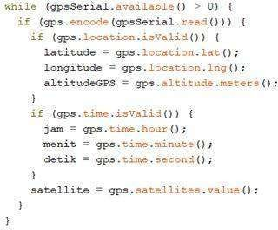
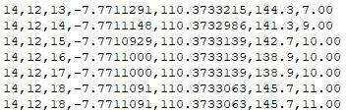
GPS Sensor Summary
Sensor |  |  |  | GPS Beitian BN 220
Tracking Sensitivity (dBm) | Operating Voltage (V) | Weight (g) / Size (mm) | Current Consumption (mA) | Channel | Accuracy (m) | Interface | Update Rate (Hz) | Data Format
-165 | 4-6 | 7 20 x20 x10 | 29 | 72 | ~2.5 | UART | 18 | Float and Integer
Longitude, latitude, and the other data will be collected and processed with the help of Tiny GPS Plus library by Mikal Hart. This sensor can lock onto GPS satellite quickly.
Data Processing
Sample Output
Source:
https://github.com/mikalhart/TinyGPSPlus/blob/master/src/TinyGPS%2B%2B.h
Left to right:
Hour, minute, second, latitude, longitude, altitude, satellite

Slide 41
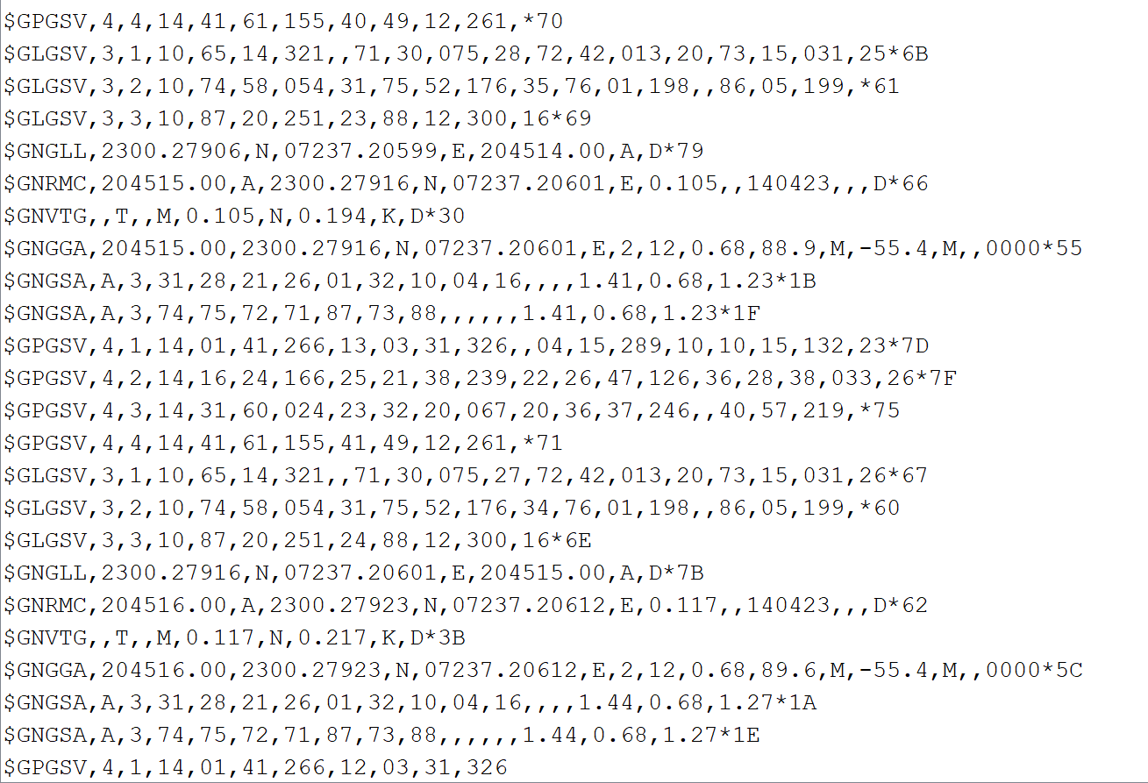
GPS Sensor Summary

Slide 42
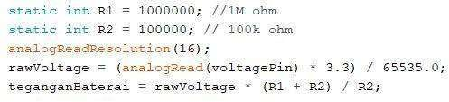
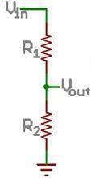
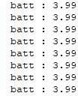
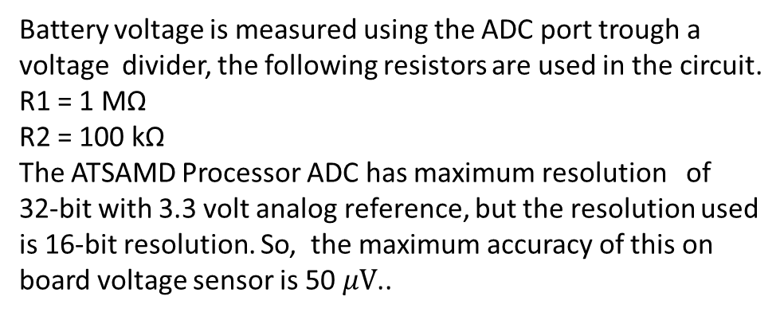
Payload Voltage Sensor Summary
Name | Range (V) | Error rate (%) | Interface | Data Format
Processor Analog Pin (Voltage Divider) | 0 - 5 | 0.03 | ADC | Float X.XX (Volt)
Data Processing
Battery voltage is measured using the ADC port trough a voltage divider, the following resistors are used in the circuit.
R1 = 1 MΩ
R2 = 100 kΩ
The ATSAMD Processor ADC has maximum resolution of 32-bit with 3.3 volt analog reference, but the resolution used is 16-bit resolution. So, the maximum accuracy of this on board voltage sensor is 50 $μV$..
Sample Output

Slide 43
Gyroscope Sensor :
Sensor | Range (°/s) | Resolution (bit) | Accuracy (°/s) | Data Interface | Operating Voltage (V) | Cost (Rs.) | Dimension (mm) | Weight (gm)
MPU6050 | ±250 | 16 | 1.9 | I2C/IIC | 3-5 | 120 | 4 X 4 X 0.9 | 3
Reason for selecting MPU6050 :
Light weight, small size and Low Cost.
Using same sensor for acceleration and orientation measurement will reduce the cost and weight of Cansat.

Slide 44
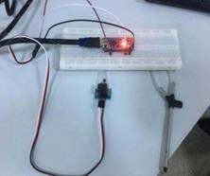
SENSORS TESTING PROCEDURE & SUMMARY
Each of the sensors was tested on the breadboard with the use of the required software and the microcontroller. The accuracy of the data obtained from each sensor was checked.
Then the sensor tests were carried out in a combined manner.
CDH
The communication between the microcontroller and the sensors was tested.
The communication between the receiver and transmitter XBee were tested using the XCTU Software for the competition distance requirements (600-800 meters).
The gain test of the antenna was tested using the XCTU Software.
The data transmission altitude requirement (750 meters) in competition will be tested via drone. Then, the data transmission speed and the accuracy of the data sent to the ground station will be checked.
EPS
Prototype circuit was installed on the perforated plate and breadboard. It was checked if it works with the required power supply.
The total current of the system was measured. Calculated and measured values were compared. The melt of fishline circuit was installed and the break time of the melt was measured.
The MOSFET used in circuit was triggered with 3.3V to check its operation. It will be checked whether there is a short circuit on the PCB.

Slide 45
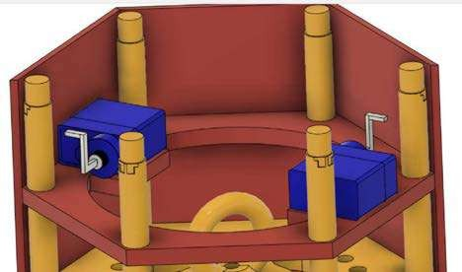
Actuator Design
As proposed in the previous design concept of PDR we were having a setup of Pogo Pins to release the Parachute 2 after achieving a height of 500m. But due to guidelines and mission requirements prohibiting the usage of spring in the CANSAT, we decided to find a substitute parachute deployment system.
After further consideration we are using the following configuration, pair of servo motors and actuators system.
Fig. Placement and Alignmentof Servo Motors Acting as the driving element of Actuator Design of Ejection Mechanism

Slide 46
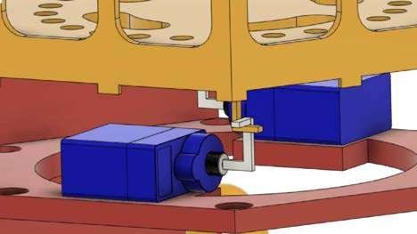
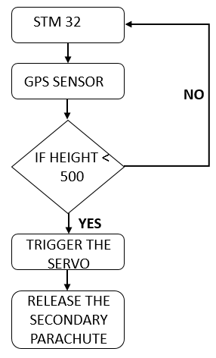
Fig2. Servo-actuator is holding the parachute 1 base plate until reaching 500m.
GPS sensor controlled by STM32 will detect the position of our CANSAT from ground. When the height of our CANSAT goes below 500m, it triggers our servo motors and thus unlocked the upper chamber of our CANSAT, releasing the secondary parachute.
Block diagram for working of actuator system for parachute deployment

Slide 47
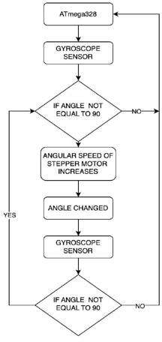
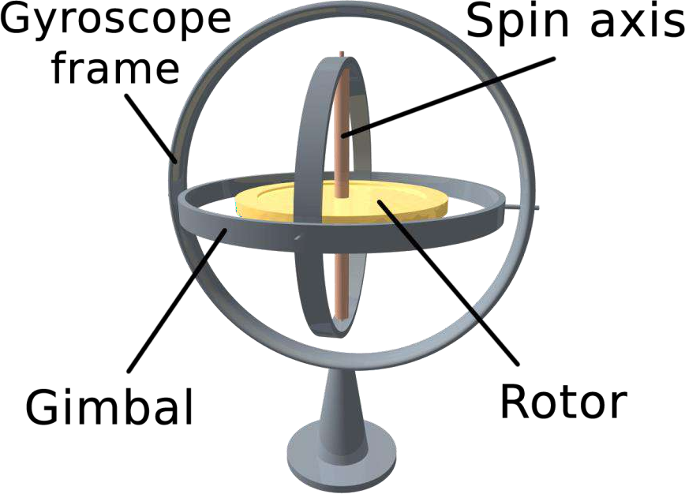
CONTROL MECHANISM OF GYROSCOPE
STM 32
With the help of STM-32, gyroscope sensor detect the orientation of our CANSAT. If the angle detected by gyroscopic sensor is not equal to 90° i.e., our CANSAT is not perfectly straight then the angular speed of stepper motor attached to our gyroscope increases and thus our gyroscope applied force on the CANSAT to make it perpendicular. The angular speed increases until the CANSAT is not aligned perpendicularly.
Once our CANSAT is aligned perpendicularly the angular speed of stepper motor remains constant. Whenever an external force is applied to our CANSAT, accordingly the speed of stepper motor increases or decreases in order to align our CANSAT 90°.

Slide 48
MECHANICAL
The CanSat's mechanical tests will be checked (separation, drop and fit check etc.).
The payload release mechanism will be tested with FSW.
The CanSat's subsystems durability before and after the test flights will be checked.
The CanSat will be checked for the given environmental test requirements.
Thanks to the structural designers in our team. It fits well into the container.
The camera stabilization will be achieved by programmed controlling payload with and elevator using servo motors.
Decent Control
The installed electronic circuit will be placed in the payload and it will be tested at 500 meters via the drone.
Active control of the payload will be provided with rudder and elevator using the servo motors. The opening of the payload’s parachute will be tested at an altitude above 100 meters.

Slide 49
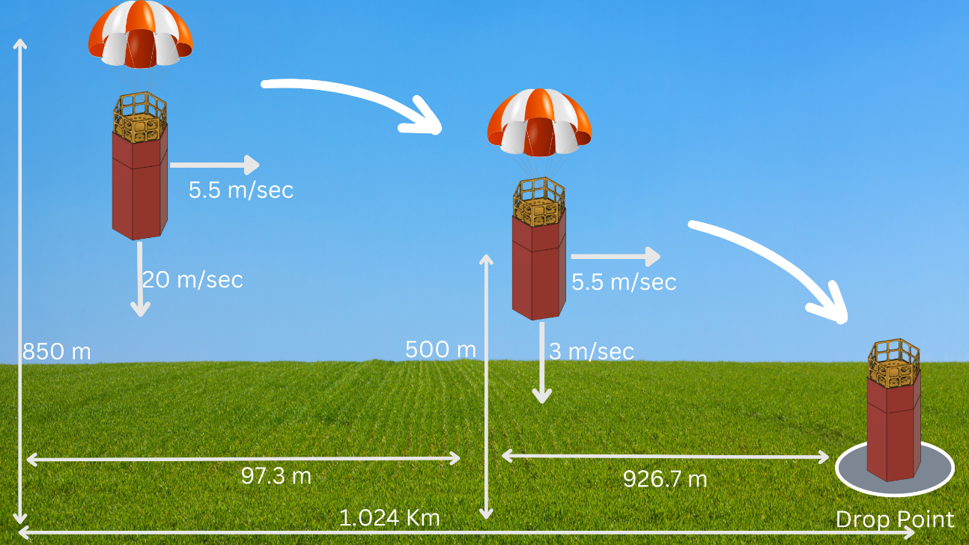
SUMMARY OF TRAJECTORY CONTROL
The average wind speed of DHOLERA in the month of June is 20km/hr. that’s why we consider the horizontal velocity of our CANSAT is to be 5.56 m/s.
In the first line of decent i.e. from 850 m to 500 m the vertical velocity of CANSAT is 20m/s. Thus during this period of time our CANSAT travels the horizontal
distance of 97.3 m.
In the second line of our decent i.e. from 500m to ground our CANSAT travels the speed of 3m/s. thus the horizontal distance travel by our CANSAT is 926.7 m
Thus when combining the horizontal distance travelled in the first as well as second line of decent is 97.3m plus 926.7m is equal to 1.024 Km
Thus we know how far our CANSAT can reach from our
ground station, thus we know that we have to design antenna with the range of 1.5-2 km, so that we can communicate with our CANSAT when it reach to ground.

Slide 50
MASS BUDGET
Method of correction:
In case any error occurs the lower part will be equipped with extra space for increasing weight with screws and nuts. Initially it will include 6 screws that can be detached if the structure is too heavy.
Margin = 500 – 497.1 = 2.9g
Part | Mass Contributed (in g)
PC ABS Panels | 43.79 ± 0.2
Aluminium Rods | 61.33 ± 0.2
Base Plate | 22 ± 0.2
Parachute 1 CF Container | 54.84 ± 0.2
Parachutes | 90 ± 0.2
Shackle | 10 ± 0.2
Carbon Fiber tube | 30.28 ± 0.2
Dampers and Foam | 30 ± 0.5
Screws, Washers and nuts | 20.25 ± 0.2
Servos | 27 ± 0.2
Other 3-D printed parts | 20 ± 0.2
PCB 1 | 75 ± 0.5
Camera | 20 ± 0.2
PCB 2 | 40 ± 0.5
Gyroscope | 22 ± 0.2
Wiring | 25 ± 0.5
Batteries | 105 ± 0.2
TOTAL MASS = 696.49 ± 4.6 g = 701.09 g
ALLOWED LIMIT = 700 ± 50 g = 750 g
Changes Made After PDR:
Minor revisions were made in the mass calculations.

Slide 51
POWER BUDGET
We use a double cell Lithium-Ion battery to power the main system. The battery has a nominal voltage of 9v and maximum capacity of 600mAh each. Allows up to 2 hours of duration of operation. The Battery is lightweight and compact. Well known battery manufacturer.
Component | Power Consumption (Wh)
CPU (STM 32) | 0.238
Pressure Sensor (BMP 280) | 0.007392
Acceleration and Gyro Sensor (MPU6050) | 0.02574
Beitian Bn 220 | 0.792
XBEE S2C Pro | 0.726
Servo Motor (Mechanical Gyro Control) | 3.32
Servo Motor (Parachute Ejection)(x2) | 12.24
Buzzer | 0.792
Changes Made After PDR:
Battery configuration used to power our CANSAT has been changed from Series to ‘Parallel’. This enables us for proper stepping down of voltage according to the requirements using the voltage divider system.
In the above Budget Power Consumption is calculated for a period of 2 hrs on assumption that CanSat may be turned on for 2h, while the actual flight time might be less than that.
Total Power Drained from the Battery for 2 hrs operation = 5.369772 Wh.

Slide 52
COMMUNICATION AND LINK BUDGET
+5.94 dB
+11.1 dB
+8 dB
-1 dB
-110.14 dB
-1 dB
Tx Radio
52
Rx Radio
Cable
Path Loss
Cable
Fig. Communication and Link Budget

Slide 53
COMMUNICATION AND LINK BUDGET
Some changes are done in which we revisited the Gain calculation of receiving and transmitting antenna and we rectified accordingly as shown below.
Calculation :
Transmitted Power : 8 dB
Transmitter Antenna Gain : 5.94 dB
Transmitter Loss : 1 dB
Free Space Loss : 110.14 dB
Miscellaneous Loss : 1 dB
Receiver Antenna Gain : 11.1 dB
Receiver Loss : 1 dB
Received Power : -84.14 dB
Receiver Sensitivity : -101 dB
Link Margin : 16.86 dB
Antenna
Antenna

Slide 54
FLIGHT SOFTWARE DESIGN
Overview of the CanSat FSW Design
The CanSat will collect sensor data then save to SD card and send to ground station via XBee.
The CanSat will deploy 2nd Parachute deploy mechanism after reaching 500m altitude.
The buzzer will keep beeping after landing until turned off with power switch.
Programming Language
C/C++ for CanSat container
Python/C++ for ground station
Development Environment
Arduino IDE
Visual Studio Code
Spyder

Slide 55
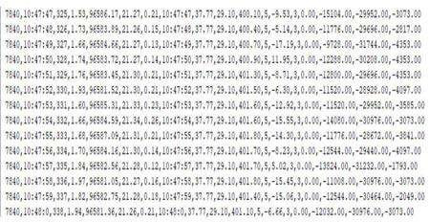
FSW
The accuracy of the data get from the each sensors were checked (particulate/dust, air speed, GPS location, temperature, pressure, etc.).
Sub-systems were tested (release mechanisms, parachute opening, communication, etc.).
Data recovery algorithms were tested in case of microcontroller reset.
The sequence of the data transmission to the ground station will be checked for consistency in the appropriate order.

Slide 56
GCS DESIGN AND OVERVIEW
Overview
Data Flow and Components
The antenna receives data over radio from the probe.
Using Xbee explorer cable , forwards data to the Xbee module.
Xbee PRO S2C module forwards data to GS’s Main Computer using micro USB to
USB cable.
Software developed in C++ parses and then displays data in engineering units and save them into a CSV file.
Main computer is capable of sending predefined commands to the probe.
Main Computer is a laptop running GS application. The application is configured in GUI so that an appropriate port and baud rate can be selected.
QHA antenna receives data from the probe (i.e. CanSat CPU) and transmits commands.
Xbee PRO S2C module forwards and receive data to form communication link between CanSat and GCS.
GS application, written in C++/Python, saves and displays data. It also saves received data in a local area network.
Progress Since PDR :
The login page of GUI is completed and currently working on dashboard page of GUI and the overall data receiving software is tested for sensors individually.
The development of helical antenna of GCS is started.
There is no changes since PDR.

Slide 57
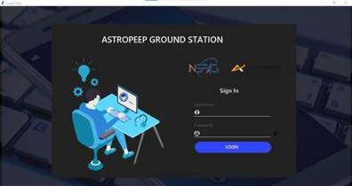
Ground Control Station GUI :
The GUI is build using SPYDER IDE using Python language and the work is still in progress the login page is build as shown above and the dashboard work is in progress and for testing we individually tested the sensor by sending data using our microprocessor and plotted graph in the SPYDER IDE using Python function matplotlib.
Fig. GCS GUI login page

Slide 58
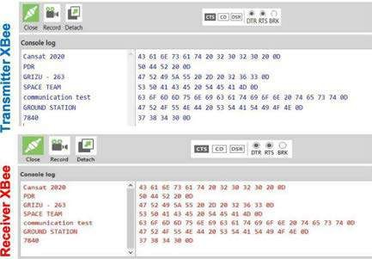
Radio Communication
The XBees setting was done over XCTU software. NETID/PANID and baud rate accuracy was checked.
The XBee communicates in unicast mode. XBees do not broadcast, the XBees only communicate with each other.
Data received from the sensors on the circuit will be transmitted to the ground station via XBee. The data will be checked from the ground station interface.
The sufficiency of the computer battery was tested for 2 hours.
We continue the tests as we have started at the PDR stage.

Slide 59
TELEMETRY DATA FORMAT
TM Parameter | Function | Resolution /Format
<TEAM ID> | Team Number | 2022ASI-002
<TIME STAMPING> | Time since the initial power | Seconds
<PACKET COUNT> | Count of transmitted packets | Integer
<ALTITUDE> | Altitude in units of meters and must be relative to ground | 0.1 meters
<PRESSURE> | Measurement of atmospheric pressure | 1 pascal
<TEMP> | Temperature in Celsius | 0.01℃
<VOLTAGE> | Voltage of the CANSAT power bus | 0.01 Volts
<GPS TIME> | Time generated by the GPS receiver | Seconds
<GPS LATITUDE> | Latitude generated by the GPS receiver | 0.0001 degrees
<GPS LONGITUDE> | Longitude generated by the GPS receiver | 0.0001 degrees
<GPS ALTITUDE> | Altitude generated by the GPS receiver | 0.1 meters

Slide 60
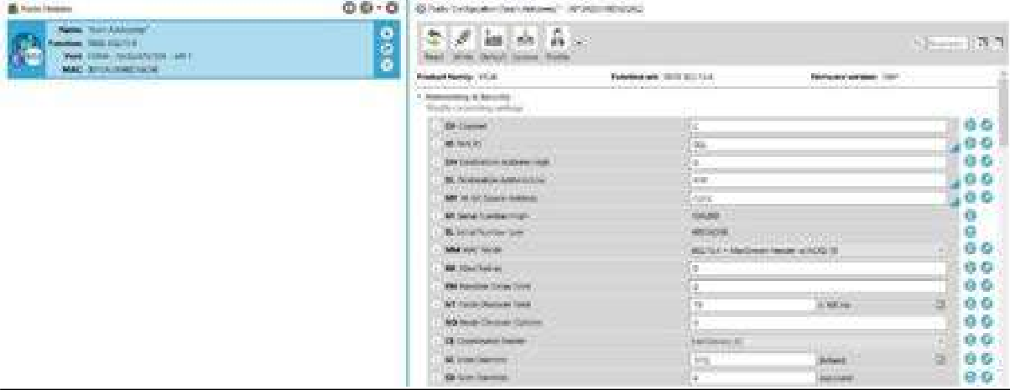
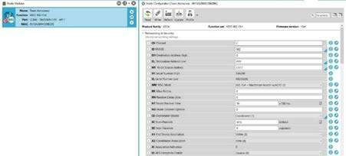
TELEMETRY
Upon powering up, the CANSAT collects the required telemetry at a 1 Hz sample rate.
The telemetry data is being transmitted with ASCII comma separated fields followed by a carriage return in the following format :
<TEAMID>,<TIMESTAMPING>,<PACKETCOUNT>,<ALTITUDe>,<PRESSURE>,<TEMP>,<VOLTAGE>,<GPSTIME>,<GPS LATITUDE>,<GPS LONGITUDE>,
<GPS ALTITUDE>,<GPS SATS>,<ACCELEROMETER DATA>, <GYRO SPIN RATE>, <FLIGHT SOFTWARE STATE>,<ANY OPTIONAL DATA>
The received telemetry for the entire mission will be saved on the ground station computer as a comma-separated value (.csv) file with name of file as 2022-ASI-002.csv
The NET ID/PAN ID of the Xbee is set to team no. as per the requirements and its setting is shown below :
Fig. . Xbee 1 Setting for NET/PAN ID
Fig. Xbee 2 Setting for NET/PAN ID

Slide 61
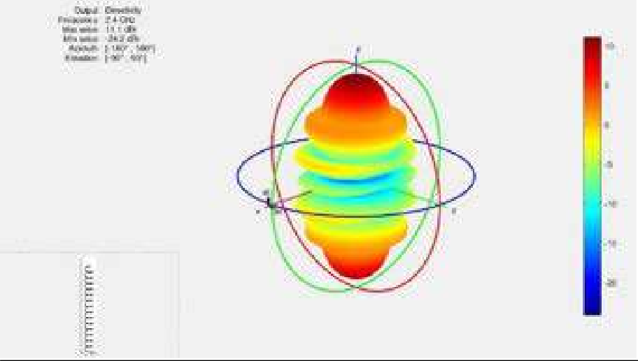
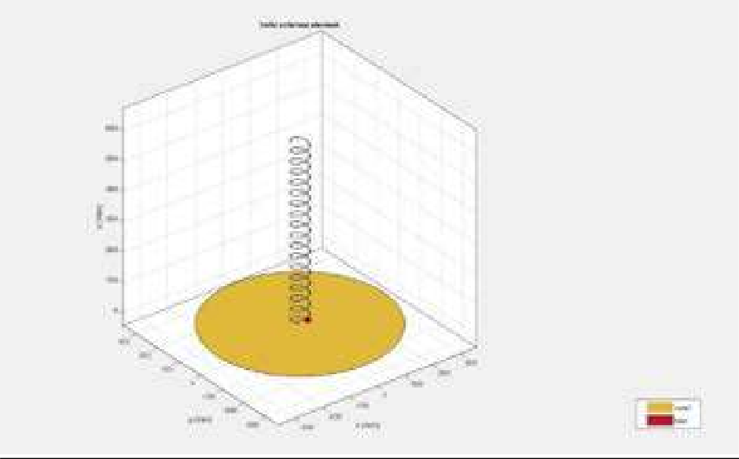
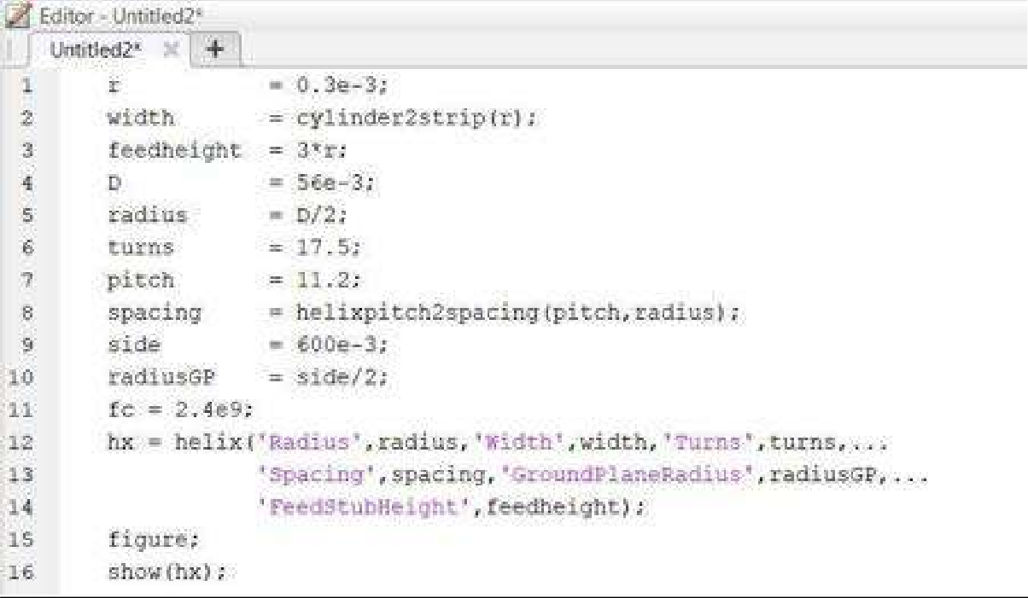
GCS ANTENNA
There is no changes since PDR just we simulated the radiation pattern of antennas and found the gains accordingly.
Antenna Radiation Pattern :
GCS Antenna
Antenna Design :
Antenna Design Code :

Slide 62
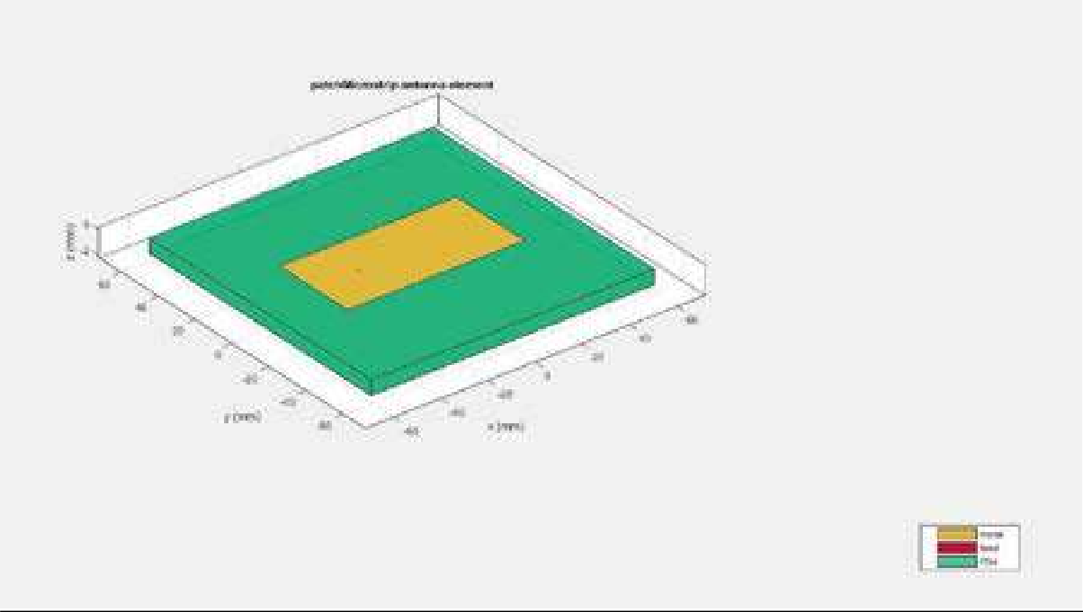


CANSAT Antenna
The gain obtained after analysis are :
GCS Antenna – 11.1 db
Cansat Antenna – 5.94 db
An after calculating we rectified the changes in the Communication and Link Budget.
Antenna Design :
Antenna Radiation Pattern :

Slide 63
Mission Operation and Analysis
Preparation for Flight
Power Cansat On
Integrate CanSat into rocket payload
Mission
Telemetry is constantly transmitted to the ground station and monitored.
First Parachute opens right after deployment of the cansat.
Recovery
Retrieval of the CanSat.
Confirmation of telemetry data reception by line of judges.
The second descent control mechanism shall open at an altitude of 500m.
Buzzer is turned on upon Landing.
Delivery of the telemetry data file to a line of judge for inspection.

Slide 64
Arrival
Check in Weight and Fit check of the CanSat
Check for any damages caused by the travel
Setting Up Ground Station
Localization of the place allocated for the ground station.
Checking communication devices and algorithms.
CanSat Preparation and Assembly
Antenna assembly and setting up ground station.
Communication test
CanSat structure has no mechanical damages
CanSat Assembly

Slide 65
Analysis
Analysis of the obtained data
Mission assessment and analysis

Slide 66
Operations
On the Ground, before Start
Awaiting on arming signal from CGS,
Continuous communication with ground starts now.
Measurement Task is started, measured values are transmitted and also stored on SD card.
When released From Rocket
All previous tasks are maintained.
CanSat is awaiting for desired altitude.
After Arming Operation
Probe waiting for release CanSat from the rocket.
After Critical Altitude crossing
CanSat will deploy 2nd Parachute.
Cansat is awaiting for landing.
After Landing
Measurement operations will be no longer performed
Buzzer signalization starts, and transmission stops.

Slide 67

CANSAT INTEGRATION AND TESTING
Testing before Integration :

Slide 68


The above mentioned steps are for testing the cansat before integration and after this testing we will go ahead for integration.

Slide 69


Integration of CANSAT
As our primary structure fabrication process which will let be a homogenous structure with no mechanical joints.
Other than this the outer body panels will be connected using the shock absorbing screws.
Batteries , PCB and Servo motors are connected to the particular damper used which are then connected to the structure of CANSAT using screws and other mechanical joints as shown below.
Fig. CANSAT Integration Stage 1
Fig. CANSAT Integration Stage 2

Slide 70
CONCLUSION
Accomplishments
Telemetry is tested.
GCS GUI is developed up to some extent.
Antenna testing is completed.
Mechanical analysis (Stress-strain , Vibration and Fit check) is completed.
Unfinished work
The fully integrated electronic & mechanical subsystem are not entirely functional yet and needs to be tested.
Prototypes are being tested and more refinements are required.
Flight software is in progress.
Next stage of development
Final Fabrication work completion
Code Review
Testing of integrated system
Assembly of complete CANSAT
Integrated testing of CANSAT.

