Slide 1
SOLUTION ARCHITECTURE • DEEP DIVE
Insurance AI Hub
Snowflake-native intelligence for governed, multilingual insurance operations
18
5
5
25+
6
7
Tables
Semantic Views
Cortex Agents
Verified Queries
RBAC Roles
Voice-enabled Pages
◉
NEW • Multilingual voice input on every page
Speak naturally. Review the translation. Send with confidence.
Presented by Team : AgentsSmith | Capgemini
September 11, 2026
VOICE IN • INTELLIGENCE OUT • IN ANY LANGUAGE
Notes:
Sources:
- User-provided presentation: Insurance_AI_Hub_Architecture_Presentation.pptx
- User-provided voice-input feature description.

Slide 2
OPERATING MODEL
Solution approach
A phased, composable path from governed data to action-oriented intelligence
PHASE 01
PHASE 02
PHASE 03
PHASE 04
Data Foundation
Semantic Layer
AI Intelligence
Experience & Action
18 tables • 3 schemas
5 semantic views
5 Cortex Agents
React hub + CoWork
PII tags + masking
25+ verified queries
RAG + NL-to-SQL
Voice + translation
RBAC hierarchy
Cortex Analyst
Charts and citations
MCP to Jira
DESIGN PRINCIPLES
Native
Composable
Grounded
Inclusive
Actionable
Storage, compute, AI and governance on Snowflake
Deploy and scale each service independently
Citations and verified queries by design
Voice input and automatic language translation
Move from insight to Jira action via MCP
ONE PLATFORM • GOVERNED DATA • TRUSTED AI • MULTILINGUAL EXPERIENCE • ENTERPRISE ACTIONS
Notes:
Sources:
- User-provided presentation: Insurance_AI_Hub_Architecture_Presentation.pptx
- User-provided voice-input feature description.

Slide 3
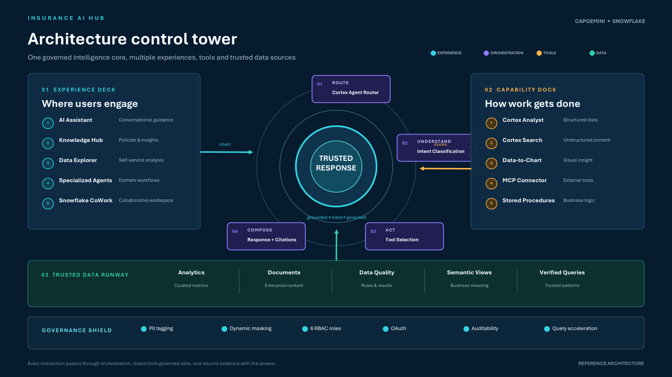

Slide 4
NEW CROSS-PLATFORM CAPABILITY
Multilingual voice experience
Every page now supports voice input, instant transcription and automatic translation
1
2
3
4
5
6
Speak
Transcribe
Detect + Translate
Review
Confirm
Understand
Tap the microphone and ask a question in any language.
Web Speech API converts speech into text instantly.
Cortex AI Translate detects non-English input and converts it to English.
Translated text appears in the input field before sending.
A compact indicator shows the detected original language.
The agent receives a consistent English prompt and preserves intent.
AVAILABLE ACROSS ALL 7 PAGES
AI Assistant
Knowledge Hub
Data Explorer
Claims Agent
Fraud Agent
Pricing Agent
Product Agent
VOICE IN, INTELLIGENCE OUT — IN ANY LANGUAGE
Notes:
Sources:
- User-provided presentation: Insurance_AI_Hub_Architecture_Presentation.pptx
- User-provided voice-input feature description.
- Web Speech API and Snowflake Cortex AI Translate behavior are described by the user.

Slide 5
END-TO-END JOURNEY
Data flow architecture
From user voice to governed insight and enterprise action
1
2
3
4
5
6
Capture
Normalize
Route
Execute
Ground
Act
Voice or typed prompt
Transcribe + translate
Classify intent + agent
SQL • Search • MCP
Compose with citations
Chart • Jira • Share
CORE DATA MODEL
DATA ESTATE
BILLING
18
7
CUSTOMERS
POLICIES
CLAIMS
Tables
Views
AT-RISK
5
Semantic
~2,070
Rows
INPUT IS NORMALIZED ON THE EXPERIENCE LAYER; GOVERNANCE IS ENFORCED THROUGHOUT THE DATA AND AI PATH
Notes:
Sources:
- User-provided presentation: Insurance_AI_Hub_Architecture_Presentation.pptx
- User-provided voice-input feature description.

Slide 6
CORTEX AGENTS
Agent orchestration deep dive
Intent-led routing across analytical, retrieval, visualization and action tools
Prompt
Classify
Route
Execute
Respond
Voice / text
Domain + intent
Agent + tool
SQL / RAG / MCP
Citations + action
ROUTING MAP
Customers • policies • claims
Insurance Operations
Cortex Analyst
SV_INSURANCE_OPS
Data quality • failed rules
Data Quality
Cortex Analyst
SV_DATA_QUALITY
Coverage • exclusions • benefits
Policy Search
Cortex Search
SEARCH_SVC
Pricing • market • competition
Market Intelligence
Cortex Analyst
Semantic Views
Product recommendation
Product Matching
Cortex Analyst
SV_PRODUCT_MATCHING
Create / search work items
Enterprise Hub
Atlassian MCP
Jira / Confluence
Notes:
Sources:
- User-provided presentation: Insurance_AI_Hub_Architecture_Presentation.pptx
- User-provided voice-input feature description.

Slide 7
CORTEX ANALYST
Semantic layer and verified queries
How natural language becomes accurate, governed SQL
Ask
Select
Match
Generate
Execute
Return
Natural language
Semantic view
Verified query
Fallback SQL
Warehouse
Data + chart
Insurance Ops
Data Quality
Competitive Intel
Market Intelligence
Product Matching
6 tables • 15 facts
4 tables • 10 facts
4 tables • 17 facts
2 tables • 8 facts
3 tables • 8 facts
10 VQRs
5 VQRs
4 VQRs
3 VQRs
3 VQRs
VERIFIED QUERY EXAMPLES
✓ Premium revenue by policy type
✓ Revenue at risk by category
✓ Pricing versus competitors
✓ Best product-matching strategy
VERIFIED QUERIES IMPROVE REPEATABILITY; SEMANTIC VIEWS KEEP BUSINESS LANGUAGE CONNECTED TO GOVERNED DATA
Notes:
Sources:
- User-provided presentation: Insurance_AI_Hub_Architecture_Presentation.pptx
- User-provided voice-input feature description.

Slide 8
INSIGHT TO ACTION
MCP and CoWork integration
Convert a governed insight into an enterprise action without context switching
1
2
3
4
5
Discover
Recommend
Authorize
Execute
Track
Agent identifies a material pattern
Agent proposes a follow-up action
Per-user OAuth secures the request
MCP creates or searches Jira
Work item links back to evidence
MCP ARCHITECTURE
CO-WORK EXPERIENCE
External MCP server registered in Snowflake
Conversational BI and in-chat charts
Dynamic client registration; no shared secret
Domain-specific or unified agent selection
Tokens stored per user
Scheduled reports and shareable artifacts
Jira + Confluence tools discovered by the agent
Per-user OAuth for enterprise actions
RESULT: INSIGHTS BECOME TRACKABLE ACTIONS WITH THE SUPPORTING DATA ATTACHED TO THE WORKFLOW
Notes:
Sources:
- User-provided presentation: Insurance_AI_Hub_Architecture_Presentation.pptx
- User-provided voice-input feature description.

Slide 9
TRUST BY DESIGN
Governance and security architecture
Protection, access control and traceability are built into the platform
1
2
3
4
5
Access
Protect
Classify
Authenticate
Ground
6 database roles
3 masking policies
PII + domain tags
Per-user OAuth
Citations + VQRs
Role-specific access and agent visibility
Email, phone and address protected at query time
Governance metadata applied at table creation
MCP tokens remain server-side
Responses trace back to tool results
ROLE HIERARCHY
INSURANCE ADMIN
DATA STEWARD
EXEC
UNDERWRITER
CLAIMS
ANALYST
Full access + masking bypass
DQ read
Analytics read
Analytics read
Analytics + documents
Base analytics read
PII at query time • no duplicate datasets • structural tags • controlled agent visibility • auditable tool execution
GOVERNANCE IS A CROSS-CUTTING CONTROL PLANE, NOT A FINAL CHECKPOINT
Notes:
Sources:
- User-provided presentation: Insurance_AI_Hub_Architecture_Presentation.pptx
- User-provided voice-input feature description.

Slide 10
OUTCOME FRAMEWORK
KPIs and business value
A balanced scorecard across six insurance decision domains
Underwriting
Claims
Fraud
Premium • active policies • loss ratio
Volume • resolution time • workload
High-risk claims • exposure • prevalence
Retention
Pricing
Data Quality
Revenue at risk • churn • complaints
Price ratio • share • scenario impact
Composite score • rule health • trends
EXPERIENCE KPIs • NEW
Voice adoption
Transcription success
Translation usage
Review-to-send
Language coverage
% prompts initiated by microphone
% voice sessions producing reviewable text
% prompts auto-translated
% translated prompts sent after review
Distinct detected languages used
MEASURE BUSINESS OUTCOMES AND EXPERIENCE ADOPTION TO PROVE VALUE AT EXECUTIVE LEVEL
Notes:
Sources:
- User-provided presentation: Insurance_AI_Hub_Architecture_Presentation.pptx
- User-provided voice-input feature description.

Slide 11
EXECUTIVE CLOSE
Summary and next steps
A production-ready foundation with a clear path to scale
18
5
5
25+
7
1
governed tables
semantic views
Cortex Agents
verified queries
voice-enabled pages
MCP connector
WHAT IS NOW DIFFERENT
PRODUCTION READINESS PATH
Every page accepts voice input
Connect production sources via Openflow / CDC
Non-English prompts are translated automatically
Benchmark agent quality with Cortex Evaluations
Users review translated text before sending
Harden network, MFA and audit controls
Agents receive a normalized English prompt
Load test at production data volumes
Governance and citations stay intact
Onboard role-based user cohorts
Insights can flow into Jira through MCP
Promote CI/CD from dev to staging to prod
VOICE IN, INTELLIGENCE OUT — A GOVERNED, MULTILINGUAL AI HUB FOR INSURANCE
Notes:
Sources:
- User-provided presentation: Insurance_AI_Hub_Architecture_Presentation.pptx
- User-provided voice-input feature description.

