Slide 1
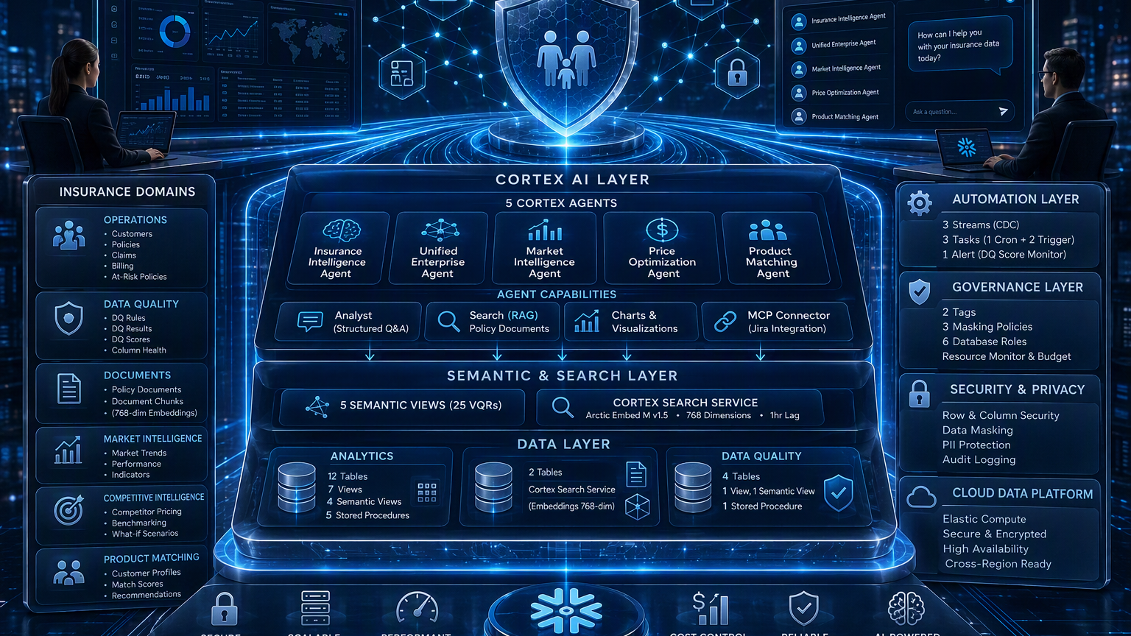
INSURANCE AI HUB
AI-native insurance intelligence, built on Snowflake
Solution & Technical Architecture
Conversational analytics • Multi-agent orchestration • Governed data • Real-time automation
5 Agents
5 Semantic Views
14-page UI
Executive architecture narrative
24 September 2026
Notes:
[Sources]
- SOLUTION_ARCHITECTURE.md and TECHNICAL_ARCHITECTURE.md
- Visual on this slide was generated with Microsoft Copilot.

Slide 2
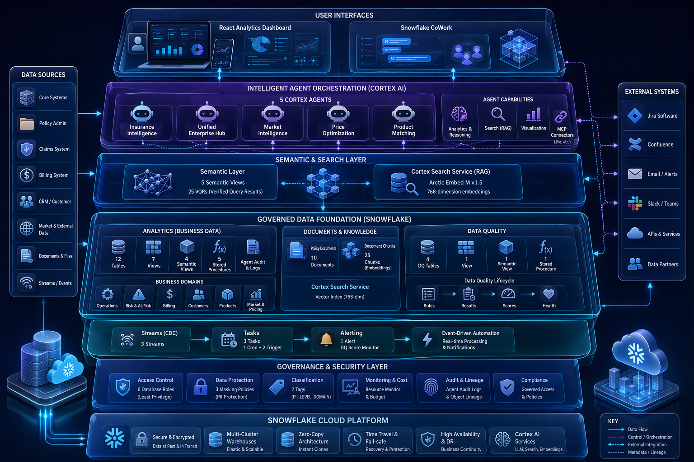
01 • PLATFORM BLUEPRINT
End-to-end solution architecture
A governed intelligence stack connecting business experiences to Snowflake-native AI and data services.
Architecture at a glance
Experience
React dashboard + CoWork
Intelligence
5 Cortex Agents
Grounding
5 semantic views + RAG
Foundation
Analytics, documents, DQ
Automation
Streams, tasks, alert
Guardrails
RBAC, masking, cost controls
Single governed Snowflake platform
Notes:
[Sources]
- SOLUTION_ARCHITECTURE.md: sections 2, 3, 7 and 9; TECHNICAL_ARCHITECTURE.md: section 1.
- Visual on this slide was generated with Microsoft Copilot.

Slide 3
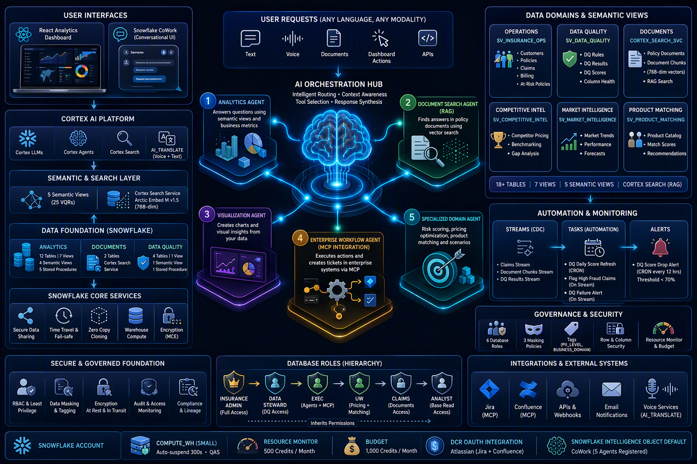
02 • INTELLIGENT ORCHESTRATION
Multi-agent routing and grounded response flow
Natural-language requests are routed to the right analytical, search, visualization or enterprise action tool.
Routing logic
1
Operations
customers, claims, billing
2
Data quality
scores, rules, root cause
3
Documents
policy search via RAG
4
Market & pricing
trends, benchmarks, scenarios
5
Product matching
eligibility + recommendations
6
Actions
charts and Jira via MCP
Outcome
Grounded answer with source citations and tool trace
Notes:
[Sources]
- SOLUTION_ARCHITECTURE.md: section 4; TECHNICAL_ARCHITECTURE.md: sections 3, 5 and 6.
- Visual on this slide was generated with Microsoft Copilot.

Slide 4
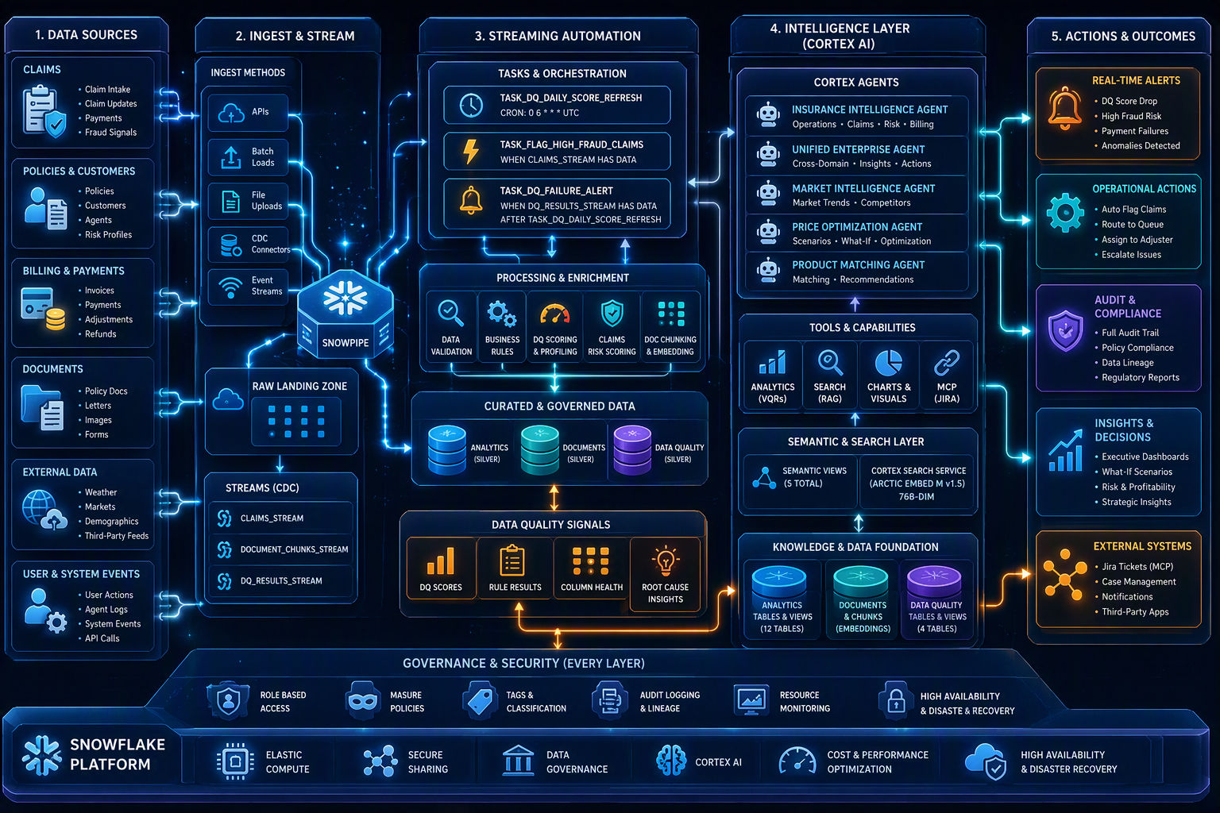
03 • EVENT-DRIVEN INTELLIGENCE
Data flow, CDC automation and operational signals
Batch and real-time change events drive fraud flagging, data-quality scoring, alerts and auditable outcomes.
Automation controls
3 streams
Claims, document chunks, DQ results
3 tasks
1 scheduled + 2 triggered
1 alert
DQ score threshold below 70%
Audit trail
Agent and automation events
Operating model
Detect → score → escalate → log
Notes:
[Sources]
- SOLUTION_ARCHITECTURE.md: section 5; TECHNICAL_ARCHITECTURE.md: section 7.
- Visual on this slide was generated with Microsoft Copilot.

Slide 5
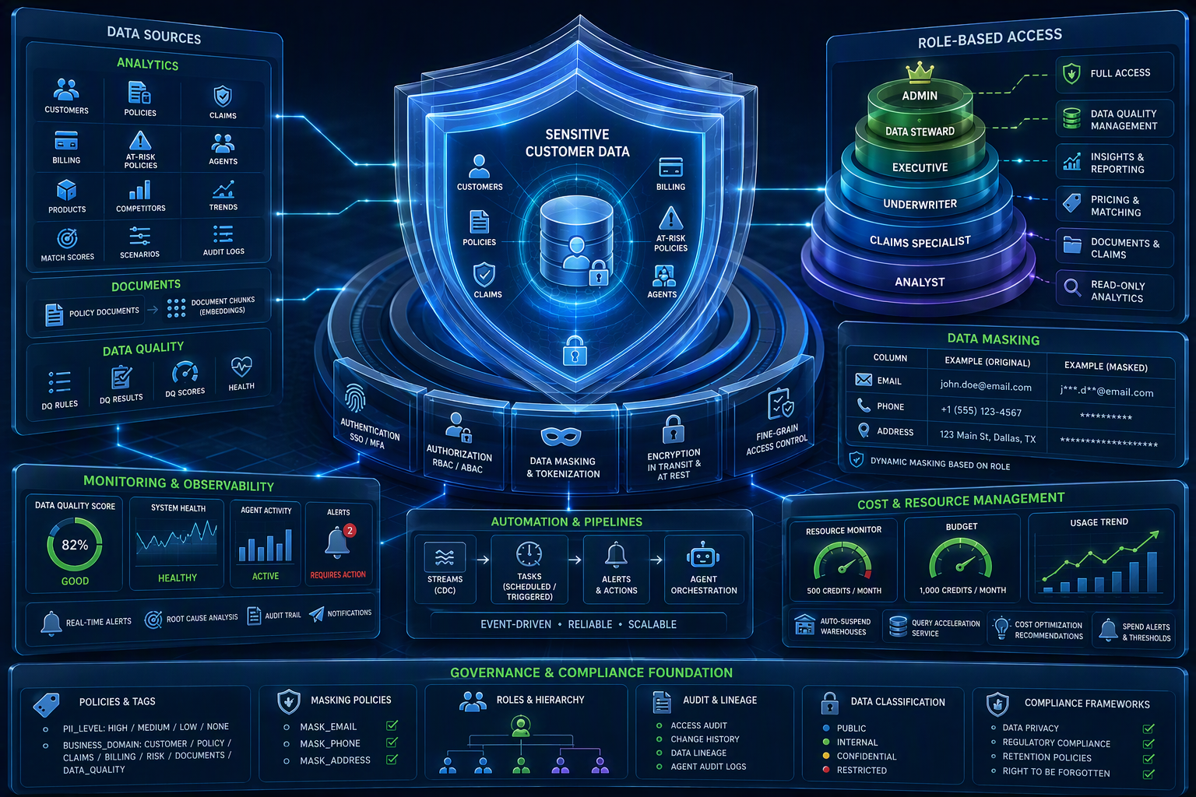
04 • TRUST BY DESIGN
Security, governance and cost-control architecture
Protection is embedded across identity, role hierarchy, sensitive fields, monitoring and platform consumption.
Control framework
Access
6 database roles + hierarchy
Protection
3 masking policies + PII tags
Monitoring
Audit logging + DQ alerts
Cost
500-credit monitor
Budget
1,000-credit monthly cap
Least privilege • masked by default
Notes:
[Sources]
- SOLUTION_ARCHITECTURE.md: section 6; TECHNICAL_ARCHITECTURE.md: sections 9 and 10.
- Visual on this slide was generated with Microsoft Copilot.

Slide 6
05 • NEW CROSS-PLATFORM CAPABILITY
Multilingual voice experience
Every page supports voice input, instant transcription and automatic translation before agent processing.
1
2
3
4
5
6
Speak
Transcribe
Detect + Translate
Review
Confirm
Understand
Tap the microphone and ask a question in any language.
Web Speech API converts speech into text instantly.
Cortex AI Translate detects non-English input and converts it to English.
Translated text appears in the input field before sending.
A compact indicator shows the detected original language.
The agent receives a consistent English prompt and preserves intent.
AVAILABLE ACROSS ALL 7 PAGES
AI Assistant
Knowledge Hub
Data Explorer
Claims Agent
Fraud Agent
Pricing Agent
Product Agent
VOICE IN, INTELLIGENCE OUT — IN ANY LANGUAGE
Notes:
[Sources]
- User-provided reference slide: Multilingual voice experience

Slide 7
05 • DELIVERY BLUEPRINT
Deployment, operations and executive value
A repeatable release path from source control to governed Snowflake services and business-facing experiences.
SOURCE
BUILD
DEPLOY
VALIDATE
OPERATE
GitHub repository
GitHub Actions
SnowSQL + Cortex
3 jobs + checks
Dashboard + agents
Operational readiness
What this enables
Deployment options
Automated script • manual SQL • CI/CD • Cortex project
Faster insight
Natural-language access across six domains
Trusted decisions
Semantic grounding, VQRs and citations
Rollback
Dependency-aware teardown for agents, search, semantic views and governance
Actionable operations
Alerts, visualizations and Jira workflows
Runtime resilience
Retry, polling, SSE fallback and 30-minute inactivity timeout
Controlled scale
Governance and spend guardrails built in
One governed platform: insight → decision → action
Notes:
[Sources]
- SOLUTION_ARCHITECTURE.md: sections 7 and 8.
- TECHNICAL_ARCHITECTURE.md: sections 8 and 11.

