Slide 1
Aureon Evidence OS
Local-first AI workflow software for evidence-heavy business operations.
Prepared for OpenOcean
AI & data infrastructure
Gary Leckey | R&A Consulting and Brokerage Services Ltd
Automation software
B2B evidence workflows
Deck status: staged for route-fit review, not yet externally submitted.
Aureon Evidence OS | OpenOcean pitch route | 01

Slide 2
Problem
The workflow problem is proof, not only productivity.
Small companies already have the material investors, funders and advisers need. The hard part is turning scattered source records into controlled external evidence without losing traceability.
Source records
Emails, screenshots, PDFs, portals, code and files sit in different places.
Review gates
Claims need source checks before they leave the company.
Receipts
Every external handoff should preserve what was sent and why.
Aureon Evidence OS | OpenOcean pitch route | 02

Slide 3
Product
Aureon turns scattered work into an auditable operator loop.
1
2
3
4
Gather
Control
Package
Record
Index source material from local folders, portals, screenshots and prepared packs.
Classify what is usable, gated or unsafe before external action.
Generate funder, compliance, accounting or investor-ready material.
Preserve receipts, screenshots, hashes and ledger updates.
Aureon Evidence OS | OpenOcean pitch route | 03

Slide 4
Wedge
The first wedge is grant and diligence evidence for SMEs.
The initial buyer pain is practical: prepare controlled evidence packs faster, keep claims source-grounded, and avoid sending unsupported material to funders, advisers, accountants or investors.
Grant application packs
Compliance and accounting support records
Partner diligence material
Investor route-fit and data-room evidence
Positioning: workflow evidence infrastructure, not a generic AI wrapper.
Aureon Evidence OS | OpenOcean pitch route | 04

Slide 5
Proof so far
The operating evidence is already visible in the current workflow.
46
45
20
36
funding opportunities indexed
application and investor records tracked
IFS routes reconciled
screenshot receipts indexed
These are operator receipts and ledger counts from the Aureon grant/investor workspace. They show execution discipline and evidence control; they are not revenue, customer or funding claims.
Aureon Evidence OS | OpenOcean pitch route | 05

Slide 6
Data/workflow moat
The defensible layer is evidence metadata around work.
Each run records what was used, excluded, reviewed, changed, blocked and sent. Over time, that creates a structured workflow graph around real business evidence.
Input
source files, emails, screenshots, portal readbacks
Control
eligibility gates, language checks, unsafe-claim blocking
Output
application packs, receipts, ledgers, submission manifests
Learning
route history, evidence gaps, reusable source mappings
Aureon Evidence OS | OpenOcean pitch route | 06

Slide 7
Commercial path
The route to market starts with service-led proof, then software repeatability.
Now
OpenOcean fit
Operator-led evidence packs for grant, diligence and compliance workflows.
The thesis sits where B2B automation, data infrastructure and AI-native software overlap. The near-term test is whether the wedge is sharp enough to earn design-partner or pre-seed interest.
Next
Repeatable templates, review gates and receipt ledgers for adviser-led SMEs.
Then
Self-serve workspace with human approval gates and integrations.
B2B software
Data economy
Automation
Aureon Evidence OS | OpenOcean pitch route | 07

Slide 8
Ask
The ask is a route-fit conversation before a full raise package.
What we are asking OpenOcean for now
Funding stage
A short fit call or clear team pointer on whether this evidence-workflow wedge belongs in OpenOcean's AI/data infrastructure and automation software mandate.
Pre-seed / early seed exploration. The exact round size, instrument and investor data-room fields should be confirmed before external submission.
Prepared controls: no private finance, raw tax, payroll, password, token or bank data is included in this deck.
Aureon Evidence OS | OpenOcean pitch route | 08

Slide 9
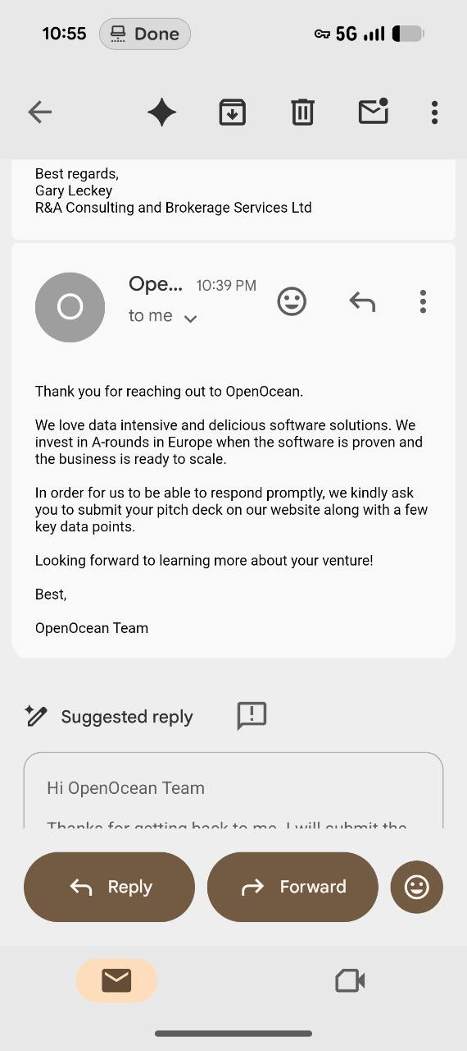
Route evidence
OpenOcean asked for the deck route, so the next step is controlled submission.
Incoming reply evidence
OpenOcean replied asking Gary to submit the pitch deck on their website with a few key data points. The official contact page points pitch submissions to info@openocean.vc.
Recommended handoff
Send this deck and the key-data sheet only after confirming the funding ask and whether the website route requires extra fields beyond email.
Aureon Evidence OS | OpenOcean pitch route | 09

