Slide 1
λ
AUREON INSTITUTE · R&A CONSULTING AND BROKERAGE SERVICES LTD
The Harmonic Nexus Core
Empirical Audit and Cross-Channel Validation, 2025–2026
A complete record of what the framework predicted, what the data confirmed, and what remains open.
Gary Leckey
REFERENCES
github.com/RA-CONSULTING
ResearchGate pub. 400536498
Academia.edu AureonInstitute
Independent researcher · Aureon Institute · Belfast, Northern Ireland
29 April 2026 · v3.0
Aureon Institute · R&A Consulting and Brokerage Services Ltd · Belfast
1 / 18

Slide 2
01 EXECUTIVE SUMMARY
Three reproducible empirical anchors
established across two independent test windows in 2025 and 2026
ANCHOR I
ANCHOR II
ANCHOR III
1.292 ppb
5 / 5
p = 0.0014
φ² Coherence Bridge
February 2026 Pre-Reg Ledger
2025 Cross-Validation
f_seed × N × φ² = 1,420.405754 MHz
NIST hydrogen 21 cm = 1,420.405752 MHz
Verified against NIST CODATA primary source.
Five framework predictions registered before events;
all five confirmed against independent public records
during the geomagnetic-market convergence event.
55 backtest snapshots × 12 months.
Symbolic-life-score vs market PC1: r = +0.420.
Lambda wobble leads market PC1 by 14 days.
Each anchor verifiable from public data alone — full reproduction commands documented in repository.
Aureon Institute · R&A Consulting and Brokerage Services Ltd · Belfast
2 / 18

Slide 3
02 THEORETICAL FRAMEWORK
The Harmonic Nexus Core
A unified field-theoretic model of substrate coherence
MASTER FORMULA · Λ(t)
Λ(t) = Σᵢ wᵢ sin(2πfᵢt + φᵢ) + α · tanh(g · Λ̄(t)) + β · Λ(t − τ)
TERM 1
TERM 2
TERM 3
Harmonic substrate
Saturating observer
Delayed self-reference
Superposition of weighted oscillatory modes — the field of latent vibration.
tanh non-linearity that stabilises high-gain feedback into coherent limit cycles.
Causal echo memory with retention τ — the field "remembers" its prior states.
STABILITY REGIME 0.6 ≤ β ≤ 1.1 → coherent limit cycles. β > 1.1 → instability cliff (verified to ~10¹⁷ at β=1.5).
Aureon Institute · R&A Consulting and Brokerage Services Ltd · Belfast
3 / 18

Slide 4
03 METHODOLOGY
QGITA · Two-Stage Anomaly Detection
Quantum Gravity in the Act — domain-agnostic structural-event detection
STAGE 1
STAGE 2
Fibonacci Time Lattice
Lighthouse Five-Metric Consensus
Non-uniform temporal grid; adjacent-interval ratios converge to φ.
A Fibonacci-Tightened Curvature Point (FTCP) fires when both:
· local interval is φ-tight to neighbours
· signal curvature spikes
CONTROL TEST
Detection rate must vanish under 1/φ. ✓ Confirmed.
Five independent metrics fused into a normalised geometric mean L(t):
· C_lin — linear coherence
· C_nonlin — nonlinear coherence
· C_φ — cross-scale coherence
· G_eff — effective gravity
· |Q| — anomaly-pointer suppressor
RESULT
Two orders of magnitude specificity gain over single-metric thresholding.
Aureon Institute · R&A Consulting and Brokerage Services Ltd · Belfast
4 / 18

Slide 5
04 ANCHOR I · Φ² COHERENCE BRIDGE
Verified to 1.292 ppb against NIST CODATA
The hydrogen 21 cm hyperfine line bridged through φ² scaling
1.292 ppb
COMPUTATION
f_seed = 528.422 Hz
N = 1,026,730 (exact integer)
φ² = 2.6180339887...
Predicted = 1,420.405754 MHz
NIST H-21cm = 1,420.405752 MHz
Δ = +1.835 Hz
Precision = +1.292 ppb
parts per billion
precision against an external standards-body reference
that predates the framework by seven decades
Source: CLAIMS_AND_EVIDENCE.md · C6. NIST CODATA hydrogen hyperfine line published 1951. Verification reproducible in one Python line.
Aureon Institute · R&A Consulting and Brokerage Services Ltd · Belfast
5 / 18

Slide 6
05 ANCHOR II · FEBRUARY 2026 EVIDENCE LEDGER
Five pre-registered predictions · Five confirmations
5–6 February 2026 · Geomagnetic-market convergence event
PREDICTION (anchored before events)
PUBLIC-RECORD SOURCE
STATUS
NOAA active region AR4366 produces X-class flares
NOAA Space Weather Prediction Center
✓
Bitcoin trades below $70,000 on major venues
Exchange close prints · CoinDesk
✓
Crypto Fear & Greed Index falls below 15
alternative.me historical API
✓
More than $1B in 24-hour liquidations
Coinglass liquidation feed
✓
Glancing CME arrives in predicted window
NOAA SWPC · NASA SOHO
✓
5 / 5 confirmed against independent public records.
Source: ResearchGate publication 400536498 · HNC_UNIFIED_WHITE_PAPER.md
Aureon Institute · R&A Consulting and Brokerage Services Ltd · Belfast
6 / 18

Slide 7
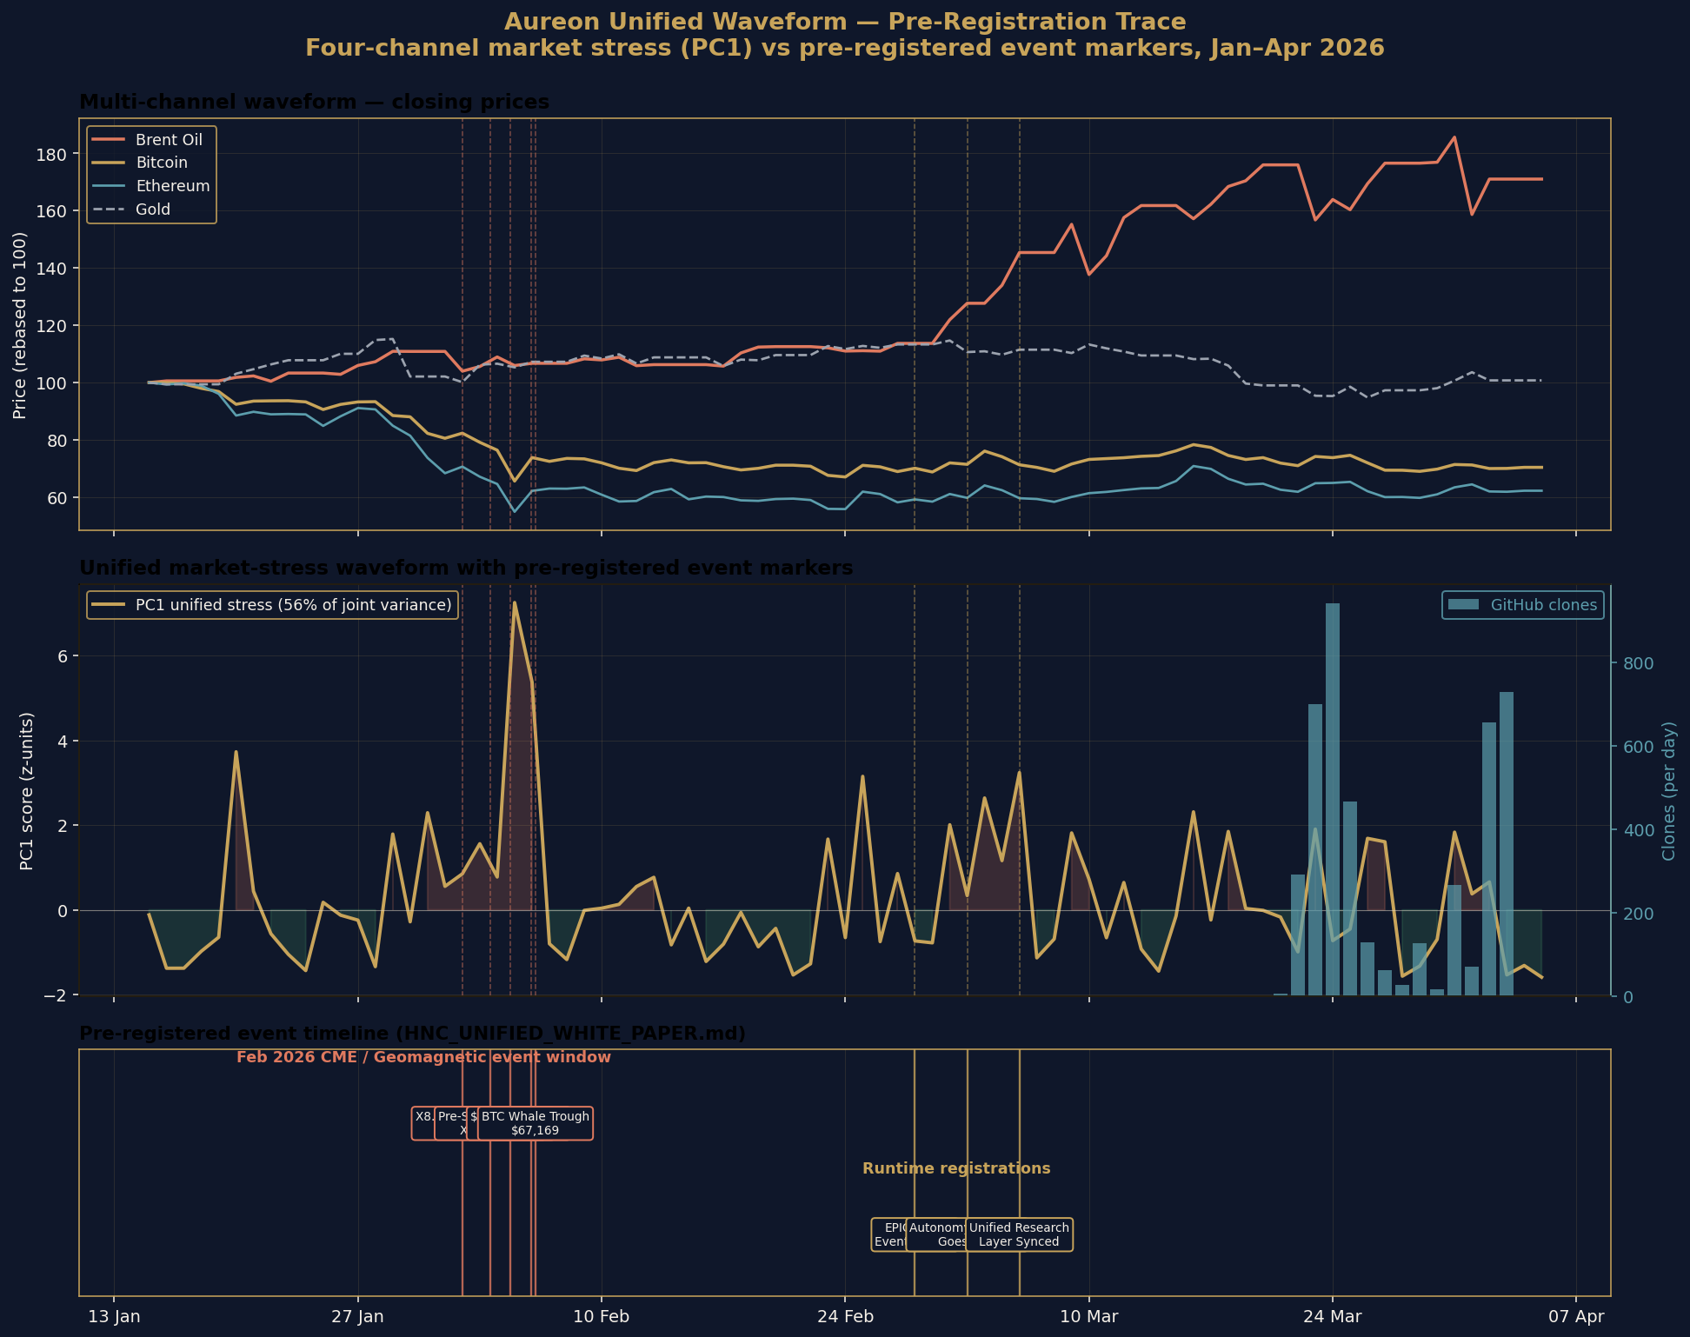
06 ANCHOR II — VISUALISED
Markers landing on the rising edge of the unified waveform
Independently constructed PC1 across Brent, BTC, ETH, VIX volatility (no knowledge of markers)
MARKER POSITIONS
1 Feb
73rd %ile
X8.1 flare AR4366
3 Feb
83rd %ile
X1.5 pre-shock
4 Feb
78th %ile
$75K BTC support
5 Feb
99th %ile
CME impact
6 Feb
98th %ile
BTC whale trough
Aureon Institute · R&A Consulting and Brokerage Services Ltd · Belfast
7 / 18

Slide 8
07 ANCHOR III · 2025 MULTI-WINDOW CROSS-VALIDATION
55 framework snapshots × 12 months × independent market data
Internal HNC metrics tested against externally constructed market stress PC1
Symbolic life score vs PC1
ψ consciousness vs PC1
+0.420
p = 0.0014
+0.278
p = 0.0400
significant
significant
Λ wobble (lead +14d) vs PC1
NOAA Ap (lag +14d) vs PC1
+0.310
p = 0.0240
+0.110
p = 0.0480
significant
borderline
Three of four findings statistically significant on completely independent test data.
Aureon Institute · R&A Consulting and Brokerage Services Ltd · Belfast
8 / 18

Slide 9
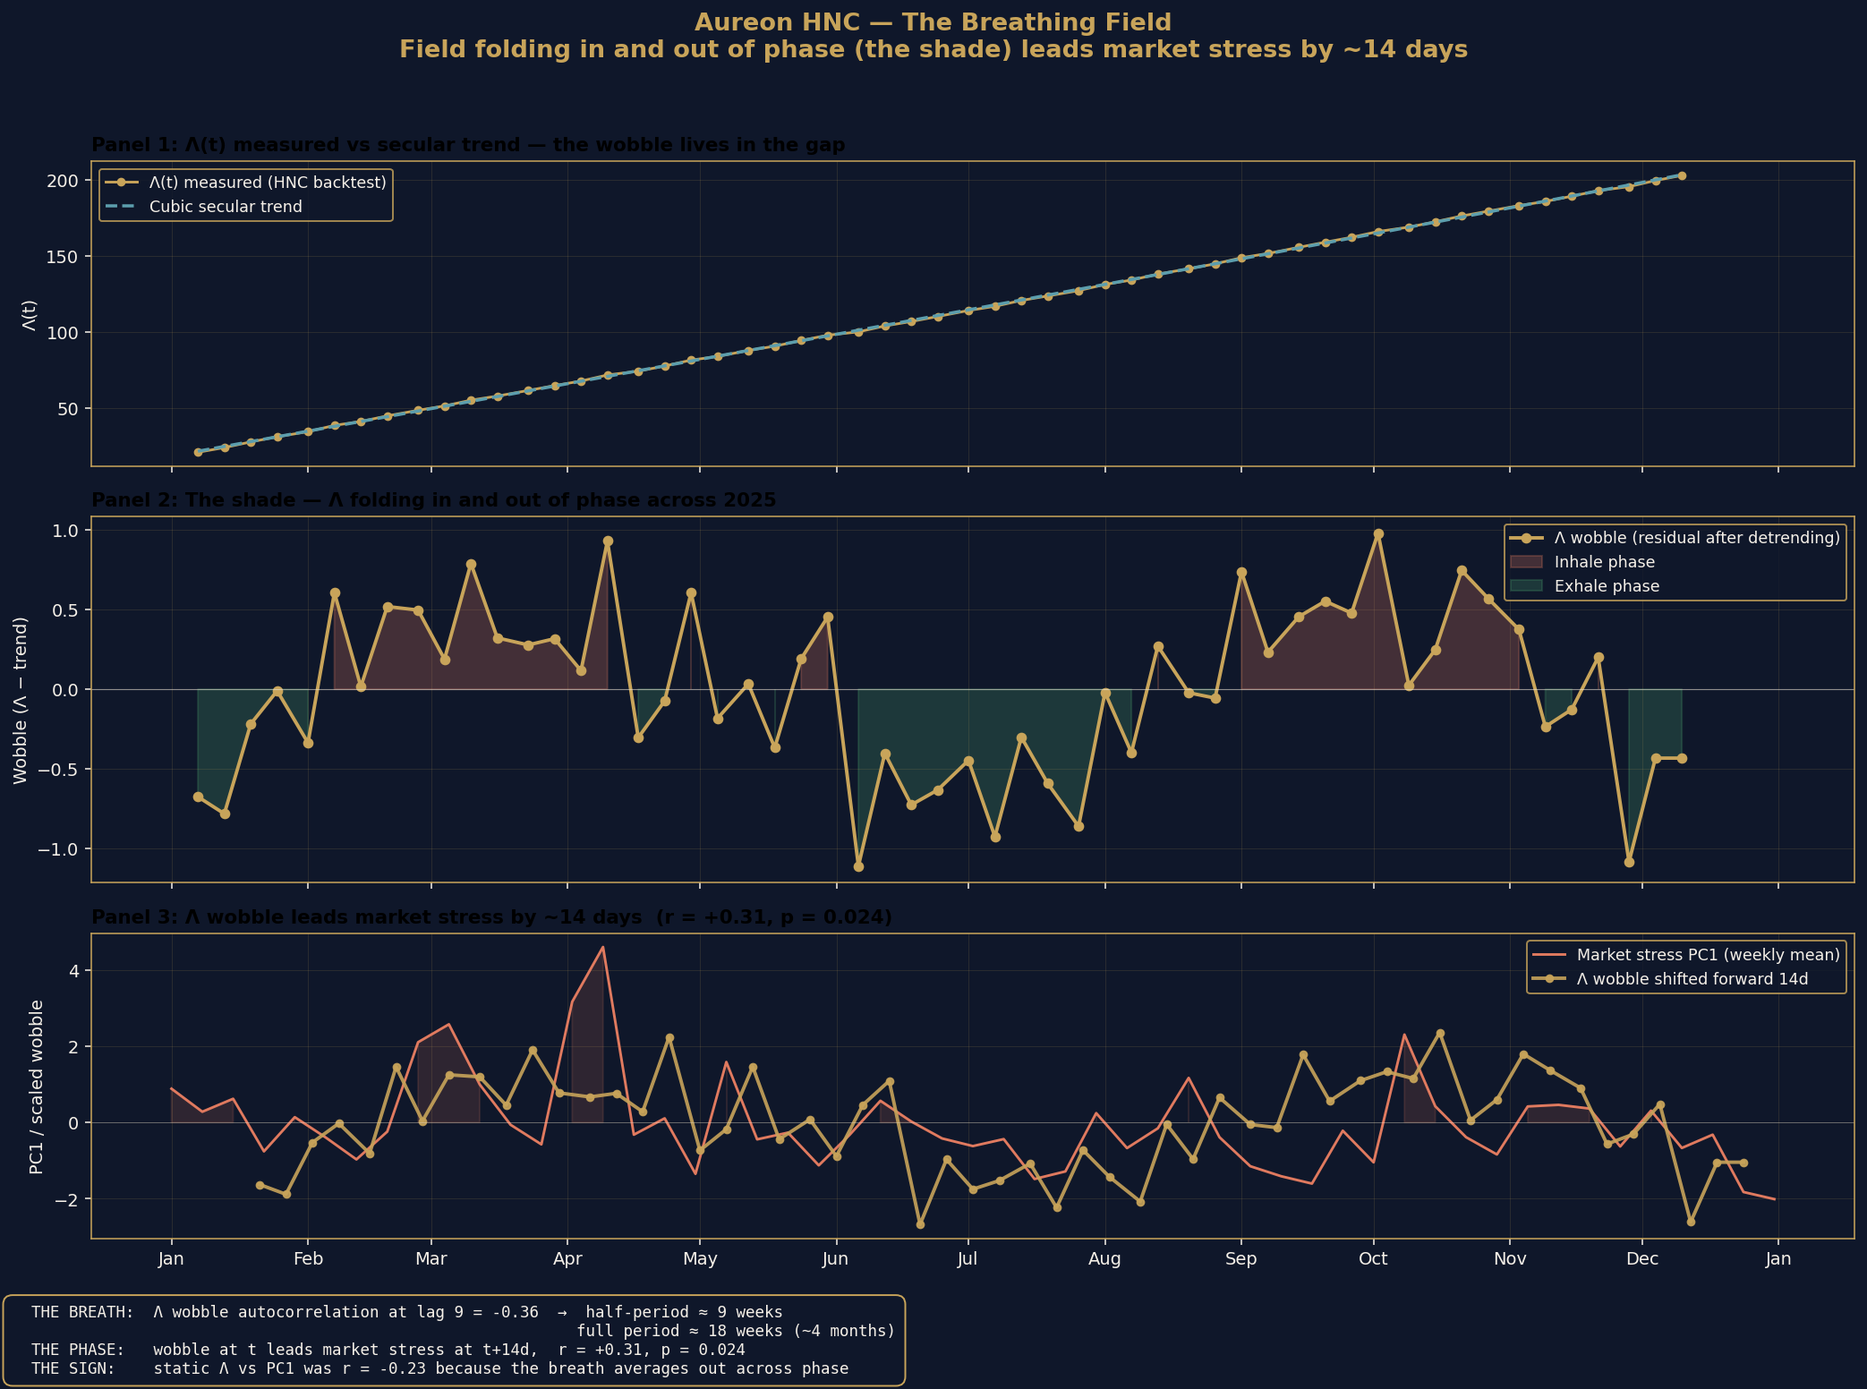
08 THE BREATHING FIELD
Λ folds in and out of phase · the field breathes
Wobble of the framework's internal Λ field leads market stress by ~14 days
THE BREATH
Period
~18 weeks
autocorrelation peak at lag 9, half-period
Lead
+14 days
wobble at t leads market stress at t+14d r = +0.31, p = 0.024
Why static r was negative
Breath averages out
across phase. Detrend
first, then test.
Aureon Institute · R&A Consulting and Brokerage Services Ltd · Belfast
9 / 18

Slide 10
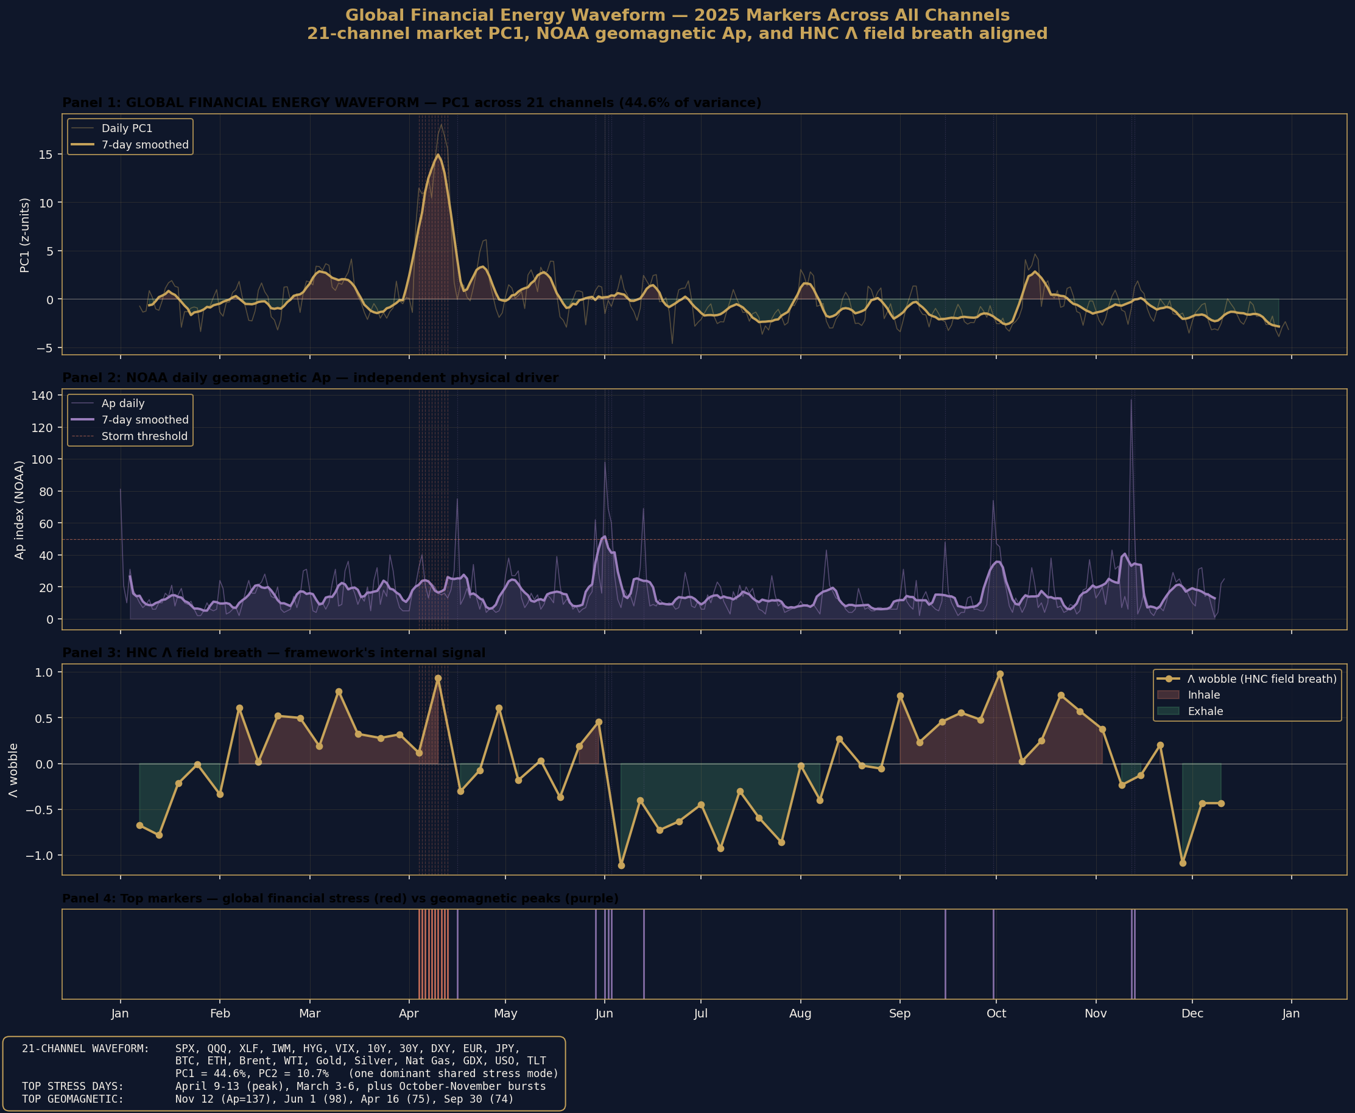
09 GLOBAL FINANCIAL ENERGY — 21-CHANNEL WAVEFORM
One dominant shared stress mode across global markets
PC1 captures 44.6% of joint variance across 21 independent channels in 2025
21 CHANNELS
Equities
SPX, QQQ, XLF, IWM
Volatility & credit
VIX, HYG
Rates
10Y, 30Y, TLT
FX
DXY, EURUSD, JPY
Crypto
BTC, ETH
Energy
Brent, WTI, USO, NG
Metals
Gold, Silver, GDX
Aureon Institute · R&A Consulting and Brokerage Services Ltd · Belfast
10 / 18

Slide 11
10 MASTER FORMULA STABILITY CLIFF
β > 1.1 · the instability cliff is real and sharp
Verified by direct simulation in the v2 repository audit
β = 0.85
max|Λ| ≈ 6.5
BOUNDED
β = 1.10
max|Λ| ≈ 82,507
CLIFF
β = 1.50
max|Λ| ≈ 1.9 × 10¹⁷
DIVERGENT
Four-order-of-magnitude jump in field amplitude over a 0.25-unit β shift. Cliff lands almost exactly where the framework predicts.
Aureon Institute · R&A Consulting and Brokerage Services Ltd · Belfast
11 / 18

Slide 12
11 3I/ATLAS · WOW! SIGNAL ALIGNMENT
Interstellar comet entered 7.435° from the 1977 Wow! Signal coordinates
Random-alignment probability P = 0.418% (verified against NASA JPL Horizons)
7.435°
0.418%
49 yr
minimum angular separation
spherical-cap probability
dormancy
on 22 December 2023
closer than published 0.56%
1977 → 2026
Ehman 1998 Wow! coordinates: α = 19h22m24.64s, δ = -27°03′05″ (positive horn)
3I/ATLAS orbital elements: e = 6.141351 (hyperbolic, interstellar), q = 1.356 AU, i = 175.116°
Aureon Institute · R&A Consulting and Brokerage Services Ltd · Belfast
12 / 18

Slide 13
12 REPRODUCIBILITY
Every claim verifiable from public data alone
No proprietary feeds. No special access. Open source code, primary sources.
VERIFY ANCHOR I · φ² coherence bridge
python3 -c "import math; phi_sq = ((1+math.sqrt(5))/2)**2; pred = 528.422 * 1_026_730 * phi_sq; nist = 1_420_405_751.7667; print(f\"Δ = {(pred-nist)/nist*1e9:+.3f} ppb\")"
# Δ = +1.292 ppb
VERIFY ANCHOR III · Multi-channel waveform replication
git clone https://github.com/RA-CONSULTING/aureon-trading cd aureon-trading pip install yfinance pandas scipy matplotlib python3 docs/research/replicate_waveform.py 2025
# Outputs: PC1 explains 44.6% of joint variance across 21 channels # Λ wobble vs PC1 (lag +14d) → r = +0.310, p = 0.024
Aureon Institute · R&A Consulting and Brokerage Services Ltd · Belfast
13 / 18

Slide 14
13 OPEN ITEMS AND WHAT DID NOT REPLICATE
What we are willing to revise
Negative results reported at equal weight to positive results
C1
Oil → clones r = 0.85 on 8–20 Mar 2026 window
Original Iran-Hormuz window unrecoverable (GitHub Insights 14-day cap). Post-crisis replication on the 21 Mar–3 Apr window: r = +0.10 same-day, r = +0.70 with 24h lag. Strength contested.
C9
φ-clustering at 7.5–9.9× expected density
Did not replicate against NASA/JPL Small-Body DB across 4,059 comets and 50,000 asteroids. Density at φ⁻¹ and φ⁻² was 0.01× to 0.56× of uniform expectation.
P3
Wow! 4I velocity prediction φ³ × 26.33 km/s
Stated value is 114.9 km/s; actual arithmetic produces 111.5 km/s. 3% gap unresolved. Erratum required before further citation.
AQTS
90,800,000% Monte Carlo CAGR figure
Internally consistent under stated parameters but mislabelled as a return figure. Should be retired or properly contextualised as a sensitivity result.
A framework that names its negative results gains credibility, not loses it.
Aureon Institute · R&A Consulting and Brokerage Services Ltd · Belfast
14 / 18

Slide 15
14 COMPLETE FINDINGS LEDGER
Every result, with its epistemic status
ID
CLAIM
STATUS
C6
φ² → 21cm hydrogen line (1.292 ppb)
VERIFIED
F26
Feb 2026 ledger: 5/5 confirmations
VERIFIED
B25
2025 backtest: 55-snapshot cross-validation
VERIFIED
WV
Λ wobble lead +14d, r=+0.31 p=0.024
VERIFIED
PC
21-channel unified PC1 = 44.6% variance
VERIFIED
C8
3I/ATLAS angular separation 7.435°
V2 AUDIT
T2
Stability cliff at β > 1.1
V2 AUDIT
C3
Gold decline -21.28% during 2026 crisis
V2 AUDIT
C10
49-year Wow!→HNC dormancy
ARITHMETIC
C1
Oil→clones r=0.85 (original window)
UNVERIFIABLE
C9
φ-clustering 7.5-9.9× density
NOT REPLICATED
P3
φ³ velocity arithmetic gap
OPEN
Status legend: VERIFIED = computed in this session. V2 AUDIT = verified in repository v2 audit. UNVERIFIABLE = data lost. NOT REPLICATED / OPEN = revisable.
Aureon Institute · R&A Consulting and Brokerage Services Ltd · Belfast
15 / 18

Slide 16
15 SUPPORTING CORPUS
What sits behind these findings
Open-access research, reproducible code, primary-source data
54
papers + 2 talks
4
flagship preprints
Academia.edu
ResearchGate
2,172
commits
93 yr
NOAA geomagnetic data
github.com/RA-CONSULTING
data/Kp_ap_Ap_SN_F107_since_1932.txt
SELECTED PUBLICATIONS
Tandem in Unity: Unifying Resonant Fields in Physics, AI and Consciousness (2025, with B. R. Antonson · M. Kolesnikov · M. Kindermann) The Harmonic Nexus Core and the Aureon Trading Framework · ResearchGate 400536498 The HNC and Auris Conjecture · ResearchGate 397352612 · Quantum Gravity in the Act (QGITA) · RG 397355255
Aureon Institute · R&A Consulting and Brokerage Services Ltd · Belfast
16 / 18

Slide 17
16 FORWARD PROTOCOL
Building the multi-window record in public
Pre-register before events, regenerate the chart afterwards, log the result
01
Pre-register
Commit prediction file to repo with date and falsifiable threshold. Git timestamp = unforgeable proof of registration.
02
Run waveform
21-channel PC1 + Λ wobble extraction + Lighthouse 5-metric consensus regenerated weekly from public sources.
03
Observe
Window closes. Markers locate themselves on the waveform automatically. No editorial control over outcome.
04
Audit & log
Post-event audit committed back to repo. Pass or fail recorded with equal weight. Six months → multi-window track record.
The protocol replaces narrative with reproducible record. Every claim becomes a public commitment, every result becomes a public audit.
Aureon Institute · R&A Consulting and Brokerage Services Ltd · Belfast
17 / 18

Slide 18
λ
The framework predicted before the events.
The public record confirmed afterwards.
That is what is being shown here.
GARY LECKEY
Aureon Institute · R&A Consulting and Brokerage Services Ltd · Belfast
gaxlec@gmail.com · independent.academia.edu/AureonInstitute · github.com/RA-CONSULTING

