Slide 1
Analysing Bias in Learning due to Unfair Imputation

Slide 2
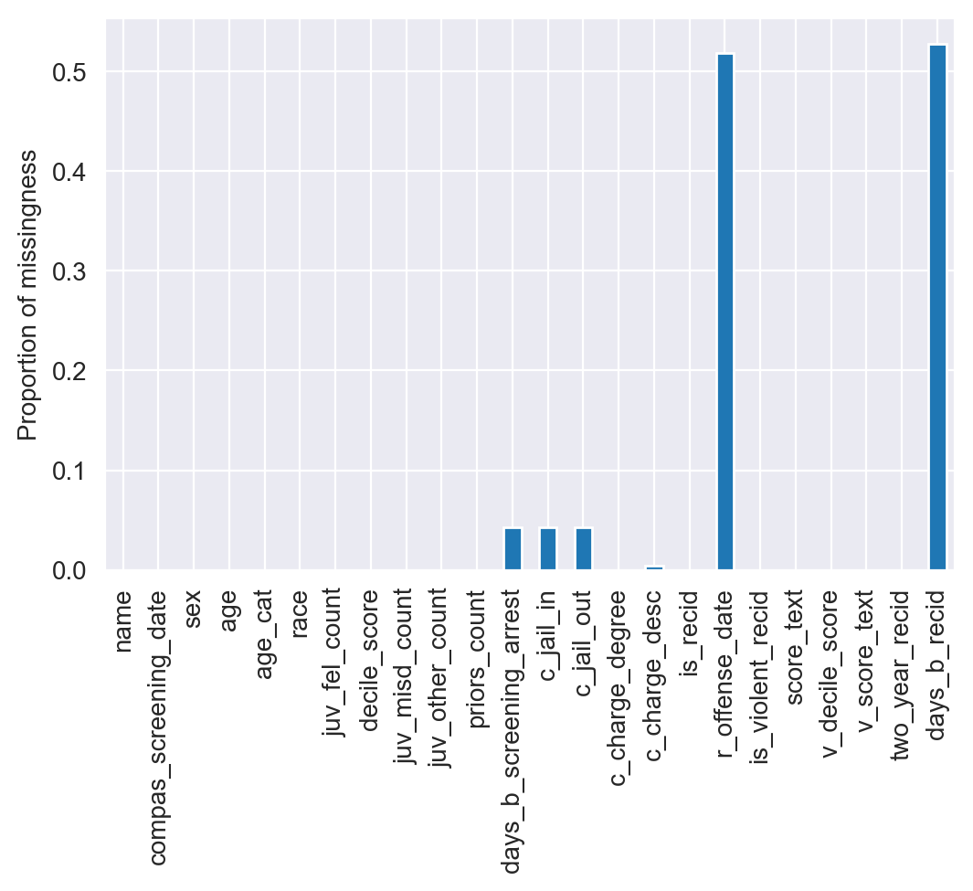
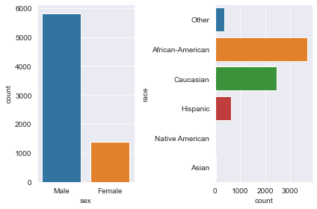
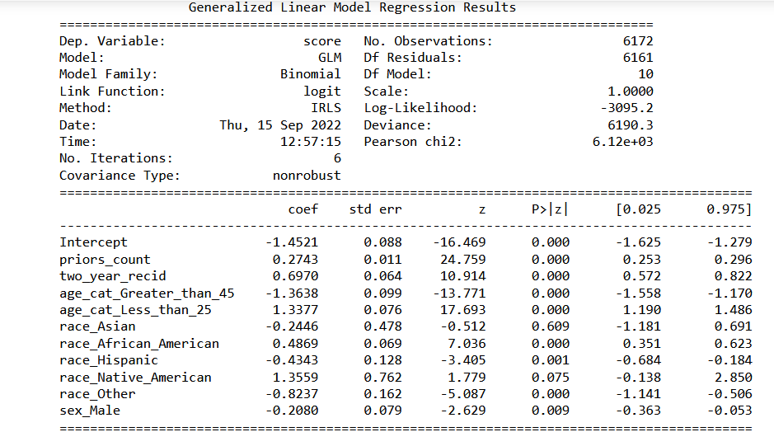
Why do this in the first place?
Missing data are always around in the real world.
Do we really know how well the imputation is working?
Studying imputation fairness is a fairly new branch.
Ex: Iris species classification for 1000 samples, 10 misclassified observations. What's the impact of incorrect imputation to the end user?
Causes of unfairness in machine learning can mainly be attributed to missing values, prediction algorithms and data imbalance.

Slide 3
Literature Review
Zhang et al. Fairness in Missing Data Imputation
Talks about the fairness in imputation methods across sensitive groups, how to measure it and experiments carried out on various imputers to measure the fairness.
Bakker et al. Fair Enough: Improving Fairness in Budget-Constrained Decision Making Using Confidence Thresholds
Talks about AFA system and how a novel confidence threshold based method is used with it to further determine the cost-effectiveness of each of the unselected features based on the features we have already selected.
Plumed et al. Fairness and Missing Values
Talks about the relationship between missing data and fairness, trade-off between fairness and performance and analyse the sources of missing data and biasness.

Slide 4
How Does the Imputation Fairness Problem Relate to my Last Internship
My last internship was related to building a time series model to predict the severity amount to the company at the end of each year(severity = Total loss/no. of claimants)
Data was on a daily claimant level and had to be aggregated to a weekly level.
For handling the missing values, a new column for keeping track of null proportions that came up each week was used. Although, this approach gave a very robust model, but there was no concern, whatsoever on the biasness or fairness of the imputation method used.
One possible impact to end user: The company might see that a particular subset of people belonging to a specific sensitive group might be the cause of high severity amounts and the premiums for those groups might be increased substantially!

Slide 5
Questions Than Can Be Addressed
How severe is the imputation unfairness?
Some metrics for quantifying the severity of imputation
Statistical properties of the estimated metrics like mean, variance etc.
What factors influence the imputation & prediction accuracy unfairness?
Missing mechanism
Imbalanced data
Imputation methods
Ratio of no. of missing values to data size
Learning algorithm
Recommended procedures for dealing with missing data?
Use of confidence thresholds in AVA for selecting a partial subset of features?
Missingness structure based imputation vs one size fits all imputation?
Possible to assess the risk of unfairness to the end user based on a weighted case-specific cost?

Slide 6
Current Progress…
Can be divided into 2 parts:
Successful replication of experiments(not results) from the existing literature
Adding a specific metric & imputation technique to address the issues found in existing literature
Dataset used for the replication of experiments is from the Recidivism dataset
7214 observations filtered from original dataset used by COMPAS Algorithm
3 attributes originally missing which are not included
11 features are selected for the experiment excluding target
Target is the risk of recidivism viz. low, medium and high
Judges are often presented with two sets of scores from the COMPAS system -- one that classifies people into High, Medium and Low risk, and a corresponding decile score.

Slide 7
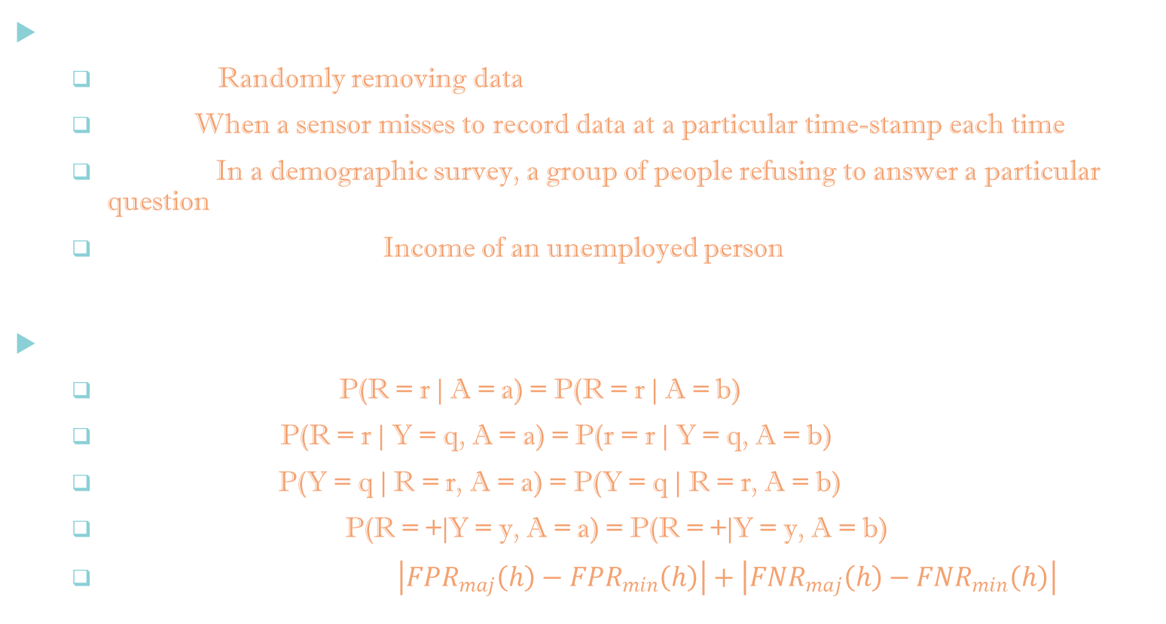
Experimental Setup : Basic Terminologies
Types of Missingness
MCAR : Randomly removing data
MAR : When a sensor misses to record data at a particular time-stamp each time
MNAR : In a demographic survey, a group of people refusing to answer a particular question
Structurally Missing : Income of an unemployed person
Fairness Notions
Independence : P(R = r | A = a) = P(R = r | A = b)
Separation : P(R = r | Y = q, A = a) = P(r = r | Y = q, A = b)
Sufficiency : P(Y = q | R = r, A = a) = P(Y = q | R = r, A = b)
Equalized Odds : P(R = +|Y = y, A = a) = P(R = +|Y = y, A = b)
Equalized Odds Diff : $\left|{FPR}_{maj}\left(h\right)−{FPR}_{min}\left(h\right)\right|+\left|{FNR}_{maj}\left(h\right)−{FNR}_{min}\left(h\right)\right|$

Slide 8

Experimental Setup : Method
Let $Z=z_{ij}∈R^{n∗p}$ be complete data matrix and R$=r_{ij}∈R^{n∗p}$ be missing data indicator matrix with $r_{ij}=I(ifz_{ij} is observed)$.
Let $Z^{a}= {z_{ij}}^{a}$ & $R^{a}= {r_{ij}}^{a}$ for A = a, where ‘a’ denotes sensitive group. Let $\hat{Z^{a}}\left(g\right)=\hat{z_{ij}^{a}}$ denote imputed data matrix for group ‘a’.
Mean Square Imputation Error(MSIE) : ${MSIE}_{a}\left(g\right)=\frac{{\sum_{i,j}{\left(\hat{z_{ij}^{a}}\left(g\right)−z_{ij}^{a}\left(g\right)\right)}}^{2}(1−r_{ij}^{a}) }{\sum_{i,j}{(1−r_{ij}^{a})}}$. Imputation accuracy parity difference(IAPD) : $IAPD\left(g\right)={MSIE}_{maj}\left(g\right)−{MSIE}_{min}(g)$
7 different imputation techniques are used: MICE, missForest, KNN, SoftImpute, OptSpace, Gain & misGAN.
Data from the original dataset is removed following the 3 different missing mechanisms. Only a specific set of columns viz. sex, age, race, priors_count & c_charge_degree have nulls.
Different imputation techniques combined with different missingness mechanisms are used to impute the missing values. These imputed values are then compared with actual values using MSIE and IAPD for different sensitive groups A = {‘race’, ‘gender’}. This experiment is repeated 100 times and the average metrics values and their confidence intervals are noted.

Slide 9
Preliminary Results
 | MSIE(race) = (MSIE(black) + MSIE(white))/2 |  |  |  |  |  |  | MSIE(gender) = (MSIE(male) + MSIE(female))/2 |  |  |  |  |  |  | IAPD(race) |  |  |  |  |  |  | IAPD(gender)
Method | I1 | I2 | I3 | I4 | I5 | I6 | I7 | I1 | I2 | I3 | I4 | I5 | I6 | I7 | I1 | I2 | I3 | I4 | I5 | I6 | I7 | I1 | I2 | I3 | I4 | I5 | I6 | I7
MCAR(1a) | 0.73 | 0.82 | 0.85 | 2.73 |  |  |  | 0.61 | 0.67 | 0.7 | 1.52 |  |  |  | -0.17 | -0.19 | -0.21 | 1.65 |  |  |  | -0.003 | 0.009 | 0.006 | -0.04
MCAR(1b) | 1.06 | 1.075 | 0.95 | 1.54 |  |  |  | 0.87 | 0.86 | 0.78 | 1.15 |  |  |  | -0.28 | -0.31 | -0.25 | -0.097 |  |  |  | -0.019 | 0.01 | 0.027 | -0.001
MCAR(1c) | 1.125 | 1.42 | 1.17 | 1.36 |  |  |  | 0.97 | 1.18 | 0.96 | 1.09 |  |  |  | -0.25 | -0.38 | -0.33 | -0.2 |  |  |  | -0.05 | 0.013 | 0.021 | 0.006
MAR(2a) | 0.79 | 1.13 | 1.027 | 1.31 |  |  |  | 0.67 | 0.91 | 0.85 | 1.04 |  |  |  | -0.21 | -0.31 | -0.28 | -0.129 |  |  |  | 0.002 | 0.024 | 0.03 | 0.01
MAR(2b) | 0.76 | 0.8901 | 0.8997 | 2.14 |  |  |  | 0.64 | 0.7405 | 0.7477 | 1.52 |  |  |  | -0.17 | -0.197 | -0.232 | 0.2 |  |  |  | -0.124 | -0.023 | 0.007 | -0.147
MAR(2c) | 0.96 | 1.04 | 0.95 | 1.69 |  |  |  | 0.79 | 0.82 | 0.775 | 1.271 |  |  |  | -0.3 | -0.32 | -0.26 | -0.09 |  |  |  | -0.014 | -0.014 | -0.0044 | -0.008
MAR(2d)
MNAR(3a)
MNAR(3b)
MNAR(3c)
MNAR(3d)
Index represents the missingness mechanism type and column header represents the metric observed.
IAPD of race is highly negative which means MSIE(black) >> MSIE(white).
This is a clear evidence of imputation unfairness being present within a sensitive group.

Slide 10
Next Steps
Continue working on the imputation methods
I6(Gain), I7(misGAN) are based on Generative Adversial Networks.
Few more type of missing mechanism subtypes can be added.
Highly dependent on what type of missing mechanism is present.
Fairness in prediction accuracy
Study the prediction fairness using EOD.
Relationship between imputation fairness and accuracy.
Address the drawbacks
Cant be applied in real world as actual missing values are not available
No cost associated for the risk in unfairness to the end user

