Slide 1

G2M Insights for Cab Investment Firm
RAKSHIT GROVER
19th July 2024

Slide 2

Agenda
Executive Summary
Approach
Data Information
EDA and EDA Insights
Hypothesis results
Recommendations

Slide 3
Executive Summary
Client:
XYZ is a private firm in US. Due to remarkable growth in the Cab Industry in last few years and multiple key players in the market, it is planning for an investment in Cab industry and as per their Go-to-Market(G2M) strategy they want to understand the market before taking final decision.
Objective:
XYZ is interested in using your actionable insights to help them identify the right company to make their investment.

Slide 4
Data Information
Cab_Data.csv : This file includes details of transactions for 2 cab companies (9 features).
Customer_ID.csv : This is a mapping table that contains a unique identifier that links the customer’s demographic details (4 features).
Transaction_ID.csv : This is a mapping table that contains transaction to customer mapping and payment mode (3 features).
City.csv: This file contains a list of US cities, their population, and the number of cab users (3 features).

Slide 5
APPROACH
I start by loading the data ,understanding the data and doing some research about the cab industry
Then I move onto pre processing and cleaning the dataset by looking for null values , converting the features in each dataset to the right format.
I also did some feature engineering to create new features that will be useful
Then I move onto doing eda and testing out different Hypothesis

Slide 6
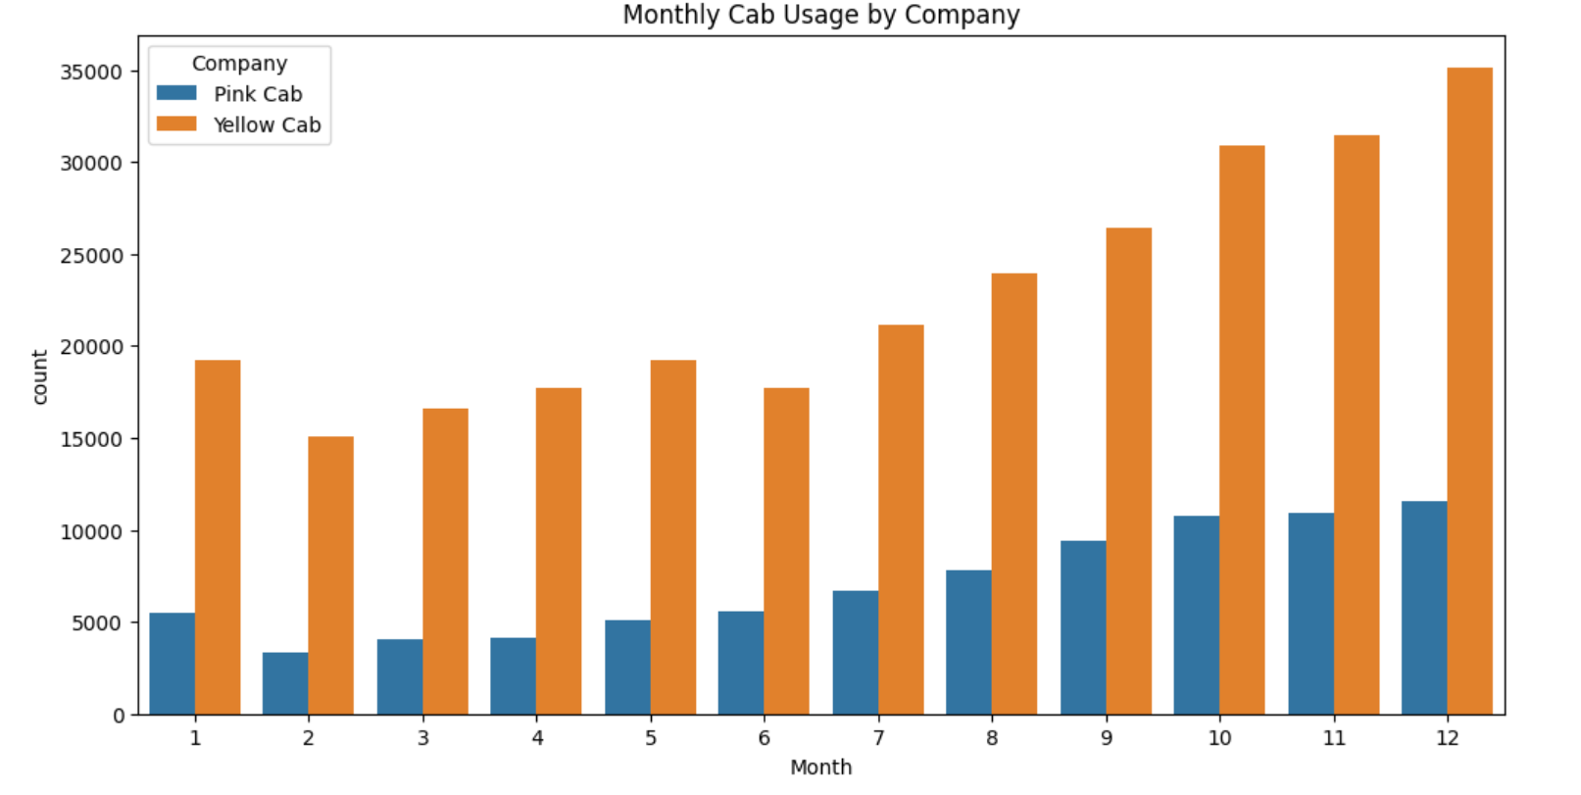
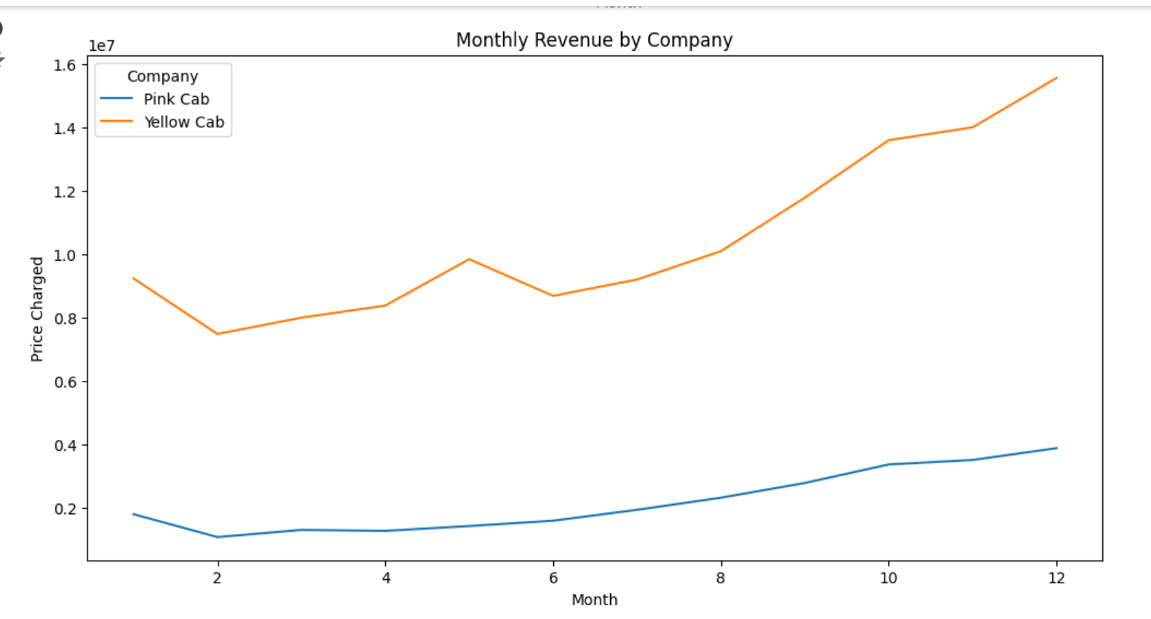
EXPLORATORY DATA ANALYSIS
Here we can see that yellow cab has more users per month and thus has more monthly revenue as well. We can see also that December is the month with most cab users.

Slide 7
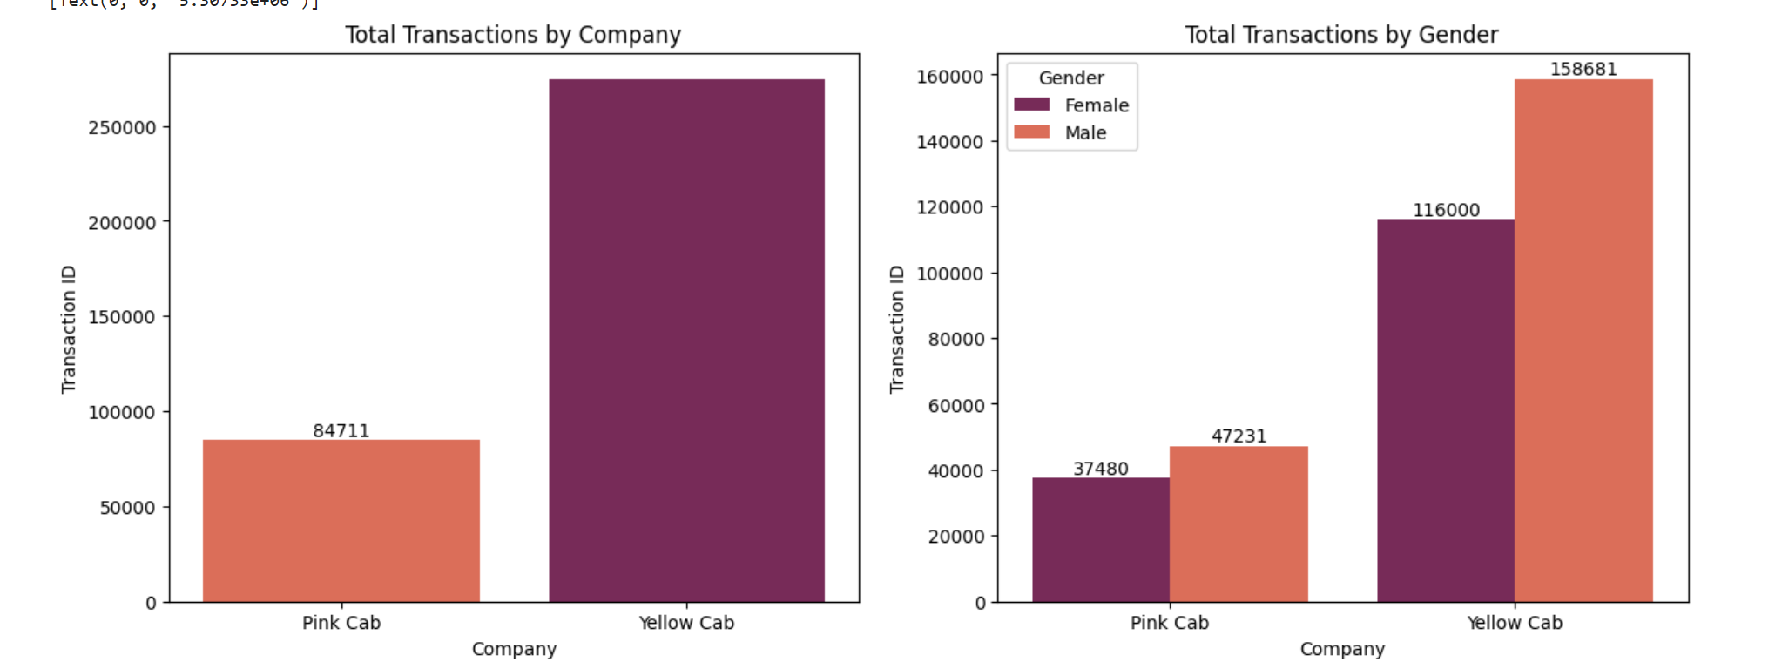
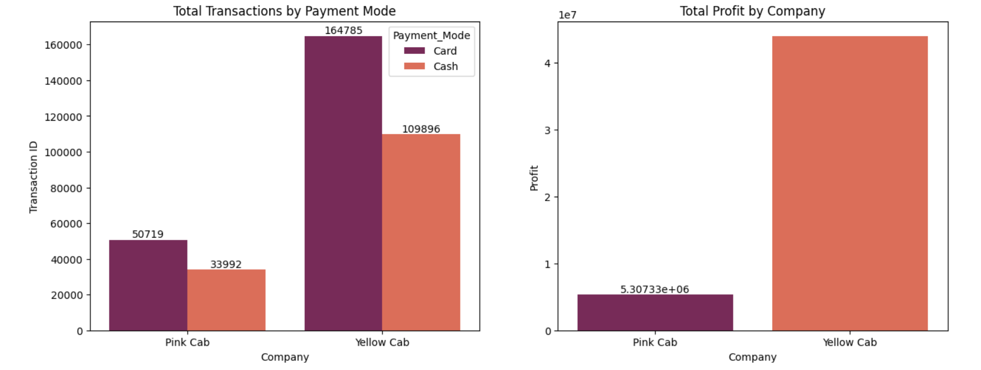
Here we can see the total number of transactions plotted against different features. We can see that yellow cab has more transactions, Males are making more transactions as compared to females,Card is the more used payment mode for both cab companies and Yellow cab company is making more profits.

Slide 8
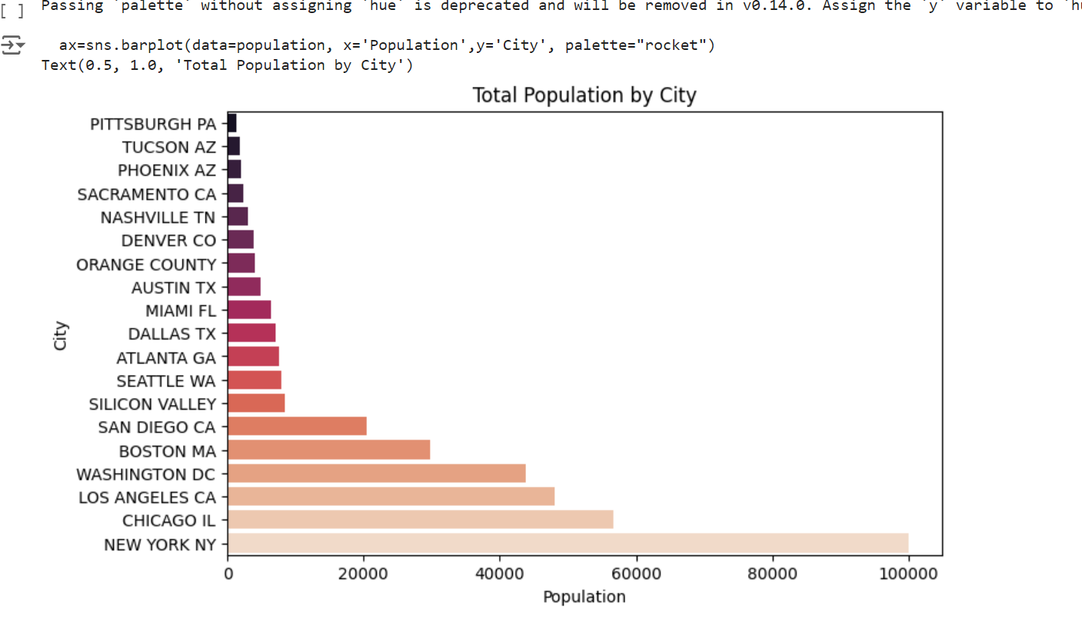
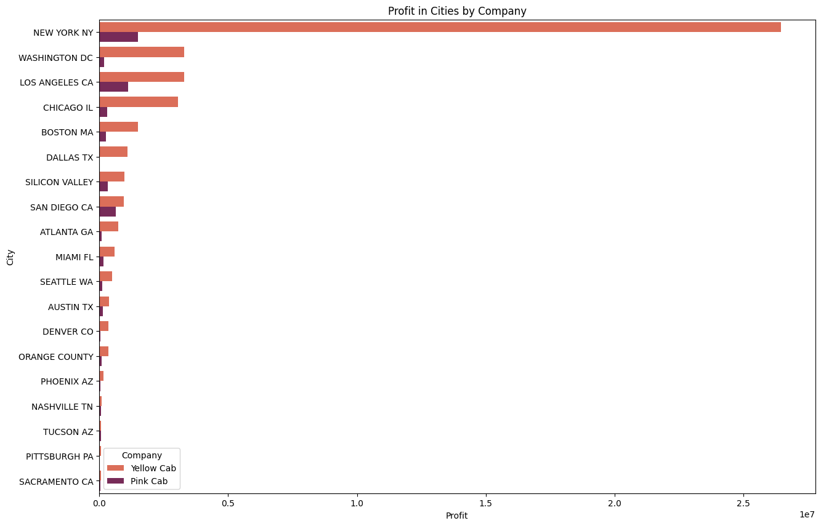
Here we can see the population of different cities and the profits made by both cab companies in each city

Slide 9
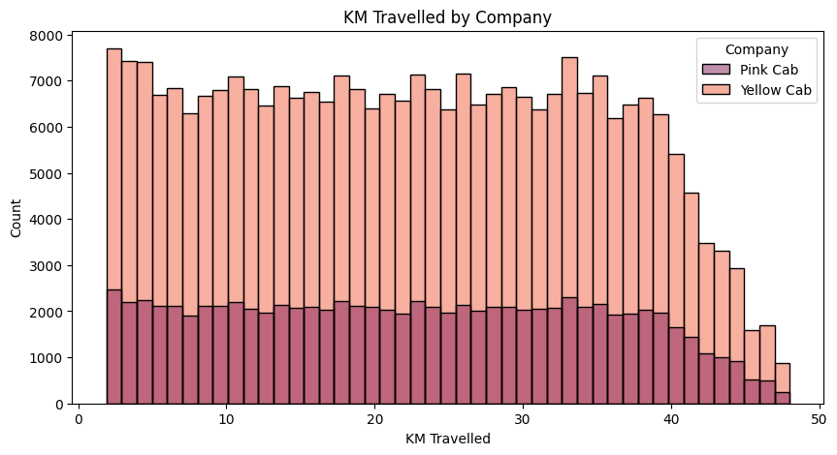
We can clearly see that yellow cab is preferred for both long and short distance rides

Slide 10
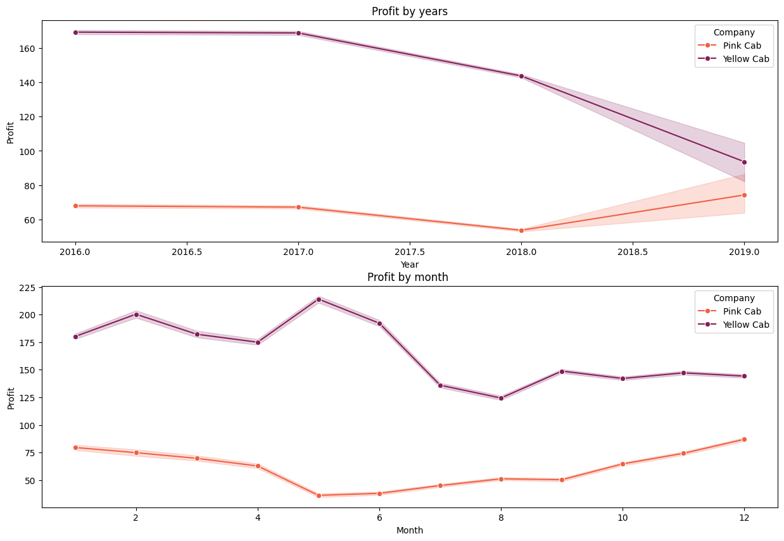
Here we can see the profit made by both cab companies over the years and the profit made by both in different months.
We can observe that-
Yellow cab is making more profit as compared to pink cab.
Since 2017 the profit made yellow cab is decreasing
Since 2018 the profit made by pink cab is increasing
Yellow cab makes the most profit in May and Pink cab makes more profit in December

Slide 11
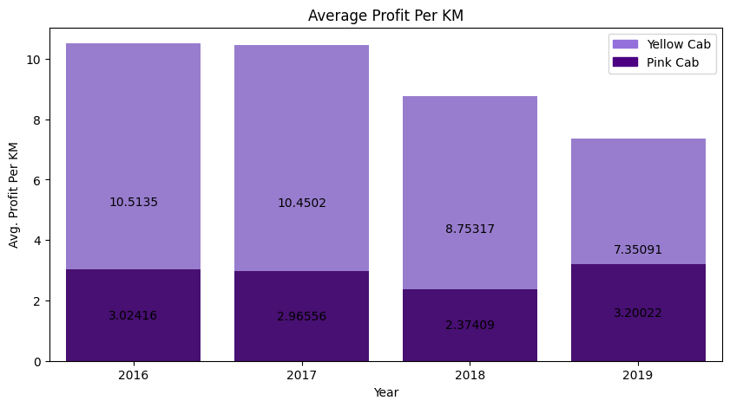
Here we can see the profit made by both companies per km . We observe the following-
Yellow cab is making more profit per km each year.
Since 2018 the profit made by yellow cab has started to decrease.
In 2019 Pink cab made the most profit per km

Slide 12
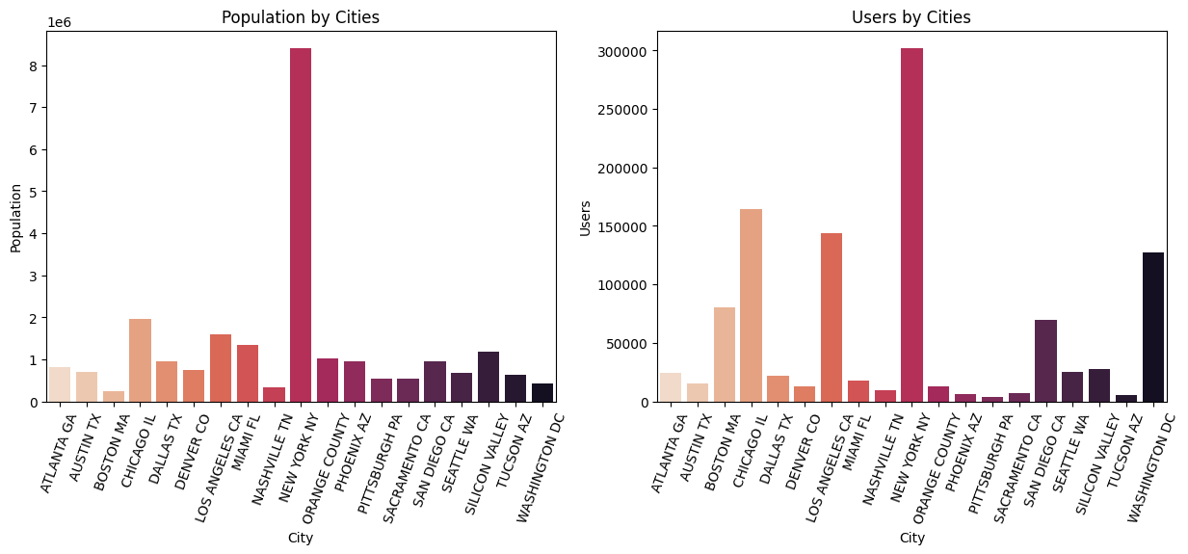
Here we try to find the population and the number of users in each city. Here we can see that New York has most population and most users a city like Denver which has a high population but low number of users. The cab comapies can use this to target areas which have higher population but low number of users which could help them make more profits.

Slide 13
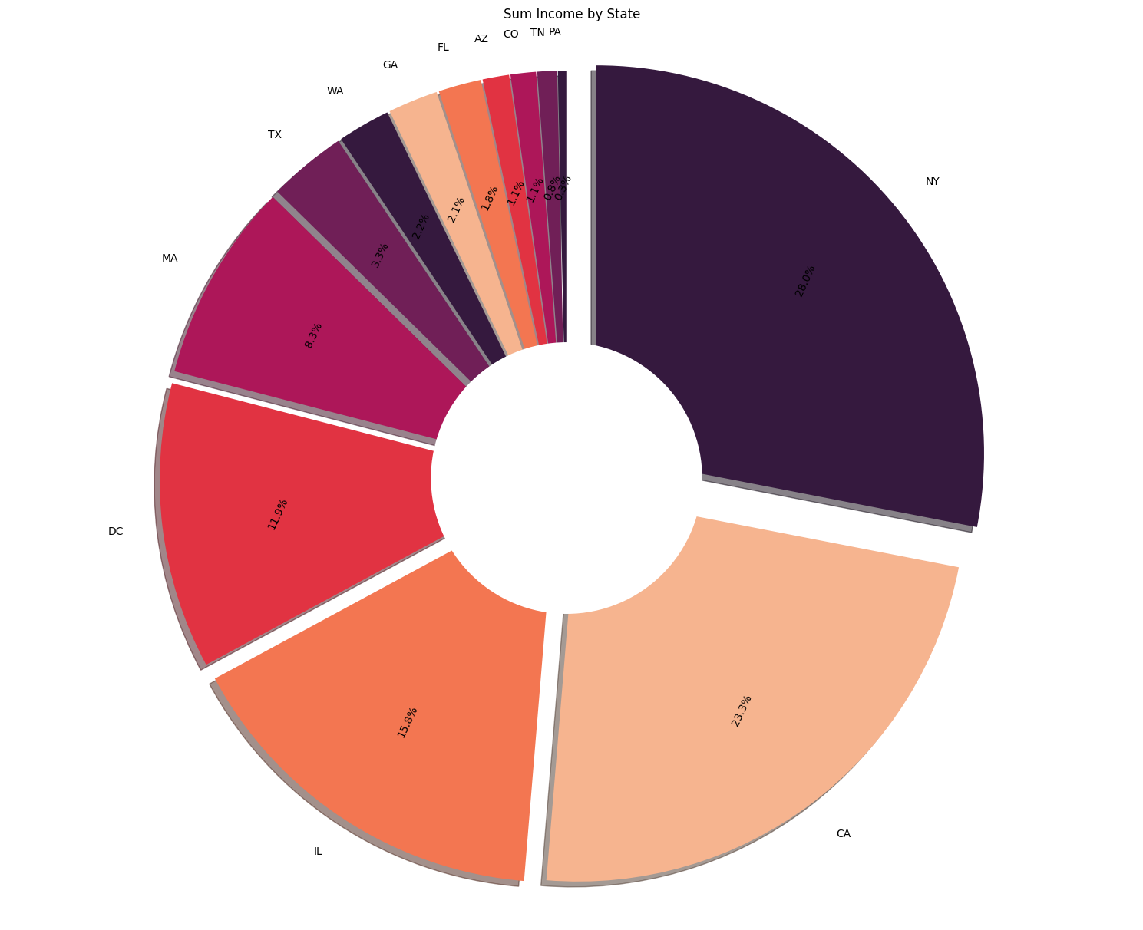
Here we can see the average income of different states. The cab companies can target high income states lik CA,NY,IL to increase their profits.

Slide 14
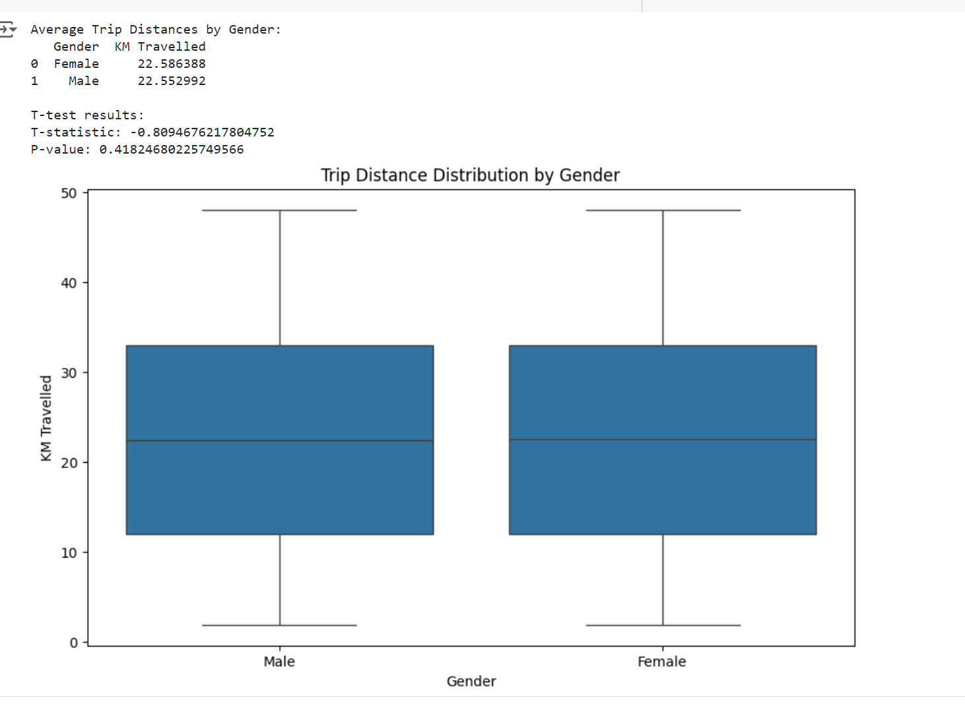
Hypothesis1: Impact of Gender on Trip Distance
The Hypothesis is proven false by the data as both men and women travel almost the same average distances

Slide 15
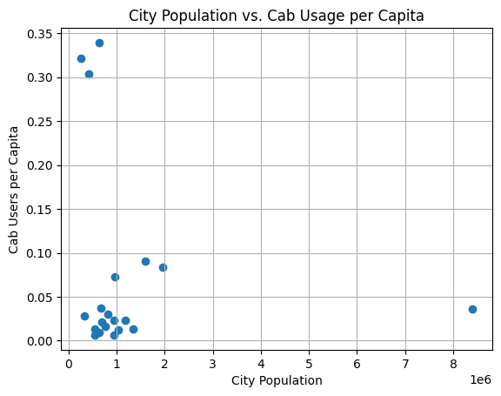
Hypothesis2 : There is correlation between population and cab users per capita in a city
Correlation between Population and Cab Users per Capita: -0.15031212128935015 The correlation is not positive, so the hypothesis is not strongly supported by this data.

Slide 16
Hypothesis 3: H0:The variable Year has not a positive correlation with mileage H1:The variable Year has a positive correlation with mileage
t_statistic: [-0.66243408]
p_value: [0.57581736]
Reject Alternative Hypothesis(H1)

Slide 17
Hypothesis 4: Is there any difference in profit regarding Gender H0 : There is no difference regarding Gender in both cab companies. H1 : There is difference regarding Gender in both cab companies.
P value is 0.11515305900425798
We accept null hypothesis (H0) that there is no difference regarding gender for Pink Cab

Slide 18
Hypothesis 5: Is there any difference in Profit regarding Payment mode H0 : There is no difference regarding Payment_Mode in both cab companies. H1 : There is difference regarding Payment_Mode in both cab companies.
P value is 0.7900465828793286 .We accept null hypothesis (H0) that there is no difference in payment mode for Pink Cab
P value is 0.2933060638298729 .We accept null hypothesis (H0) that there is no difference in payment mode for Yellow Cab

Slide 19
RECCOMENDATIONS
When both cab companies are compared, it is seen that the yellow cab is much more successful .It has a higher average profit per km, number of users, income,Total profit.Total Revenue
Since 2017 the profit made yellow cab is decreasing,Since 2018 the profit made by pink cab is increasing which could indicate that the pink cab company is growing whereas the yellow cab company might be going downwards though we need more data to be sure of that.
New York has the highest population and the most number of cab users . Whereas a city like Denver has high population but low number of cab users, cab companies can target cities like Denver with low users to population ratio to increase profits and revenue.

Slide 20
Thank You

