Slide 1
EARTHQUAKE PREDICTION
Tanmay Purwar RA1911033010072
Pranav Gupta RA1911033010074
Neelabh Saxena RA1911033010093

Slide 2
Abstract
Earthquakes have occurred since the planet came into being and yet we are still unable to
predict with even half decent accuracy their magnitude, timing or location. Government
and academic departments around the world have continued their hard work and in recent
years scientific evidence has emerged which one day could save thousands of
Earthquake prediction– It is usually defined as the specification of the time, location, and
magnitude of a future earthquake within stated limits and particularly of "the next strong
earthquake to occur in a region.

Slide 3
Issues
Why can’t we predict earthquakes?
• So far, scientists haven't been able to find a signal for earthquakes - there is no obvious sign to say that an earthquake is coming very soon. Vibrations can be detected just before an earthquake occurs, but this doesn't give enough time for people to escape.
• The processes that cause earthquakes mostly occur far below the Earth's surface. There are many tectonic plates - sections of the Earth's crust that rub together and cause earthquakes - and their interactions are complex. This makes earthquakes very hard to study.

Slide 4
Problem Statement
Anticipating seismic tremors is a pivotal issue in Earth science because of their overwhelming and huge scope outcomes. The goal of this project is to predict where likely and on what dates the earthquake will happen. Application and impact of the project includes potential to improve earthquake hazard assessments that could spare lives and billions of dollars in infrastructure and planning. Since given dataset is in form of .csv, we can tell it is outdated past occurred activity and yet so useful for predict or forecast in future that is yet to come, the places where quake would likely happen. Since this is event series problem type, proposed solution in this project follows considering binary classification of earthquake occurrence with training period includes fixed rolling window moving averages of past days while for which its labels, a fixed window size shifted ahead in time. The model will be trained with model_selection and compared with past data.

Slide 5
Objective
The objective of this project is to predict when the earthquake will take place.
Specifically predict the time remaining before artificial earthquakes occur from real-time seismic data performed in laboratories.

Slide 6
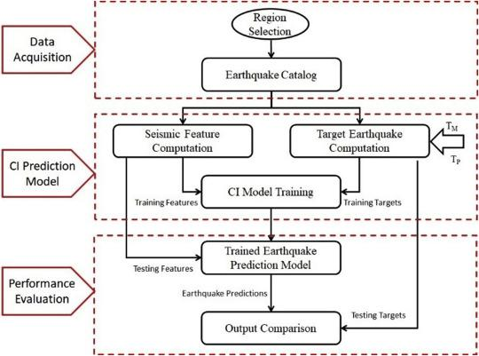
Proposed Methodology

Slide 7
Purpose of Problem Statement
As the purpose of short-term prediction is to enable emergency measures to reduce death and destruction.
Impact of this project: potential to improve earthquake hazard assessments that could save lives and billions of dollars in infrastructure.

Slide 8
Demo & Screenshots

Slide 9
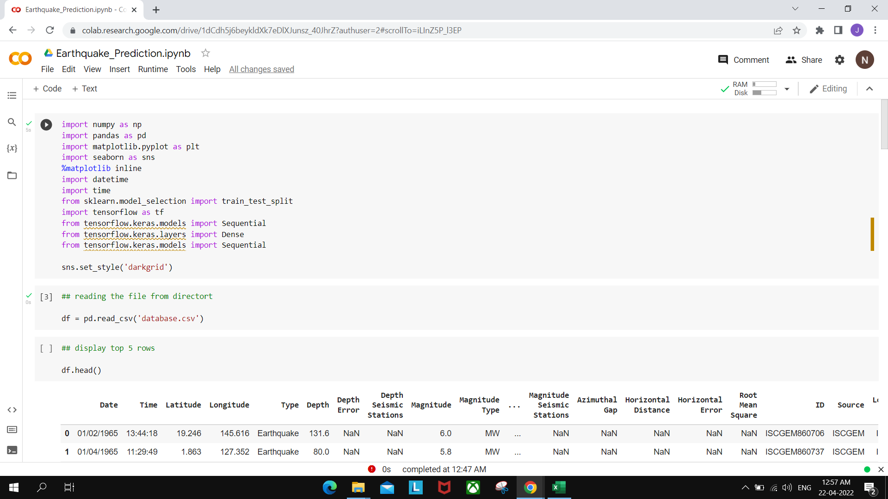

Slide 10
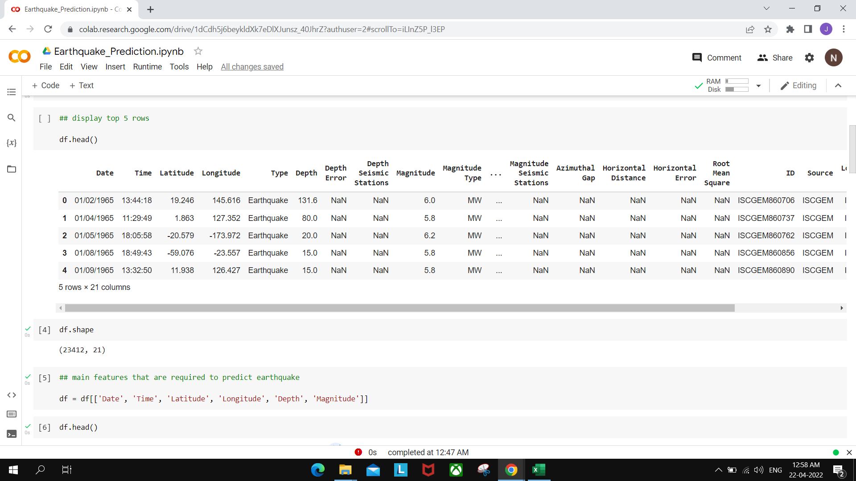

Slide 11
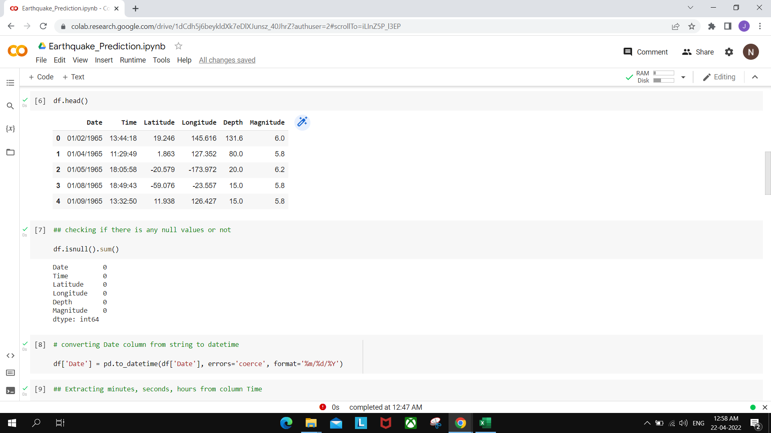

Slide 12
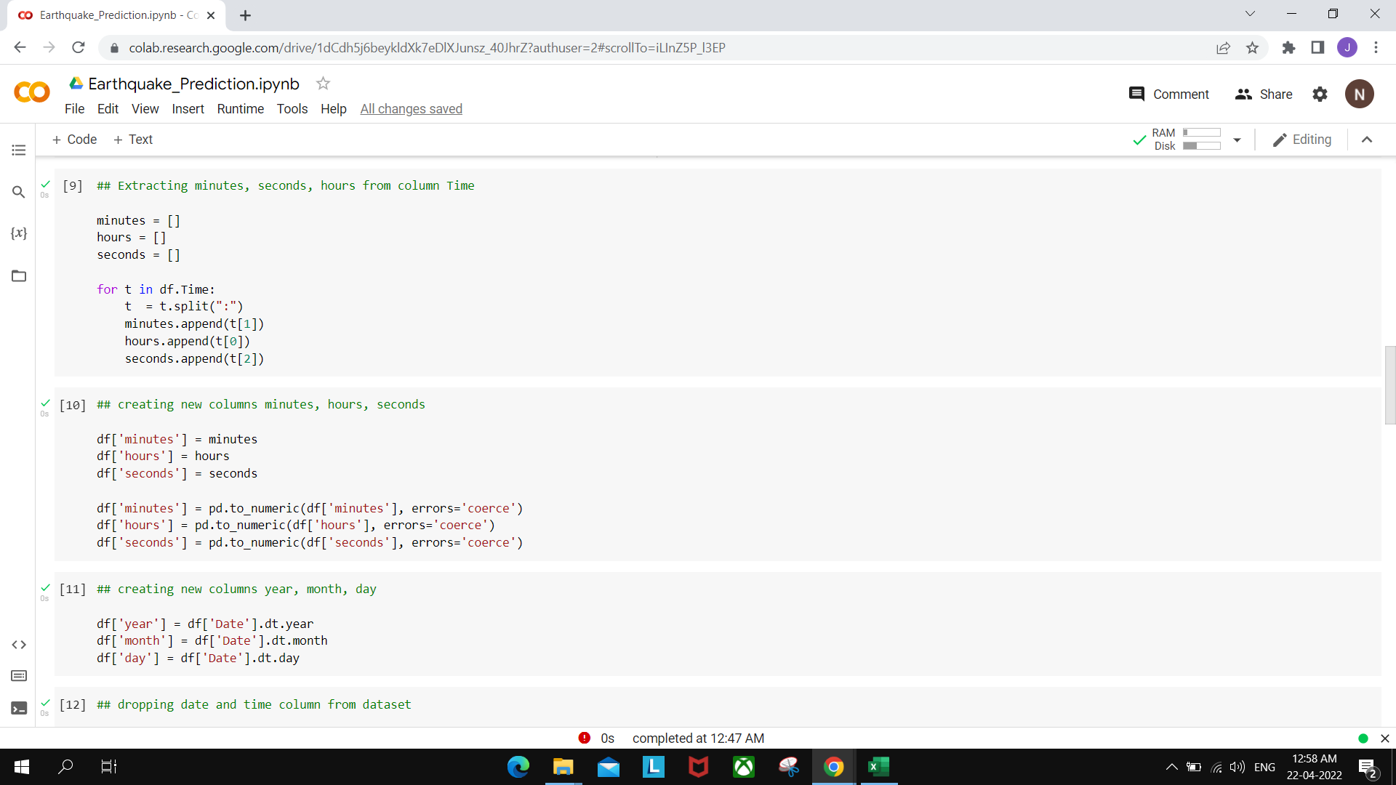

Slide 13
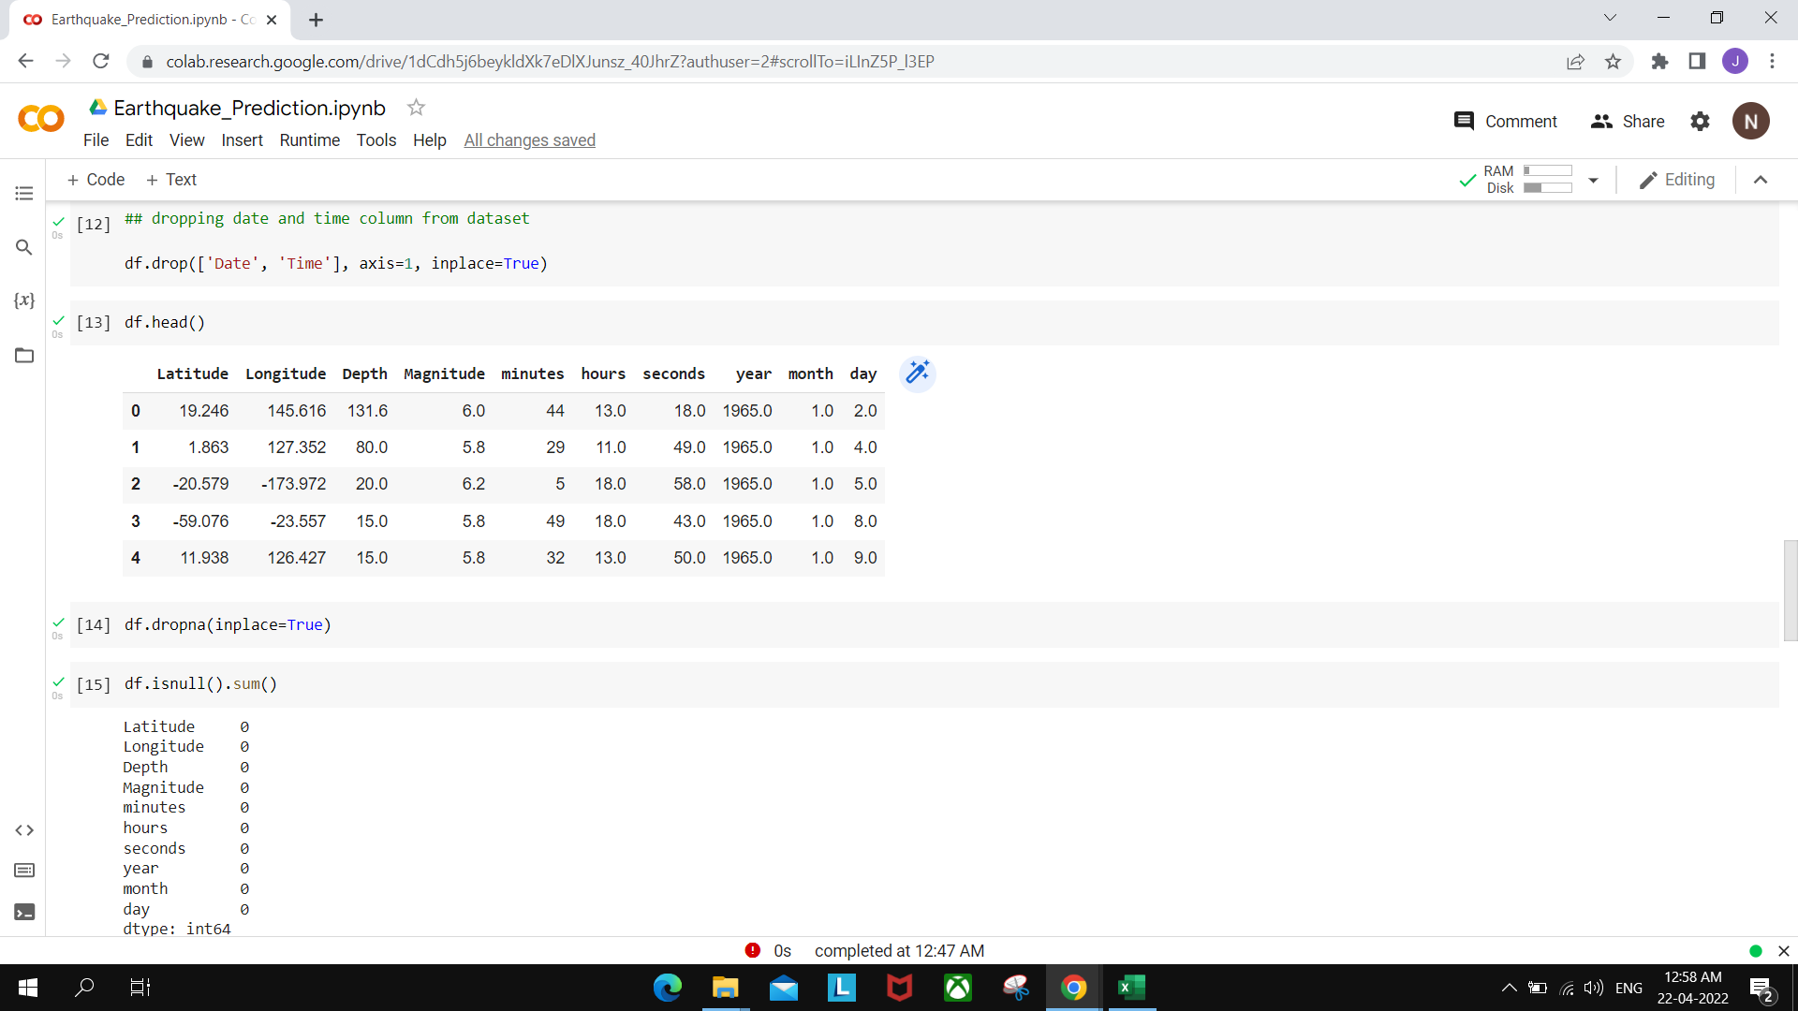

Slide 14
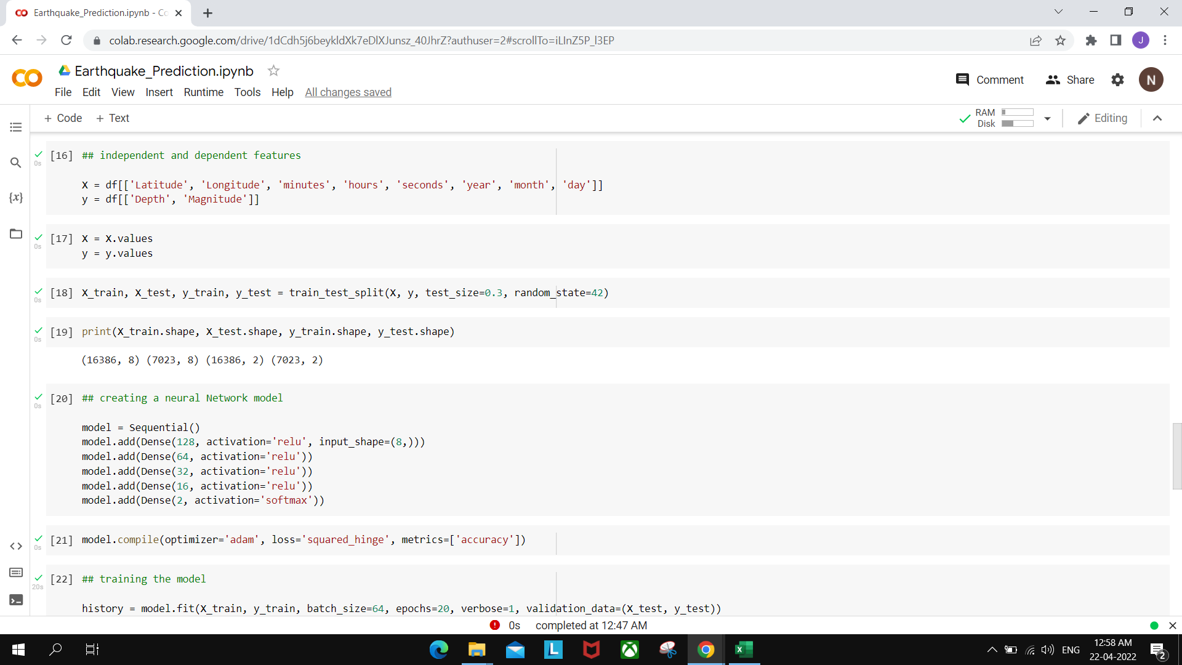

Slide 15
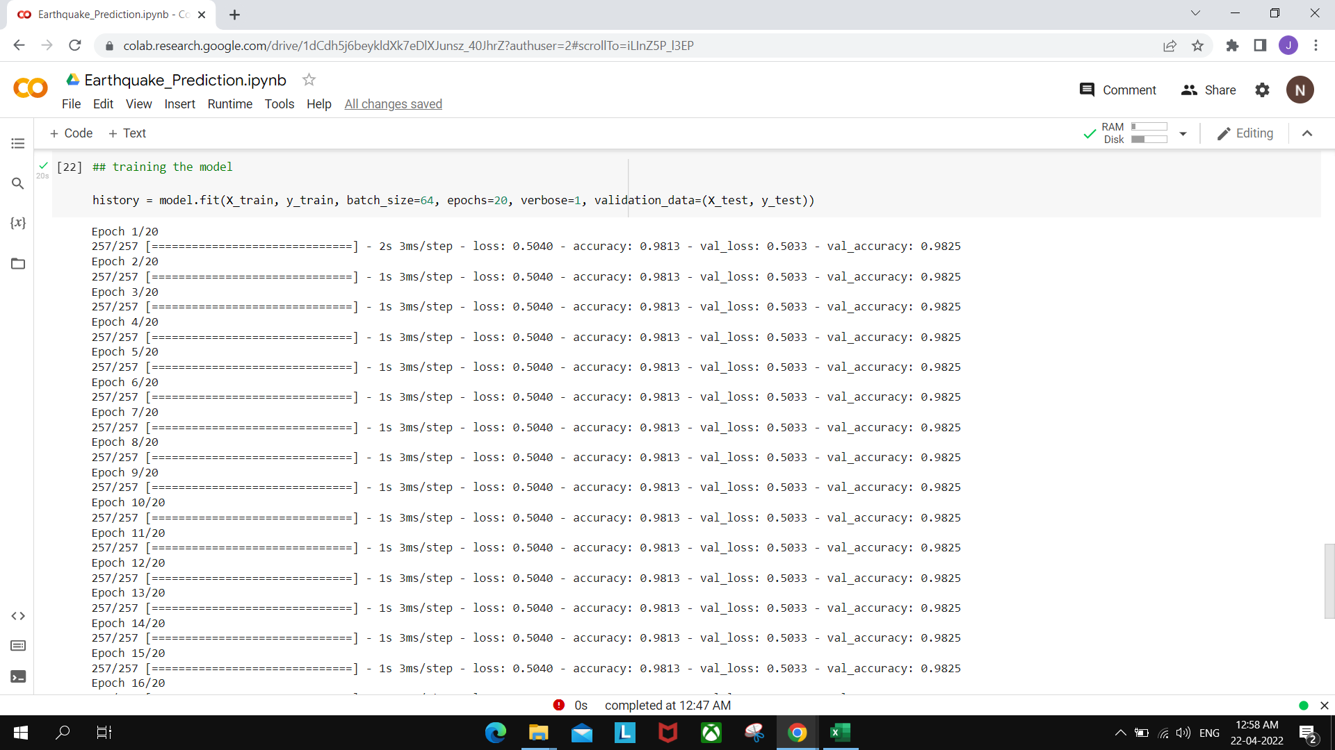

Slide 16
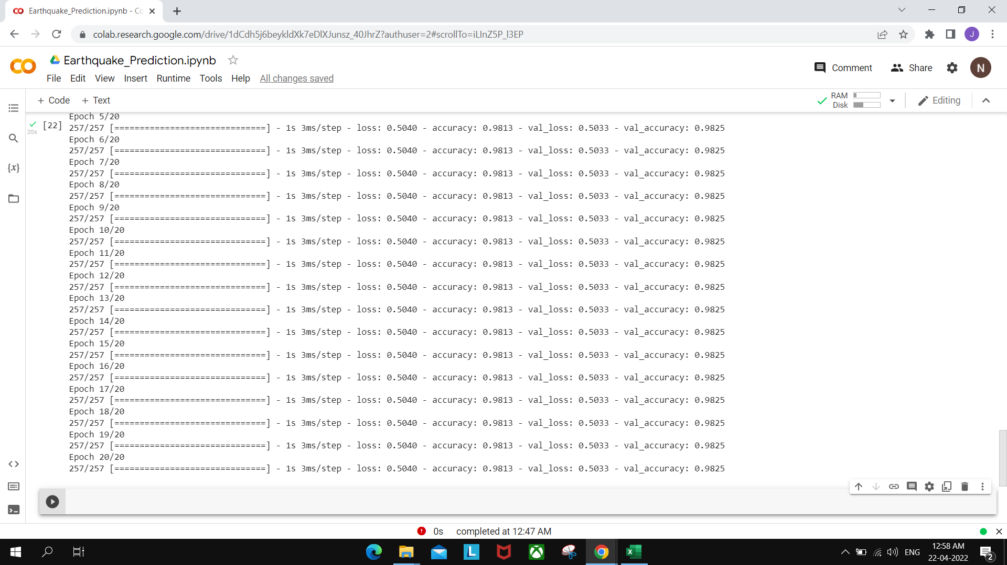

Slide 17
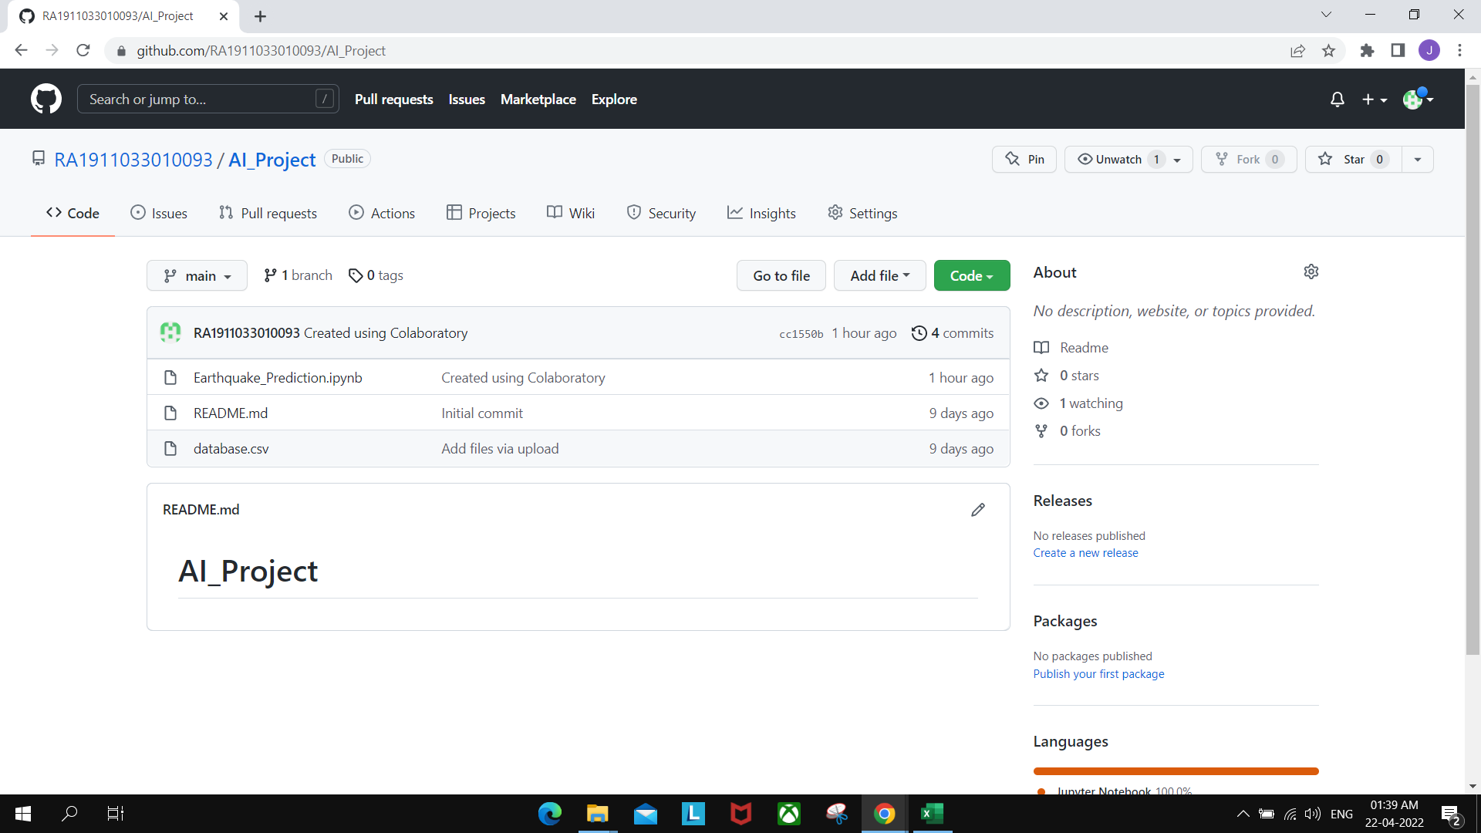
Proof of GitHub Upload

Slide 18
Thank You
& Have a Nice Day!
Prediction Table

