Slide 1

Two-side turing machine
By
Dheeraj garla(RA2111026010113)
Yaswanth kalluru(ra2111026010123)
Nihith penumuchu(ra2111026010124)

Slide 2
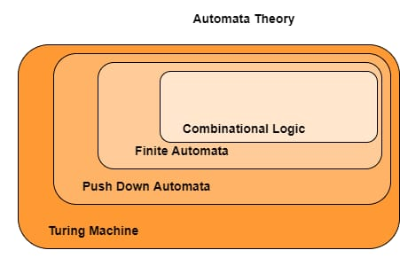
Agenda
Introduction
Objective of problem
Application
System architecture(flowchart)
Explanation
Example problem

Slide 3
Objective of the problem:-
reversing the string entered using the two-sided turing machine.

Slide 4
Applications:-
Here are the key characteristics of a two-sided Turing machine:
Bidirectional Movement: Unlike a standard Turing machine, which can only move its tape to the right or stay in place, a two-sided Turing machine can also move its tape to the left.
Enhanced Computational Power: Two-sided Turing machines are more powerful than standard Turing machines in terms of computation.
Equivalence to Standard Turing Machines: It's important to note that despite their enhanced capabilities, two-sided Turing machines are equivalent in computational power to standard Turing machines.
Two-sided Turing machines are primarily used in theoretical computer science to study the properties of algorithms and computability.

Slide 5
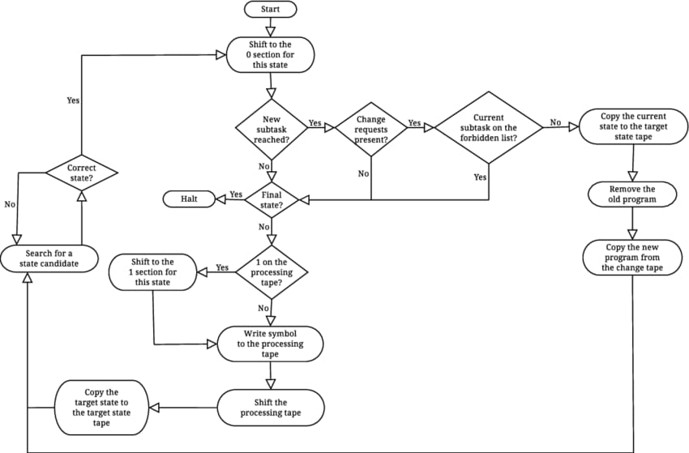
FLOWCHART

Slide 6
Team contribution
Dheeraj garla
(Ra2111026010113)
Nihith penumuchu
(ra2111026010124)
Yaswanth kalluru
(ra2111026010123)
CODE
CODE
PPT

Slide 7
Thank you

