Slide 1

SRM INSTITUTE OF SCIENCE AND TECHNOLOGY
FACULTY OF ENGINEERING AND TECHNOLOGY DEPARTMENT OF DATA SCIENCE AND BUSINESS SYSTEMS
IP ADDRESS FINDER
ABHAY SHAJI [Reg No: RA2112704010006]
SUJAL SINGH [Reg No: RA2112704010001]
VAMSHI GADDE [Reg No: RA2112704010017]

Slide 2
OBJECTIVE
Develop a system that can detect when IP geolocation fraud is occurring.
This system should be able to make automated decisions when possible.
When not possible, this system should gather additional information to help a human decide whether the IP is using correct geolocation or not.
This system should be able to process many IPs at once without supervision.

Slide 3
ABSTRACT
This project is based in C which is a ip address finder With the help of splay tree data structure, we would create a tree whose nodes are embedded with the Ip address of the device that are connect to a specific network router. In our code we have taken 11 devices connected to one network router and so there would be some common part in the Ip address of each of the devices.
Now, router gets some specific data packets from the net which is supposed to be given to a specified device and so it uses searching operation to find the correct Ip address. To increase the speed of this process we use splay tress for searching and inserting the Ip addresses.

Slide 4
Literature Survey
The splay tree
A splay tree is a self-balancing tree, but AVL and Red-Black trees are also self-balancing trees then. What makes the splay tree unique two trees. It has one extra property that makes it unique is splaying.
A splay tree contains the same operations as a Binary search tree, i.e., Insertion, deletion and searching, but it also contains one more operation, i.e., splaying. So. all the operations in the splay tree are followed by splaying.
Splay trees are not strictly balanced trees, but they are roughly balanced trees.

Slide 5
Literature Survey(Cont)
Like the AVL tree, the splay tree is not actually a distinct data structure, but rather reimplements the BST insert, delete, and search methods to improve the performance of a BST. The goal of these revised methods is to provide guarantees on the time required by a series of operations, thereby avoiding the worst-case linear time behavior of standard BST operations.
The splay tree access functions operate in a manner reminiscent of the move-to-front rule for self-organizing lists, and of the path compression technique for managing a series of Union/Find operations. These access functions tend to make the tree more balanced, but an individual access will not necessarily result in a more balanced tree.

Slide 6
Operations of splay tree
Operations of splay tree
When a node x is accessed, a splay operation is performed on x to move it to the root. To perform a splay operation we carry out a sequence of splay steps, each of which moves x closer to the root. By performing a splay operation on the node of interest after every access, the recently accessed nodes are kept near the root and the tree remains roughly balanced, so that we achieve the desired amortized time bounds. Each particular step depends on three factors:
Whether x is the left or right child of its parent node, p,
whether p is the root or not, and if not
whether p is the left or right child of its parent, g (the grandparent of x).

Slide 7
Operations of ST(Cont)
There are three types of splay steps, each of which has two symmetric variants: left- and right-handed. For the sake of brevity, only one of these two is shown for each type. (In the following diagrams, circles indicate nodes of interest and triangles indicate sub-trees of arbitrary size.) The three types of splay steps are:
Zig step
Zig-zig step
Zig-zag step

Slide 8
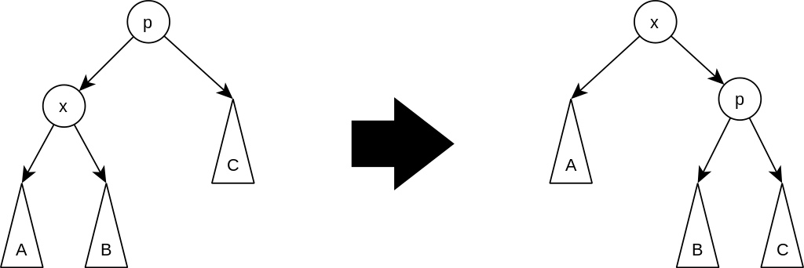
Operations of ST(Cont)
Zig step: this step is done when p is the root. The tree is rotated on the edge between x and p. Zig steps exist to deal with the parity issue, will be done only as the last step in a splay operation, and only when x has odd depth at the beginning of the operation.

Slide 9
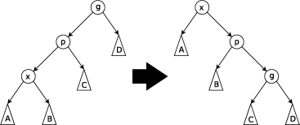
Operations of ST(Cont)
Zig-zig step: this step is done when p is not the root and x and p are either both right children or are both left children. The picture below shows the case where x and p are both left children. The tree is rotated on the edge joining p with its parent g, then rotated on the edge joining x with p. Note that zig-zig steps are the only thing that differentiate splay trees from the rotate to root method introduced by Allen and Munro prior to the introduction of splay trees.

Slide 10
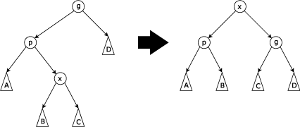
Operations of ST(Cont)
Zig-zag step: this step is done when p is not the root and x is a right child and p is a left child or vice versa (x is left, p is right). The tree is rotated on the edge between p and x, and then rotated on the resulting edge between x and g.

Slide 11
Operations of ST(Cont)
Join
Given two trees S and T such that all elements of S are smaller than the elements of T, the following steps can be used to join them to a single tree:
Splay the largest item in S. Now this item is in the root of S and has a null right child.
Set the right child of the new root to T.
Split
Given a tree and an element x, return two new trees: one containing all elements less than or equal to x and the other containing all elements greater than x. This can be done in the following way:
Splay x. Now it is in the root so the tree to its left contains all elements smaller than x and the tree to its right contains all element larger than x.
Split the right subtree from the rest of the tree.

Slide 12
Operations of ST(Cont)
Insertion
To insert a value x into a splay tree:
Insert x as with a normal binary search tree.
when an item is inserted, a splay is performed.
As a result, the newly inserted node x becomes the root of the tree.
Alternatively:
Use the split operation to split the tree at the value of x to two sub-trees: S and T.
Deletion
To delete a node x, use the same method as with a binary search tree:
If x has two children:
Swap its value with that of either the rightmost node of its left sub tree (its in-order predecessor) or the leftmost node of its right subtree (its in-order successor).
Remove that node instead.

Slide 13
The Splay Tree Advantages
Splaying ensures that frequently accessed elements stay near the root of the tree so that they are easily accessible. By staying near the top of the tree, the tree can benefit from the locality of reference.
The average case performance of splay trees is comparable to other fully-balanced trees: O(log\space n) O(log n).
Splay trees do not need bookkeeping data; therefore, they have a small memory footprint.

Slide 14
The Splay Tree Disadvantages
The major disadvantage of splay trees is that - although unlikely - a splay tree can arrange itself linearly. Therefore, the worst-case performance of a splay tree is O(n).
Multithreaded operations can be complicated since, even in a read-only configuration, splay trees can reorganize themselves.

Slide 15
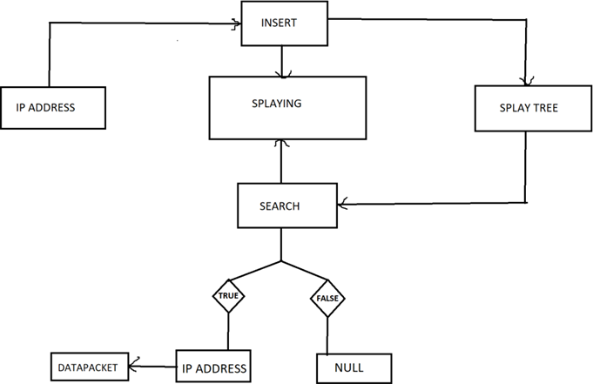
Block Diagram

Slide 16
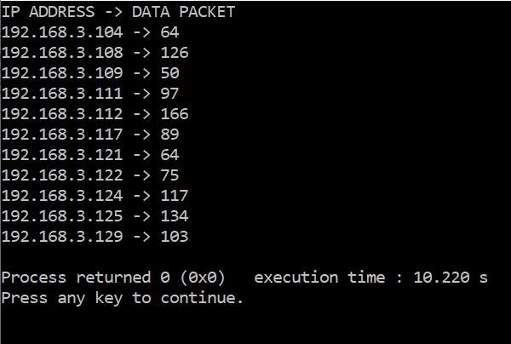
Output Screenshots

Slide 17
Feature Extraction
We find relationships among the app popularity, categories, open source and LoC, and explore reuse of smart contracts and source codes. Our findings provide valuable implications for different stakeholders in the decentralized application industry and in the research community of blockchain and decentralized applications. This paper mainly focuses on the descriptive analysis of the apps. In future, we will focus questions about the app projects and source codes, such as how to build the app project, how to keep synchronization on and off the chain, and how to improve throughput of the apps

Slide 18
Thank you

