Slide 1
The Control System from the View of:
Commissioning,
Operation and
User Interface
Mark Pleško
mark.plesko@cosylab.com

Slide 2
Caveats
A personal view, not a series of facts
Deliberately provocative
  Trying to point out the obvious that people don’t talk about
I work (and am co-founder and co-owner) at a commercial company that sells control system development and consulting
  And might try to be selling my services to you!
    even subconsciously ☺

Slide 3
Part I: What the Hell is a Control System?
Part II: Engineering or Black Magic?
Part III: Or is it Art?

Slide 4


Will Avoid Eternal Topics for Discussions...
Commercial or in-house?
  how to measure benefit/cost
software sharing yes/no?
  and why it never works
real-time - hard/soft or not at all?
  who really knows what is real-time?
  1 second response time can be real-time!
maintenance
  software doesn’t wear!

Slide 5

… like Microsoft vs. the World.
Unix vs. Windows NT
  Both claim to be open systems
EPICS vs. TANGO vs. TINE vs. ACS vs. ...
Does the bone fight ?

Slide 6
What Is Meant By “Control System”
Not a shrink-wrap package with an installation wizard, but rather a service
  Engineering according to specifications
  Configuration of packages like EPICS, TANGO or ACS
    Some hope this is just a few days of work
  “Outsourcing” software/hardware development
  Installation
    Some believe this refers to cabling
All customized for a specific accelerator

Slide 7
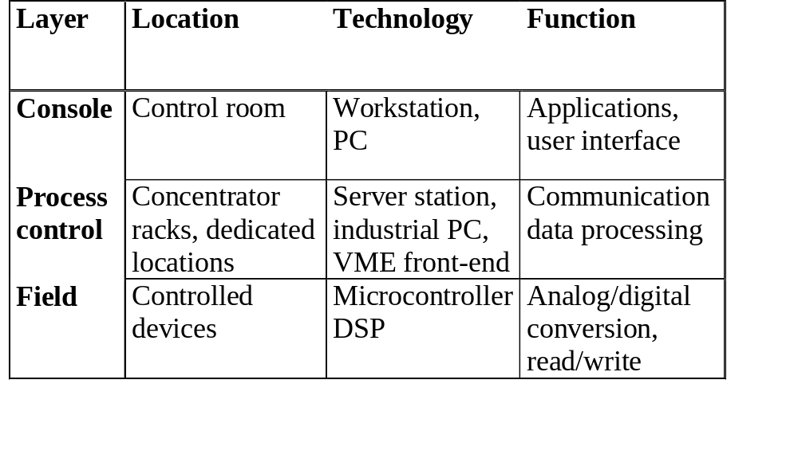
The Cabibbo-Kobayashi-Maskawa Matrix of Controls?

Slide 8
From the Analog to the Digital...
Graphical User Interface
Front-end,
Data aquisition
Communication
mechanism
gauge
sensor
wire
local computer
SNSR1 8.76
SNSR2 -0.9
SNSR3 5.61
terminal connection
terminal

Slide 9
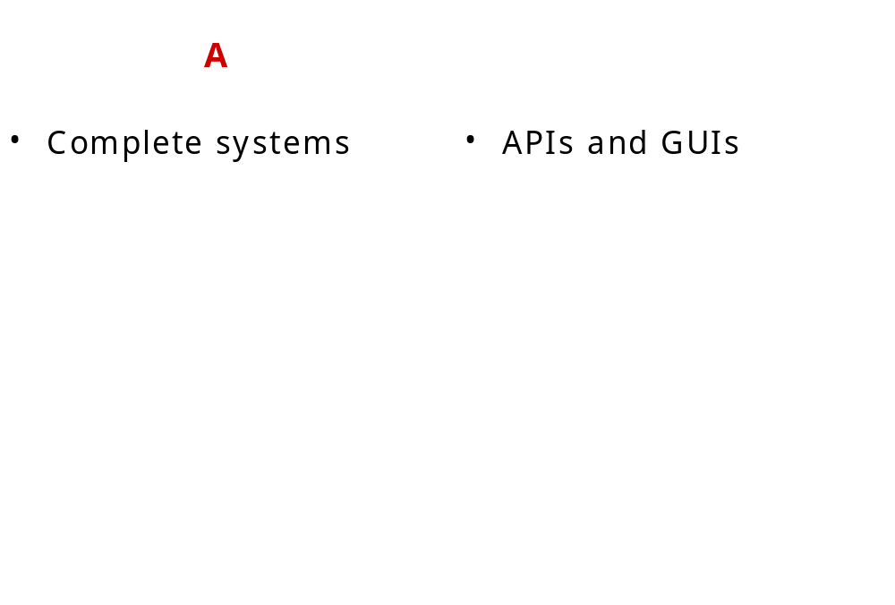
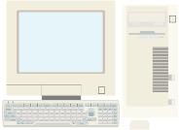

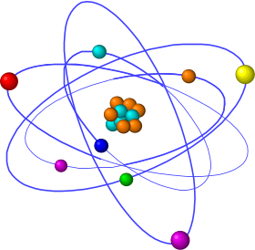

… to the Distributed Era
fieldbus
Branch
controller
LAN
Control Room
...
VME
switch
PLC
Internet

Slide 10
Confused?
Check this Object Oriented Programming language:
  “persistent store”
  “method”
  “field”
Translation:
  save to file
  function, subroutine
  variable
Just don’t trust buzzwords!

Slide 11
How To Compare Control System Packages
^{EPICS}
^{chan. acc.}
^{MEDM}
^{TINE}
^{ACOP}
^{DOOCS}
^{DDD}
^{COACK}
^{TANGO}
^{ACS}
^{CDEV}
^{JDM}
^{Abeans}
^{CosyBeans}
driver data
SERVER
commu-
nication
API visual support
CLIENT
All have applications (alarm manager, GUI, logger, trending, scripting etc.), but their quality, flexibility, configurable etc. makes the largest difference
Notes:
To illustrate the difficulties (and dangers) of making comparisons such as these we note that, just comparing TINE and EPICS is already like comparing apples and oranges. TINE is more of a communication protocol and should be compared to channel access. Note also that the EPICS database is really at the lowest level of the control system. One should be aware of this point, because when people say EPICS, they mean the whole lot of very unrelated things like the database, the channel access protocol and the MEDM GUI tool. The database is a viable idea and - apart from some historic glitches that are being addressed in the upcoming versions, like the short limit for names, poor debugging options - a useful approach for I/O integration. Such low-level IO integration is frequently not found in CS packages, DOOCS being a notable exception, where similar concepts are also in place. The problem for a CS integrator might be the EPICS extensions, which one is forced to use by taking EPICS or one is forced to develop with the limited API that is available.
As we see, each package has certain advantages, unmatched by any other package. So, apart from simply allowing religious freedom to reign, where each engineer can use his preferred package (but the systems coordinators nonetheless have to get the accelerator to operate), there are actually good reasons to mix the control systems in order to get best-of-breed services and applications.

Slide 12
Which to Choose?
Don’t worry:
  Computing including control is now totally industry driven
  modern computer technology allows any reasonable implementation of software and hardware to function properly
So what is really important?
  To define the development procedures
    Project management
    Resource plan
  To make everyone agree on the interfaces (not just API)
  To have documentation (specs, design, test plan, etc. maybe even manuals) before implementation starts

Slide 13
Part I: What the Hell is a Control System?
Part II: Engineering or Black Magic?
Part III: Or is it Art?

Slide 14
Development Procedures: Control System is NOT just Playing with Software
Control Systems are an engineering discipline like all the others, but with an even more complicated cycle
  Write specifications
  Architecture
  Design
  Prototyping – probably the only fun part
  Test procedures
  Implementation (coding) – the only software part
  Documentation
  Testing
  Debugging
  Acceptance at customer

Slide 15
What Operations Should Agree With Control Group Before Development Starts
User Interface and Operation Procedures
  You have to write at least the requirements
    Don’t forget 2nd order effects – define error conditions!
  Even better to provide specifications
    You have to actually think about procedures and write them up!
  dummy screenshots (use pencil and paper, PPT, VisualBasic, LabView, whatever you are comfortable with!)
Signal List
  Signal names (define name convention and stick to it – allow no exceptions)
  Don’t forget alarm levels and operational limits – 2nd order again

Slide 16
What Operations Should Agree With Control Group Before Commissioning Starts
Logistics of installations
  What is first: the hen or the egg?
Error handling
  How the system behaves when I/O or other errors occur
Bugs
  Plan testing, debugging and workarounds
Configuration management
  Critical during commissioning

Slide 17
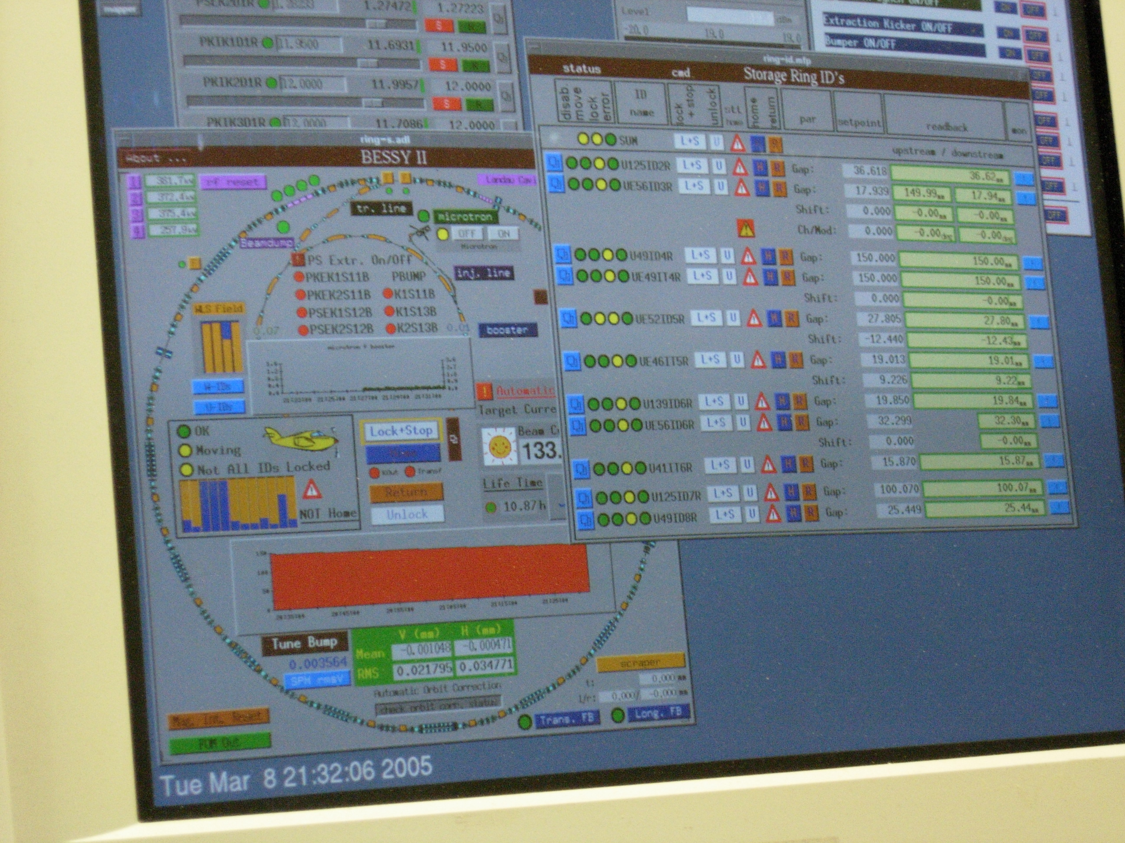
Operations: The One Button Machine
status
  BESSY
sequence
  Elettra
Model driven
control
  GSI
Who writes
this?

Slide 18
Why Everybody Thinks She/He Can Write Software?
Would you build the vacuum chamber or the magnets yourselves?
Why not?
  Too complicated (technically, procedures, volume)
  Boring (not fun playing)
What’s so different about the control system then?
  It can be changed arbitrary number of times?
  It can’t be described by a Hamiltonian!

Slide 19
Other Real Problems
It’s faster to do it than to write specs
  True, but if you don’t write specs for yourself, you’ll be in trouble later
Physicists (or operators?) change requests
  True: use economic principles, let them pay the price!
Specs, targets are not clear
  May happen, but then also your costs aren’t under control
  Indicates that team leaders are good in technology but bad in management

Slide 20
Should Operators Write Panels, Then?
For operator-programmers: maintenance, upgrades
Wrong!
N Operators are smart: but get N+1 different solutions
Nobody is writing documentation unless forced
  Operator will just use the panel
  In-house control person will at least tell you
    until she/he is gone
  External company is forced to write it because of payment
Rule from finances: a single person handling both purchasing and payments will cheat sooner or later

Slide 21
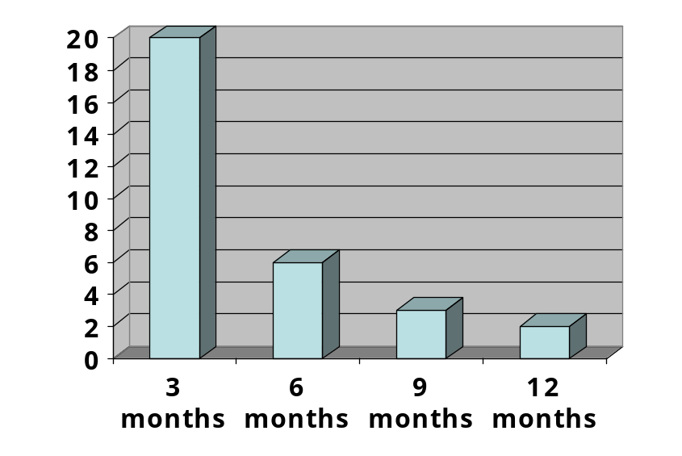
It Just Takes Time (There Is No Silver Bullet)
Saving money costs more time than you think
  Time is money – expensive is what you can’t get done!
  Big effective cost of new people
Why is so little done in a day?
  Effective work time is 4 hours
But it’s only a matter of a few hours
  With or without bugs?
  Beware of 80/20 rule
Writing documentation takes 1 day per page
We just take the software from another lab
  It takes as much time to understand software as to write it

Slide 22
The Three Phases of Development Chaos
We will write specs, but we don’t know yet what
We have some nice technical prototypes, and we don’t really need any specs for now
We should have thought about specs before, but now we have already invested so much of our work that we can not justify throwing it all away

Slide 23
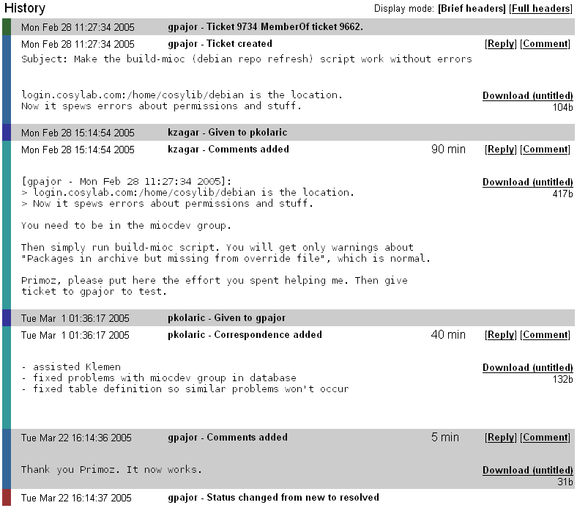
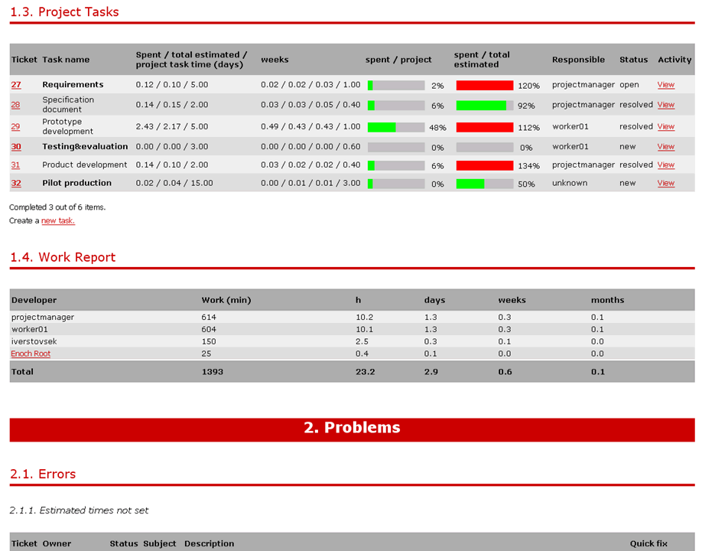
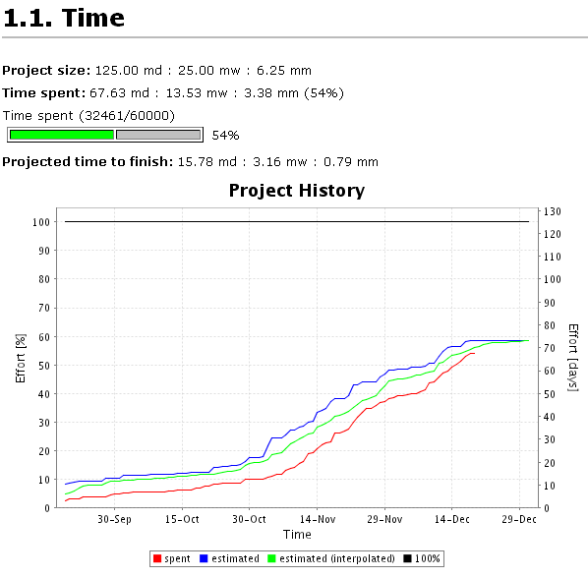
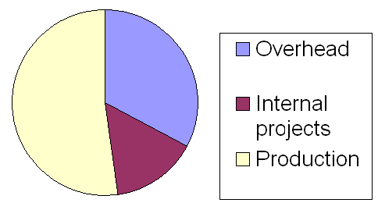
Use Project Management/Reporting Software
Web/email ticketing system
Measure and analyse time
“on-click” project reports
Notes:
Imas desettisoce kontrolnih tock.
Zadeve gredo s svetlobno hitrostjo.
Imas 64 anten.
Marsikaj gre lahko narobe.
Zadeva je dinamicna - dodajajo in odvzemajo se naprave.
Naprave so si med seboj razlicne, a precej podobne funkcionalno...
Imas 100 racunalnikov.
Rad bi kontroliral 20000 km stran.
Vam je ze kdaj crknil program? Kako se je javila napaka - intuitivno?
Povezat reda 100 racunalnikov med seboj. Kilometre kablovja, ipd ipd.

Slide 24
Part I: What the Hell is a Control System?
Part II: Engineering or Black Magic?
Part III: Or is it Art?

Slide 25
Common Sense Rules
You are, what you wear
  how to find a “good” dress except by the price?
OSF/Motif: know the user; empower the user
  Consistency everywhere
    Don’t lie to the operator (P. Clout, Vista)
    Make consistent reactions to user actions even in different contexts
    use same conventions as computing environment
      Save or store, open or load, left- or right-click
  Details are very important
    but noticed only when they’re absent
    industry average in client/server: GUI takes ~60%

Slide 26
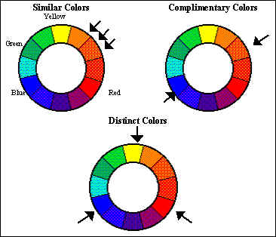
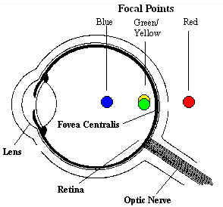
Use Colour Effectively
Minimize colour
  pastel background, consistent with ambient light
  7+/-2 colours for state

Slide 27

Layout
Reduce “eye scan time”
  Lower case and b/w
  align onto grid; 70-80% “white” space or tables
  use icons, gauges, charts, etc.
Visible vs. hidden information
  Tiled vs. overlapping windows
    ignore mouse clicks in background GUI
  sub-menus and sub-windows only for options
  minimize pop-up/dialog windows
    “Cancel” always does nothing
      Do you want not to do it: yes/no?

Slide 28
How We Did It for ANKA
Identify all GUI atomic actions/widgets
Combine those actions into unit blocks
Add secondary functionality to blocks
  (error handling, setup windows, config files…)
Blocks have reasonable defaults + customization sub-panels
Extensively test those blocks
Write good user/programmer manuals
Compose panels just out of these blocks

Slide 29
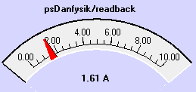

Make Complex GUI Widgets
}
ADC.description()
Gauge
ADC.max()
ADC.get()
ADC.unit()
}
Ulong bitPattern()
color[] whenSet()
Status
color[] whenCleared()
String[] bitDescription()

Slide 30
Advantages of Complex Widgets
A result of long thinking, designing, comparing, testing, reconsiderations, etc.
Consistent behaviour of widgets in all panels
  connection+timeout handling
  colour coding of states and alarms
  relate error codes to meaningful messages
No duplication of programming efforts
  no subtle differences to learn
Small number of different widgets
  adding new features quickly is possible

Slide 31
My Own Experiences
People complain anyway
Negligence backfires very strongly later
  difficult to introduce new, albeit better behaviour
Highlights of user feedback
  Bugzilla rulez !
  Timeout warnings
  Save to file in correct default directory
  Ramping table: Excel is so much more powerful
Provide central logging of panels
  important for remote and post-mortem debugging

Slide 32
Some Words About Help
Who really reads it?
  people want real help, not a document!
Need an editor, not related to programmers
  thankless job – find many errors and criticize people who have already put a lot of effort
Give a template to authors
  but even then the editor has work to do
keep consistent crosslinks and references
In-house docs are rarely good and finished

Slide 33
Conclusions
What is a Control System?
  Software and Control will go where other subsystems went
  Even if not, it is wise to write specifications anyway
Engineering, Art, or Black Magic?
  Like we need to master the technique before we can create art
  So there is artistic creativity in finding engineering solutions
Who is responsible for all this: Controls group, Operations or the Project Leader?
  Don’t use desing by committee
  Just don’t leave it to the European Commission ☺

