Slide 1
Multilevel Parking System

Slide 2
PRESENTATORS
Course Name : Microprocessor & Embedded Systems
Course Instructor :MD ALI NOOR
Section : I
Group: 03
ID | Name
21-45153-2 | LABUNY AKTER JIMMY
22-46207-1 | RAFSAN MAHMUD
22-46211-1 | AKID MAHMUD
22-46229-1 | ISHTIAK BILLAH EMON
22-46242-1 | M SHAHRIAR ALAM SHAJID
22-46442-1 | AFIFA AKTER MARIA

Slide 3
TABLE OF CONTENTS
1
Introduction
5
Working Method
2
Objective
6
Result
3
Components
7
Discussion
4
Diagram
8
Conclusion

Slide 4
01
INTRODUCTION
With the emergence of parking technologies, parking management systems have become an essential attribute of the whole parking process for parking operators and users. Parking management without a proper system is complex nowadays. Parking management systems are pretty convenient and flexible when controlling the flow of vehicles in a parking area. This project is about multilevel parking system. A multilevel parking system is a way of autonomously parking and retrieving vehicles using a microprocessor system and signaling devices. It provides benefits such as safety, conserving space, time, and fuel, but requires careful assessment of parking requirements, space availability, and traffic flow.

Slide 5
OBJECTIVE
02
Through this project, a multilevel parking system can be constructed which is necessary for parking management, especially in busy cities. To conduct this experiment, microprocessor and embedded systems, digital logic components such as logic gates, servo motor, sensors, Arduino board, 7-segment display were used. The main objective of this project is- To develop a system to avoid overcrowding and congestion in the parking space. To show proper automated space availability response to user by opening gate for whether any level or which level has vacant parking space or not for avoiding extra vehicle entrance jam and handling car parking safety.

Slide 6
03
Components
1
2
3
4
3 input NAND Gate
NOT Gate
Breadboard
16X2 LCD Display
5
6
7
8
Servo Motor
Jumper Wire
IR Sensor
Arduino UNO Board

Slide 7
04
Diagram
BLOCK DIAGRAM
CIRCUIT DIAGRAM

Slide 8
BLOCK DIAGRAM
Block diagram of multilevel parking system with actuated gate control along with display.
IR Sensors
Arduino
Display
Servo

Slide 9
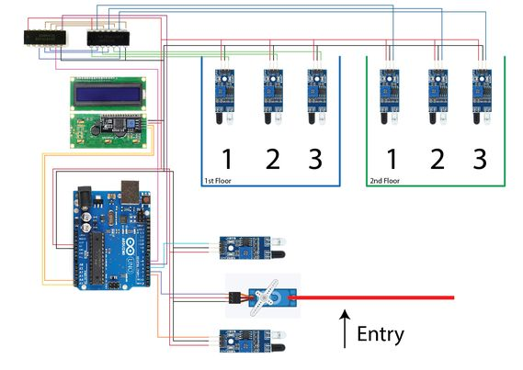
CIRCUIT DIAGRAM
In Our Multilevel Parking System, we use 2 level Parking space using Arduino UNO Board.

Slide 10
Working Method
05
Counting
Arduino Board
Display
Counting the number of vehicle we use IR sensors, Servo Motor and Arduino UNO board.
We use Arduino boards to read inputs - light on a sensor, activating servo motor, turning on LED.
We use 16X2 Display because it can display 16 characters per line and there are 2 such lines.

Slide 11
RESULT
06
Here we mention the simulations of this system

Slide 12
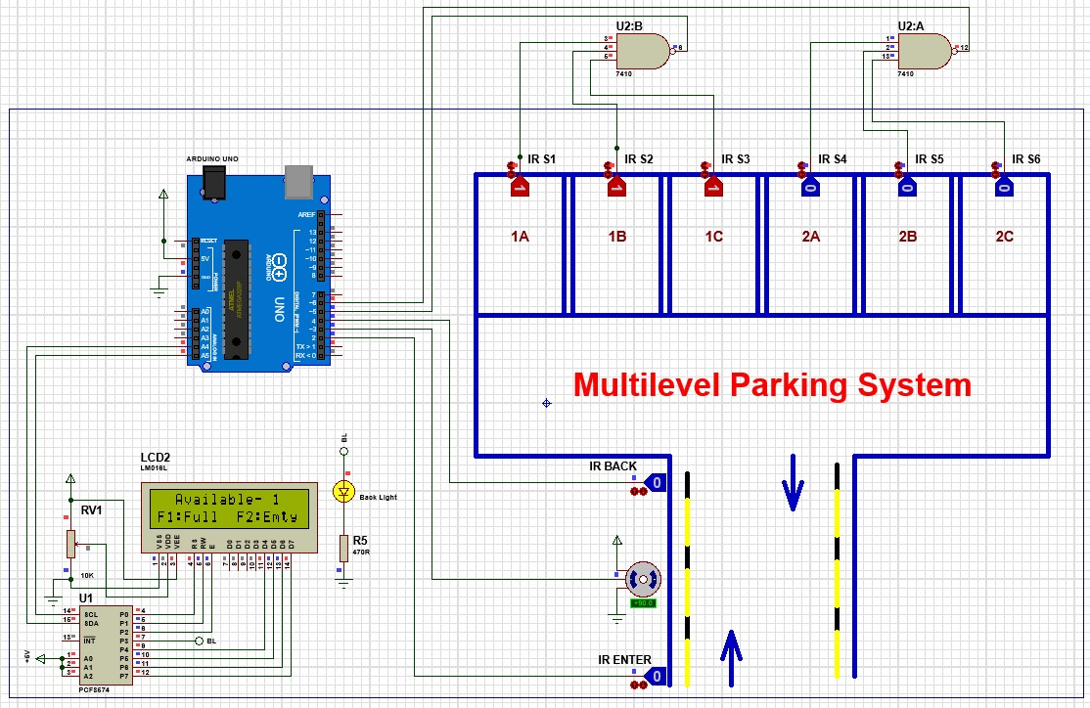
Simulation of First Floor FULL

Slide 13

Simulation of Second Floor FULL

Slide 14

Simulation of 2 Empty Slots in 2 Floors

Slide 15

Simulation of ALL Empty

Slide 16

Simulation of Parking Full

Slide 17
Discussion
07
We use IR sensors which are low power consumption, high sensitivity and high dynamic range, extremely compact and Inexpensive. In this parking system, if any IR sensor has defects, accurate vehicle presence won't be detected. Similarly, if the display has any defect, it will not show anything of available spaces. Here in every parking space sensor was used. But in a bigger parking system, this much sensors along with other components are costly. In case, any component gets damaged, we have change it immediately. It can be Arduino UNO board or logic gates.

Slide 18
Conclusion
08
In this report, the concept of multilevel parking system was discussed which uses sensors to detect whether there is a free parking space available or not. The various types of sensors, their applications, advantages and limitations were also discussed. In conclusion, the multilevel parking system project using digital logic component, sensor, Arduino board provides an effective and reliable solution for managing parking spaces. The system accurately detects vehicle entry and parking availability, guides driver to empty spot and incorporates features light display and LEDs. Future advancement to this system can make it more easy and secure to use.

Slide 19
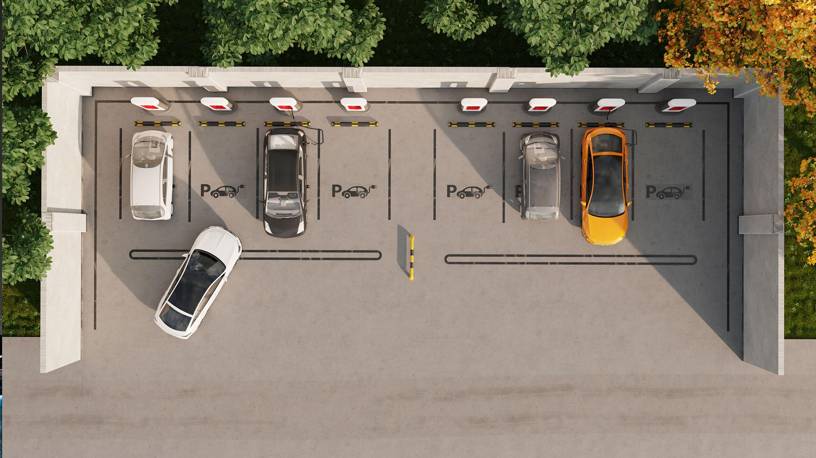
THANK YOU!

