Slide 1

Face Recognition using Graph Auto Encoder
A Minor Project Final Presentation
Under the guidance of
Dr. Swarup Roy
Professor
DATE: 15th March, 2023
Department of Computer Applications, Sikkim University, Gangtok-737102, India
Submitted By:
Krishanu Bhattacharjee 20MCA006
Ram Babu Ray 20MCA013
Rashmi Keot 20MCA014

Slide 2
CONTENT
1. Introduction
a) Face Recognition
b) Uses of Face Recognition
2. Literature Study for Face Recognition
a)EigenFace method
b)Template matching
c)Convolution neural network
d)Artificial neural network
3. Our Approach for Face Recognition
a) Motivation
b) GNN, and reason for using GNN
Proposed Methodology for Minor Project
Experiment & Results
6. Conclusion
7. References

Slide 3
Introduction
Face Recognition:
It is way of identifying a person, using image of their face.
Face recognition is the better option than biometric and Iris authentication.
It involves minimal effort to take testing samples from the end user.
Uses of Face Recognition:
In recent years it has been actively used for security Purpose.
Finding missing peoples and to identify criminals.
Use it in institutes for attendance tracking.

Slide 4
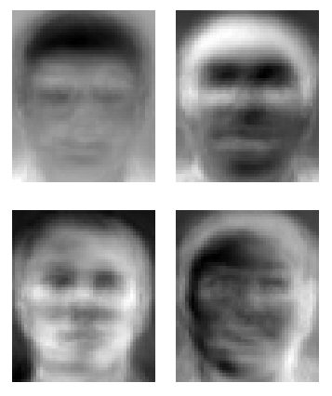
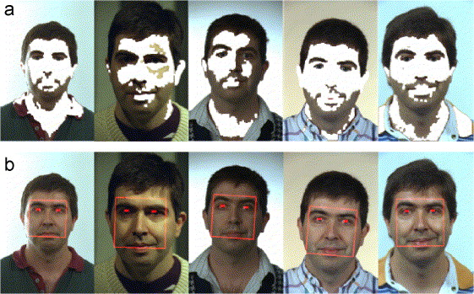
Literature Study
Eigenface Method[1]
Eigen faces (it is similar to blurry image). In this method machine learning model takes training images, converts it into Eigenfaces and this image is compared with those eigen images.
Disadvantages: If a person is smiling or changing the posture of its face and also if the image of the face is rotated or captured from different angle it cannot recognize
Template matching[2]
Divide image into segments and match with a template image.
Disadvantages: If a person is smiling or changing the posture of its face and also if the image of the face is rotated or captured from different angle it cannot recognize

Slide 5
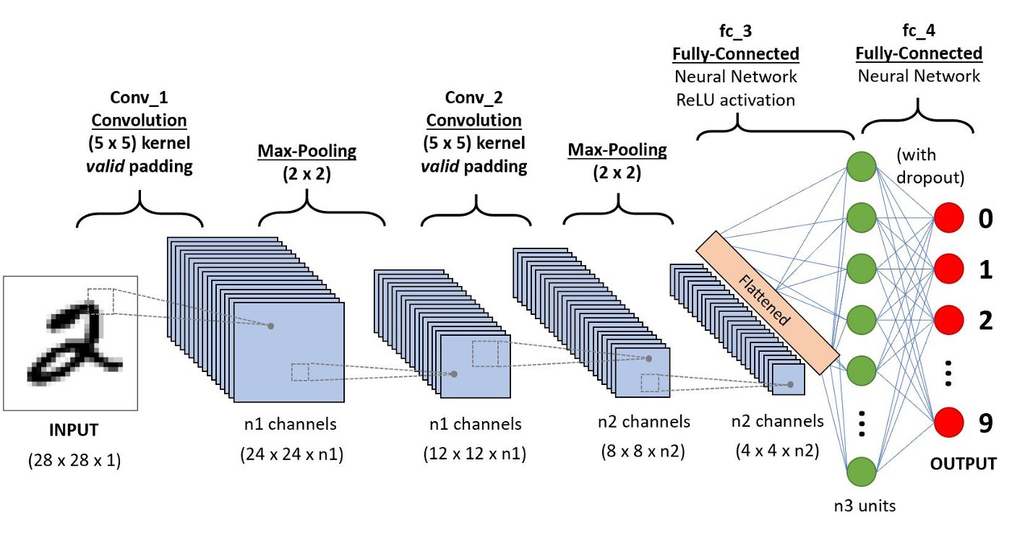
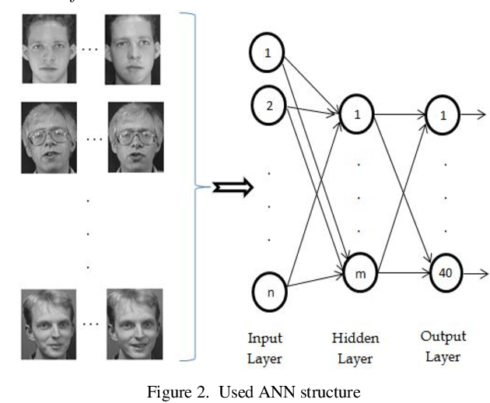
Convolution Neural Network[3]
This model works on the pixel values of image,
it classifies input image into based on some target .
Disadvantages :CNN do not encode the position and orientation of object,Lack of ability to be spatially invariant to the input data,Lots of training data is require.
Artificial Neural Network (ANN)[4]
ANN pass information in one direction, through various
input nodes, until it makes it to the output node.
Disadvantages :Hardware dependence,Unexplained behavior of the network,Determination of proper network structure.

Slide 6
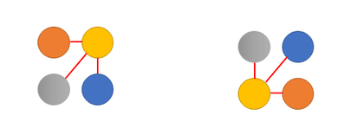
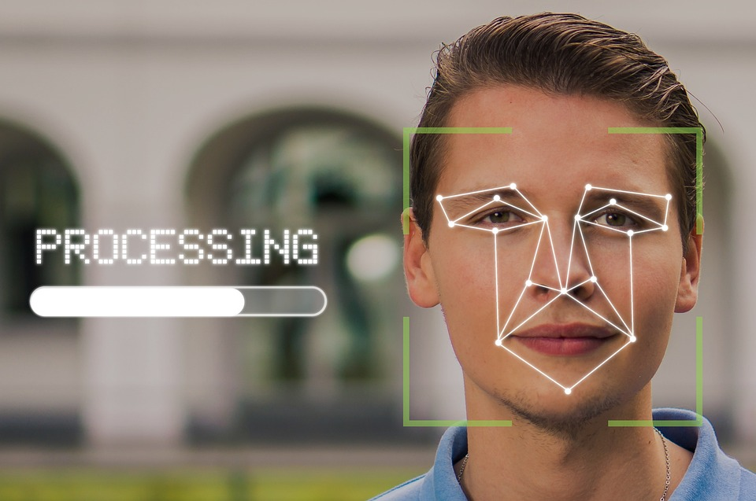
Motivation
We can see that there are few limitations in the methods used earlier. So we have used graph data structure to recognise face.
Graph is permutation invariant, therefore it can detect rotated images or images taken from different angles.
Each node/landmark in the graph contains important information of a person face

Slide 7
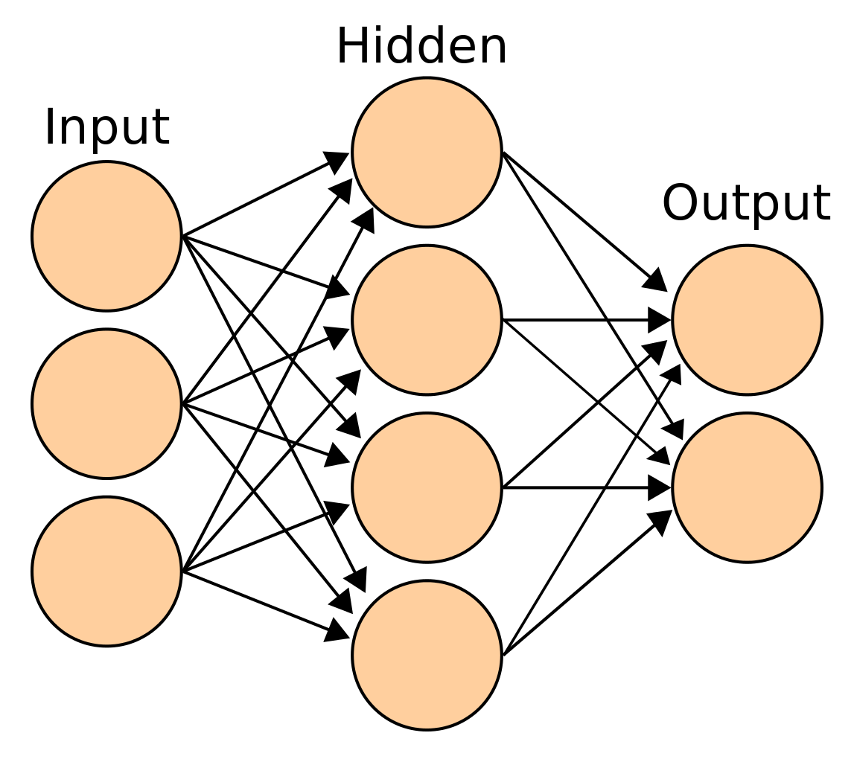
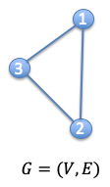
Graph representation learning
Graph Neural Network based method
GRAPH
NEURAL NETWORK
Examples of Graph Neural Network Model are: graph auto-encoder, graph convolution network

Slide 8


Graph Auto-Encoder
gae
Feature Matrix (X)
INPUT
ENCODER
DECODER
Z
Decoded Matrix (A’)
Latent Representation
Adjacency Matrix (A)
0.55 | 0.1 | 0.4 | 0.0

Slide 9
Proposed Methodology
Our approach consists of the following steps:
1. Landmark Detection and Graph Construction:
We are using Mediapipe for Landmark Detection.
2. Encoding using GAE with weighted edge:
Passing our Adjacency Matrix to GAE for training.(signature generation)
Storing its lower dimensional vector representation in database.
3. Comparison and Recognition:
Comparing the vector representation of testing data and trained data for face recognition.

Slide 10
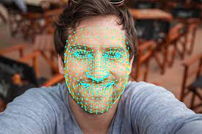
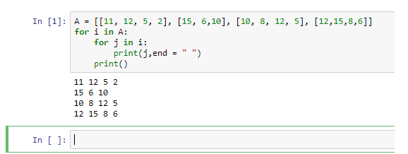
Flow Chart for Methodology
FACE IMAGE DATASET
TEST IMAGE
Landmark detection and Graph Construction
Landmark detection and Graph Construction
Result of Mediapipe
GAE With Weighted Edge
GAE Model
LATENT REPRESENTATION OF TRAINED DATA
LATENT REPRESENTATION OF TESTING DATA
DATABASE
COMPARISON
RECOGNIZED FACE
Signature

Slide 11
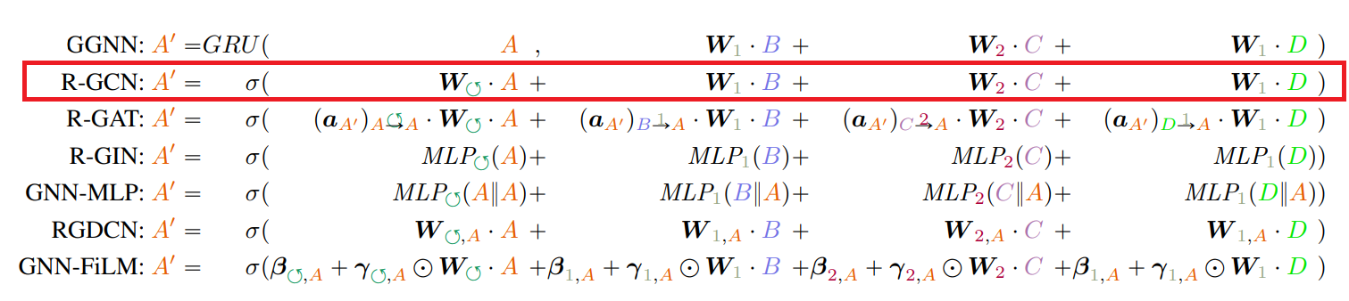
Edge Weight in GAE

Slide 12
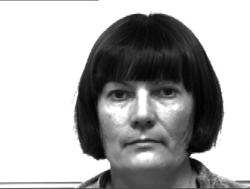
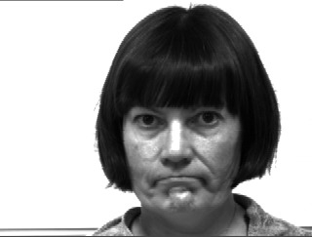
Experiment and Results
Dataset
In this project we have used Yale and Orl dataset which has 165 grayscale images, 11 different images for each of the 15 subjects.
This images has both expression and light variation with face occlusion like glasses on few images.
To test our model we have divided the dataset into two different part:
Neutral face image (30 images)
Non-neutral face image (135 images)
We used 1 image of each person for generating signature, and rest image for testing our model
Neutral Face
Non-neutral Face

Slide 13
Method used for comparing images
Euclidian Distance:
In a two-dimensional space, the Euclidean distance between two points, say (x1, y1) and (x2, y2), can be calculated using the Pythagorean theorem as:
distance = sqrt((x2-x1)^2 + (y2-y1)^2)
Cosine Distance:
The cosine distance between two vectors A and B is calculated as the cosine of the angle between them. Mathematically, it is defined as:
Cosine distance (A, B) = 1 - (A . B) / (||A|| * ||B||)
Pearson Distance:
The Pearson distance between two variables X and Y is calculated as the covariance of X and Y divided by the product of their standard deviations. Mathematically, it is defined as:
pearson_distance(X, Y) = cov(X, Y) / (std(X) * std(Y))

Slide 14
Experiment and Results
Experiment number | Difficulty Level | Number of Signatures for each person | Number of Test Images of each person | Dataset | Edge Feature | Result
1 | Easy | 1 | 1 | Orl | Yes | 90%
2 | Easy | 1 | 1 | Orl | No | 80%
3 | Difficult | 1 | 9 | Orl | Yes | 51%
4 | Difficult | 1 | 9 | Orl | No | 45%
5 | Easy | 1 | 1 | Yale | Yes | 100%
6 | Easy | 1 | 1 | Yale | No | 93%
7 | Difficult | 1 | 10 | Yale | Yes | 50%
8 | Difficult | 1 | 10 | yale | No | 46%

Slide 15
Conclusion
Our model can recognize neutral faces with more then 90% accuracy.
Our model is failing in recognizing non-neutral faces.
Without including edge weight, our accuracy was 80%.
After including edge weight our accuracy is 90%.
Edge weight helped in increasing our accuracy, but it didn’t helped in improving recognizing of non-neutral faces.

Slide 16
Future work
A end to end face recognition system can be created for better application.
Find any method to increase the accuracy of recognizing non-neutral faces.
Scope for mask face recognition using this model can be investigated.

Slide 17
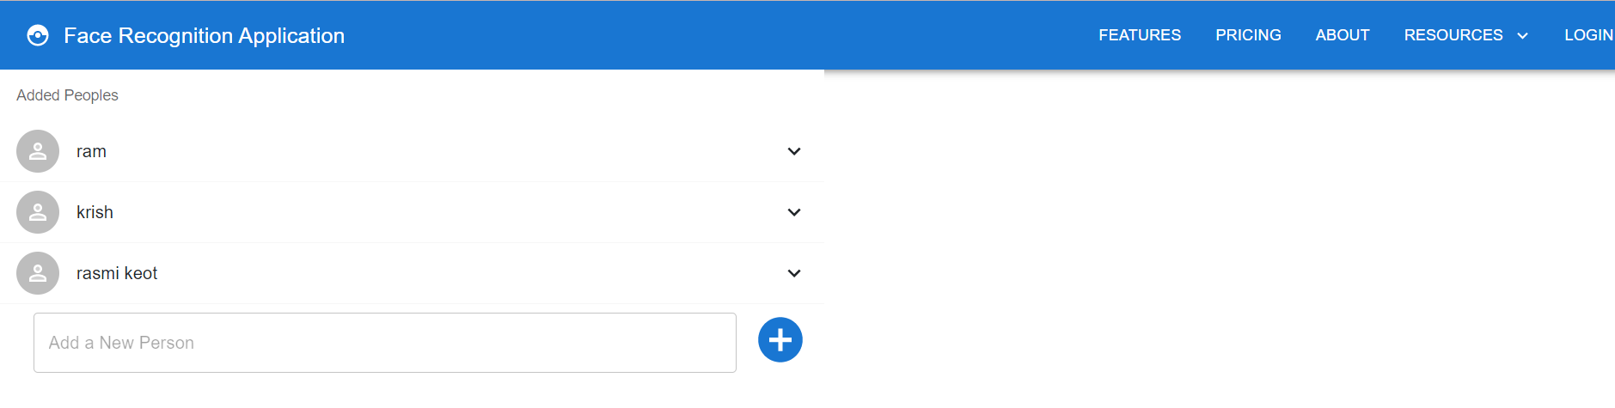

Face Recognition App
We are using React JS for front-end of our application
We are using Django for backend of our application

Slide 18
References
[1] Lawrence, Steve, et al. "Face recognition: A convolutional neural-network approach." IEEE transactions on neural networks 8.1 (1997): 98-113.
[2] Lawrence, S., Giles, C. L., Tsoi, A. C., & Back, A. D. (1997). Face recognition: A convolutional neural-network approach. IEEE transactions on neural networks, 8(1), 98-113.
[3] Lawrence, Steve, C. Lee Giles, Ah Chung Tsoi, and Andrew D. Back. "Face recognition: A convolutional neural-network approach." IEEE transactions on neural networks 8, no. 1 (1997): 98-113.
[4] Allamanis, M., Brockschmidt, M., and Khademi, M. Learning to represent programs with graphs. In International Conference on Learning Representations (ICLR), 2018.
[5] Ba, L. J., Kiros, R., and Hinton, G. E. Layer normalization. CoRR, abs/1607.06450, 2016.
[6] Balog, M., van Merrienboer, B., Moitra, S., Li, Y., and Tar- ¨ low, D. Fast training of sparse graph neural networks on dense hardware. CoRR, abs/1906.11786, 2019.
[7] Busbridge, D., Sherburn, D., Cavallo, P., and Hammerla, N. Y. Relational graph attention networks. CoRR, abs/1904.05811, 2019.

Slide 19
Thank you

