Slide 1
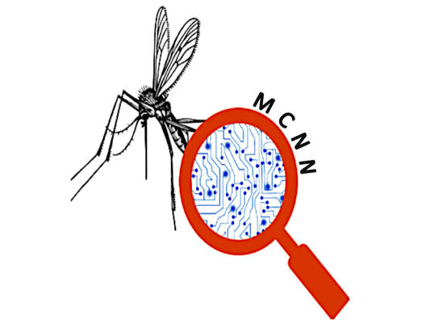
Malaria detection using Convolutional Neural Network
Presented by:
Raya Fahad Alswayeed

Slide 2
Introduction
A CNN is used mainly for image processing, classification, segmentation, and also for other autocorrelated data. Malaria is widespread disease, it’s transmitted by infected mesquites. Early detection of malaria is essential for ensuring proper diagnosis and increasing chances of cure. CNN can be paramount to faster and reliable diagnoses.

Slide 3
Problem statement
Malaria is a life-threatening disease.
There were an estimated 228 million cases of malaria worldwide in 2018.
Number of deaths reaches 405000.
The traditional process may not scale well.

Slide 4
Proposed Solution
(MCNN) Malaria detection using Convolution Neural Network. This solution speeds up the examination of the non-spread of the disease, especially the poorer communities where people cannot afford more health risk that comes from chemical spraying. By that future generations would be able to be healthier.

Slide 5
Objectives
Produce faster diagnostic method.
Produce system that can be used by everyone.
An reliable malaria results.

Slide 6
System Analysis
CNN has two stages which are:
Feature extraction
Can automatically learn hierarchical representation from data by extracting features from the input data.
Classification
The Backpropagation (BP) is one of the most widely used algorithms for supervised training networks.

Slide 7
Software Requirements
Python (For the coding).
Anaconda Server (For python coding).
Kaggal (For malaria dataset).

Slide 8
Preparing data
I’m going to use kaggal dataset and work with approximately 27k image of malaria cell
(total of infected and uninfected) reference to who works on
“Improving Malaria Parasite Detection from Red Blood Cell using
Deep Convolutional Neural Networks”
i will divide the images into 3 parts (70%train, 15%test and 15%validate).

Slide 9
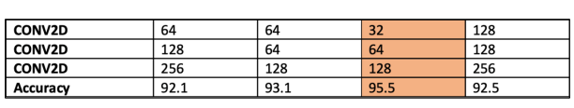
Modeling
extracted features using Conv2D with kernel sized (3,3) and choosing the most affected filter numbers, here in the table as you see there are all our filter numbers used to achieve the higher accuracy. Starting with (64,128,256) which give us 92.1%, (64,64,128) with 93,1% accuracy, (32,64,128) with 95.5% and (128,128,256) which gave us 92.5%, so the most affected filter number is (32,64,128).

Slide 10
Evaluation
Evaluation This project presents malaria classification using Convolutional Neural Network and backpropagation algorithm.
Ibuild CNN that recognize almost 27k image, the dataset was divided into (70% training, 15% test, 15% validate). • Accuracy: 95.5% • Error rate: 0.03%

Slide 11
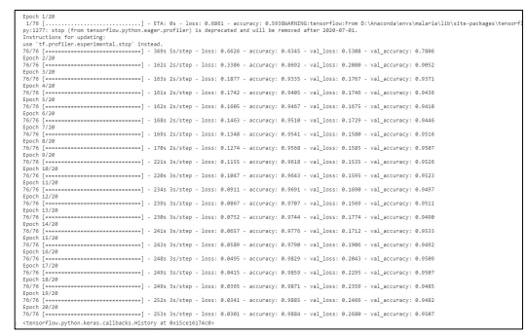
Evaluation

Slide 12
Thank You

