Slide 1

Project: My Digital Will

Slide 2





Table Of Contents
Our team
The idea
Process
Used programs

Slide 3

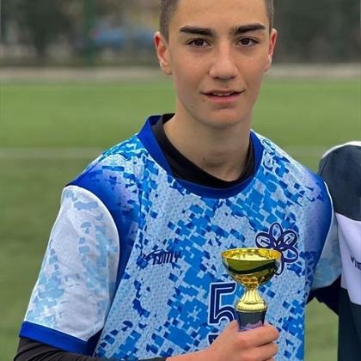
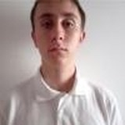
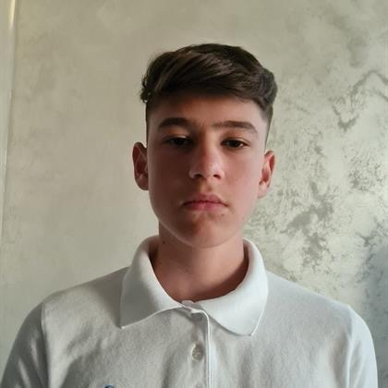
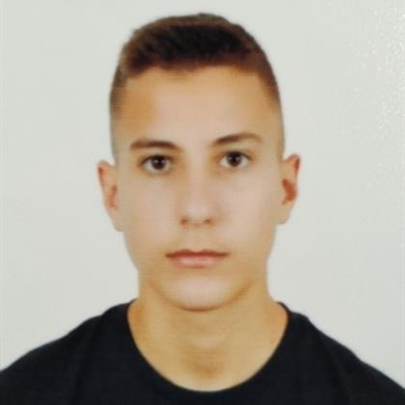
Our team
Radomir
Aleksandrov
10А
Scrum Trainer
Ivan
Delchilov
10В
Back-end Developer
Enis
Mustafa
10V
Back-end Developer
Stilian
Georgiev
10G
Front-end Developer

Slide 4

The idea
- …..our idea, which will accept from the many, is to digitize the way of yawning…..

Slide 5

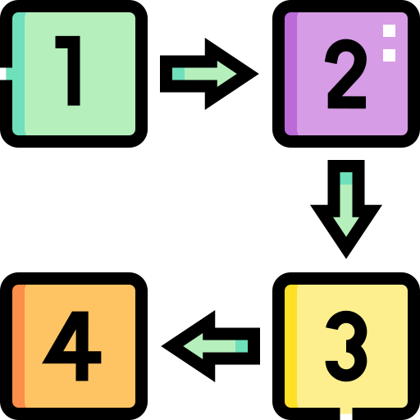

Process
Step at work.
Discussing the idea
Coding
Idea and explanation.
work on the idea
Debugging
Realization
Troubleshooting the errors we have
Ways of implementation.

Slide 6












Used programs

Slide 7


Thanks
Let’s go to the app ...

