Slide 1
Next level
E-school project

Slide 2
Table of contents
01
Our team
02
The idea
03
Step at work
04
Technologies

Slide 3
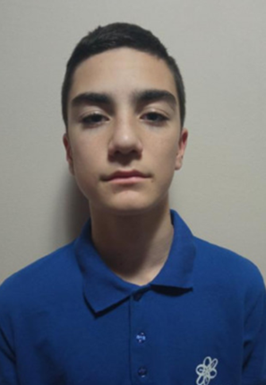
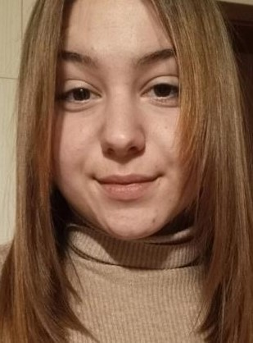
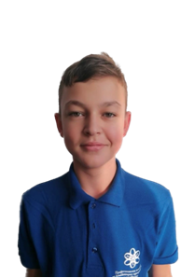
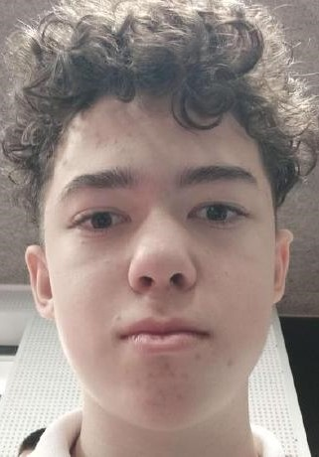
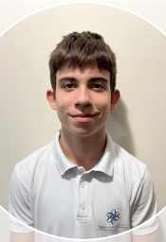
Our team
Radomir
Aleksandrov
10А
Scrum Trainer
Zhasmina
Valkova
10A
QA
Asparuh
Georgiev
9G
Back-end Developer
Kaloyan
Petrov
9G
Back-end Developer
Petko
Kovachev
9G
Back-end Developer

Slide 4

The idea
- Creation of an electoral school for learning level

Slide 5

Our steps at work
Team
Idea
Used technologies
Realization

Slide 6






Technologies

Slide 7
Thanks
Let’s go to the app...

