Slide 1

The test tubes
Biology-Chemisty Project

Slide 2
Table Of Contents
01
02
Our team.
03
Technologies.
THE IDEA
THE IDEA.
04
Step at work.
.

Slide 3
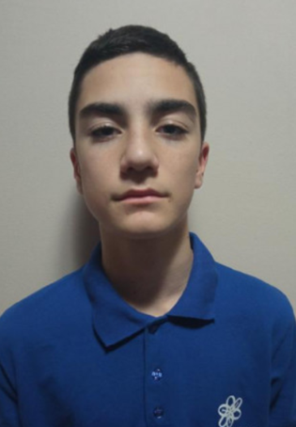
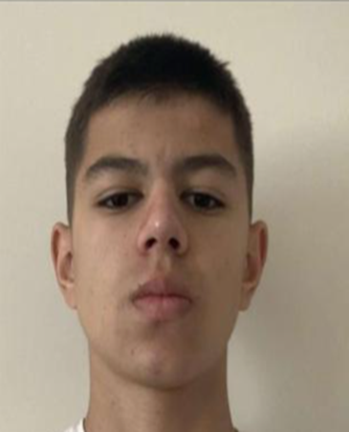

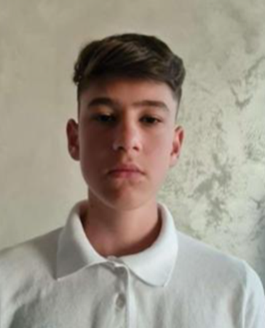
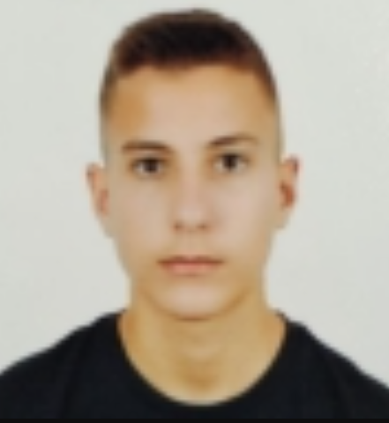
Our team:
Stanimir
Popov
10В
Designer
Radomir
Aleksandrov
10А
Scrum Trainer
Stilian
Georgiev
10G
Front-end Developer
Enis
Mustafa
10V
Back-end Developer

Slide 4
The idea:
Protect the ecology by answering the questions
Earn maximum points and win

Slide 5
Our steps at work:
04
01
03
02
Used technologies
Idea
Choice of technologies.​
Idea and explanation. explanation.
Realization
Team
Ways of implementation.
Distribution of duties.​

Slide 6







Technologies:

Slide 7
Thanks
Let’s go to the game...

