Slide 1
References
The keys to object interactions

Slide 2
Creating a Reference
Anytime we create an object like this:
ReferenceType reference = new Object();
We can also create a reference using a preexisting reference to a preexisting Object like this:
newReference = reference;
The reference contains a value that is the memory location of the Object it is pointing to. Through references we are able to interact with and alter Objects.

Slide 3
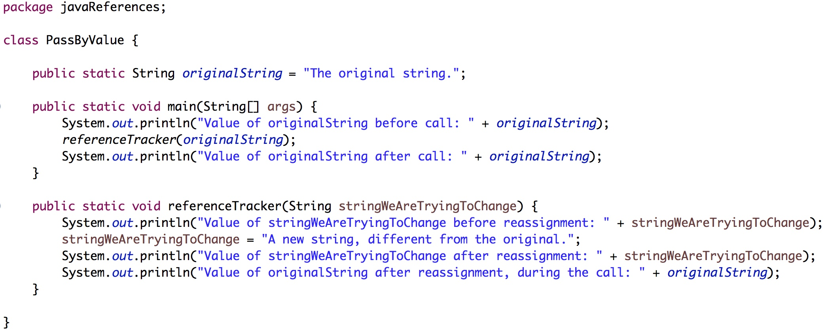
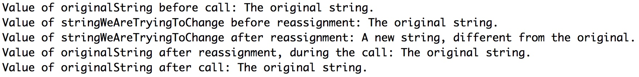
Pass By Value
Involves passing a copy of data values, where changes to the copied values are not reflected in the original values. Used mostly when you want to use the value of that data in a computation.
In the example seen here, we pass a copy of the values stored in the original String to our method. Since this is not linked to the identity of the String we are never able to change the original string since we are never interacting with it in the method call. The only thing we change is the variable we set up to hold the values held within the original String.

Slide 4
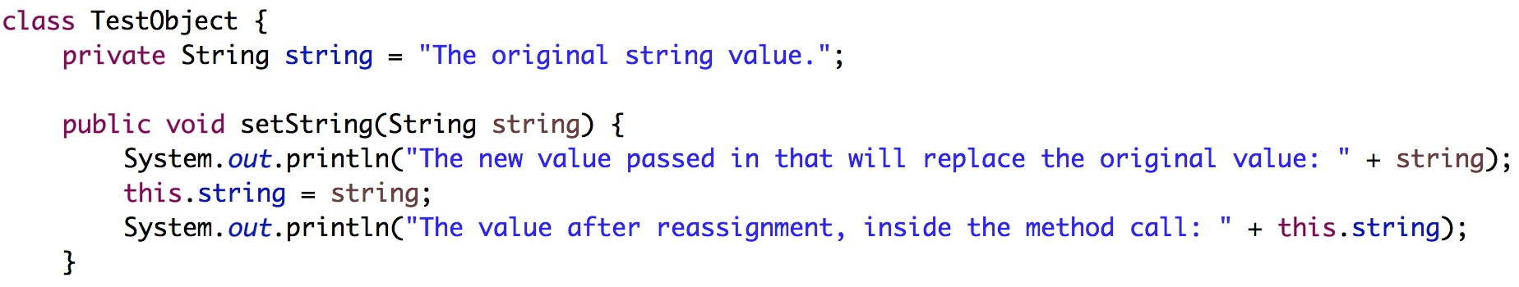
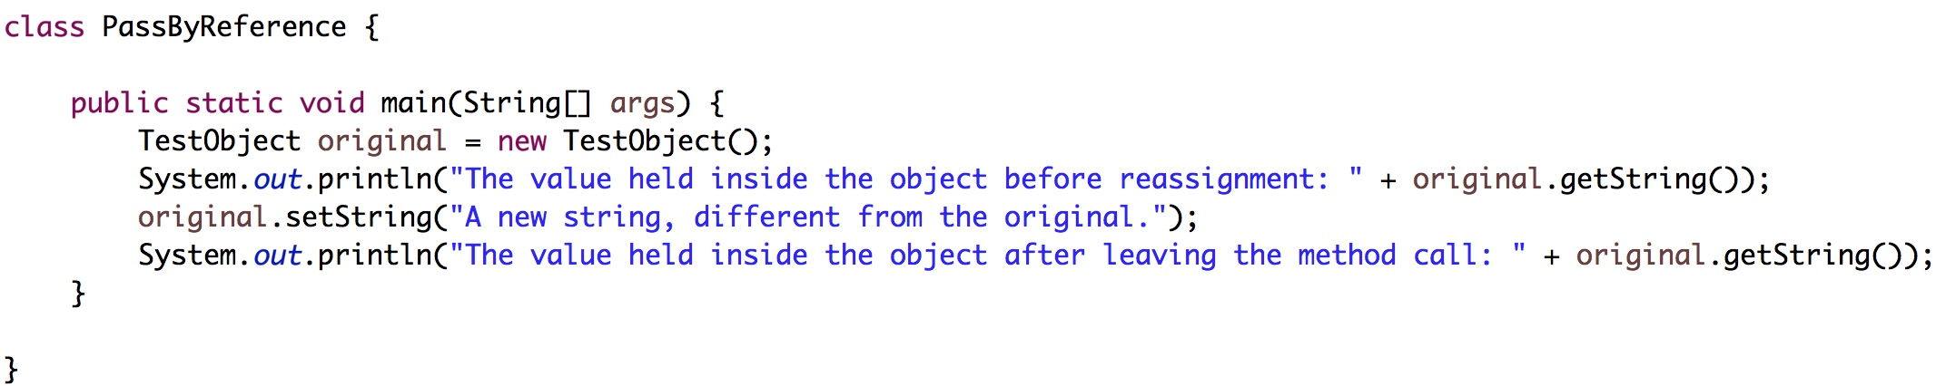
Pass By Reference
Involves passing a memory location of an Object, where changes to the copied memory location are reflected in the original value. Used mostly when you need to alter a data set.
In the example seen here, we use the reference to the Object to interact with it. By referencing the Object with its identity we can call its own field change methods on it and actually change the data values it holds inside itself.

Slide 5
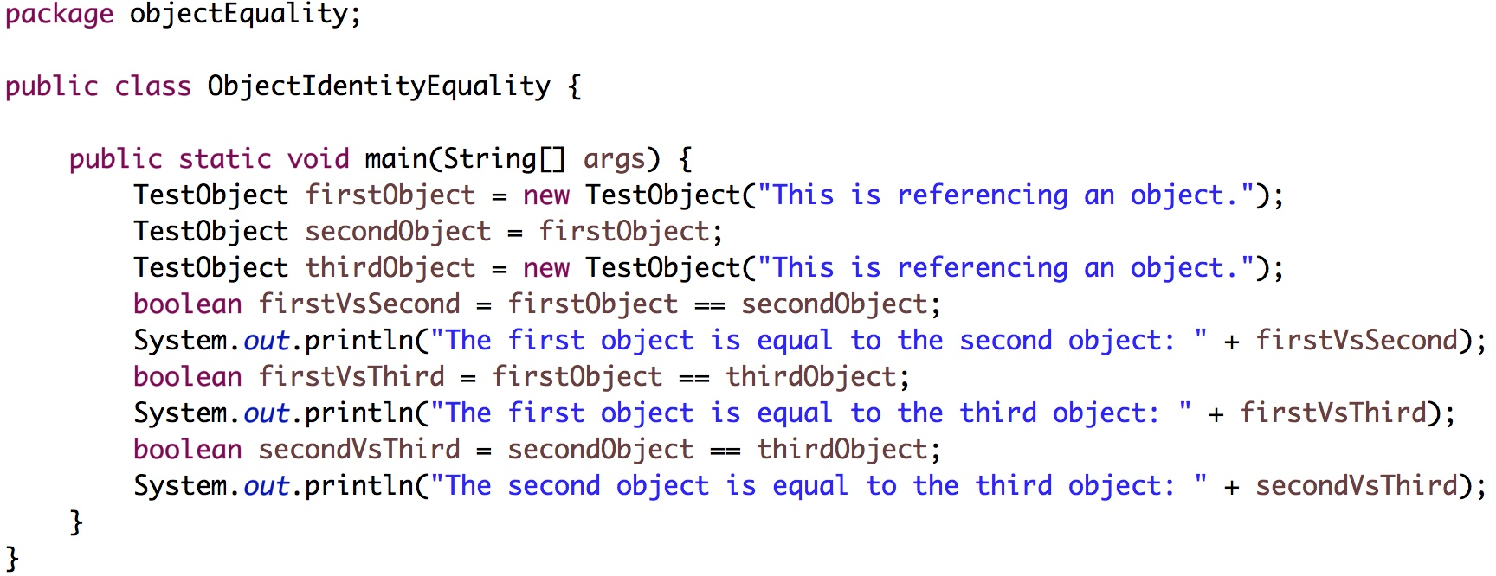
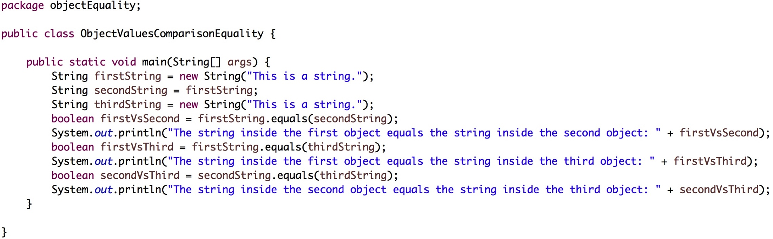
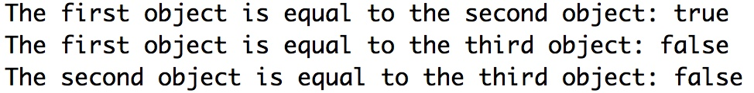
Object equality
There are two ways to compare Object equality: by an Object’s identity using the == operator or by using a .equals() method. In the case of the .equals(), if there was no preexisting .equals() method, we would need to define it.
In the left example, we can see that two references pointing to the same Object are identity identical. They are the same object. An Object with identical fields is not identical to the identity of the other object. They are different Objects.
In the right example, we can see that two different objects that contain the exact same values can be determined to be equivalent. They are not the same Object, but given the equivalency determinants they can be evaluated to equal.

Slide 6
Object Lifecyle
Created: ReferenceType reference = new Object();
In Use: at this point the Object is in use
Invisible: reference = aNewObject; at this point no Strong References are accessible
Unreachable: at this point no Strong References to object exist anywhere
Collected: at this point the Garbage Collector has recognized an object is ready for collection
Finalized: at this point if an object is still unreachable after executing any existing finalize methods
Deallocated: the final step in garbage collection

Slide 7
Garbage collection
Once an object becomes unreachable it is eligible for garbage collection. This could happen in many ways, a reference being set to null or a reference being reassigned would both meet these requirements.
If we do nothing, Java will eventually process these items for garbage collection and deallocate them if Java determines that is appropriate.
We can attempt to speed up garbage collection on an item by running System.gc; however, this will not force Java to garbage collect an item, it merely suggests to Java to collect it.
After deallocation, that object ceases to exist in memory.

