Slide 1
SECURE DATA HIDING IN IMAGES USING STEGANOGRAPHY
CAPSTONE PROJECT
Presented By: RABIYA BASRI
Student Name : RABIYA BASRI
College Name & Department : Vaagdevi College Of Engineering
(Computer science Engineering)

Slide 2
OUTLINE
Problem Statement
Technology used
Wow factor
End users
Result
Conclusion
Git-hub Link
Future scope

Slide 3
Problem Statement
Problem Statement
Digital communication faces increasing surveillance. Protecting sensitive information is a challenge. Steganography offers a solution.
Rising Demand
Privacy concerns are growing among individuals. Organizations need secure data transfer methods. Covert communication is becoming essential.

Slide 4
Technology used
LSB Embedding
Least Significant Bit (LSB) embedding is common. Data replaces the least important bits. This minimizes visual changes.
The OpenCV or Open -Source Computer Vision Library) is one of the most important libraries for computer vision and image processing. It provides a rich set of tools and functionalities for handling, analyzing, and manipulating images and videos.
Advantages
These methods provide high capacity and security. They are resistant to common steganalysis attacks.

Slide 5
Wow factors
Corporate Security
Companies use it to protect sensitive data. This prevents data breaches and espionage. Secure communication is crucial.
Journalists
Journalists protect sources in authoritarian regimes. It helps bypass censorship and surveillance. This secures information flow.
Privacy Advocates
Individuals seeking private communication use steganography. It protects messages from unwanted eyes. It ensures confidentiality.

Slide 6
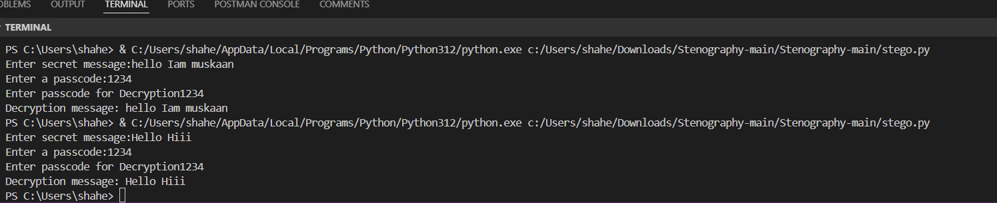
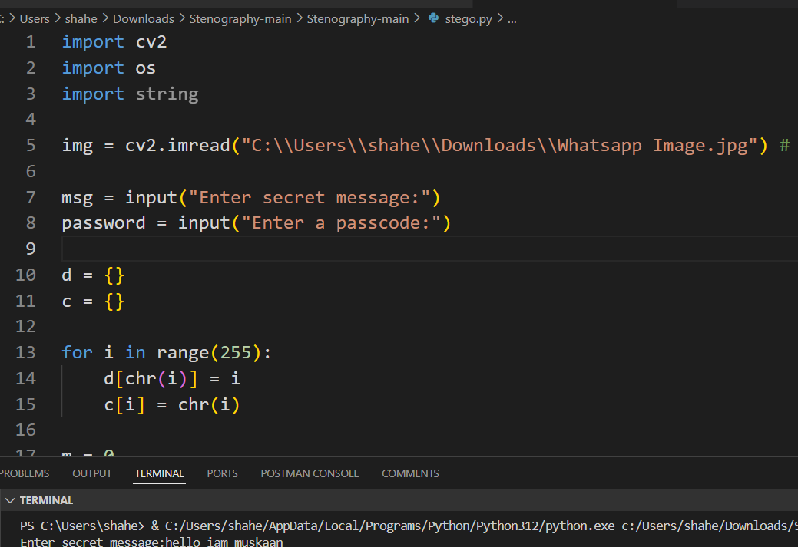
Results

Slide 7

Results

Slide 8
Conclusion
Steganography, the practice of hiding information within another medium (in this case, images), offers a secure and effective method for data protection and confidentiality. By embedding secret data into the least significant bits of image pixels, steganography ensures that sensitive information remains undetectable to the human eye, making it a valuable tool for secure communication and data transfer.
In the context of image-based steganography, the key aspects can be summarized as follows:
Data Security: The primary advantage of steganography is that it allows for secure data hiding without raising suspicion. Unlike encryption, which makes the existence of hidden data apparent, steganography embeds the data in such a way that it remains invisible in the host image.
Robustness: With proper techniques, steganographic methods can withstand common image manipulation, compression, or transformations, ensuring that the hidden data remains intact during transmission. More advanced techniques can even detect attacks such as cropping, resizing, or format conversion.

Slide 9
GitHub Link

Slide 10
Future scope(optional)
Improved Capacity
Future techniques aim for higher embedding capacity. More data can be hidden in images. This increases efficiency.
Enhanced Security
Research focuses on robust steganography. Techniques will withstand advanced attacks. The data remains hidden.
AI Integration
AI can enhance steganographic algorithms. This makes them more secure. This prevents steganalysis.

Slide 11
THANK YOU

