Slide 1
Cyclistic Case Study
A Google Capstone Project

Slide 2
Agenda
Introduction
Objective
Project Details
Analysis
Insights
Actionable steps

Slide 3
Introduction
This case study is about a cycle rental company called Cyclistic. It is a bike sharing program which features more than 5,800 bikes and 600 docking stations. It offers reclining bikes, hand tricycles, and cargo bikes, making it more inclusive to people with disabilities and riders who can't use a standard two-wheeled bike

Slide 4
objective
The Company Goal is to convert the casual riders into annual members
The Business Goal is to use digital media to influence casual riders to become members

Slide 5
Project Details
In this project we will apply following steps :- Ask, Prepare, Process, Analyze, Share, and Act
We are going to perform cleaning , analyzing and visualizing of data
We are going to use R programming language, Tableau and various tools

Slide 6
Analysis
By Analyzing the data we have some great insights which will help us in solving the business goal

Slide 7
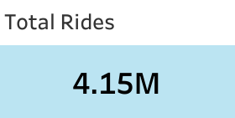
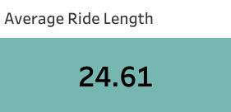
The total rides done within a span of 1 year (2020-2021)
are:
The average ride length by riders are:

Slide 8
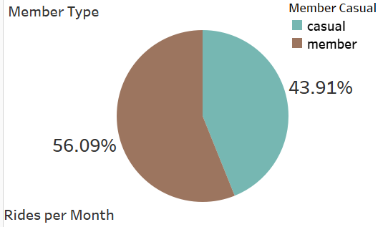
This Visualization Shows us that we have 56.09% are member and 43.91% are casual rider

Slide 9
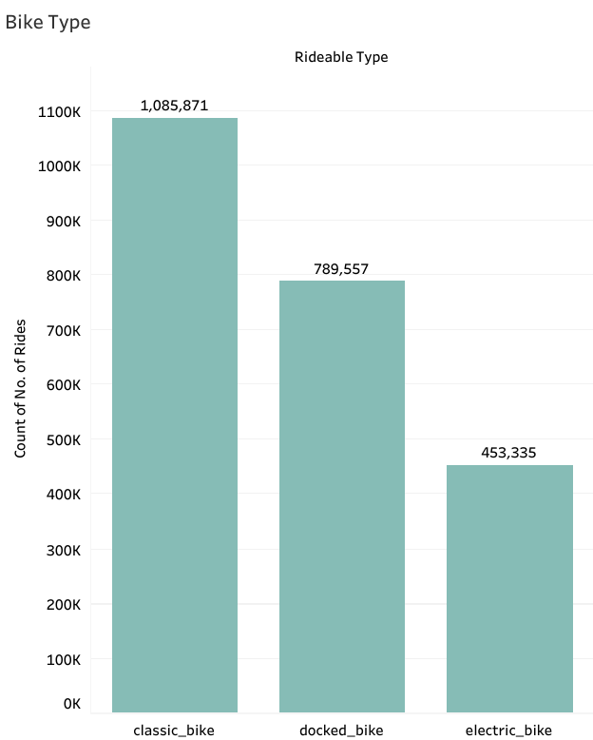
This visualization shows us that there are three types of bike classic bike, docked bike and electric bike in which classic bike are used more by member compare to others

Slide 10
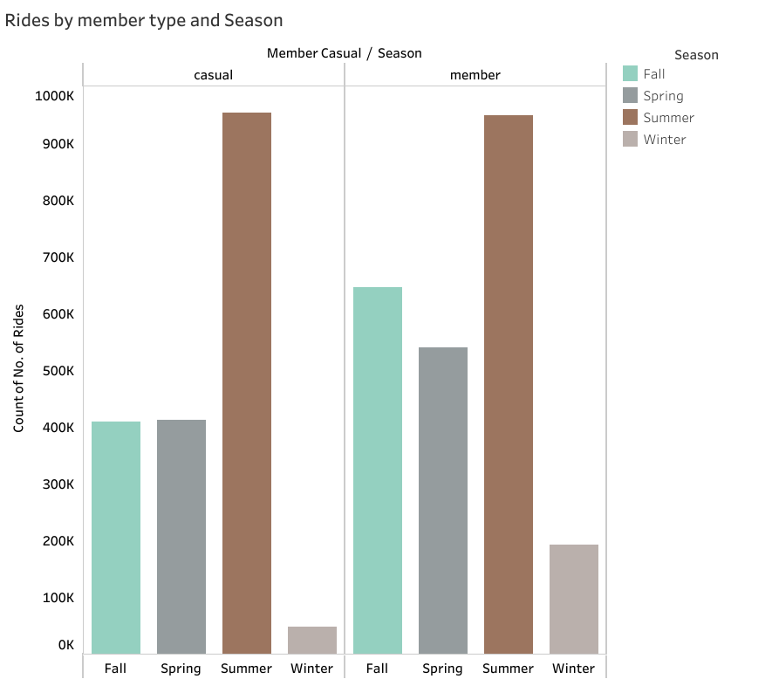
This visualization shows us that maximum number of rides are done in summer season and minimum number of rides are done in winter season by both casual rider and member

Slide 11
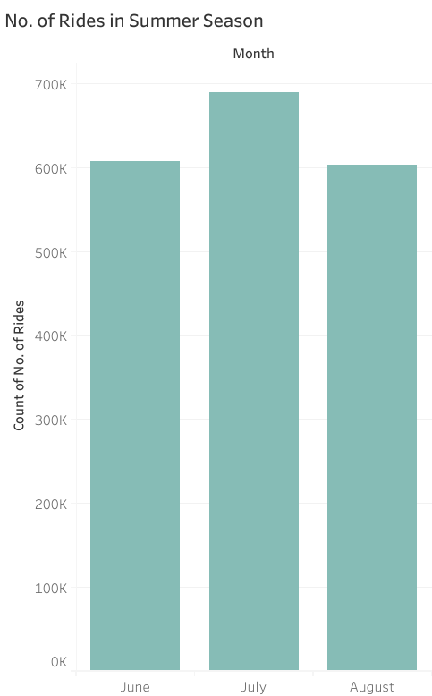
This visualization shows us that in Summer season July month is where maximum number of rides occurred compare to june and august

Slide 12
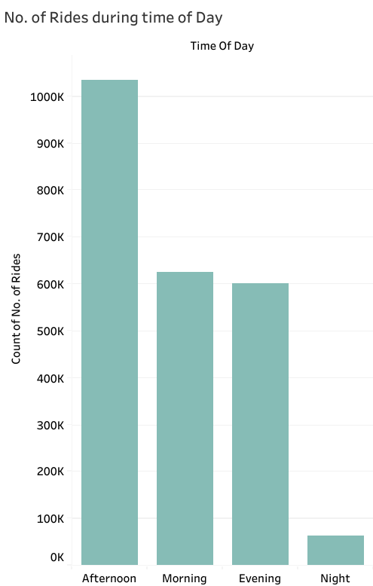
This visualization shows us that maximum number of rides are done in afternoon time of the day and minimum number of rides are done in night time of the day.

Slide 13
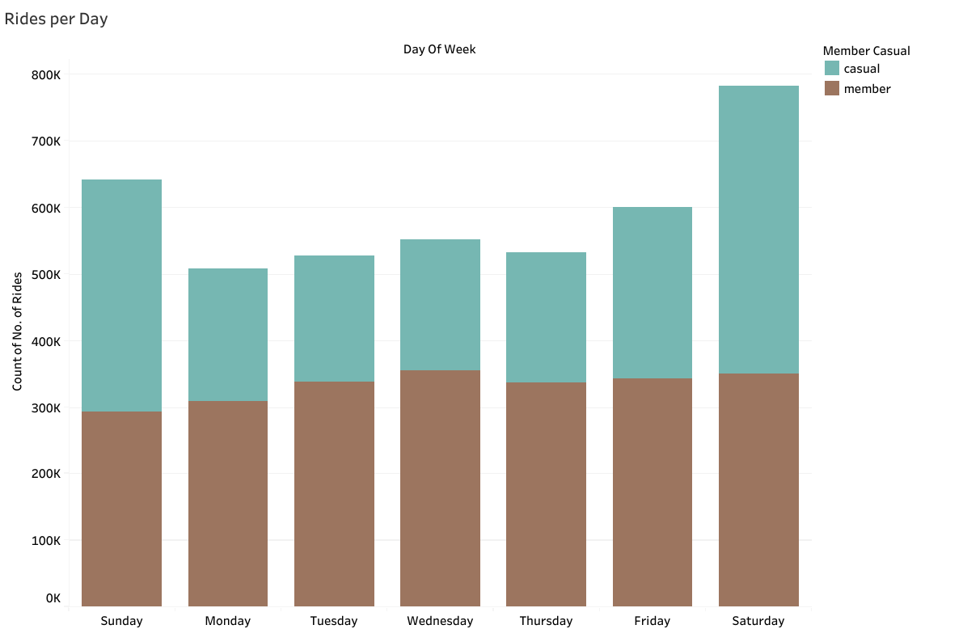
This visualization shows us that among the casual riders and members maximum number of rides are done in weekend i.e Saturday

Slide 14
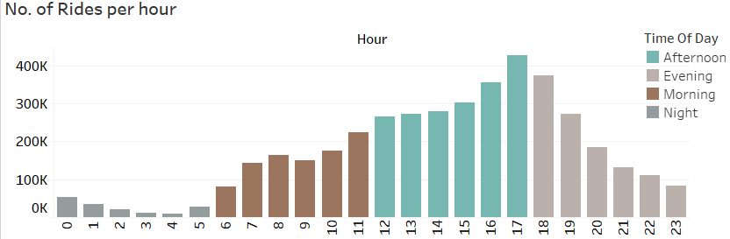
This visualization shows us that among the casual riders and members maximum number of rides are done in 17th hour of the day i.e Afternoon

Slide 15
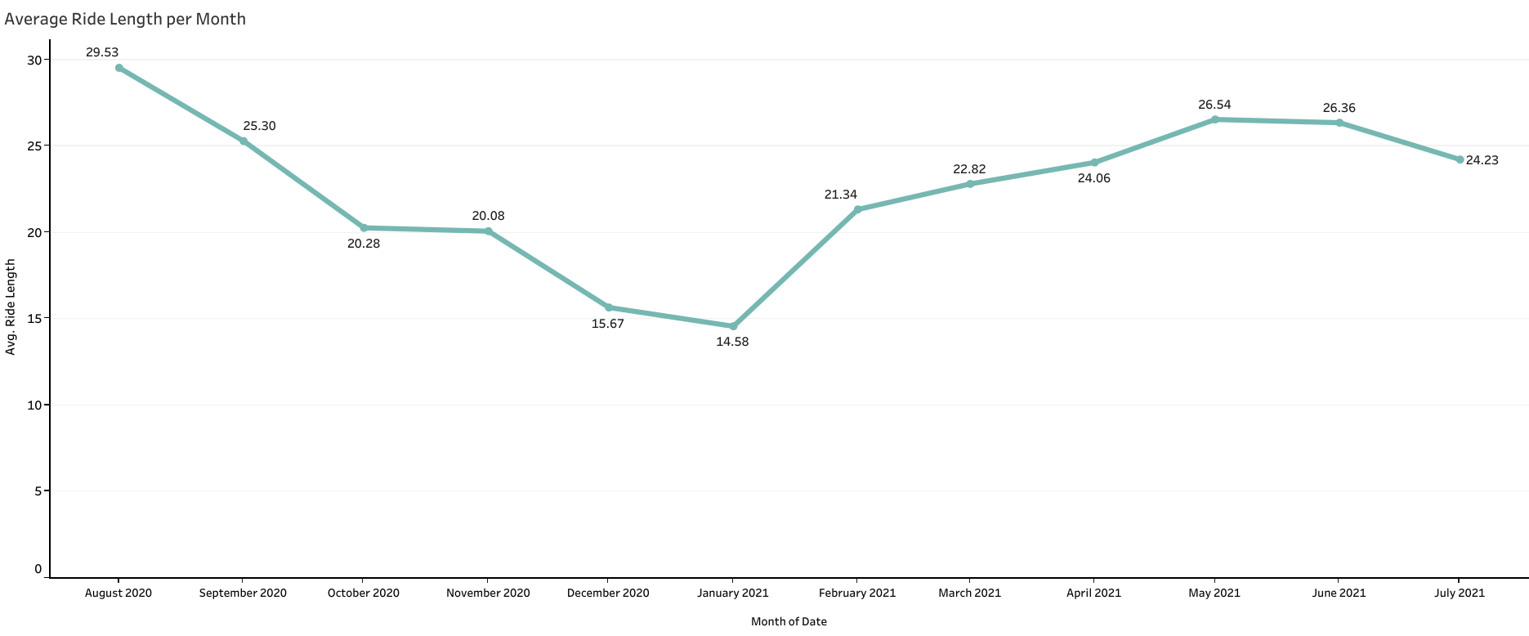
This visualization shows us that among the casual riders and members average Ride length per month in which August 2020 has maximum average ride length.

Slide 16
Insights
insight we gained from the Analytical phase are:
Busiest Season is : Summer
Busiest Time is: Afternoon
Busiest Month is: July
Busiest Hour is: 15
Busiest Day is: Saturday

Slide 17
Suggestion
Based on the insight we gained the riders use cycles more in summer season and during weekend
So we can create membership plans for weekends Only.
We can give various offers and deals in summer season to increase the conversion rate.

