Slide 1
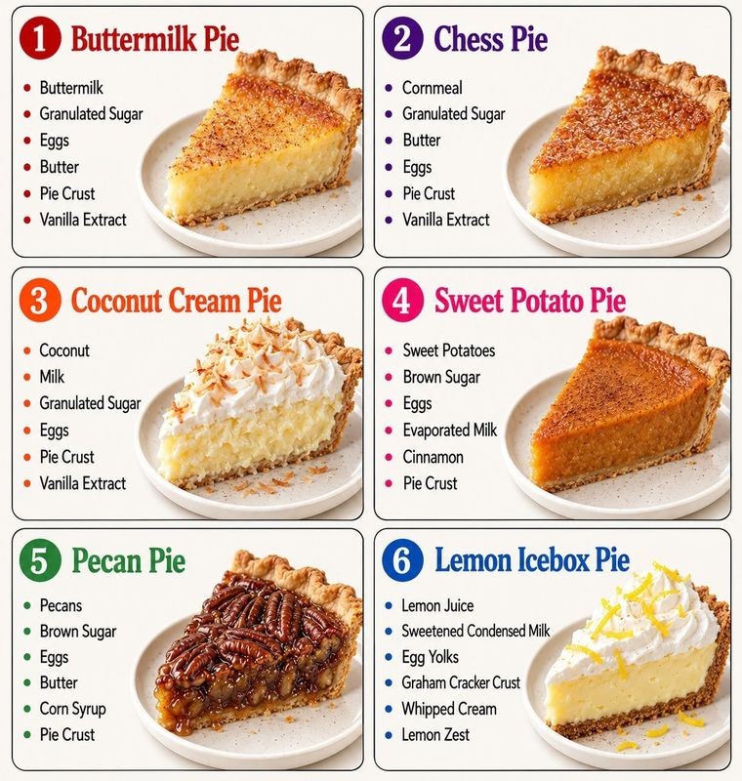
EL PUBLISHING · A 90-MINUTE ELPA21 LESSON · GRADES 6–12
Six Southern pies, four domains.
Listening · Reading · Writing · Speaking — every task in four lanes.
One infographic. One block. A timer on every section.
Today I can compare two pies and say which one is better, with a reason.
Notes:
Project this while students come in. The objective is in student words — read it with the class at minute 0. Timers: each section slide has a badge; click it to open a full-screen countdown in a new tab (radan55.github.io/everyteacher/timer.html). Keep the countdown on the projector and advance the slides on your laptop, or drag the timer window to a corner.

Slide 2
The block, minute by minute
Time | Segment | Students do | Check
0–5 | Open · one slice | Say one thing you see. Read the objective. | Thumbs
5–12 | Five words first | Echo, point, say to a partner. | Point to the crust
12–18 | Cognate hunt | Circle look-alike words; compare. | Fingers: how many?
18–33 | Listening A → B → C | Pie number with fingers; answer; compare. | Fingers for A
33–50 | Reading | Preview, reading job, one sentence unpacked, read by lane. | a/b/c/d fingers
50–60 | Talk before writing | Describe pie 3; three partner questions. | Pick three
60–80 | Writing by lane | W1 labels · W2 frames · W3 paragraph · W4 essay/email. | both / unlike by 70
80–87 | S4 / S2 | Record an opinion, or give the steps. | Recording exists
87–90 | Exit ticket | Today I learned that ___ pie ___. | Sort by lane
Notes:
The full plan with teacher moves is on the hub: six-pies-elpa21.html → 90-minute plan. Materials: student packets by lane, teacher pages, a device per Progressing/Challenge pair for the S4 recording.

Slide 3


0–5 min
5:00
click to start timer
One slice.
What do you see? A word counts. Three answers, any level.
Five words
Cognates
Listening
Reading
Talk
Writing
S4 / S2

Slide 4
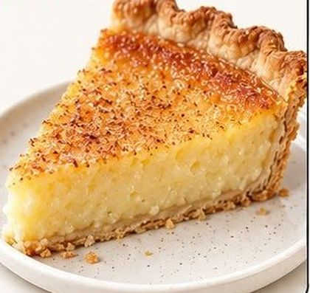
What do you see?
I see ______.
It is ______.
It looks ______.
Thumbs up: Have you eaten a pie like this? Is there a dessert like this at home?
5:00
click to start timer
Notes:
Project pie 1 only. Take three answers; a single word counts. Then read the objective slide aloud with the class.

Slide 5

5–12 min
7:00
click to start timer
Five words first.
Say → the class echoes → say it to a partner. Point to each one on the slice.
Five words
Cognates
Listening
Reading
Talk
Writing
S4 / S2

Slide 6
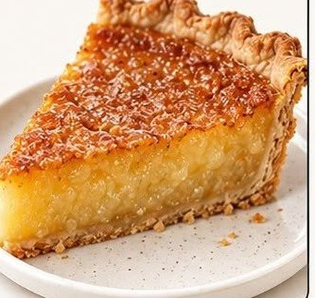
Five words first
1
ingredient a thing you need to make the food
ingrediente
crust
2
crust the outside, made of flour and butter
—
3
filling the inside of the pie
relleno
filling
4
bake to cook in the oven
hornear
5
slice one piece of the pie
rebanada
Check: point to the crust. Point to the filling. One finger = ingredient, two = slice.
Notes:
Say each word; class echoes; pairs say it to each other. Point to crust and filling on the slice as you say them. Write ingrediente beside ingredient. Use the same five words the whole block — don't switch to 'pastry' or 'piece' later without saying they're the same.

Slide 7

12–18 min
6:00
click to start timer
Cognate hunt.
Circle every word that looks like a word in your language. Compare with a partner.
Five words
Cognates
Listening
Reading
Talk
Writing
S4 / S2

Slide 8
Which words do you already know?
ingredient ingrediente
cream crema
sugar azúcar
vanilla extract extracto de vainilla
cinnamon canela
lemon limón
coconut coco
condensed milk leche condensada
evaporated milk leche evaporada
traditional tradicional
similar similar
different diferente
recipe receta
pecan nuez pecana
crunchy crujiente
Target: at least ten. Hold up fingers — how many did you find?
Half of the words you need are already yours.
6:00
click to start timer
Notes:
Students circle on the cover page of the packet; pairs compare; collect five on the board. Vietnamese, Arabic and Chinese speakers: ask which words sound like a word they know — 'lemon', 'coconut' and 'vanilla' travel across many languages.

Slide 9

18–33 min
15:00
click to start timer
Listen two times.
A: write the pie number. B: a conversation. C: a short lecture (Progressing and Challenge).
Five words
Cognates
Listening
Reading
Talk
Writing
S4 / S2

Slide 10
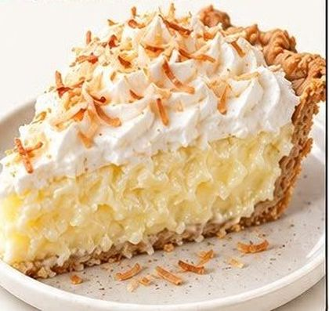
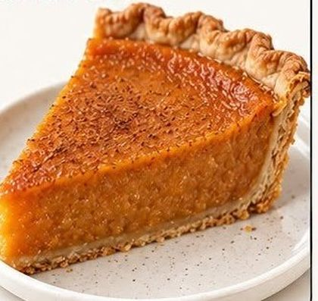
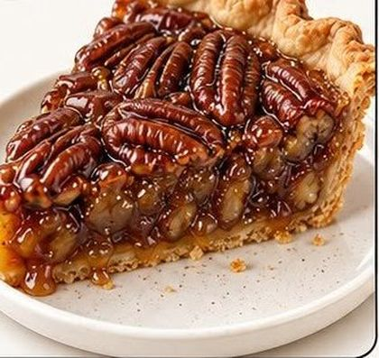
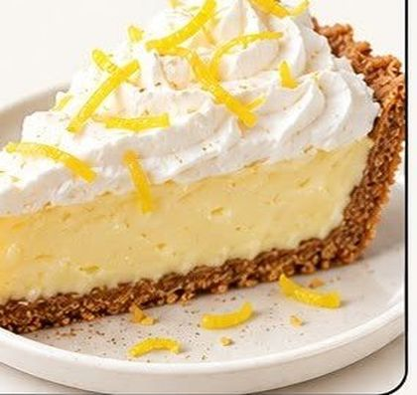
A · Listen and match
1 Buttermilk
2 Chess
3 Coconut cream
4 Sweet potato
5 Pecan
6 Lemon icebox
Your teacher describes a pie. Hold up the number with your fingers. Then write it.
A1 → pie number ___
A2 → pie number ___
A3 → pie number ___
5:00
click to start timer
Notes:
SCRIPT A (read twice): A1. This pie is made with nuts. The top is brown and sticky because of the corn syrup. (5) A2. This pie has a white topping and a yellow filling. The topping is whipped cream, and there is lemon zest on top. The crust is made of graham crackers. (6) A3. This pie is orange. It is made with a vegetable, brown sugar and cinnamon. (4)

Slide 11

B · A conversation: the bake sale
1 · What are the students planning?
2 · Why does Daniel suggest buttermilk pie?
3 · What do they decide to do?
5:00
click to start timer
Listen first. Answer in the packet. Then compare with a partner: "I think ___ because I heard ___."
NEWCOMER
Listen with the pictures. Point to pecan and buttermilk.
EMERGING
Teacher reads three times. Answer 1 and 3 first.
PROGRESSING
Answer all three; underline the reason.
CHALLENGE
Also: what would YOU bring to the bake sale, and why?
Notes:
SCRIPT B (read twice; three times for Emerging): Maya: We need two pies for the bake sale on Friday. I was thinking pecan pie — everybody loves it. Daniel: Pecan is good, but pecans are expensive right now. Buttermilk pie costs almost nothing. It's just buttermilk, sugar, eggs and butter. Maya: True. But people don't always know what buttermilk pie is. Pecan sells itself. Daniel: Then let's do one of each. Maya: Deal. I'll buy the pecans tonight. Can you make the buttermilk pie Thursday after school? Daniel: Sure — it only takes an hour. KEY: bake sale · cheap to make · one of each.

Slide 12
C · A short lecture: why custard pies set
4 · What makes a custard turn from a liquid into a soft solid?
5 · When should you take a custard pie out of the oven?
5:00
click to start timer
Listen for: proteins · link together · jiggle
Progressing and Challenge. Newcomers and Emerging: re-do A with the teacher at the side table.
Notes:
SCRIPT C (read twice): Three of these pies — buttermilk, chess and sweet potato — are called custard pies. A custard is a mixture of eggs, sugar and milk or cream. When you bake a custard, the proteins in the eggs change shape and link together. That is what turns a liquid into a soft solid. If the oven is too hot, the proteins tighten too much, and the pie cracks or turns watery. So custard pies are usually baked at a moderate temperature, and the center should still move a little — the cooks say it should jiggle — when you take the pie out. It finishes setting as it cools. KEY: egg proteins linking together · when the center still moves a little.

Slide 13

33–50 min
17:00
click to start timer
Preview. Reading job. One sentence.
Thirty seconds on the page before anyone reads a word.
Five words
Cognates
Listening
Reading
Talk
Writing
S4 / S2

Slide 14
Preview the page — 30 seconds
What is the title?
Which words are in bold?
What is in the picture?
What do you already know about this?
Your reading job
Underline the sentence that tells the difference between buttermilk pie and chess pie.
NEWCOMER
Match the bold pie names to the pictures. Do the procedure with a partner.
EMERGING
Questions 1, 2 and 4, plus the procedure. Underline where you found each answer.
PROGRESSING
All five questions. For #5, write one sentence from the text that supports your answer.
CHALLENGE
All five, then: which story about the name “chess” is more believable? Two sentences.
12:00
click to start timer
Notes:
Preview together (30 s): title, bold pie names, the picture. Give the reading job. Then unpack the sentence on the next slide before students read. Students read by lane; pairs compare before the class check with fingers a/b/c/d.

Slide 15
Unpack one sentence
“Some people say ‘chess’ comes from ‘chest,’ because the pie kept well in a pie chest, a wooden cabinet used before refrigerators.”
Who says it?
→ some people
Says what?
→ “chess” comes from “chest”
Why?
→ the pie kept well in a pie chest
What is a pie chest?
→ a wooden cabinet used before refrigerators
Now say it in three short sentences.
Notes:
Three minutes, whole class, before they read. Rewrite together: Some people say 'chess' comes from 'chest.' A pie chest was a wooden cabinet. People used it before refrigerators.

Slide 16

50–60 min
10:00
click to start timer
Talk before you write.
Partner A talks. Partner B says one thing back. Switch.
Five words
Cognates
Listening
Reading
Talk
Writing
S4 / S2

Slide 17
S1 · Observe and report
I see ______.
It has ______.
It looks ______ because ______.
Newcomer: three words. Emerging: three sentences. Progressing / Challenge: describe it and guess how it tastes, with because.
Say-it-back: "You said ______."
4:00
click to start timer
Notes:
Pairs. A talks for a minute, B listens and says back one thing, switch. Count to five before calling on anyone. Pick who shares — you pick, not hands.

Slide 18
S3 · Classroom chat
Which pie would you like to try? Why?
Is there a dessert like this in your family or your country? What is in it?
Which pie do you think is the easiest to make? Why?
6:00
click to start timer
I would like to try ______ because ______.
In my family we make ______. It has ______.
My partner said ______.
Notes:
Ask, then switch. Everyone writes one thing their partner said in the packet. Listen for 'because'.

Slide 19

60–80 min
20:00
click to start timer
Three things on the page first.
Word bank · frame · model. Then write for your lane.
Five words
Cognates
Listening
Reading
Talk
Writing
S4 / S2

Slide 20
Word bank
ingredients
both
only
unlike
because
however
similar
different
sweet
creamy
crunchy
traditional
first · then · finally
in my opinion
for example
Model (a different topic): Both a bike and a car have wheels. Only a car has an engine. Unlike a bike, a car needs gas. However, a bike is cheaper.
NEWCOMER
W1 · Label the three pie photos. Complete three frames.
EMERGING
W2 · Two pies, four frames: both / only / unlike / because.
PROGRESSING
W3 · One paragraph, 5–7 sentences, with both, however, unlike. Three ingredients.
CHALLENGE
W4 · Opinion essay or email to the cafeteria manager: which pie for Thanksgiving?
Notes:
Keep this slide up for the whole writing block. Model one W2 sentence on the board about two pies you did NOT assign. Pull Newcomers/Emerging to a table. Feedback on ONE thing today: both / only / unlike used correctly. By minute 70 every student has a sentence with 'both' or 'unlike' — read two aloud.

Slide 21
W2 · Compare two pies
Both ______ and ______ have ______.
Only ______ has ______.
Unlike ______, ______ is ______.
I would choose ______ because ______.
5 Pecan
6 Lemon icebox
4 Sweet potato
Progressing: turn the four sentences into one paragraph with however. Challenge: add a counterargument — "Some people might say ___; however, ___."
20:00
click to start timer
Notes:
Newcomers: W1 — label the photos (pecan 5, lemon icebox 6, sweet potato 4) and complete the frames. Emerging: these four frames. Score the content fully; one language note.

Slide 22
80–87 min
7:00
click to start timer
Record it. Or say the steps.
Progressing and Challenge: an opinion, 45–60 seconds. Newcomer and Emerging: the steps for pecan pie with the teacher.
Five words
Cognates
Listening
Reading
Talk
Writing
S4 / S2

Slide 23
S4 · Opinion · S2 · Give the steps
S4 · Which pie for the Thanksgiving lunch?
In my opinion, the cafeteria should serve ___ because ___ and ___. First, ___. Second, ___. Some people might say ___; however, ___.
45–60 seconds. Two reasons. Challenge: answer the other side.
S2 · How do you make pecan pie?
First, ___.
Then, ___.
Next, ___.
Finally, ___.
Use the ingredient list: pecans, brown sugar, eggs, butter, corn syrup, pie crust.
Notes:
Progressing/Challenge record on a device (phone voice memo or Chromebook). Newcomer/Emerging at the teacher table do S2 pointing at the ingredient list; two sequence words is the target.

Slide 24

87–90 min
3:00
click to start timer
Exit ticket.
One sentence. Any lane.
Five words
Cognates
Listening
Reading
Talk
Writing
S4 / S2

Slide 25
Today I learned that
______ pie ______.
Newcomer: a word is fine. Emerging: use the frame. Progressing / Challenge: use because or however.
3:00
click to start timer
Notes:
Collect. Sort the tickets into lanes on your desk after class: who used a connector, who used a frame, who wrote a word. That sort is tomorrow's grouping.

Slide 26
For the teacher
Full task set, scripts, answer key and the minute-by-minute plan: radan55.github.io/everyteacher/six-pies-elpa21.html
Timer for any segment: radan55.github.io/everyteacher/timer.html?m=7&t=Five+words
Grade the content fully; language feedback on one pattern. File one dated product per student as LSP evidence.
45-minute version: Day 1 open → reading · Day 2 unpack → writing → exit; S4 as a warm-up on day 3.
Next week: students bring a dessert from home and make the ingredient card — bilingual — and that becomes the next task set.
Notes:
Elena's session on Emerging and Progressing (pd-library.html) is the eight-minute PD that sits behind this lesson's design: five words first, frames in four lanes, check by showing, talk before writing, grade the content.

