Slide 1

Project Topic : DIGITAL INDIA : E-HEALTH CARD
Theme : Health
( Project comes under Virtual health assistant & Improve medical and emergency communication problem statements )
Project members : Team Name : Infinity
ANAM BAGWAN @Anam#0593
RADHIKA JOSHI @Radhika#1387

Slide 2
Problem Statement
We have Aadhar card , Pan card, Voter id, Driving license like identity proofs for our day to day transactions, but we have major missing that is our health card, which manages our day to day health history like disease, allergy etc. And same card is used everywhere in private and public hospitals and clinics, medical store, laboratory to track your health related data , which the concern entity will enter in to the system. This gives very huge and important data analytics using machine learning and Al like City & Area wise allergy or disease etc. This will give On time information to health authority so that ,action can be taken on right time and thus it can save many people to become victim of some viral disease. we aim to gather only health related data ,so we are not aiming to involve any economical transaction in to the system.

Slide 3
Solution
The complete information about treatment and test to be done under this scheme will be digitally saved in the card.
A big benefit from this will be that if you are going to get treatment with a doctor in any corner of the country, then the old report will not have to be taken along.
The doctor will check the medical records through unique ID by scanning QR code. A single unique ID will be issued for every citizen.
It will be implemented in phase wise manner. Clinics, hospitals, doctors will be linked to a central server.

Slide 4
Module1
LOGIN AND REGISTRTAION MODEL WITH ADHAR CARD VALIDATION
Module 5
DOCTOR VIEWING PATIENT REPORT VIA SCANNING QR
Module 2
PATIENT MODULE FOR GENERATION OF HEALTH CARD
Module 4
QR CODE GENERATOR WITH USER HEALTH ID
Module3
E-REPORT GENERATOR OF PAST DISEASE

Slide 5
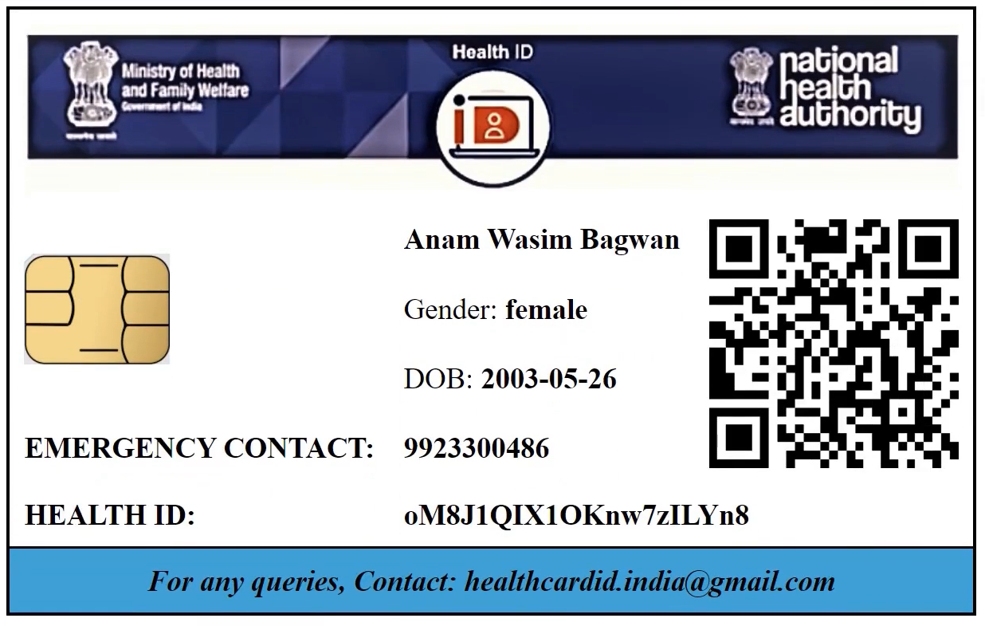
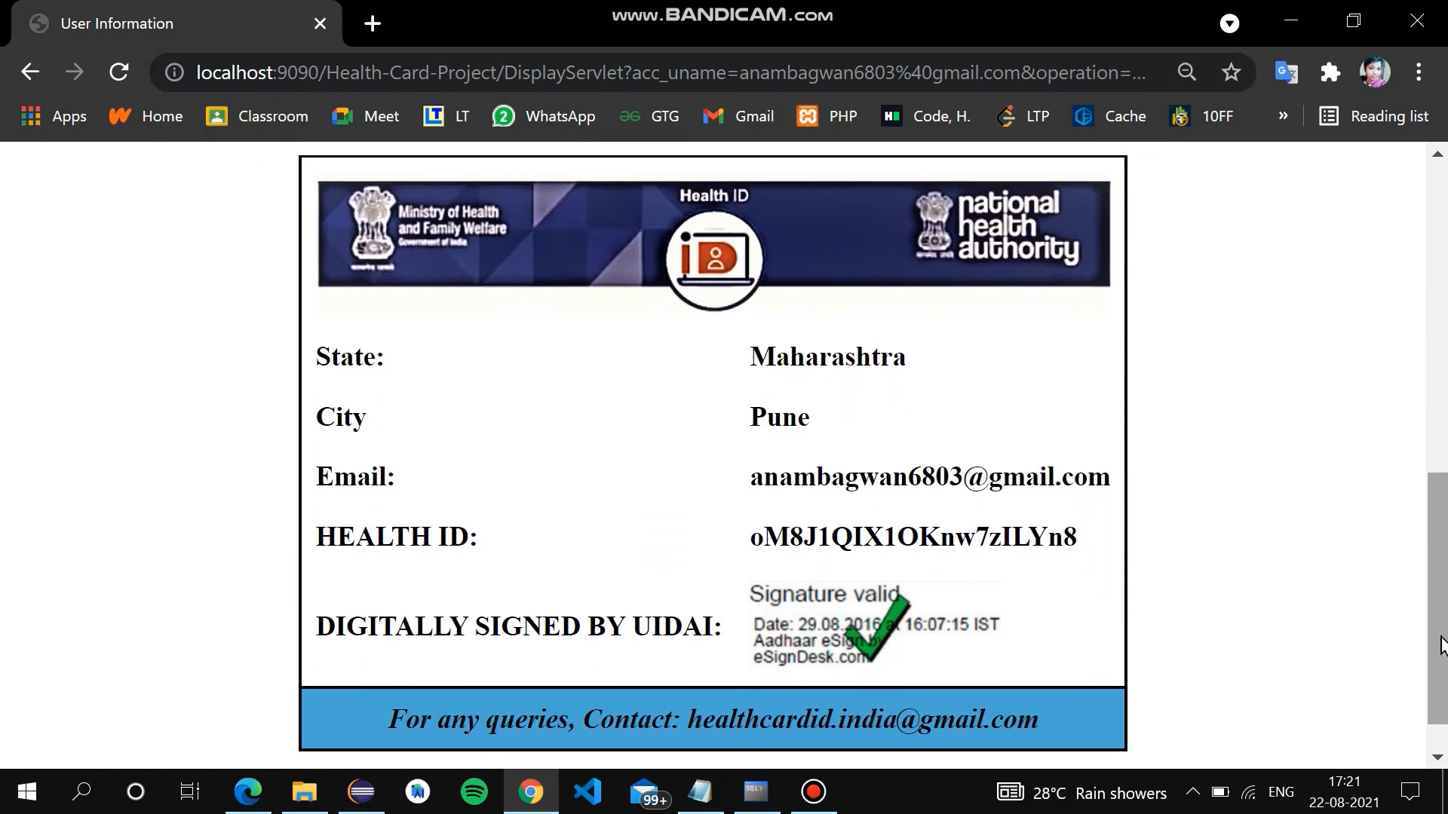
Sample health card

Slide 6
Impact
Promote and restore the physical and mental well-being of residents of India
Facilitate reasonable access to health services without financial or other barriers
Viewing of past medical history in just “one click”
Quick Diagnosis of disease by doctor through past medical reports
Recommendations for precautions through virtual health
assistant
Location based alert notification for viral disease cause
Clinics, hospitals, doctors will be linked to a central server

Slide 7
Technology Stack
1. Android application:
Android
Firebase
Data Analytics
Watson virtual assistant
2. Web portal:
HTML5
JSP
CSS 3
JS
Bootstrap 4
Tomact Server
Oracle10g

Slide 8
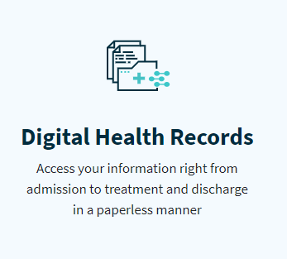
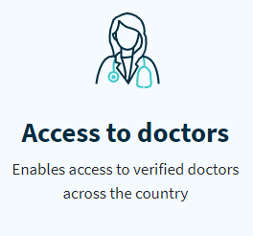
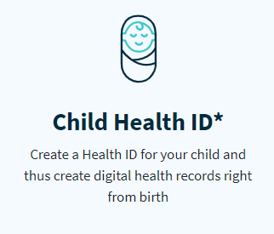
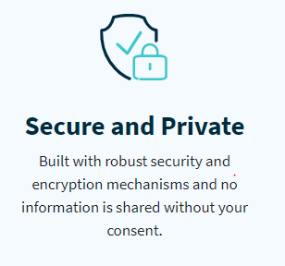
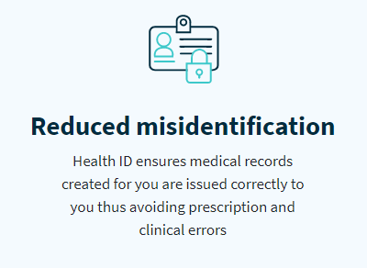
Innovations / Features

Slide 9
Future Prospects
E-pharmacy (transaction module)
Add nominee option
Covid-19 Test records
Virtual access to doctor

Slide 10
Conclusion
Using a Health ID is the first step towards creating safer and efficient digital health records for you and your family.
Your Health ID is a hassle-free method of accessing your health records digitally
With the ability to create easy to remember Health ID, you can link it with your Aadhaar or Mobile number.
Receiving your lab reports, prescriptions and diagnosis digitally from verified doctors and health service providers seamlessly.

