Slide 1


What do you think of our education system? (Excellent, Satisfactory, and Unsatisfactory)
Is it what it must be like in this technologically advanced society?
(Yes, No)

Slide 2
Right now, Aren’t we following a 2 Centuries old education system? The course curriculum that is being followed till now is exactly what our ancestors studied.
Do you think the education systems needs a major update?
(Yes, No)
Our schools and Colleges are like crammer manufacturing plants?
(Yes, No)
What do you think our education systems has to be like?

Slide 3
What is the meaning of success in this world? (Wealth, Status, Satisfaction/Peace)
For a successful life, How important the education is?

Slide 4
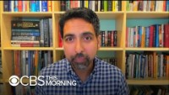
The CEO of Khan Academy launched another initiative (Schoolhouse. World) for the advancement of schooling system.

Slide 5
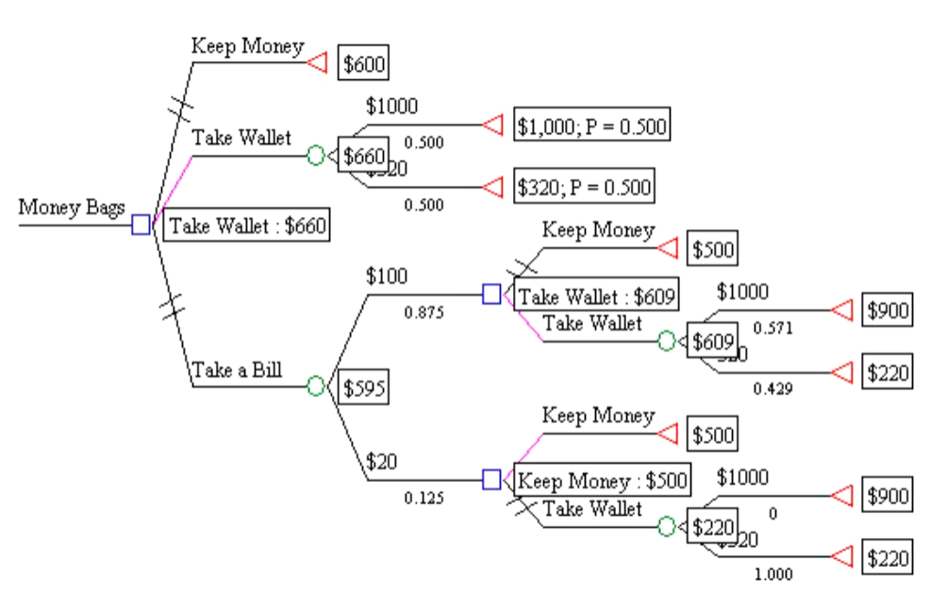
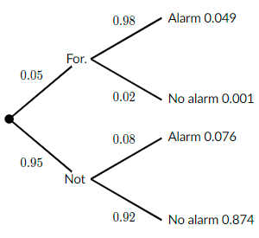

Outcome:
We will try to get some useful information out of the gathered
data that can be beneficial for the government and other education
regulatory authorities, and we have decided (for now) to use
Bayes' Theorem to find out the probability of individual outcomes
with respect to the answers to the questions asked.
Decision Tree Example 1
Decision Tree Example 2

